Slide 1

GIAW User Manual
How the GPHA Internal Audit Workspace works and how each user works in it · Version 3.0, October 2026
Notes:
Companion to docs/Usermanual.docx. Each slide points to the chapter of the Word manual that gives the full steps.

Slide 2




GIAW holds the whole internal audit cycle in one place
Auditors
Managers
Auditees
Audit Committee
Plan and perform audits: memo, risks and controls, tests, evidence, findings and the report
Annual plan, teams, reviews and sign-offs, report approval, follow-up and dashboards
One list of what Internal Audit needs, with a button for each item
Meeting packs, decisions on recommendations and risk acceptances
Aligned with the IIA Global Internal Audit Standards, Act 658, Act 921 and L.I. 1994

Slide 3
How GIAW works: nine stages, each feeding the next
Universe
Assurance map
Risk assessment
Assurance Plan
Engagement
Define auditable entities
Other providers
Score and rank
Approve and distribute
Plan, perform, review
Report
Follow-up
Reporting
Quality
Review chain and issue
Implement and validate
Committee and IAA
QAIP and practice
Information is entered once and reused: the plan comes from the risk assessment, the report from the findings, the follow-up from the agreed actions.

Slide 4






Controls built into every step
Roles and permissions
Segregation of duties
You see only the apps, records and buttons your role allows
Nobody reviews, approves or closes their own work
Electronic signatures
Gates
Approvals record who, what, when and the comment
Fieldwork waits for the approved memo and declarations; closure waits for every check
Unchangeable history
Never-lost forms
Record history, activity logs and follow-up timelines
Panels stay open; drafts save as you type

Slide 5
Who does what
The assignment, review, report and follow-up chains · Manual chapter 2

Slide 6
Assignment chain: how work reaches people
Plan
Start
Team
Work
Review
Planner names the Lead auditor on each engagement
Audit created; lead and starter join the team
Lead adds Auditors and Reviewers; auditees get access
Procedures and tests Assigned to team members
Preparer signs, names the Next Reviewer
Issue owners are notified when the issue is published
Action owners come from the issue owner or the Responsible officer
Evidence requests go to an auditee on Auditees with access
Everything assigned to you appears in My work

Slide 7
Plan approval chain
Prepare
Draft
GM Audit
Committee
IAA
Distribute
Start
Checklist, universe review, managers' meeting
Engagements; Submit for internal review
Approve (e-sign) or Return with comments
Record submission and decision; version frozen
Record IAA submission
Sites acknowledge receipt
Engagements become audits
Steps run in order. The preparer never approves. Changes after approval go through a plan change request: requester › another manager endorses › GM Audit signs › Committee for significant changes.

Slide 8
Engagement gates and the sign-off chain
Memo
Declarations
In Progress
Preparer
Reviewers
Close
Approved by Audit Manager, PIA or GM Audit
Every member: annual and engagement
Move to opens fieldwork
Sign-off; set Next Reviewer
Detail, General and further levels
GM Audit: Close (e-sign)
Nobody signs two levels or their own work. A signed page is read-only; removing a sign-off removes the later ones.

Slide 9
Report chain
Draft
Management
Unit Head
Audit Manager
PIA
GM Audit
Distribute
Create draft report; Edit report
Send to management; comments in 10 working days
Review as Unit Head (e-sign)
Review as Audit Manager (e-sign)
Review as PIA (e-sign)
Approve & issue (e-sign)
Record copy sent
Any reviewer can Reject (return for rework): the report goes back to Draft. A chain reviewer cannot also give the GM Audit approval. Corrections: Correct › Open version N+1.

Slide 10
Getting started
Sign in, find your way and use lists, forms and approvals · Manual chapters 3 and 4

Slide 11
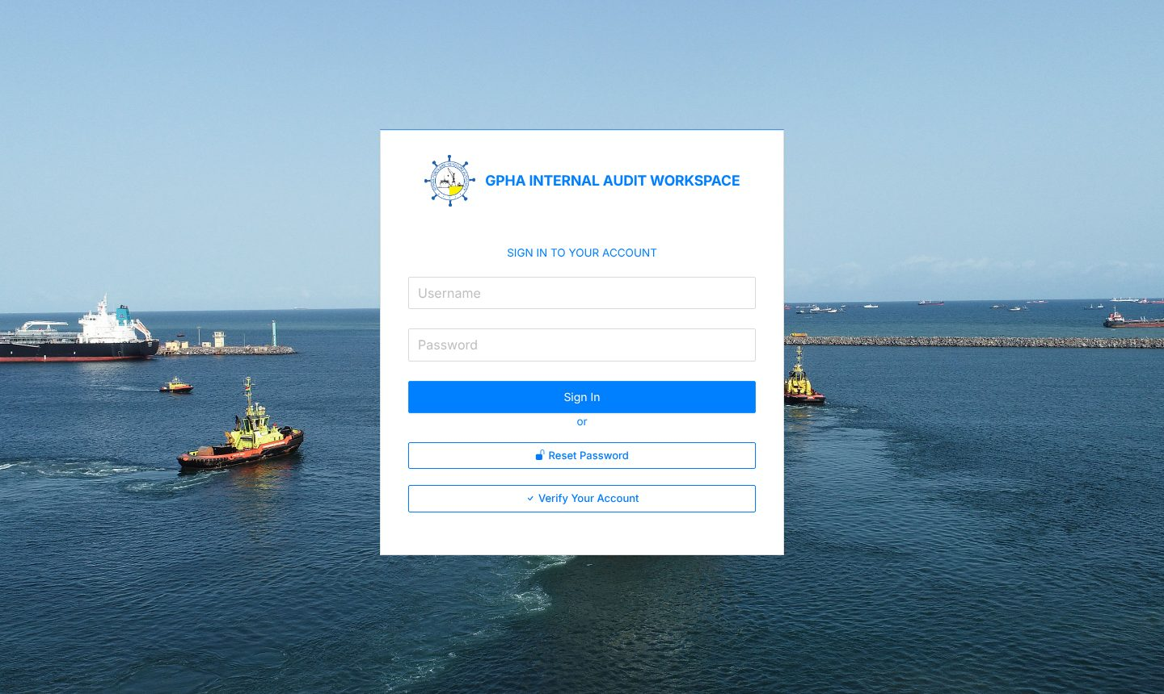
Signing in
1
Open the GIAW address in Edge or Chrome
2
Enter your username and password
3
Enter the 6-digit code if two-step verification is on
4
Five wrong passwords lock the account for 15 minutes
5
Idle sessions sign out automatically

Slide 12
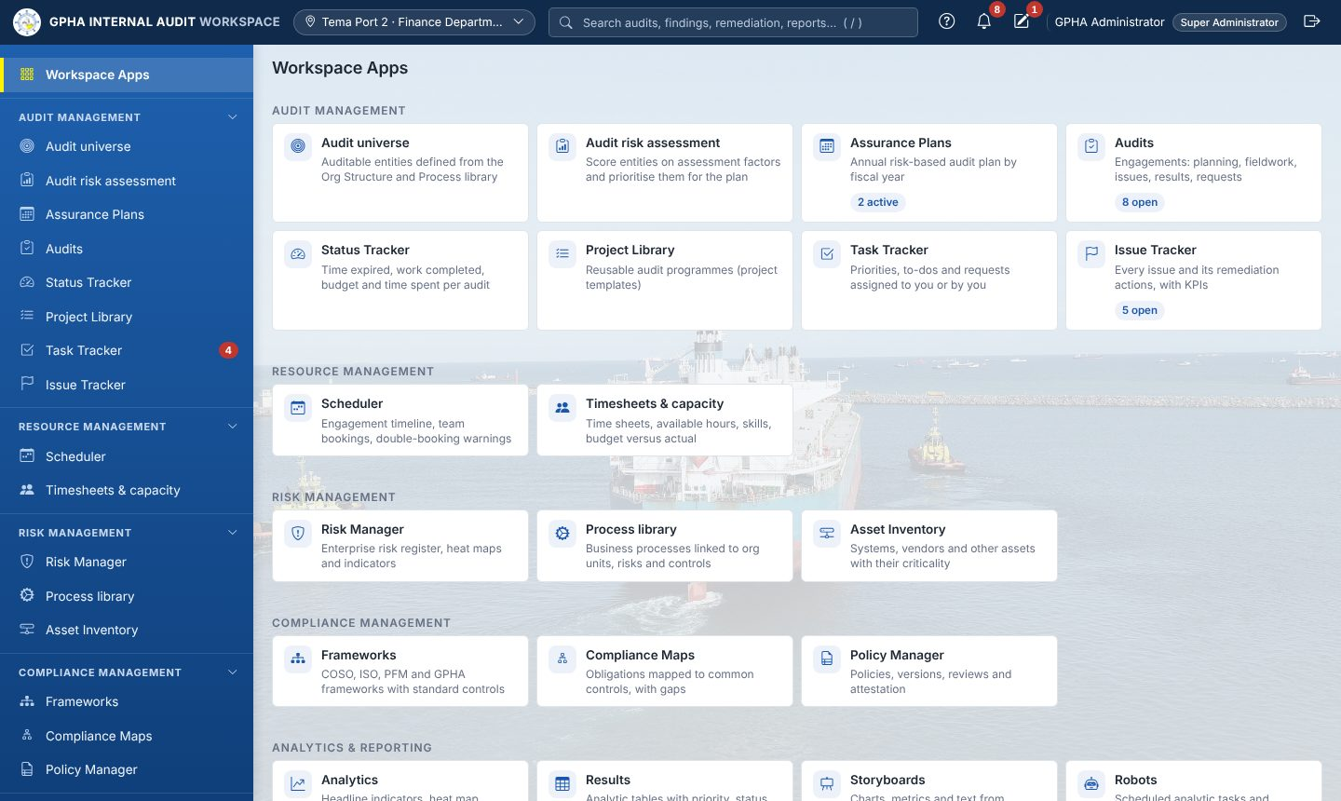
Finding your way
Sidebar: app groups; Workspace Apps and My work at the top
Search ( / ): audits, issues, actions, reports
Bell: your notifications
Pencil: My Drafts
My work: steps waiting for you, with due dates
? Help: help for the current page

Slide 13



Lists, forms and approvals work the same everywhere
Lists
Forms
Approvals
Search, filter, sort by column, choose columns, export to Excel or CSV, save views
Open in a right-hand panel that stays open until you close it, even after a refresh; drafts save as you type
Electronic signatures; you cannot approve your own work; every change is kept

Slide 14
Plan the year
Audit universe, assurance map, risk assessment and the Assurance Plan · Manual chapters 5 and 6

Slide 15
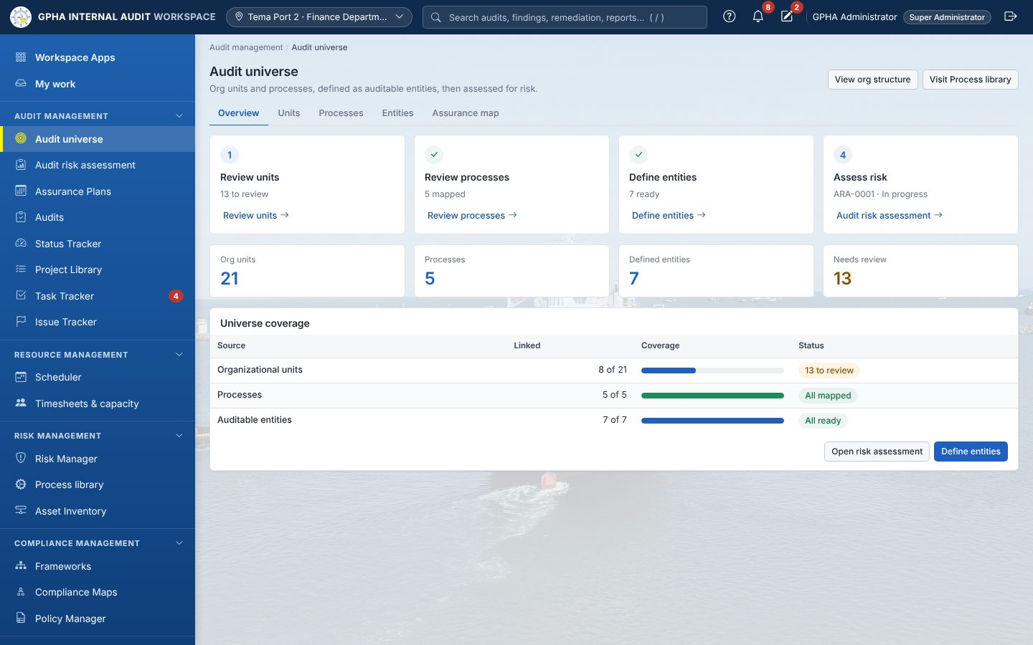
Audit universe: define what can be audited
1
Units: include or exclude, with a reason
2
Processes: map to the units that perform them
3
Entities: define scope, owner, units and processes
4
Set Ready to send an entity to risk assessment
5
Assurance map: record other providers

Slide 16
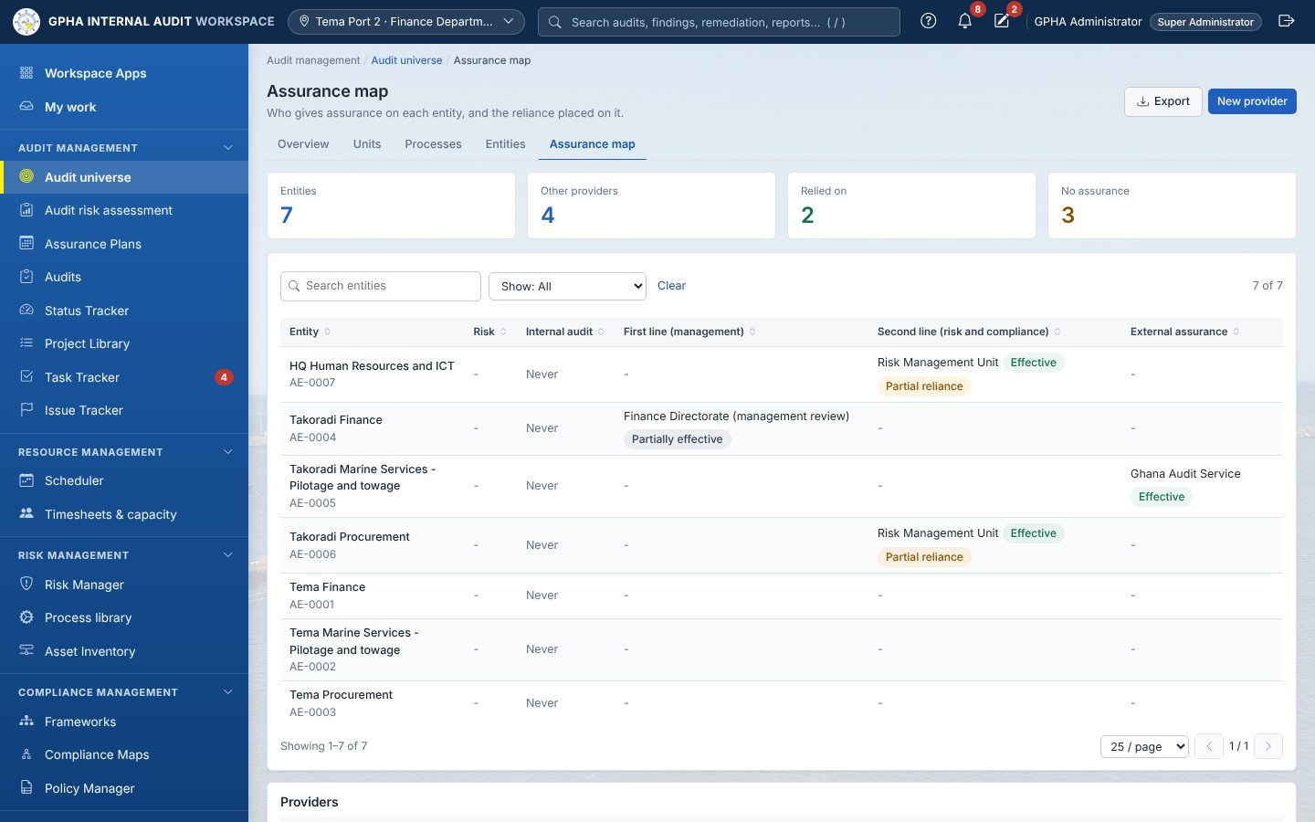
Assurance map: who else gives assurance (IIA 9.5)
First line, second line and external providers per entity
Each provider's latest result and date
Reliance None, Partial or Full, with a recorded basis
Entities with no assurance stand out for planning
Add providers with New provider; coverage on the entity's Assurance tab

Slide 17
From risk assessment to an approved plan
Score
Draft
Review
Committee
Version
Distribute
Start
Rate Ready entities on the factors
Engagements, quarters, hours, leads
GM Audit approves or returns
Decision on the plan
Frozen copy; IAA submission
HQ and ports acknowledge
Each engagement becomes an audit
Changing an approved plan: always through a plan change request, with the resource and coverage impact, an independent reviewer, the GM Audit's approval and, when significant, the Audit Committee.

Slide 18
Perform the audit
Team and independence, planning, fieldwork, evidence and findings · Manual chapter 7

Slide 19
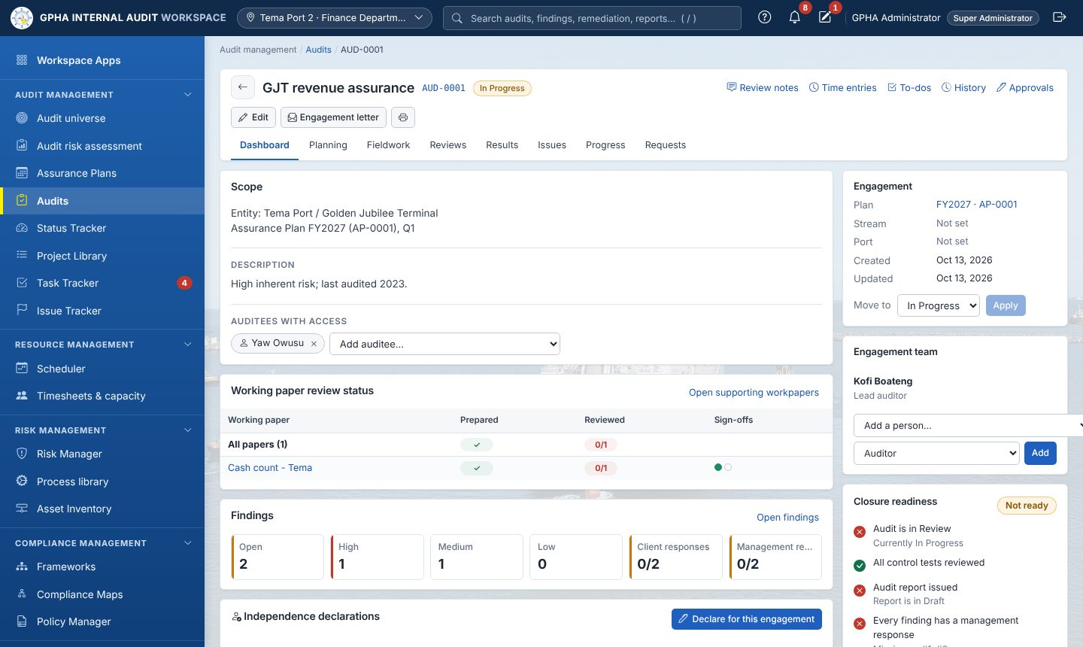
The audit page brings everything together
Tabs: Dashboard, Planning, Fieldwork, Reviews, Results, Issues, Progress, Requests
Dashboard: scope, auditees, team, declarations, closure readiness
Status: Planned, In Progress, Review, Closed
Nature: Assurance or Advisory, from the audit type

Slide 20



Every team member declares independence
Declarations
Rotation flag
Cooling-off flag
Annual declaration plus one per engagement, for every member of the team
The lead has led the same entity for 3 consecutive years (setting)
The member worked in an audited unit within 12 months (setting)
A flagged member declares the conflict; a reviewer clears it with safeguards or reassigns the member.

Slide 21
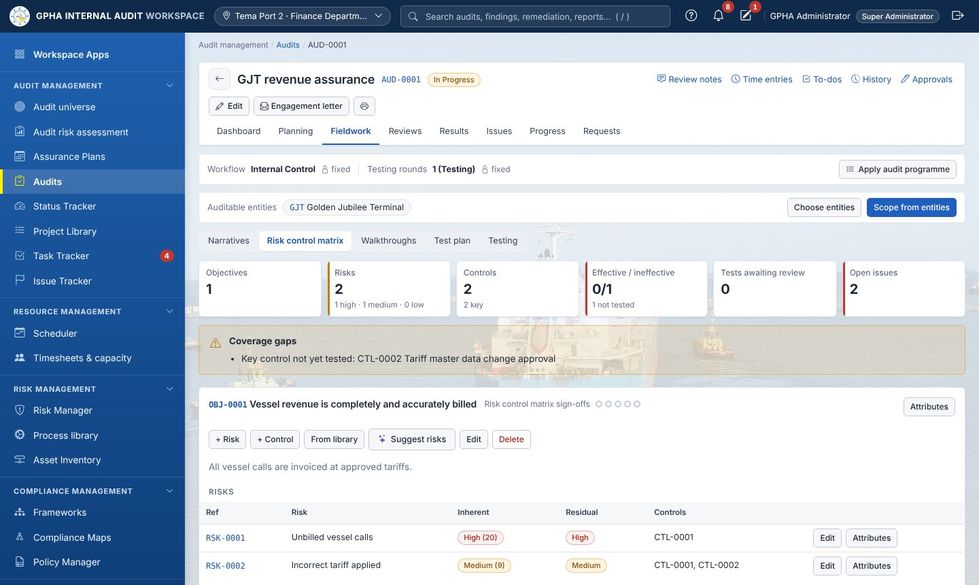
Planning, fieldwork and evidence
1
Planning memo approved; engagement letter sent
2
Risk and control matrix per objective
3
Walkthroughs and tests with samples
4
Request evidence; accept or return it
5
Sign off each page; reviewers clear notes

Slide 22
Findings follow criteria, condition, cause and effect
Criteria
Condition
Cause
Effect
Recommendation
What should be
What is
Why it happened
What it means
What to do
Issues stay internal until you Publish them (the draft report also publishes them)
Management gives a response, responsible officer and target date
An agreed remediation action is raised from the issue
Advisory work records observations; actions are optional

Slide 23
Report and follow up
The report workflow, corrections, follow-up and risk acceptance · Manual chapters 8 and 9

Slide 24

The report: from draft to issued copy
Draft
Management
Review chain
GM Audit
Distribute
Team writes; findings pulled in
Comments within 10 working days
Unit Head, Manager, PIA sign
Approve and issue (e-sign)
Record each copy (Act 658 s.16)
Correcting an issued report (IIA 11.4)
The GM Audit selects Correct and records the error. The issued version is frozen under Earlier versions; the report returns to Draft as the next version, is approved again, and everyone who had the old copy is listed as due the corrected one.

Slide 25
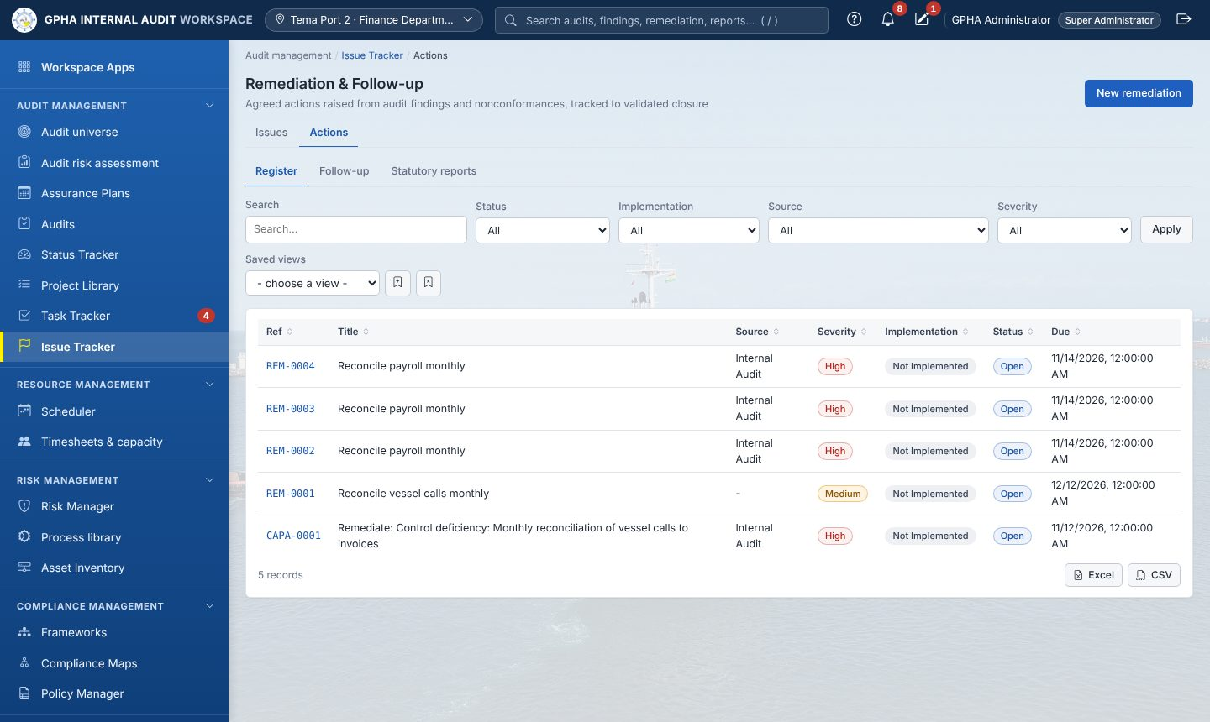
Follow-up: implement, validate, close
1
Owner records progress and evidence
2
A different auditor validates
3
Authorised manager or Committee closes
4
Overdue actions escalate automatically
5
Quarterly report and annual s.88 statement

Slide 26
Risk acceptance is escalated (IIA 11.5)
Propose
GM Audit
Committee
Close
Follow-up manager: who accepts and why
Discusses with senior management; agrees or not
Decides High-severity acceptances
Action closes as Risk Accepted
If the acceptance is not agreed at any step, the action stays open for implementation. The severities that go to the Committee are a setting.

Slide 27
Governance and quality
Audit Committee, analytics, professional practice and QAIP · Manual chapters 10 and 11

Slide 28
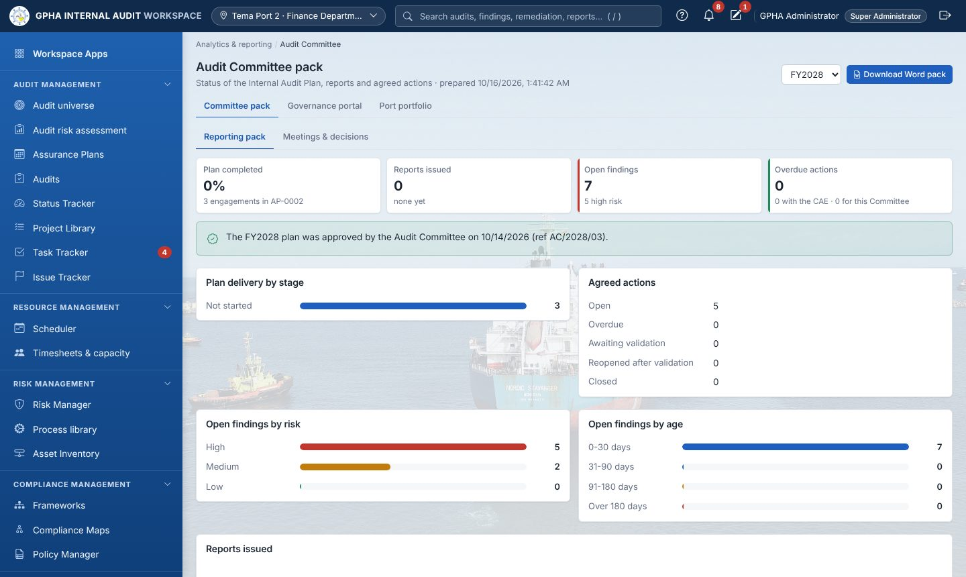
Audit Committee and governance
Committee pack: plan delivery, reports, findings, overdue actions (Word)
Meetings: attendance, quorum, minutes locked on approval
Decisions: close, withdraw, extend, escalate, accept or reject a risk acceptance
Governance portal: approved plans and issued reports

Slide 29
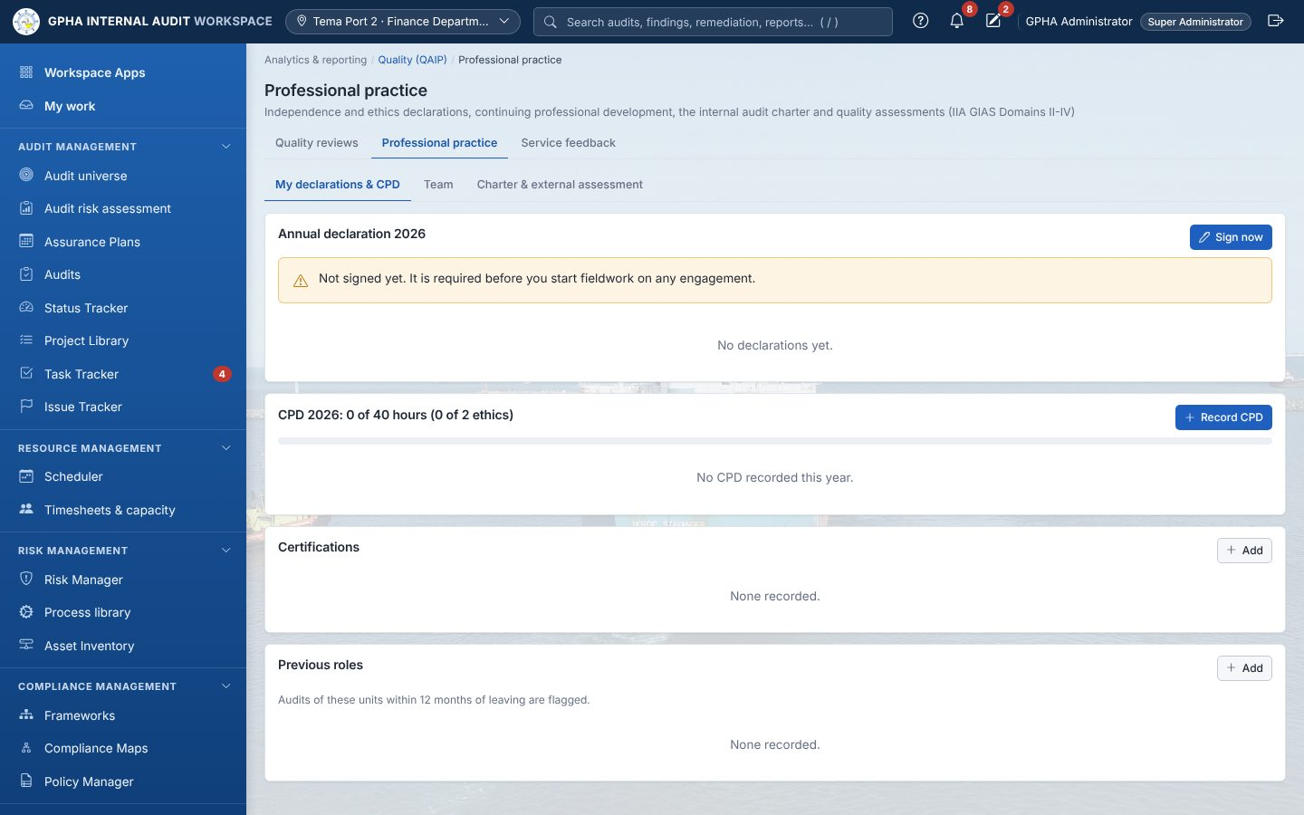
Professional practice and quality
Annual and engagement declarations
CPD hours, certifications and previous roles
Charter approval and external assessment (5-yearly)
Engagement quality reviews and auditee surveys
Yearly QAIP summary and internal assessment report

Slide 30
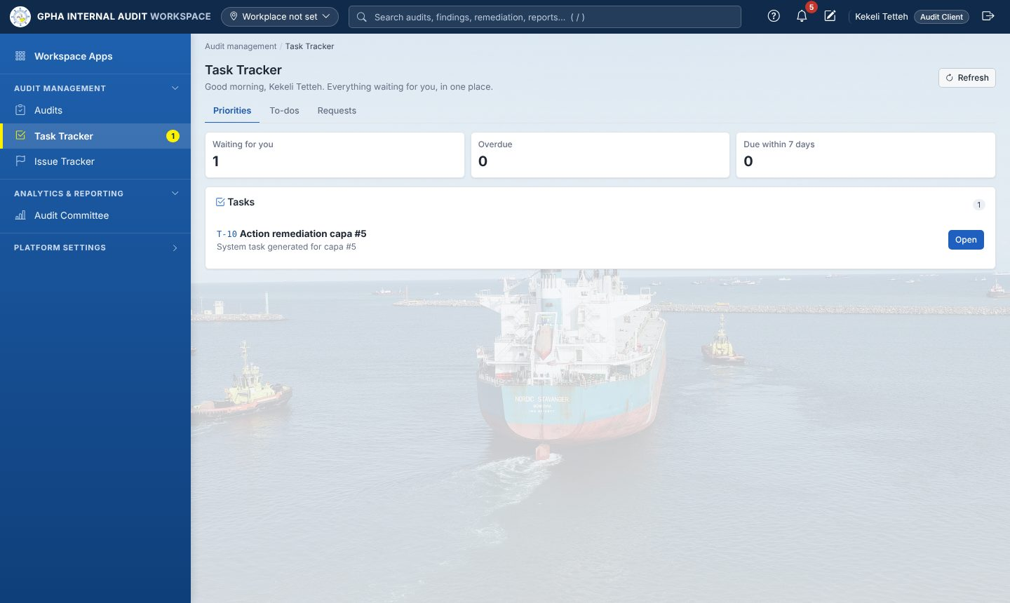
For auditees: everything starts in Priorities
1
Open Task Tracker › Priorities
2
Upload evidence and Submit
3
Comment on the draft report
4
Respond to published issues
5
Update actions with evidence
6
Complete the survey

Slide 31
Quick reference by role
Auditor
Manager
GM Audit
Auditee
My work and Priorities daily
Declare for each engagement
RCM, tests, sign-offs
Evidence and issues
Validate actions
Prepare the plan
Allocate teams; check flags
Review and clear notes
Review the report
Close audits
Approve plan and changes
Issue and correct reports
Decide risk acceptances
Committee packs
Charter and EQA
Priorities
Submit evidence
Respond to issues
Update actions
Survey and attestations

Slide 32
Need help?
Use ? Help on any page · Full steps in docs/Usermanual.docx · Access and accounts: your GIAW administrator

