Slide 1
Remaining Topics
Semiconductor Memory
  Reference: ‘Analysis and Design of Digital Integrated Circuits’ by Hodges, Jackson, and Saleh
Digital Logic using BJTs
Layout
ECE445
Notes:
ECE445 - University of Maine
Prof. David E. Kotecki

Slide 2
Semiconductor Memories
ECE445
Notes:
ECE445 - University of Maine
Prof. David E. Kotecki

Slide 3
Classification
Volatile
Speed
Density
SRAM
Yes
High
Moderate
DRAM
Yes
Moderate
High
ROM
No
High
Moderate
EPROM
No
Low
Low
Flash
No
Low
High
MRAM
No
High
Moderate
FeRAM
No
High
Moderate
ECE445
Notes:
ECE445 - University of Maine
Prof. David E. Kotecki

Slide 4
Classification
Volatile
Speed
Density
SRAM
Yes
High
Moderate
DRAM
Yes
Moderate
High
ROM
No
High
Moderate
EPROM
No
Low
Low
Flash
No
Low
High
MRAM
No
High
Moderate
FeRAM
No
High
Moderate
ECE445
Notes:
ECE445 - University of Maine
Prof. David E. Kotecki

Slide 5
Memory Classification
Stand Alone Memory
- DRAM, ROM, SRAM, FLASH, EPROM
- MRAM, FeRAM
Embedded Memory
- SRAM for cache
- DRAM
- ROM
ECE445
Notes:
ECE445 - University of Maine
Prof. David E. Kotecki

Slide 6

Memory Market
September 2006 Chip Sales Reached $21.4 Billion
SAN JOSE, CA – November 16, 2006 – The Semiconductor Industry Association (SIA) today released its annual forecast of global semiconductor sales, projecting that the industry will continue to ride a strong wave of consumer demand for electronic products, driving sales to $321 billion in 2009. The SIA forecast projects a compound annual growth rate of 9 percent for the forecast period, 2006-2009. Total worldwide microchip sales in 2005 amounted to $227.5 billion.
MEMORY accounted for ~25% of the total market
DRAM sales are projected to be the fastest-growing segment
- Compound annual growth rate >14% in 2006-2009
- Sales especially strong for remainder of 2006 and in 2007 --> Vista OS
Sales of NAND flash are projected to grow at compound annual rate of 11% through 2009.
- Driven by replacement of hard drives; Laptop computers with pure NAND drives are
projected to account for up to 25 percent of the laptop market by 2009
ECE445
Notes:
ECE445 - University of Maine
Prof. David E. Kotecki

Slide 7
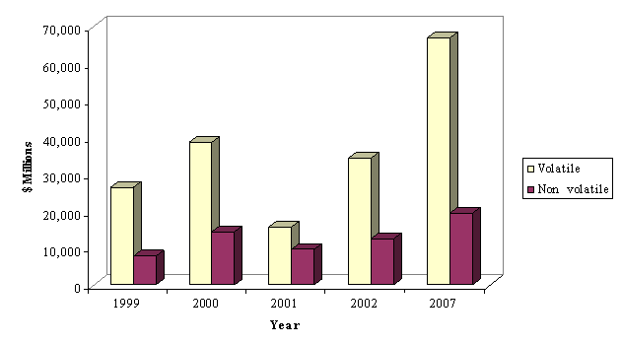
Memory Market
Source: BCC, Incorporated
ECE445
Notes:
ECE445 - University of Maine
Prof. David E. Kotecki

Slide 8
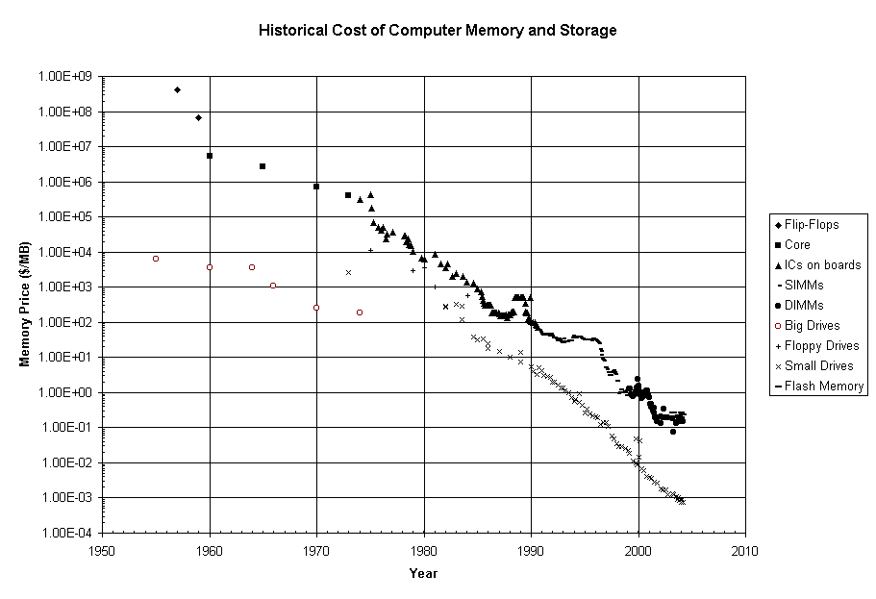
http://www.jcmit.com/mem2002.htm
ECE445
Notes:
ECE445 - University of Maine
Prof. David E. Kotecki

Slide 9
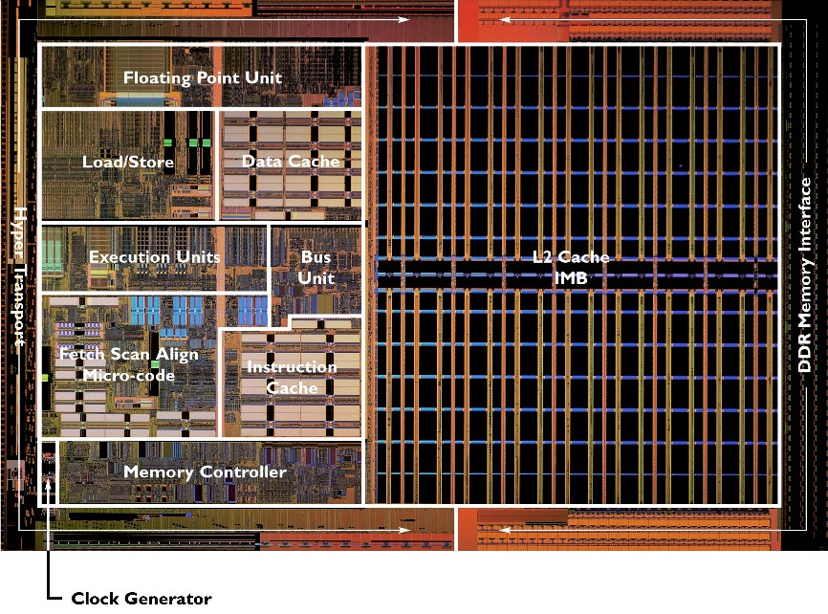
AMD Athlon
ECE445
Notes:
ECE445 - University of Maine
Prof. David E. Kotecki

Slide 10
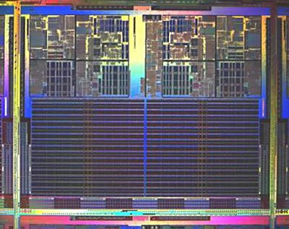
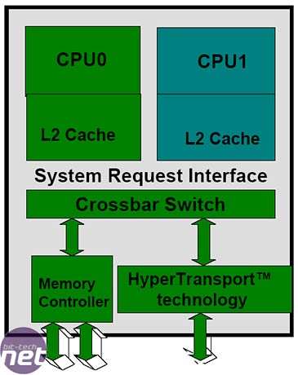
AMD Dual-Core Athlon
ECE445
Notes:
ECE445 - University of Maine
Prof. David E. Kotecki
170 million transistors, either 90 or 130nm (probably 90nm)
190 mm2 → 1.6 x 1.2cm
100W

Slide 11
Memory Density
ECE445
Notes:
ECE445 - University of Maine
Prof. David E. Kotecki

Slide 12
Cell Size
2F
F
F (1/2 the minimum pitch)
SRAM 6-T cell:
40-100 F² cell
DRAM 1-T, 1-C cell:
5-10 F² cell; most common 8F² cell
4F
G
S G D
2F
S G D
ECE445
Notes:
ECE445 - University of Maine
Prof. David E. Kotecki

Slide 13
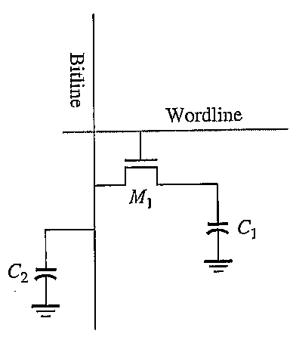
1T DRAM Cell
b
ECE445
Notes:
ECE445 - University of Maine
Prof. David E. Kotecki

Slide 14
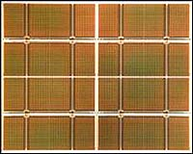
4Gb DRAM
Infineon 2004
ECE445
Notes:
ECE445 - University of Maine
Prof. David E. Kotecki

Slide 15
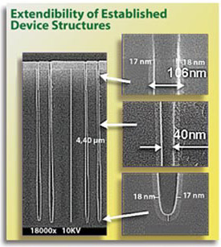
DRAM Trench Capacitor
ECE445
Notes:
ECE445 - University of Maine
Prof. David E. Kotecki

Slide 16
Redundancy
Redundancy is always used on standalone DRAMs and frequently for embedded DRAMs.
Implemented via on chip fuses in which fuses are blown either by a laser pulse or by an electrical pulse during wafer test.
Normally a few rows and columns of redundancy are offered on a large DRAM embedded macro. Smaller macros require less redundancy (or no redundancy)
Redundancy can also be implemented to some extent in the logic part of the circuits. To implement a spare decoder, for example, switches can be used that shift all decoder connections by one to bypass the faulty decoder.
ECE445
Notes:
ECE445 - University of Maine
Prof. David E. Kotecki

Slide 17
Memory Standards
Most memory standards are controlled by the JEDEC Solid State Technology Association (Once known as the Joint Electron Device Engineering Council). JEDEC is the semiconductor engineering standardization body of the Electronic Industries Alliance (EIA), a trade association that represents all areas of the electronics industry and was originally created in 1960 to cover the standardization of discrete semiconductor devices and later expanded in 1970 to include integrated circuits.
JEDEC does its work through its 48 committees/ subcommittees that are overseen by the JEDEC Board of Directors. Presently there are about 300 member companies in JEDEC including both manufacturers and users of semiconductor components and others allied to the field.
ECE445
Notes:
ECE445 - University of Maine
Prof. David E. Kotecki

Slide 18
DRAM Architecture
More than 10 Different Types of DRAM
Page Mode DRAM DRAM
Fast Page Mode DRAM FPM DRAM
Extended Data Output DRAM EDO DRAM
Burse Extended Data Output DRAM BEDO DRAM
Enhanced DRAM EDRAM
Synchronous DRAM SDRAM
PC100 Synchronous DRAM PC100 SDRAM
Enhanced Synchronous DRAM ESDRAM
Double Data Rate DRAM DDR DRAM
Direct Rambus DRAM DRDRAM
Synchronous Link DRAM SLDRAM
…..
ECE445
Notes:
ECE445 - University of Maine
Prof. David E. Kotecki

Slide 19
Memory Circuits
Memory Core - typically stores 1-bit
- can have multilevel cores)
Peripheral Circuits
- row and column decoders
- sense amplifiers
- column precharge circuits
- data buffers
- read/write (R/W) circuits
- …
ECE445
Notes:
ECE445 - University of Maine
Prof. David E. Kotecki

Slide 20
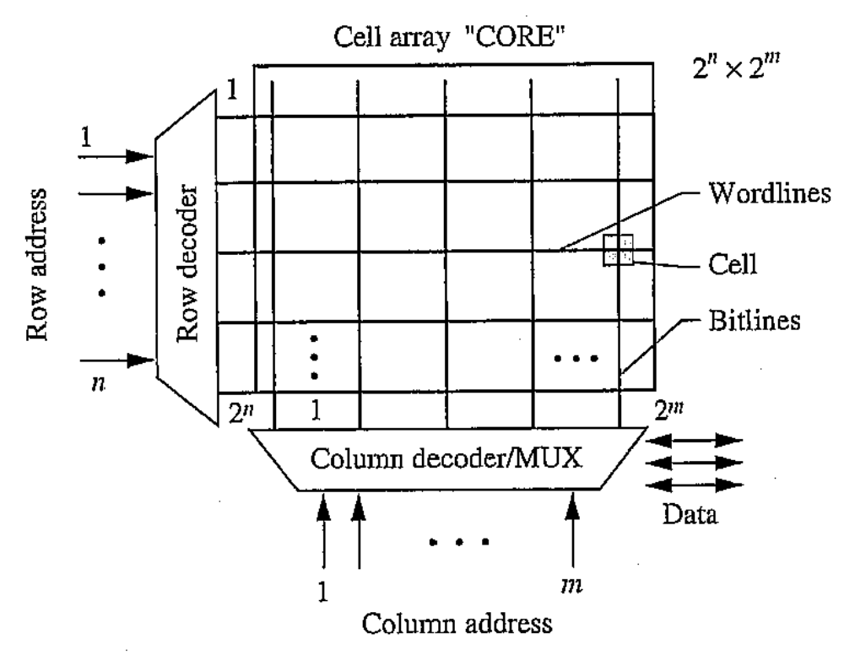
Typical Memory Organization
storage
bits
random access architecture
ECE445
Notes:
ECE445 - University of Maine
Prof. David E. Kotecki
Horizontal lines are driven from the outside call wordlines
Vertical lines along which data flows out of the cells are called bitlines

Slide 21
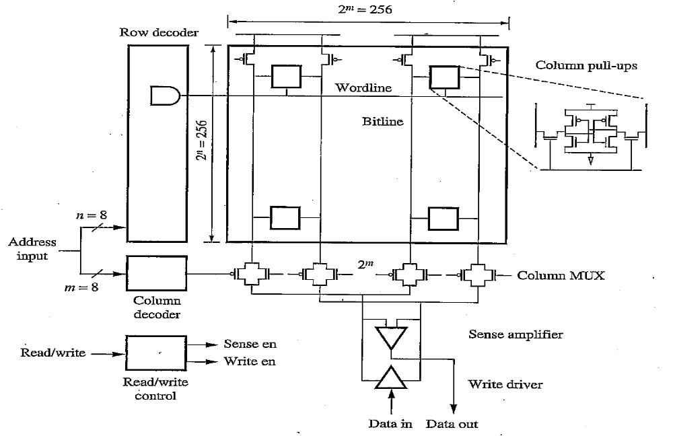
64 Kb RAM (2⁸ x 2⁸)
256 x 256 = 65,536 bits
ECE445
Notes:
ECE445 - University of Maine
Prof. David E. Kotecki

Slide 22
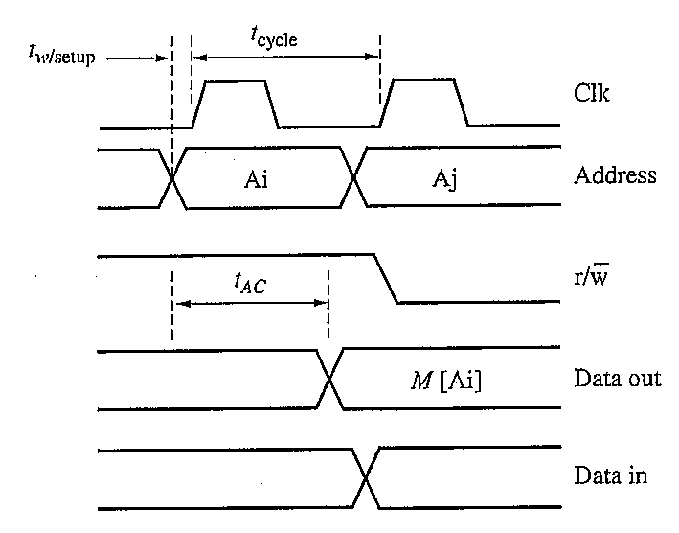
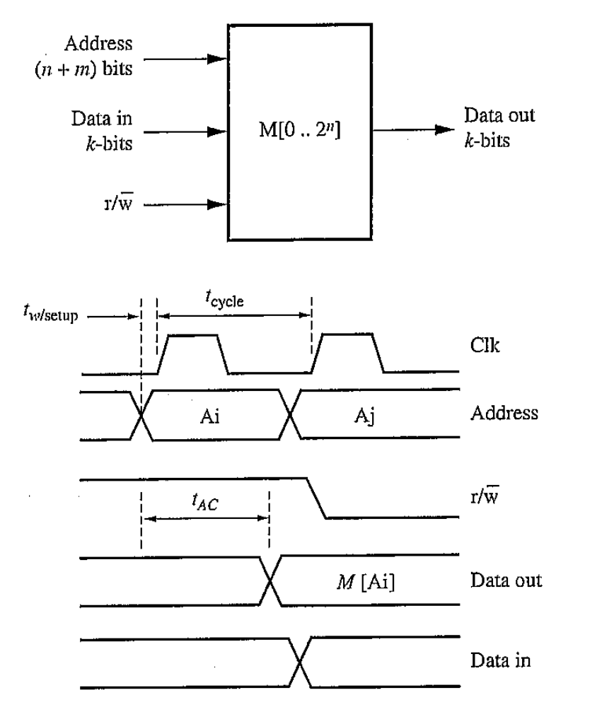
Timing Signals
Clk
t_{CYCLE} – minimum time to complete successive read or write operations
t_{W/SETUP} – write setup time
t_{AC} – read access time – delay from change in the address until data from that address
are available at the output
ECE445
Notes:
ECE445 - University of Maine
Prof. David E. Kotecki

Slide 23
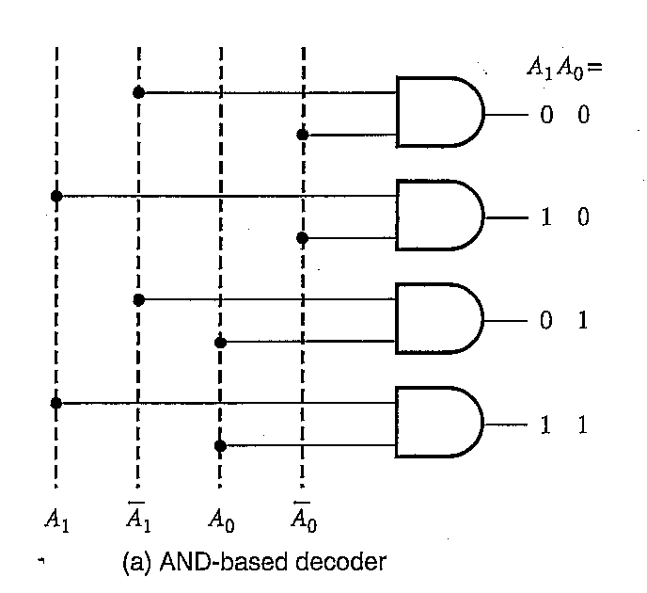
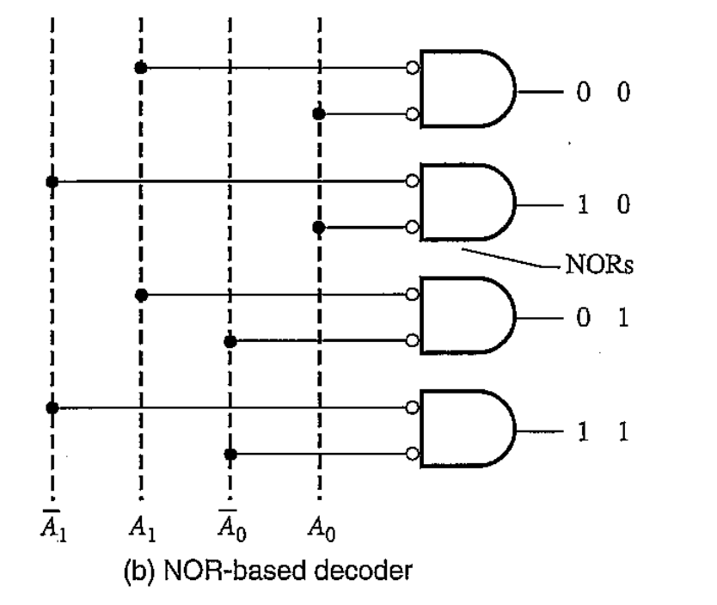
Row Decoder (n=2)
ECE445
Notes:
ECE445 - University of Maine
Prof. David E. Kotecki
Decoder can be implemented with AND based or NOR based schemes
N=2 → four bitlines
An n-bit decoder requires 2^n logic gates, each with n inputs
With n=6, we would need 64 6-input NAND gates driving 64 inverters to implement the decoder
Large number of inputs on an NAND gate introduces considerable delay → cascade the gates usually in two stages: a predecode stage and a final decode stage.

Slide 24
Cascade Decoder
An n-bit decoder → 2^{n} logic gates each with n inputs
For n=6 → requires 64, 6–input NAND gates and 64 Inverters
To minimize delay caused by large series resistances → cascade
- predecode stage
- final decode stage
Allows intermediate signals from the predecode stage to be reused by the final decoding stage
ECE445
Notes:
ECE445 - University of Maine
Prof. David E. Kotecki

Slide 25
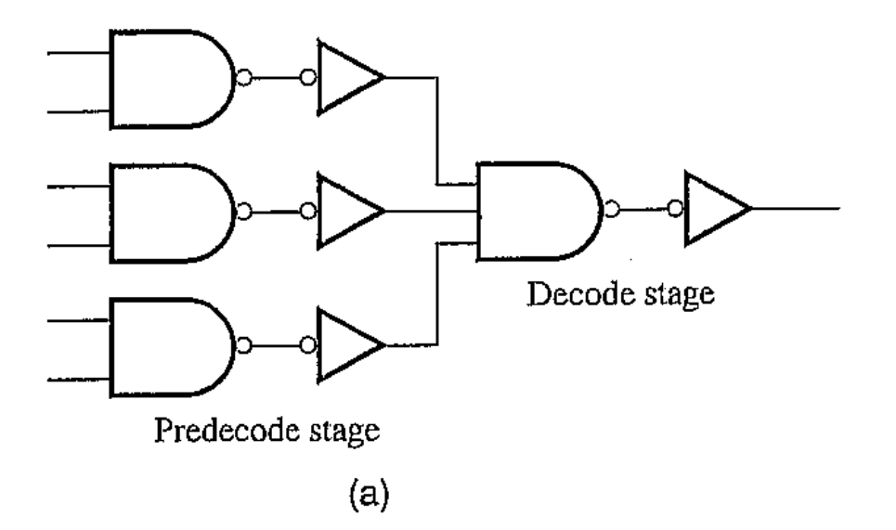
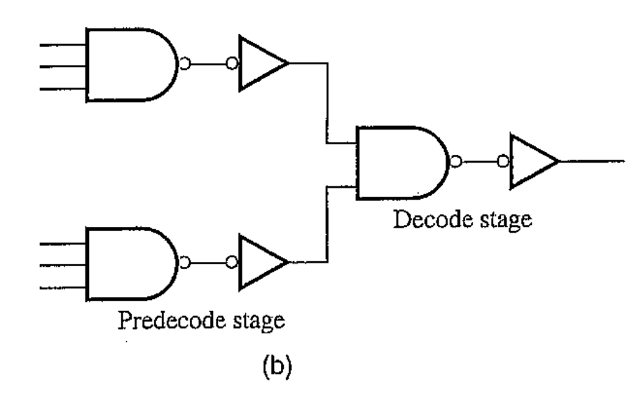
Alternative 6-input NAND
ECE445
Notes:
ECE445 - University of Maine
Prof. David E. Kotecki

Slide 26
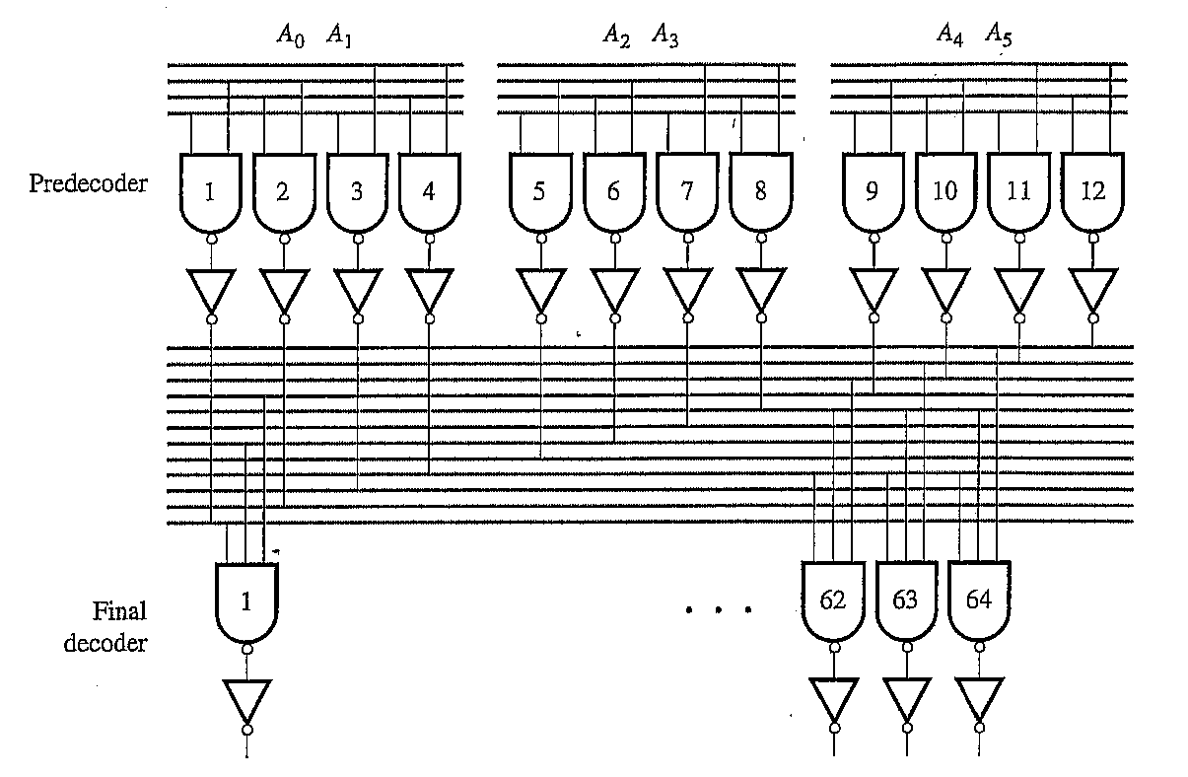
Reuse of Intermediate Signals
ECE445
Notes:
ECE445 - University of Maine
Prof. David E. Kotecki
In the predecoder, 12 intermediate signals are generated from the address bits and their complements
These signals are used by the final deocder to generate the 64 required outputs using a 3-input NAND and an inverter
Each predecoder output drives 16 3-input nand gates
What is the branching logical effort? Answer 16
Gate delays can be minimized using logical effort.
Delay through the decoder can be significant fraction of the clock cycle (40%).

Slide 27
Sizing Using Logical Effort
Size the decoder assuming:
- normalized output load = 1
- fan-out = 4
Work backwards from the output to the input:
- Normalized output has a size =
- Inverter input capacitance =
- The Logical Effort of the 3-input NAND =
- Input capacitance of 3-input NAND =
- Branching effort at output of predecoder =
- Input capacitance of the inverter =
- The 2-input NAND has an input capacitance =
ECE445
Notes:
ECE445 - University of Maine
Prof. David E. Kotecki
In the predecoder, 12 intermediate signals are generated from the address bits and their complements
These signals are used by the final deocder to generate the 64 required outputs using a 3-input NAND and an inverter
Each predecoder output drives 16 3-input nand gates
What is the branching logical effort? Answer 16
Gate delays can be minimized using logical effort.
Delay through the decoder can be significant fraction of the clock cycle (40%).

Slide 28
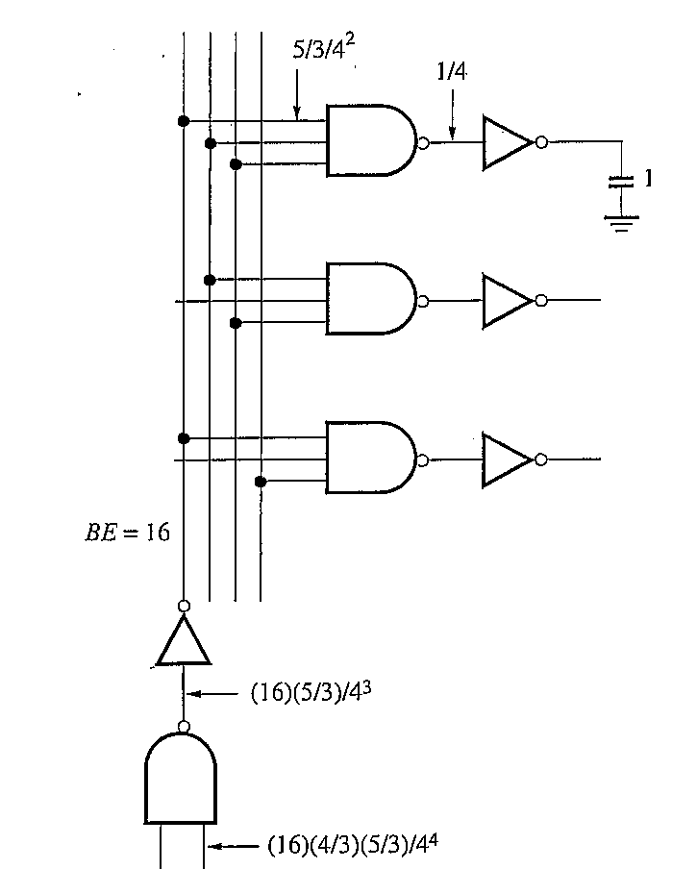
Decoder Size by Logical Effort
ECE445
Notes:
ECE445 - University of Maine
Prof. David E. Kotecki

Slide 29
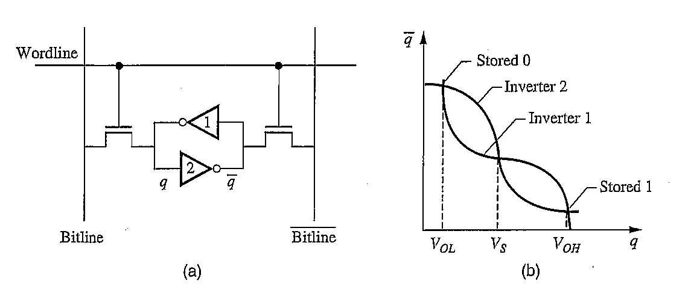
SRAM (Static RAM) Cell
Basic SRAM Cell
ECE445
Notes:
ECE445 - University of Maine
Prof. David E. Kotecki

Slide 30
Voltage Transfer Characteristics
ECE445
Notes:
ECE445 - University of Maine
Prof. David E. Kotecki

Slide 31
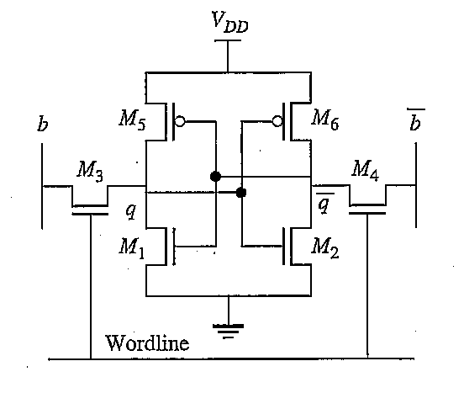
6-T Configuration
ECE445
Notes:
ECE445 - University of Maine
Prof. David E. Kotecki

Slide 32
Cell Design Considerations
1. Minimize Cell Area ←→ Increase cell density
- replace load resistors (M5 and M6) with transistors
- utilize TFTs for M5 and M6
- reduce wasted area
2. Minimize static power → Increase Vt and sub-Vt slope
3. Differential bitlines → improved noise immunity
ECE445
Notes:
ECE445 - University of Maine
Prof. David E. Kotecki

Slide 33
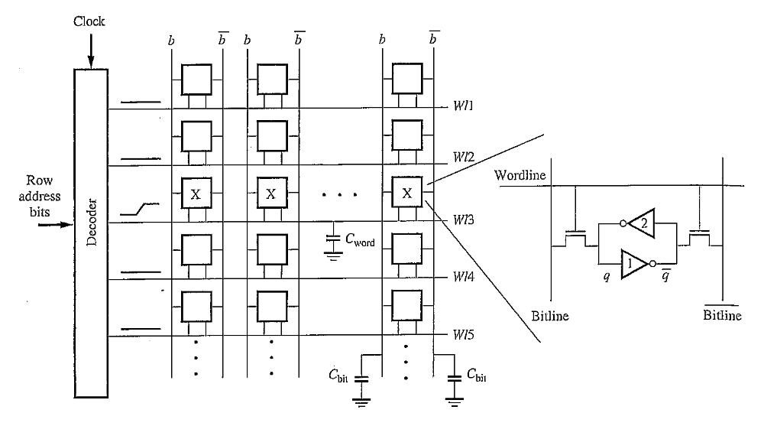
SRAM Array (simplified)
C_{WORD} = 2 (C_{G} + C_{WIRE}) x # columns
C_{BIT} = (C_{SD} + C_{WIRE} +
C_{CONT}) x # rows
ECE445
Notes:
ECE445 - University of Maine
Prof. David E. Kotecki

Slide 34
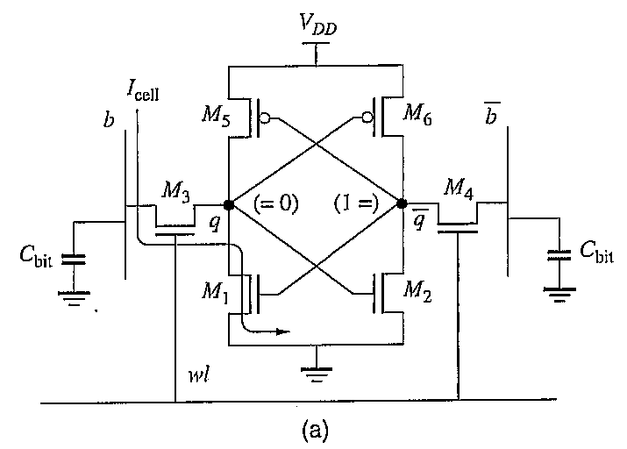
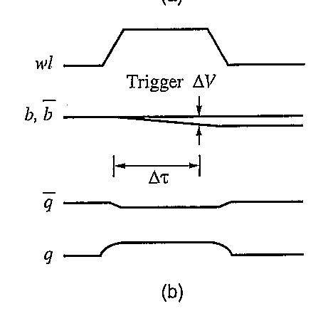
SRAM Read Operation
Precharge b, b to V_{DD} column pull-up R
Turn on wordline to select row
CBIT slowly discharges on either b or b
b and b → sense amplifier
ECE445
Notes:
ECE445 - University of Maine
Prof. David E. Kotecki
Precharge b and bbar to higg

Slide 35
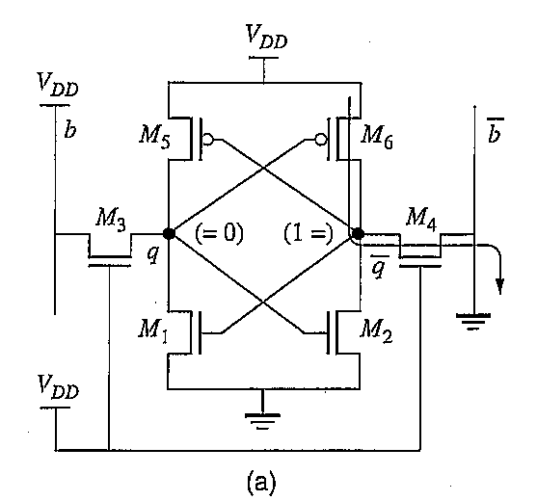
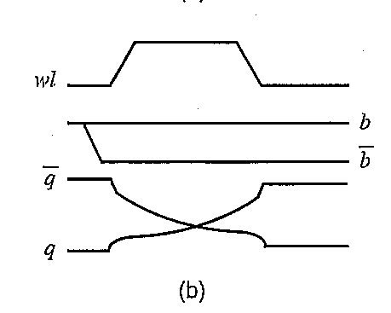
SRAM Write Operation
Force either b or b low
Turn on appropriate word line
Node q or q is driven low causing the state to switch
ECE445
Notes:
ECE445 - University of Maine
Prof. David E. Kotecki

Slide 36
Transistor Sizing Guidelines
During read: need to ensure stored value is not disturbed – voltage can not drop below V_{S}
Make conductance of M1, M2 greater than M3, M4
Need to supply enough I_{CELL} to discharge C_{BIT} sufficiently in 20-30% of a clock cycle
Can estimate I_{CELL}
5. During write: make conductance of M3, M4 greater than M5, M6
I_{CELL} = C_{BIT} ΔV / τ
ECE445
Notes:
ECE445 - University of Maine
Prof. David E. Kotecki

Slide 37
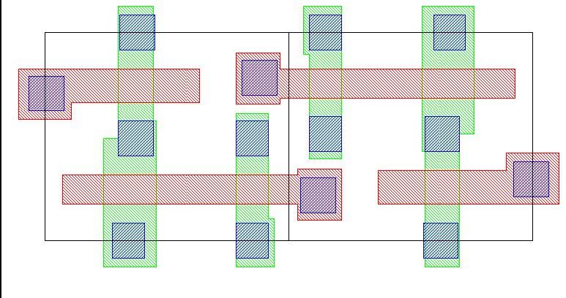
Cell Layout
WL
PD
PU
ECE445
Notes:
ECE445 - University of Maine
Prof. David E. Kotecki

Slide 38
SRAM Column I/O Circuitry
Pre-charge (PC) circuitry
- used prior to a read or write operation to pull bit lines ‘high’
- equalize b and b potentials
Address transition detection (ADT) circuitry to generate PC signal
- triggered by any transition of the address inputs
Column decoder – multiplexer
Read and Write circuitry
- R/W selection circuit
- sense amplifiers for read operation
- write drivers for write operation
ECE445
Notes:
ECE445 - University of Maine
Prof. David E. Kotecki

Slide 39
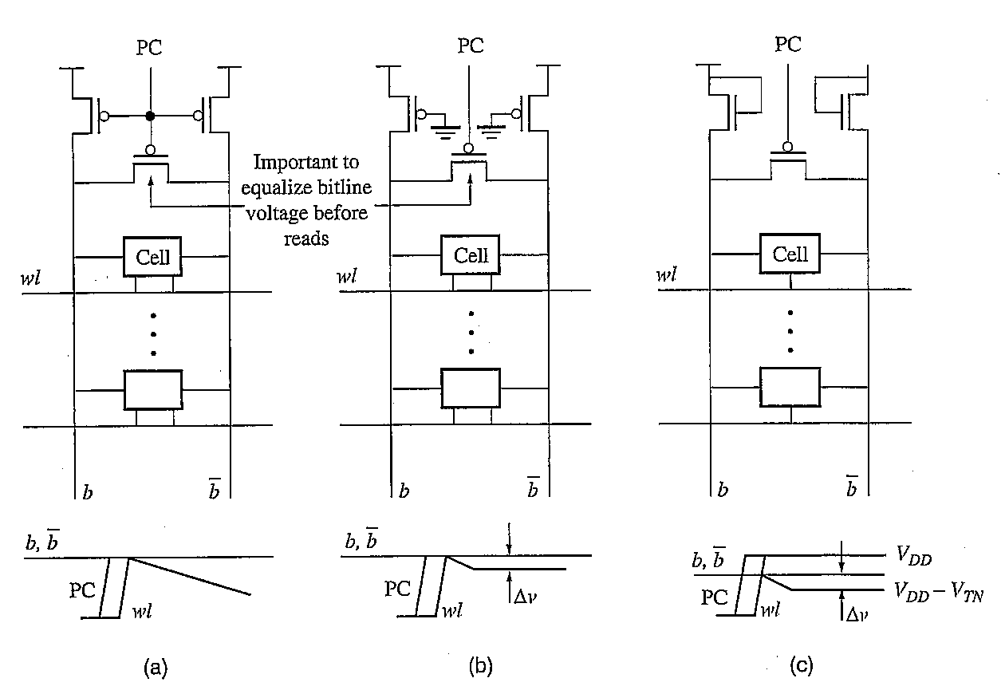
Column Pull-up Circuitry
Dynamic Logic Precharge P seudo-NMOS Precharge NMOS Saturated Enhancement Load
ECE445
Notes:
ECE445 - University of Maine
Prof. David E. Kotecki

Slide 40
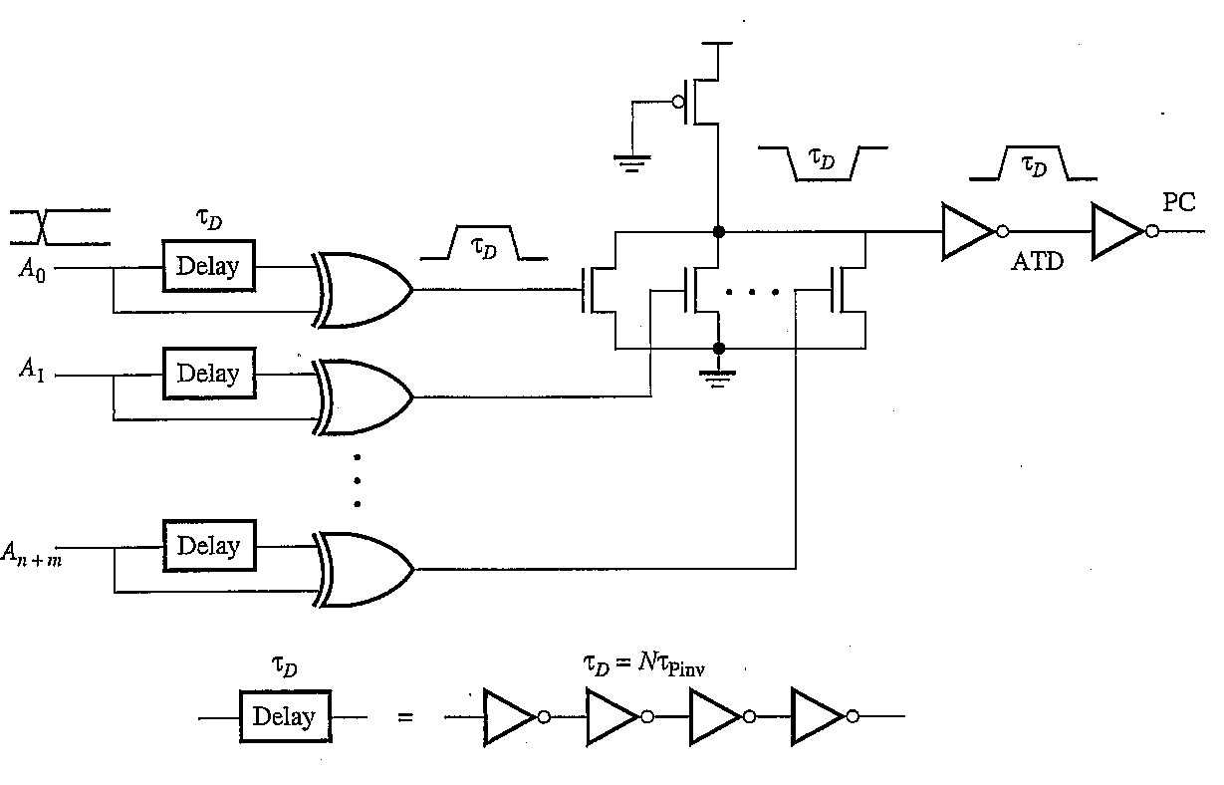
Address Transition Detection (ADT)
Generate the PC signal
ECE445
Notes:
ECE445 - University of Maine
Prof. David E. Kotecki

Slide 41
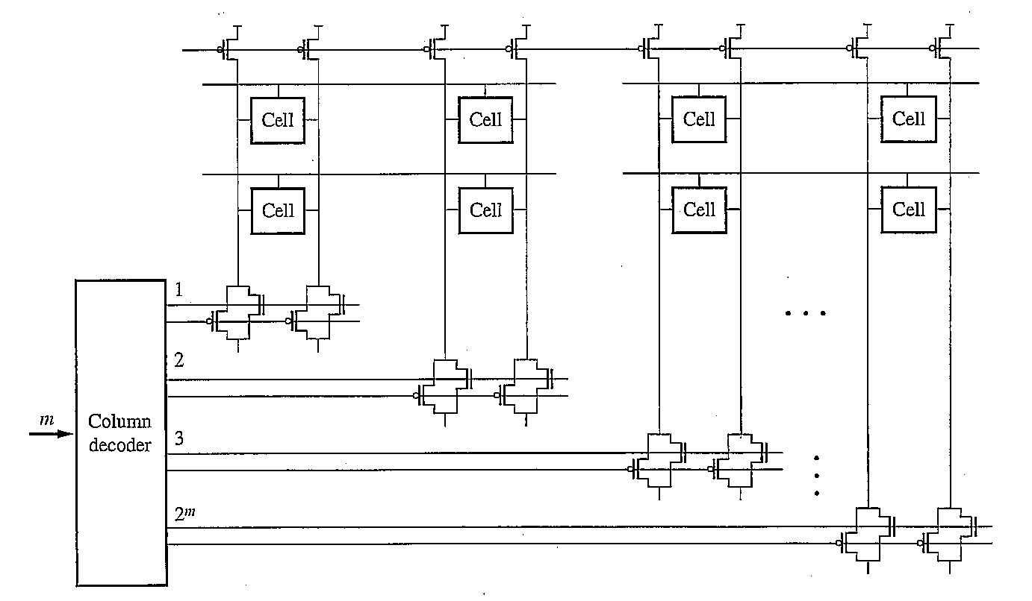
Column Decoder / Multiplexer
ECE445
Notes:
ECE445 - University of Maine
Prof. David E. Kotecki

Slide 42
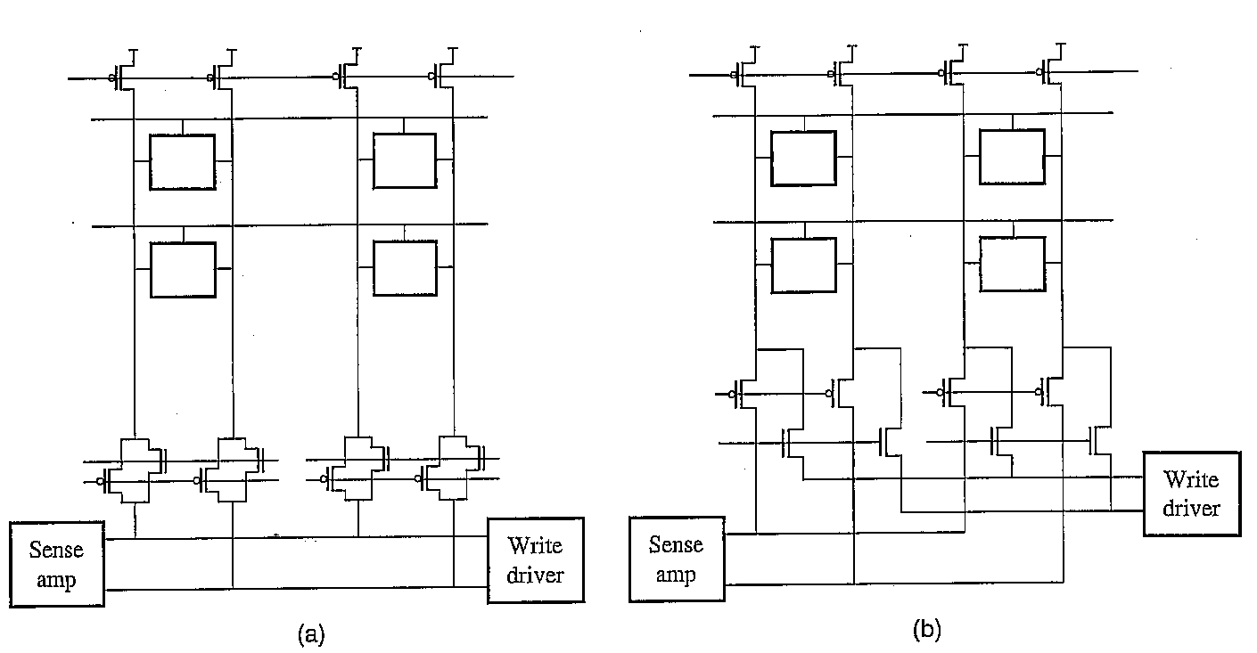
Column Selection / Read - Write
ECE445
Notes:
ECE445 - University of Maine
Prof. David E. Kotecki

Slide 43
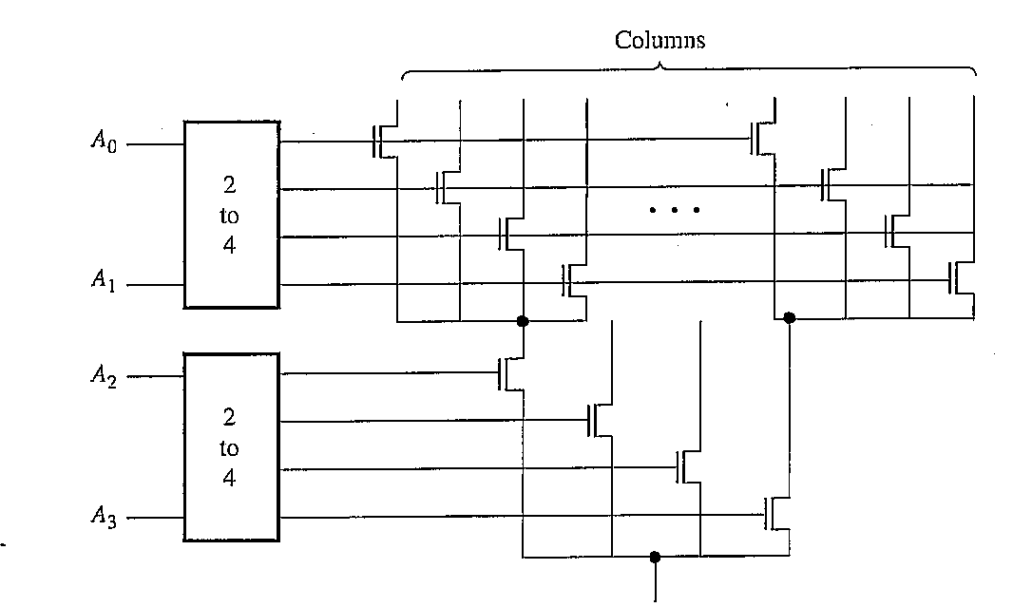
Tree Decoding Structure
Reduces transistor count
ECE445
Notes:
ECE445 - University of Maine
Prof. David E. Kotecki

Slide 44
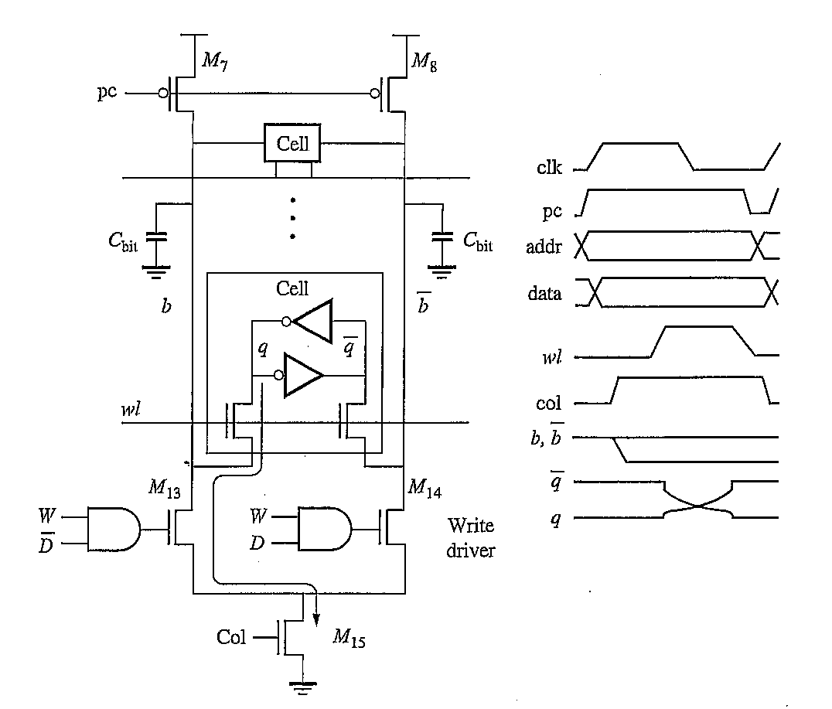
Write Driver Circuitry
ECE445
Notes:
ECE445 - University of Maine
Prof. David E. Kotecki

Slide 45
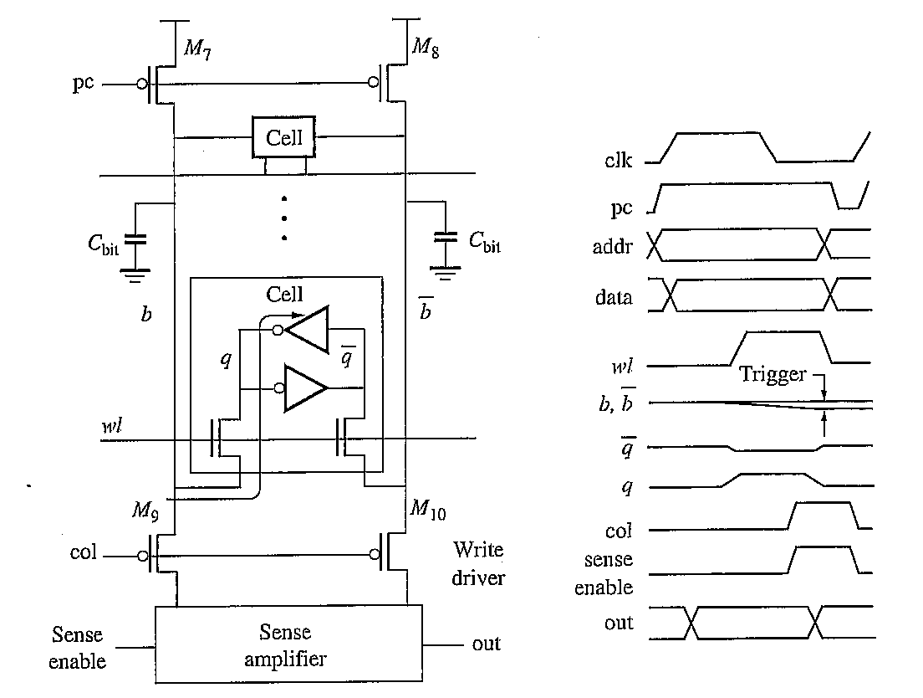
Basic Read Circuitry
ECE445
Notes:
ECE445 - University of Maine
Prof. David E. Kotecki

Slide 46
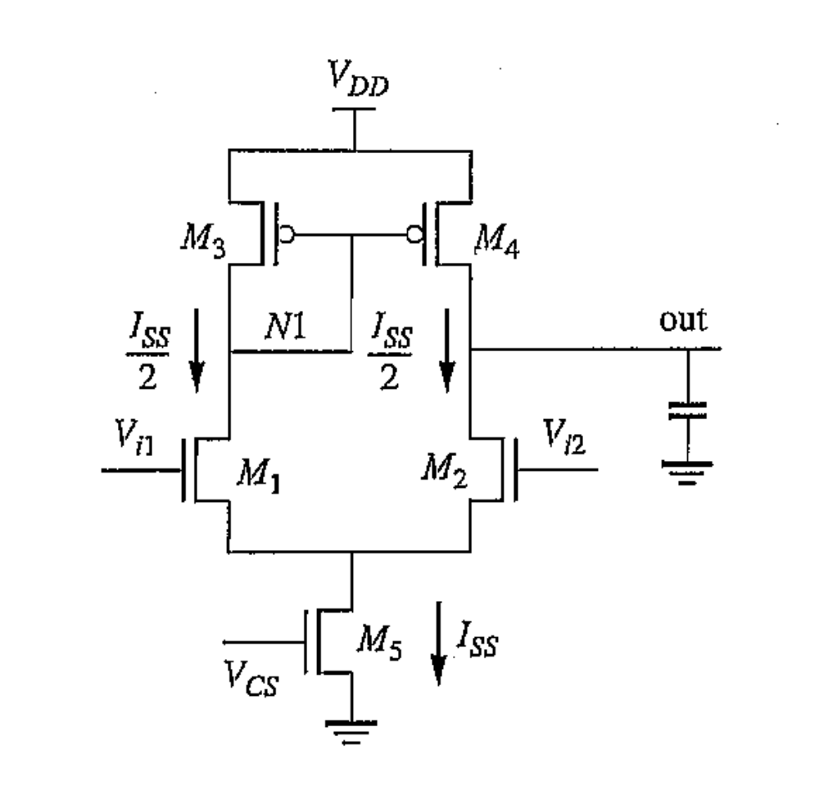
Differential Voltage Sense Amp
Consists of:
common source amp
current mirror
current biasing
Advantages:
- High Speed Operation
Good noise immunity
high CMRR
ECE445
Notes:
ECE445 - University of Maine
Prof. David E. Kotecki

Slide 47
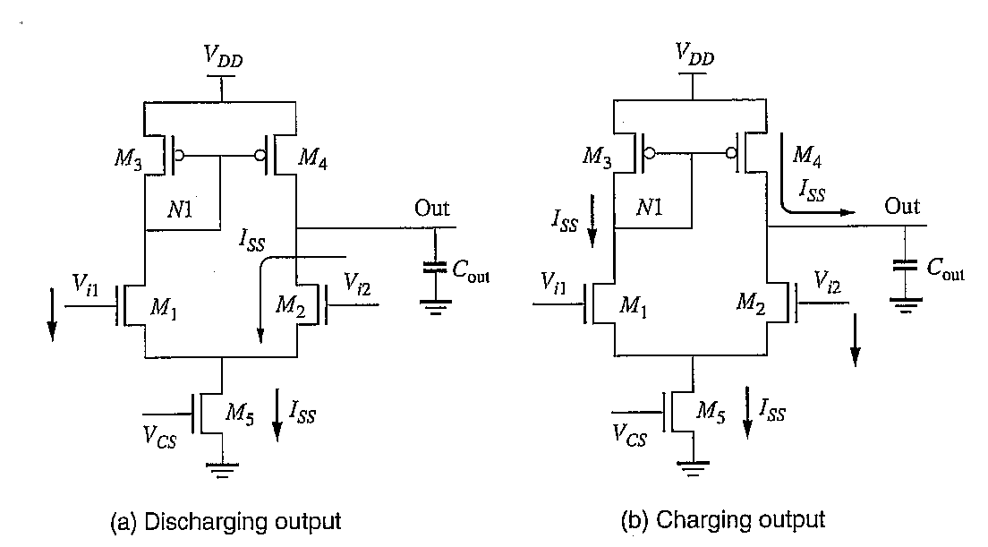
Detection of ‘0’ and ‘1’
ECE445
Notes:
ECE445 - University of Maine
Prof. David E. Kotecki

Slide 48
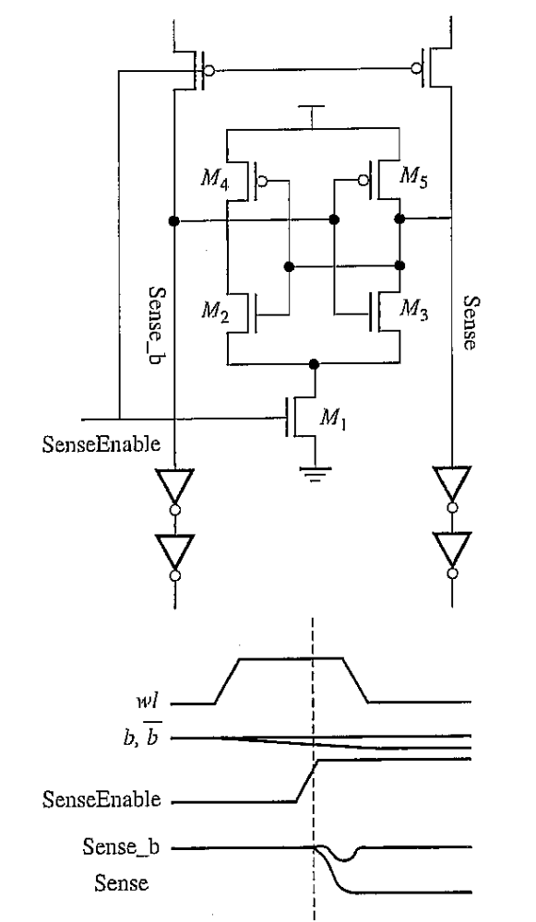
Latch-Based Sense Amp
ECE445
Notes:
ECE445 - University of Maine
Prof. David E. Kotecki

Slide 49
Memory Architecture
ECE445
Notes:
ECE445 - University of Maine
Prof. David E. Kotecki

Slide 50
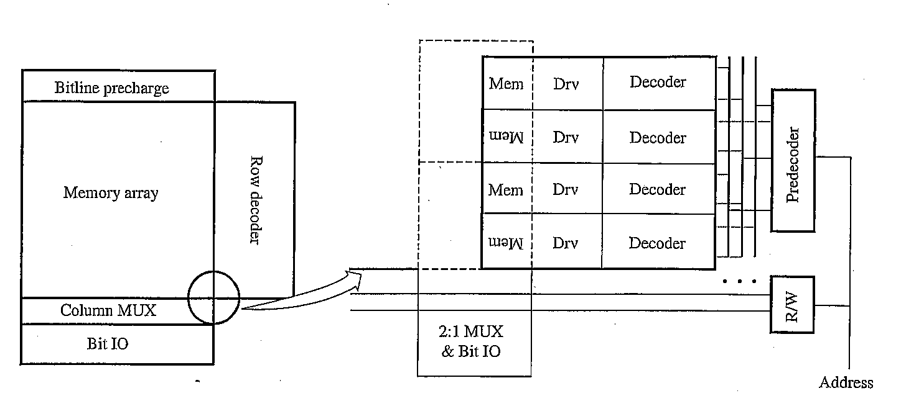
Basic Memory Architecture
ECE445
Notes:
ECE445 - University of Maine
Prof. David E. Kotecki

Slide 51
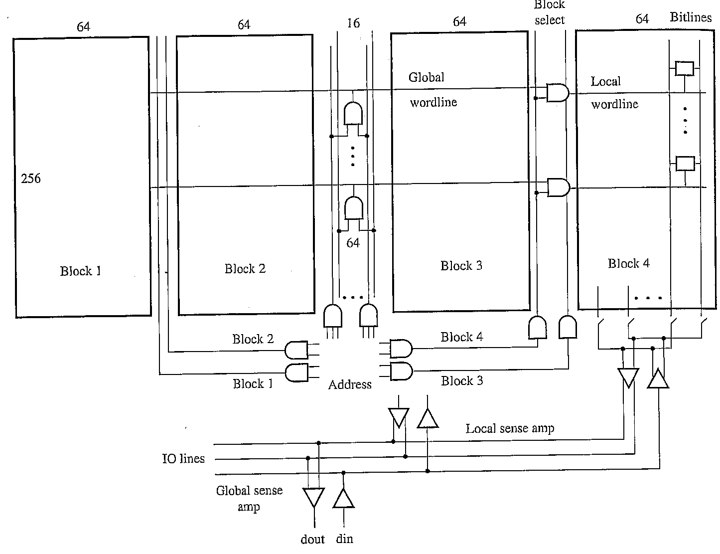
Partitioning - Divided Wordline
ECE445
Notes:
ECE445 - University of Maine
Prof. David E. Kotecki

Slide 52
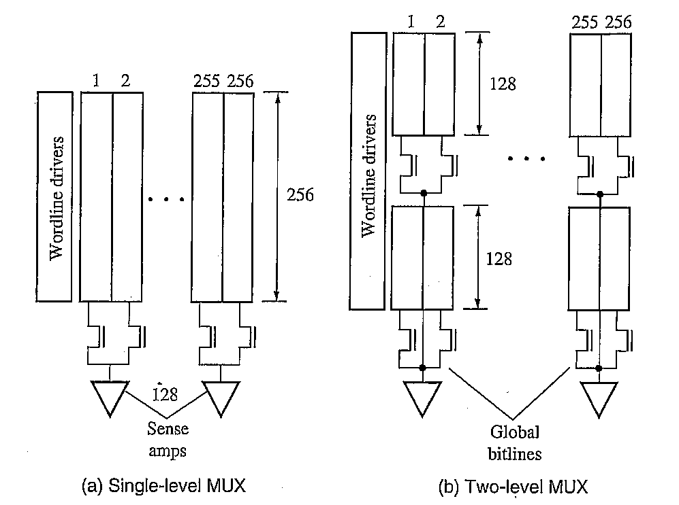
Partitioning – Divided Bitline
ECE445
Notes:
ECE445 - University of Maine
Prof. David E. Kotecki

Slide 53
Other Memory Families
Content-Addressable Memories CAM
Dynamic Random Access Memory DRAM
Flash Memory
ECE445
Notes:
ECE445 - University of Maine
Prof. David E. Kotecki

Slide 54
Associative Memories
Content Addressable Memories (CAMs)
Basic architecture is similar to SRAM
Data we seek is associated with a known binary keyword rather than a known binary address
Compare known keyword against previously stored keywords, known as tags, that reference the data we seek
Address decoder → matching scheme
Often used in:
- cache memories
- Internet routing tables
ECE445
Notes:
ECE445 - University of Maine
Prof. David E. Kotecki

Slide 55
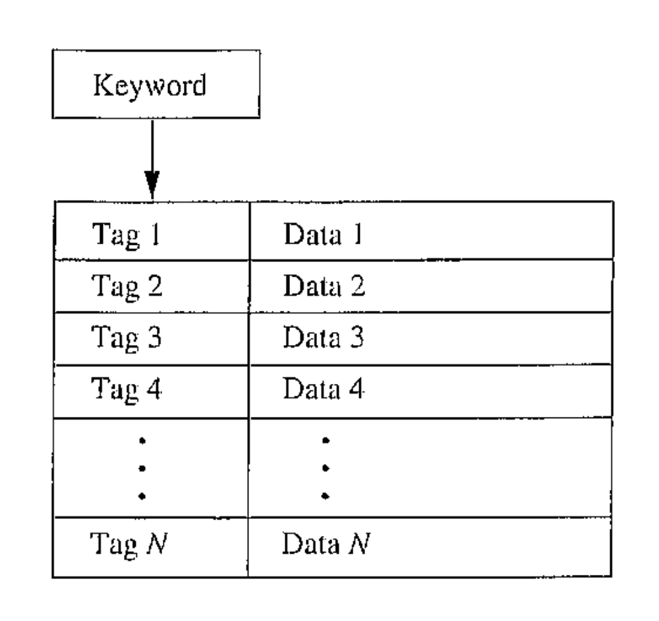
Concept of a CAM Array
ECE445
Notes:
ECE445 - University of Maine
Prof. David E. Kotecki

Slide 56
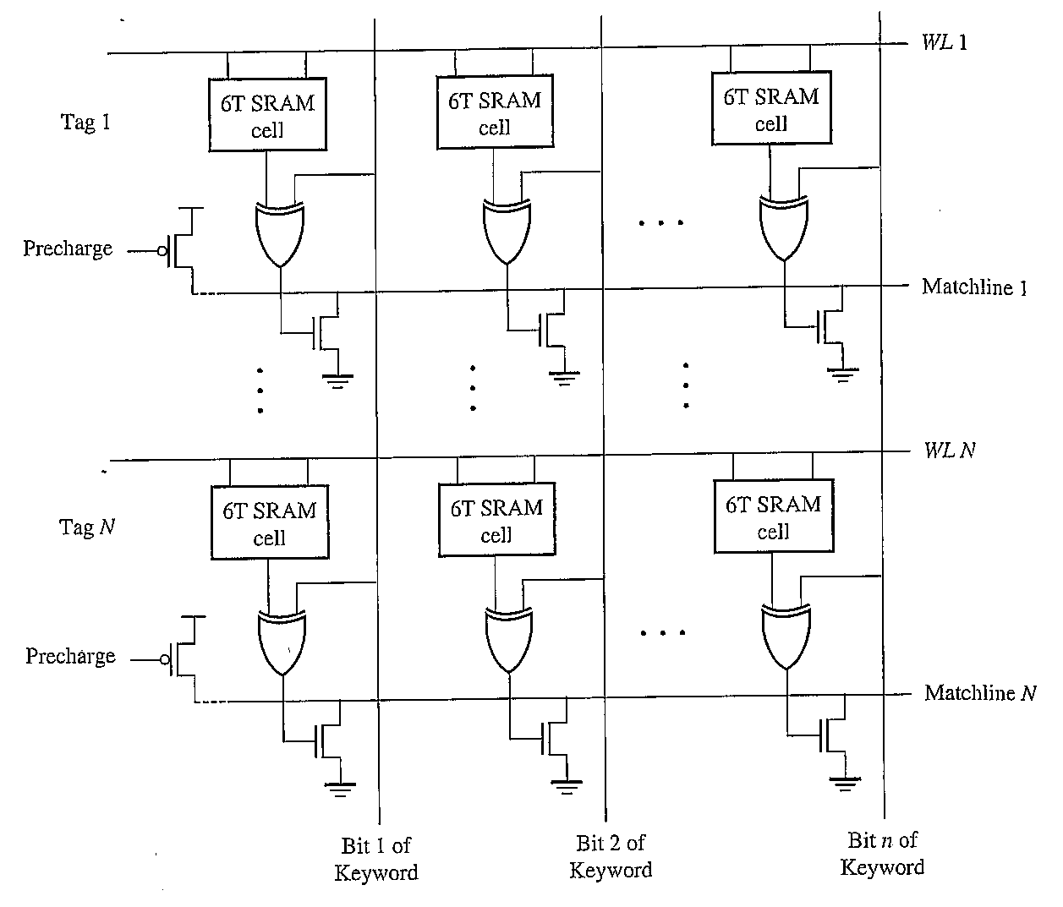
CAM Lookup Array
ECE445
Notes:
ECE445 - University of Maine
Prof. David E. Kotecki

Slide 57
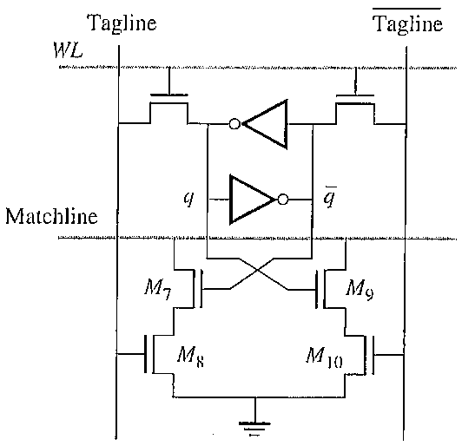
CAM Memory Cell
ECE445
Notes:
ECE445 - University of Maine
Prof. David E. Kotecki

Slide 58
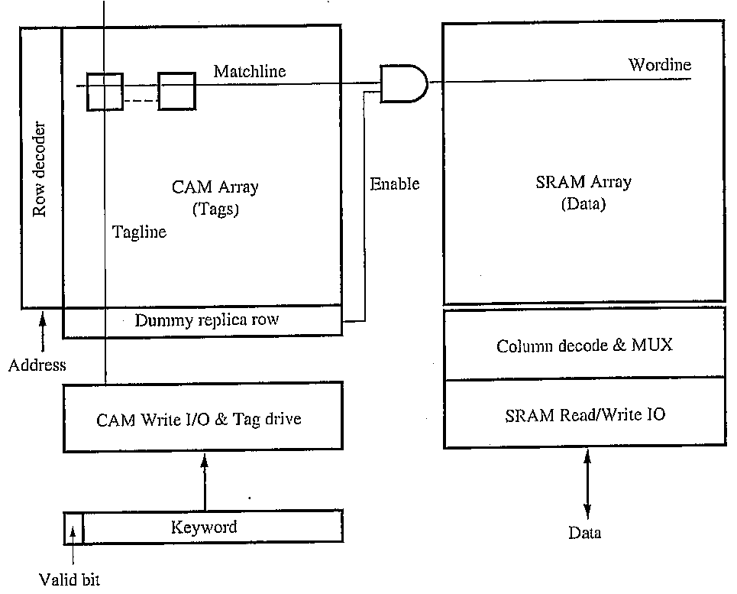
CAM Implementation
ECE445
Notes:
ECE445 - University of Maine
Prof. David E. Kotecki

Slide 59
DRAM
ECE445
Notes:
ECE445 - University of Maine
Prof. David E. Kotecki

Slide 60
1T DRAM Cell
b
ECE445
Notes:
ECE445 - University of Maine
Prof. David E. Kotecki

Slide 61
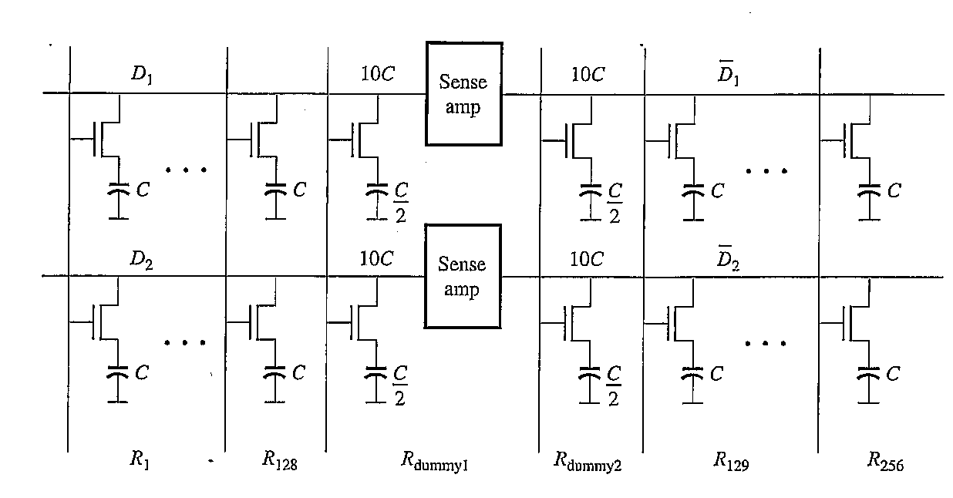
DRAM Array Configuration
ECE445
Notes:
ECE445 - University of Maine
Prof. David E. Kotecki

Slide 62
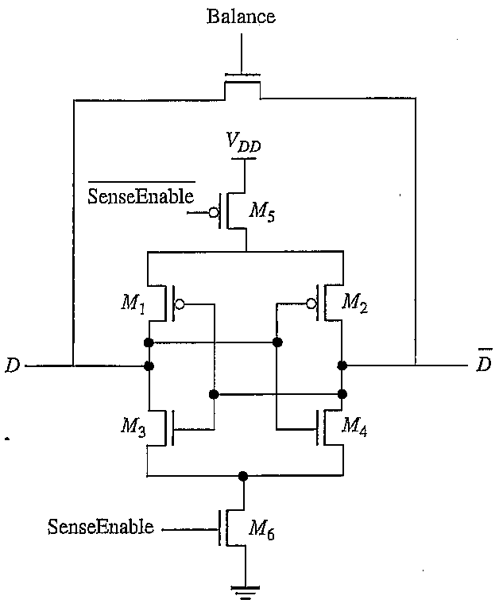
DRAM Sense/Refresh Circuit
ECE445
Notes:
ECE445 - University of Maine
Prof. David E. Kotecki

Slide 63
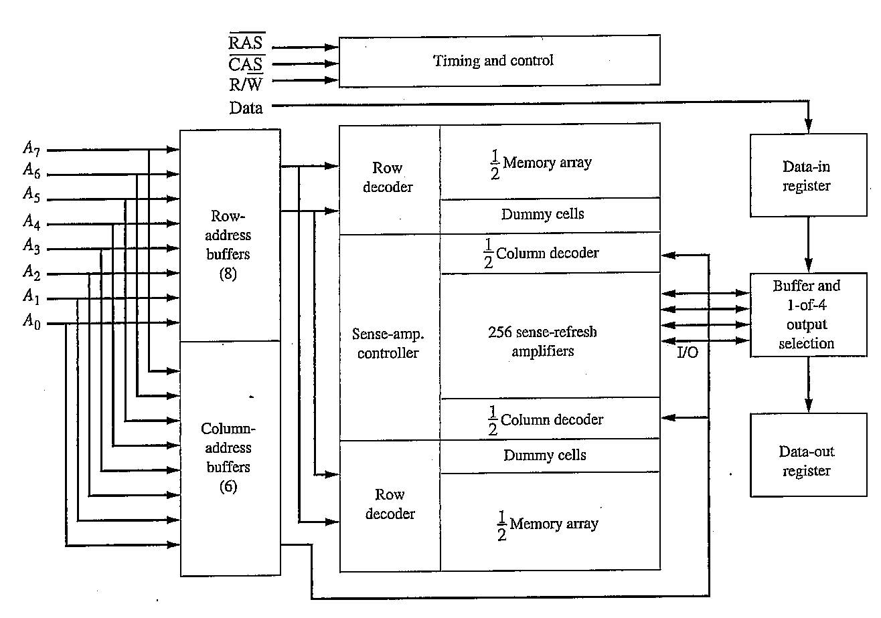
64-kbit DRAM – Block Diagram
ECE445
Notes:
ECE445 - University of Maine
Prof. David E. Kotecki

Slide 64
Flash Memory
ECE445
Notes:
ECE445 - University of Maine
Prof. David E. Kotecki

Slide 65
Applications
Read / Write Non-volatile Memory
- USB memory sticks
- Digital cameras
- MP3 players
- …
10⁶ R/W operations
1T cell implementation of E²PROM
Two architectures
- NAND
- NOR
ECE445
Notes:
ECE445 - University of Maine
Prof. David E. Kotecki

Slide 66
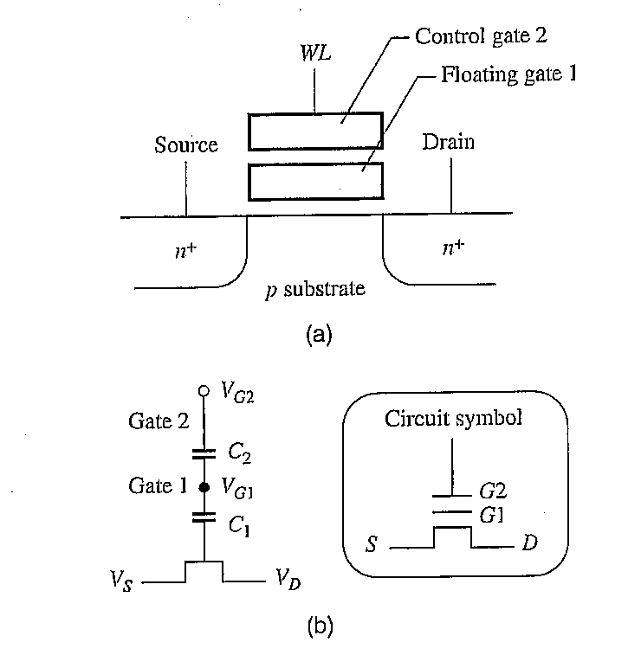
Dual-Gate Structure
ECE445
Notes:
ECE445 - University of Maine
Prof. David E. Kotecki

Slide 67
Schematic Representation
Applied Gate Voltage
Gate Voltage Which Controls Device Characteristics
ECE445
Notes:
ECE445 - University of Maine
Prof. David E. Kotecki

Slide 68
Capacitive Divider at Gate
C₂
ΔV_{G1} = ΔV_{G2}
C₁ + C₂
ECE445
Notes:
ECE445 - University of Maine
Prof. David E. Kotecki

Slide 69
To Turn The Device On
V_{G1} > V_{t}
C₂
V_{G1} = V_{G2}
> V_{t}
C₁ + C₂
C₁ + C₂
V_{G2} > V_{t}
C₂
ECE445
Notes:
ECE445 - University of Maine
Prof. David E. Kotecki

Slide 70
Device Operation
V_{G1} > V_{t}
C₂
V_{G1} = V_{G2}
> V_{t}
C₁ + C₂
C₁ + C₂
V_{G2} > V_{t}
C₂
Device operation relies on the ability to store and remove charge from the floating gate → namely node V_{G1}
ECE445
Notes:
ECE445 - University of Maine
Prof. David E. Kotecki

Slide 71
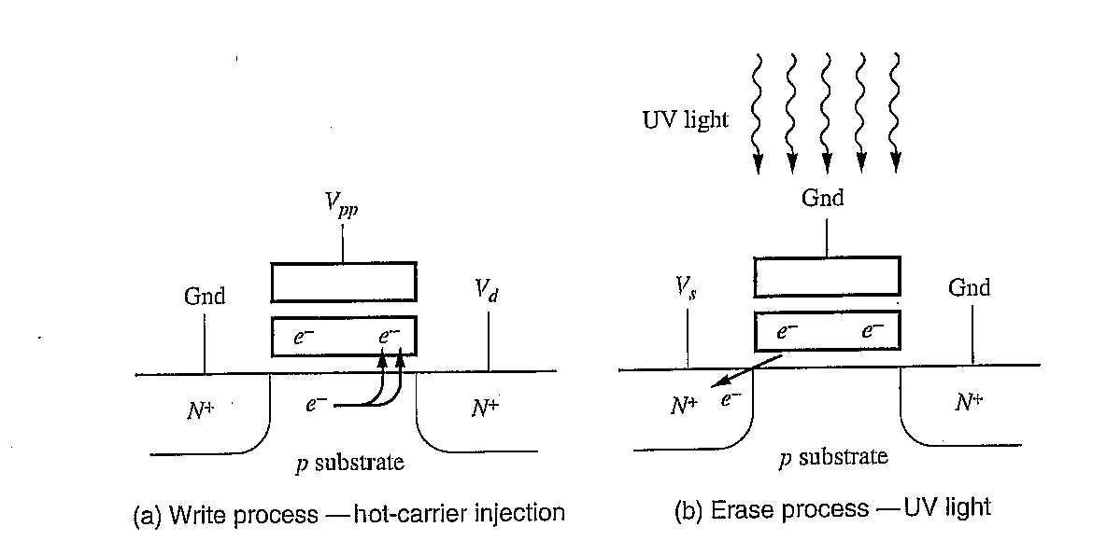
Write Process
Write process relies on “Hot Carrier Injection” (HCL)
- Raise V_{G2} and V_{DS} >> VDD
Avalanche breakdown of
Drain/Substrate Junction
Electrons are injected through the
gate oxide onto the floating gate
Self-terminating process because
V_{G1} decreases as electrons are
injected onto the floating gate
ECE445
Notes:
ECE445 - University of Maine
Prof. David E. Kotecki

Slide 72
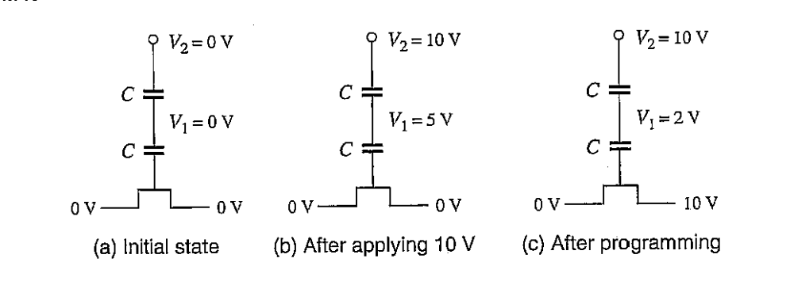
Example
Assume C1 = C2 = C
VDD = 5V, V_{T} = 1V
?
ECE445
Notes:
ECE445 - University of Maine
Prof. David E. Kotecki

Slide 73
Example
Assume C1 = C2 = C
VDD = 5V, V_{T} = 1V
ECE445
Notes:
ECE445 - University of Maine
Prof. David E. Kotecki

Slide 74
Example
Assume C1 = C2 = C
VDD = 5V, V_{T} = 1V
?
Program by applying V_{DS} = 10V
ECE445
Notes:
ECE445 - University of Maine
Prof. David E. Kotecki

Slide 75
Example
Assume C1 = C2 = C
VDD = 5V, V_{T} = 1V
Program by applying V_{DS} = 10V
Assume V_{G1} drops to 2V
ECE445
Notes:
ECE445 - University of Maine
Prof. David E. Kotecki

Slide 76
Example
Assume C1 = C2 = C
VDD = 5V, V_{T} = 1V
0V
?
Reduce gate voltage V_{G2} = 0V
ECE445
Notes:
ECE445 - University of Maine
Prof. David E. Kotecki

Slide 77
Example
Assume C1 = C2 = C
VDD = 5V, V_{T} = 1V
0V
- 3V
Reduce gate voltage V_{G2} = 0V
ECE445
Notes:
ECE445 - University of Maine
Prof. David E. Kotecki

Slide 78
Example
Assume C1 = C2 = C
VDD = 5V, V_{T} = 1V
0V
5V
- 3V
?
Raise gate voltage V_{G2} = VDD
ECE445
Notes:
ECE445 - University of Maine
Prof. David E. Kotecki

Slide 79
Example
Assume C1 = C2 = C
VDD = 5V, V_{T} = 1V
0V
5V
- 3V
-0.5V
Raise gate voltage V_{G2} = VDD
TRANSISTOR IS STILL OFF!!
Have written a “1”
ECE445
Notes:
ECE445 - University of Maine
Prof. David E. Kotecki

Slide 80
Example
Assume C1 = C2 = C
VDD = 5V, V_{T} = 1V
0V
5V
- 3V
-0.5V
Raise gate voltage V_{G2} = VDD
TRANSISTOR IS STILL OFF!!
To turn the transistor on: V_{G2} = 8V
ECE445
Notes:
ECE445 - University of Maine
Prof. David E. Kotecki

Slide 81
Different Methods to Erase
In a conventional EPROM, UV light is used generate e/h pairs in the SiO₂ dielectric making the dielectric conductive
ECE445
Notes:
ECE445 - University of Maine
Prof. David E. Kotecki

Slide 82
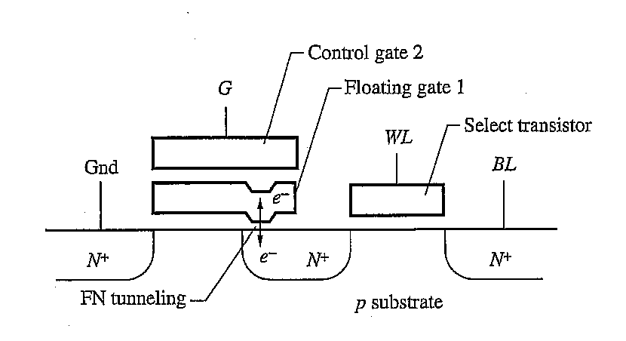
Different Methods to Erase
In a E²PROM, the charge is removed by “Fowler-Nordheim” (FN) transport.
When the field across the oxide exceed ~10 MV/cm,
electrons can tunnel across the oxide
ECE445
Notes:
ECE445 - University of Maine
Prof. David E. Kotecki

Slide 83


Fowler-Nordheim Tunneling
ECE445
Notes:
ECE445 - University of Maine
Prof. David E. Kotecki

Slide 84

FN Tunneling – 10nm SiO₂
ECE445
Notes:
ECE445 - University of Maine
Prof. David E. Kotecki

Slide 85
Symbol
ECE445
Notes:
ECE445 - University of Maine
Prof. David E. Kotecki

Slide 86
2T E²PROM Cell
ECE445
Notes:
ECE445 - University of Maine
Prof. David E. Kotecki

Slide 87

1T Cell - FLASH
ECE445
Notes:
ECE445 - University of Maine
Prof. David E. Kotecki

Slide 88
NOR Array
ECE445
Notes:
ECE445 - University of Maine
Prof. David E. Kotecki

Slide 89
Write – “hot carrier injection”
Raise 1 bitline
Select Wordline
0V 10V 0V 0V
=0V
Can write one bit at a time
ECE445
Notes:
ECE445 - University of Maine
Prof. David E. Kotecki

Slide 90
Erase – “Fowler-Nordheim Tunneling”
0V on Wordlines
0V 0V 0V 0V
=High V
ECE445
Notes:
ECE445 - University of Maine
Prof. David E. Kotecki

Slide 91
Erase – “Fowler-Nordheim Tunneling”
0V on Wordlines
0V 0V 0V 0V
=High V
All transistors connected to the source line are erased simultaneously → FLASH
ECE445
Notes:
ECE445 - University of Maine
Prof. David E. Kotecki

Slide 92

Write / Erase
ECE445
Notes:
ECE445 - University of Maine
Prof. David E. Kotecki

Slide 93

Read Operation
Precharge bitline
Source line → Gnd
Enable wordline
ECE445
Notes:
ECE445 - University of Maine
Prof. David E. Kotecki

Slide 94

NAND Flash Array
ECE445
Notes:
ECE445 - University of Maine
Prof. David E. Kotecki

Slide 95
NAND vs NOR Arrays
Write
Read
Erase
Density
NAND
Fast
Slow
Fast
High
NOR
Slow
Fast
Slow
Low
ECE445
Notes:
ECE445 - University of Maine
Prof. David E. Kotecki

Slide 96
Issues
Read / Write Endurance
- > 10⁶ Operations
Redundancy for improved yield
Multi-Bit Cell Architectures – in common practice today!
ECE445
Notes:
ECE445 - University of Maine
Prof. David E. Kotecki

