Slide 1
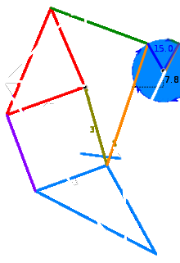
61.9
5
0
2
50
1
41.5
55.8
0
0
4
5
40.1
61.9
39.3
39.4
5
3
6
36.7
49.0
65.7
7

