Slide 1
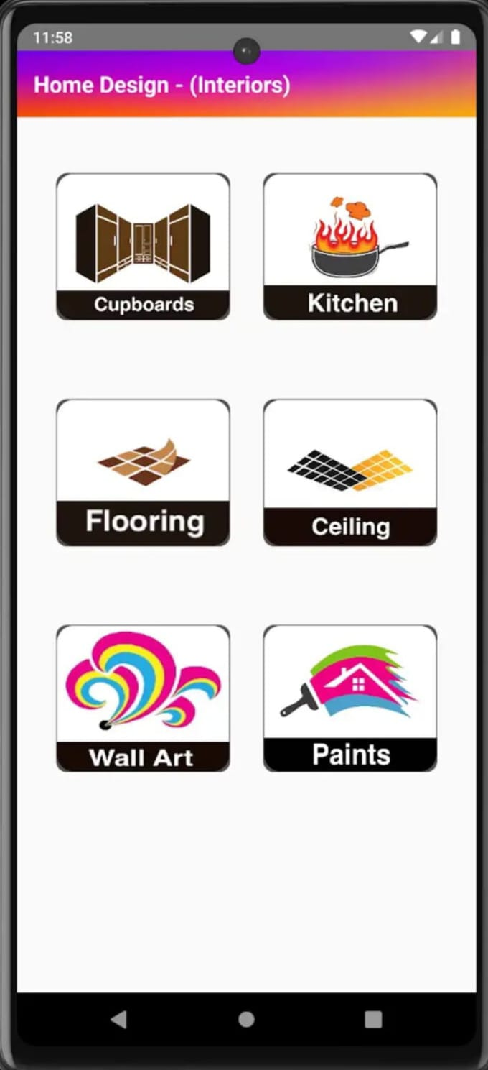
An Android Based Application For Revolutionizing Home Design
SOFTWARE REQUIREMENT SPECIFICATION
BATCH- IT-1
K.V. Hemanth -207Z1A1225
Sheldon Shaji -207Z1A1241
V.Nikil -207Z1A1248

Slide 2

INTRODUCTION
PURPOSE OF THIS DOCUMENT
The purpose of this project is Home Design App serves as a versatile and user-friendly platform that empowers individuals to envision and plan their living spaces with efficiency and creativity. By providing intuitive design tools, 2D modeling, and the app enables users to digitally craft detailed floor plans and interior layouts. It serves as a virtual canvas for homeowners, architects, and interior designers, fostering a collaborative and immersive environment.
SCOPE OF THIS DOCUMENT
Real-time collaboration options facilitate teamwork among homeowners, architects, and designers. Integration with user experience by allowing immersive previews of designs. The app will provide the attractive user experience on the both exterior and interior. The app can feature an extensive catalog of furniture and materials, aiding users in making informed design choices.

Slide 3
OVERVIEW
The Home Design App is a versatile and user-friendly application and plan their dream homes with ease. With a robust set of features, users can create detailed floor plans, experiment with interior designs, and visualize their ideas in stunning 2D. The app boasts a comprehensive catalog of furniture and materials, enabling users to personalize every aspect of their space. Compatible across various devices, from smartphones to desktop computers, the Home Design App is a comprehensive solution for anyone seeking to bring their home design visions to life.

Slide 4
GENERAL DESCRIPTION
• The "Home Design App" is an innovative mobile application designed to assist renters, and interior/exterior design in transforming their living spaces.
• Not only transforming but also assists you to build the whole structure from the scratch (i.e., core structure).
• This app leverages cutting-edge technologies to provide personalized design suggestions, advice, and inspiration for both interior and exterior spaces.
• Finally, this app offers a holistic approach to design, transforming the way people approach and execute their design.
• It serves as a one-stop solution for anyone looking to enhance the aesthetics and functionality of their homes.
• The app boasts an extensive catalog of interior and exterior design elements, including furniture, lighting, paint colors, landscaping options, and more.

Slide 5
FUNCTIONAL REQUIREMENTS
User Authentication
Interior and Exteriors Design Features
Device Compatibility
NON-FUNCTIONAL REQUIREMENTS
Portability
Maintainability
Scalability
Performance
Flexibility

Slide 6
INTERFACE REQUIREMENTS
Processor: Dual core
Ram: minimum 8GB
Hard disk: minimum 50GB
PERFORMANCE REQUIREMENTS
User Module
Minimal loading time
Compatibility across various devices.
Optimal memory Usage

Slide 7
DOMAIN REQUIREMENTS
Windows: 7/8/10
Tool: Android Studio
Coding Language: Java
UMLS: Star UML

Slide 8
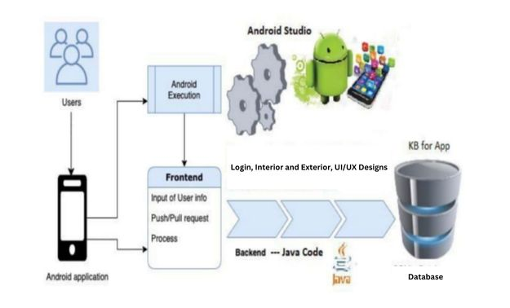
DESIGN CONSTRAINTS
System Architecture

