Slide 1

The Professor Proposes
TEAM - PROJECT
Team members:
Kannappan
Gagan

Slide 2
Problem Statement
Professor’s Diamond Characteristics:
Carat weight : 0.9
Cut : Very Good
Color : J (Faint Yellow)
Clarity: SI2(Few inclusions visible at 10x)
Polish - Good
Symmetry - Very Good
Certification: GIA
QUOTED PRICE FOR THIS DIAMOND IS
$3100
What should be the Fair price of the diamond?

Slide 3
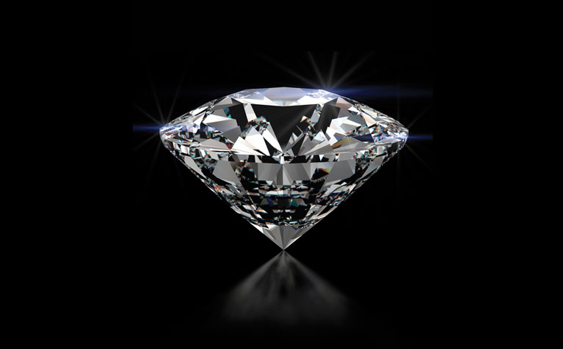
Daimond Characteristics
Polish
Carat
Symmetry
Color
Cut
Certification
Clarity

Slide 4
Classification
Carat -
Colour – (Colourless) D-F | G-I | J-K | L-N | O-S | T-Z (Yellow)
Clarity – (best)FL-IF | VVS1-VVS2 | VS1 –VS2 | SI1 – SI3 | I1 – I3 (least)
Cut
Polish Poor | Fair | Good | Very Good | Excellent | Ideal
Symmetry
Certification – (best)GIA | AGS | EGL | IGI
Wholesaler – 1 | 2 | 3

Slide 5
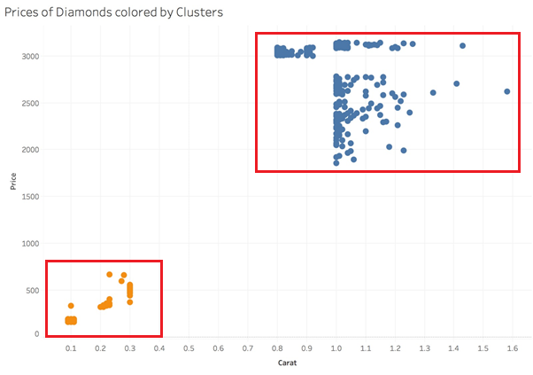
Clustering
High-carat Diamonds
Low-carat Diamonds
Why Blue Cluster ??
Professor diamond characteristics lie in blue cluster.
Traits of high carat and low carat diamonds may differ.

Slide 6
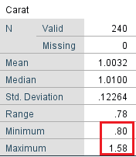
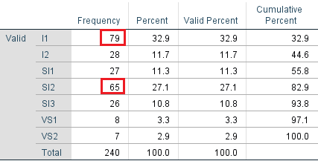
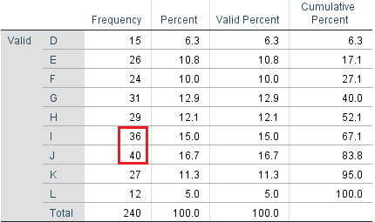
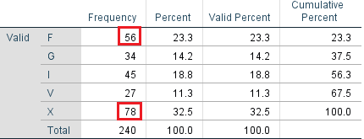
Descriptive Statistics
Carat
Clarity
Colour
Cut

Slide 7
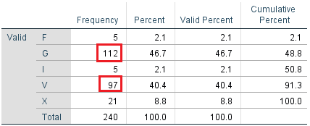
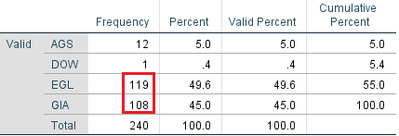
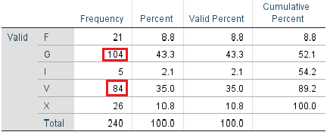
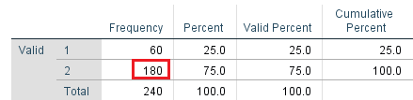
Descriptive Statistics
Polish
Certification
Symmetry
Wholesaler

Slide 8
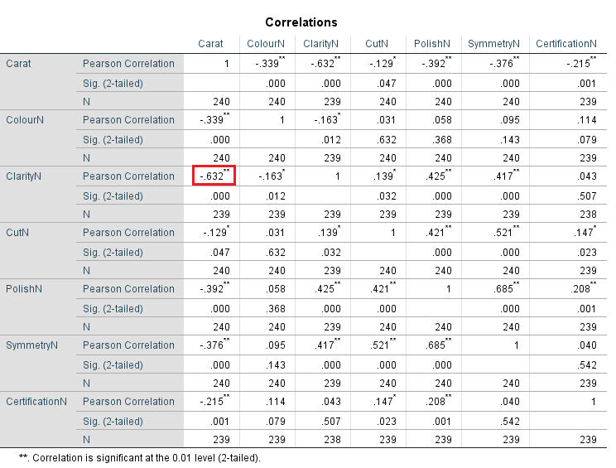
MULTI-COLLINEARITY

Slide 9
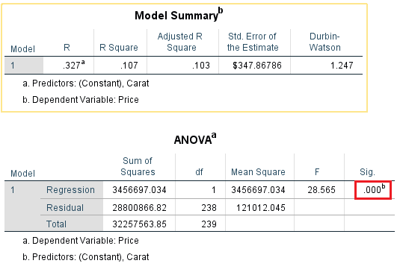
Feature Engineering
Carat vs Price

Slide 10
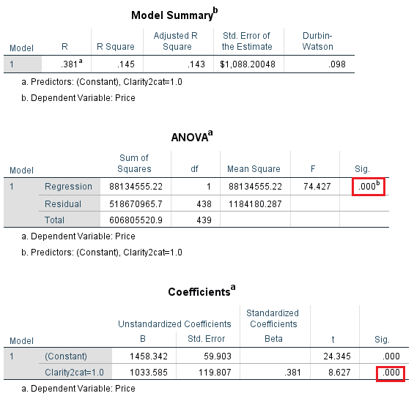
Feature Engineering
Clarity vs Price
2 categories - (Visible, Not visible)

Slide 11
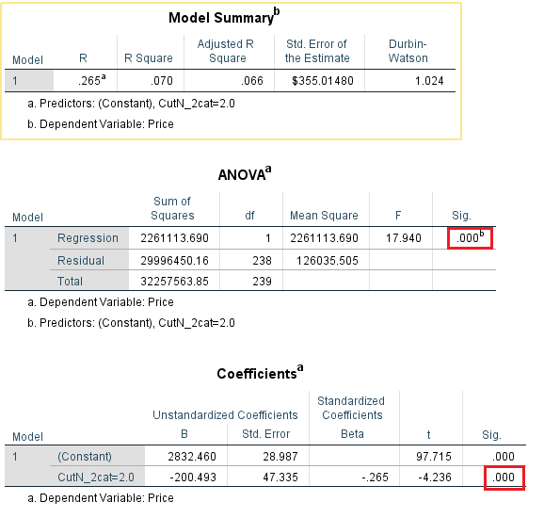
Feature Engineering
Cut vs Price
1st category – Fair, Good
2nd category – Vgood, Excellent, Ideal

Slide 12
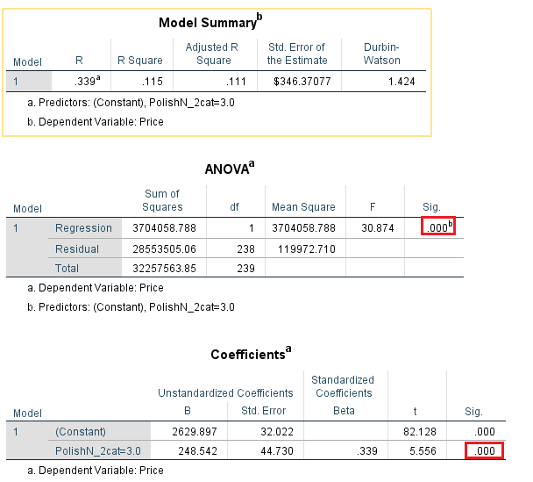
Feature Engineering
Polish vs Price
1st category – Fair, Good
2nd category – Very good,Excellent, Ideal

Slide 13
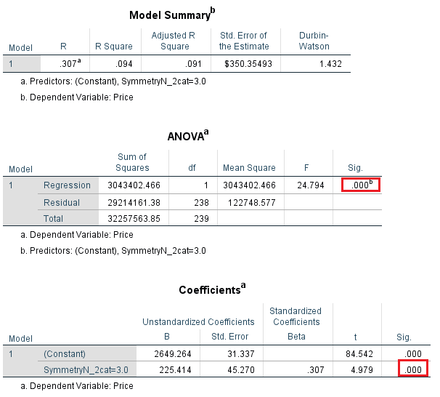
Feature Engineering
Symmetry vs Price
1st category – Fair, Good
^{2nd} category - Very good, Excellent, Ideal

Slide 14

Feature Engineering
Certification vs Price
1st category – IGI
2nd category – AGS, GIA

Slide 15
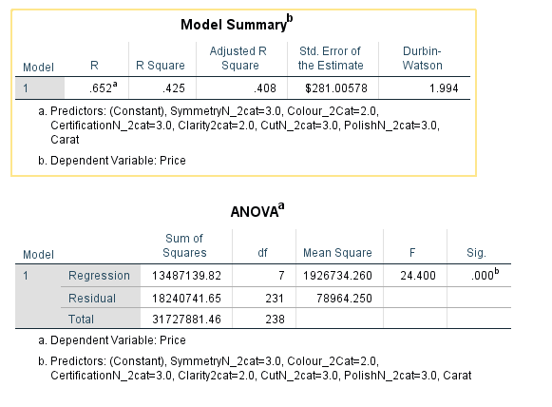
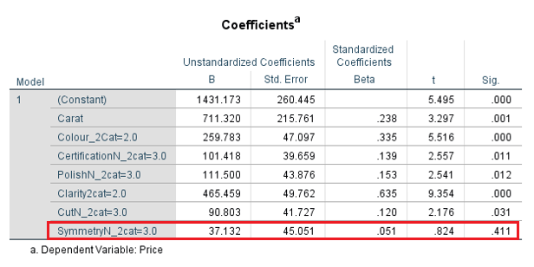
INITIAL MODEL

Slide 16
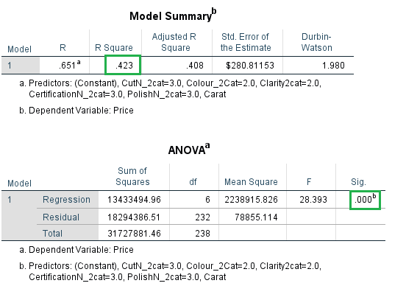
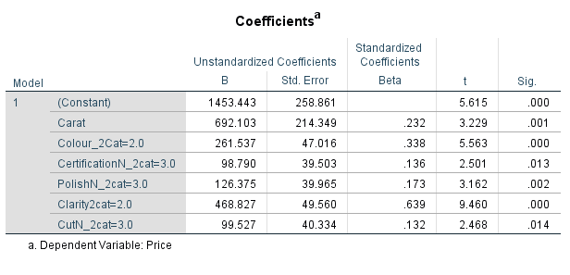
Final – Model
PRICE VS CARAT, COLOUR, CLARITY, CUT, CERTIFICATION, POLISH

Slide 17
Predicted Price Calculation
Price = 1453.443+ 261.537*colour_2 + 468.827*clarity_2 + 99.527*Cut_2 +
692.103*carat + 126.375*Polish_2 + 98.790*Certification_2
Price = 1453.443 + 261.537*0 + 468.827*1 + 99.527*1 + 692.103*0.9 +
126.375*0 + 98.790*1
Price = $2743
Fair Price of the diamond should be $2743

Slide 18
Conclusion
Quoted Price for the DIAMOND RING is $3100
Predicted price of diamond of same characteristics is $2743
Expected price for the diamond fitting into the ring is $300 - $800(Assumption)
Total Predicted Price of the DIAMOND RING will be 2743 + 300 = $3043
Difference = $3100 – $3043 = $57
Our Say!!
Professor should go with buying the ring

Slide 19
THANK YOU!!

