Slide 1
Title: Housing Price Prediction Via Different Machine Learning Techniques

Slide 2
Group Member Information
Aayush Agrawal,
Keyurkumar Dharmeshkumar Patel,
John David Conley,
Karthik reddy kothakapu

Slide 3
Role/Responsibilities and Contribution in project
Task | Responsibility
research for the topic, report for project part 1,find the dataset, heatmap, MSV, Decision Tree | Aayush
research for different machine learning models, study the dataset, MAV, Random Forest | John
finding different papers for reference, pairplot, scatterplot, linear regression, report for project part 2, Accuracy score | Keyur
Helped in report project part 2,final report, PPT | Karthik

Slide 4
Motivation
Real estate value analysis is considered essential to urban planning decisions.
house price prediction is an emerging topic
People are not aware of all the factors affect the house price.
Real estate prices are rising year by year, and we need a system to predict future real estate prices

Slide 5
Objectives
Empirical valuation for California houses
Trying to predict property prices for different locations
Implementation of Three different machine learning models
Implementation of Two error measure for comparison

Slide 6
Related work
Roy E. Lowrance developed a linear model of residential real estate prices.
Hu et al. built multivariate regression models of home prices using a dataset composed of 81 homes
Vapnik introduced three kinds of a support vector machine.
Above study displays a range of findings from each publication

Slide 7
Problem Statement
House prices and nation’s economy are linked regardless of that we do not have accurate measure of house value.
Predicting the price of California housing using various features of the house.
Determine the best model for prediction of the price.

Slide 8
Proposed Solution
The entire work process can be broken as below
Data Preprocessing
Data Analysis:
Heatmap
Scatterplot
Pair Plot

Slide 9
Continue..
Model Selection:
Linear Regression
Random Forest
Decision Tree
Error measure:
Mean Absolute Error
Mean Square Error
Accuracy Score

Slide 10
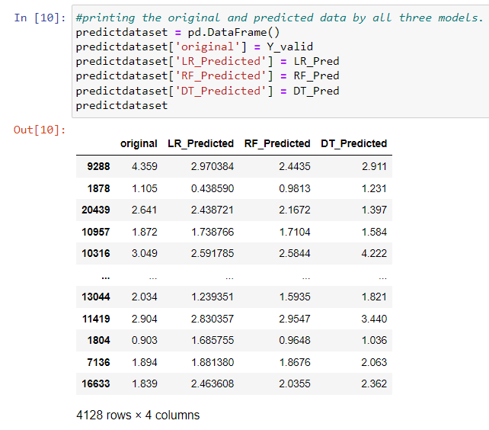
Results/Simulations
Predicted result from each model with actual value are as below

Slide 11
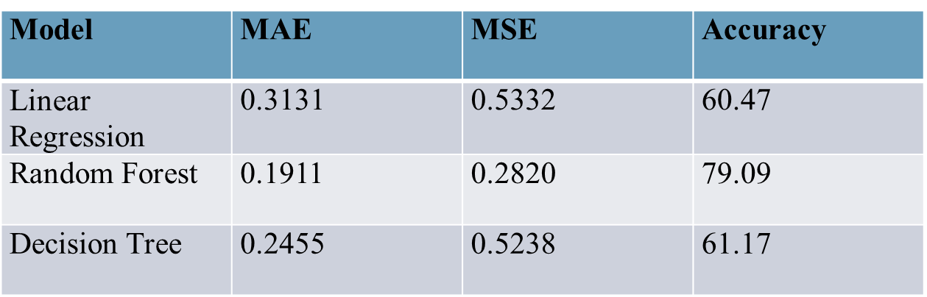
Continue..
MAE,MSE and Accuracy score for each model are as below

Slide 12
References
[1]-Quang Truong, Minh Nguyen, Hy Dang, Bo Mei, Housing Price Prediction via Improved Machine Learning Techniques, Procedia Computer Science, Volume 174, 2020, https://doi.org/10.1016/j.procs.2020.06.111.
[2]-Byeonghwa Park, Jae Kwon Bae, Using machine learning algorithms for housing price prediction: The case of Fairfax County, Virginia housing data, Expert Systems with Applications, Volume 42, Issue 6, 2015, https://doi.org/10.1016/j.eswa.2014.11.040.
[3]-A. Varma, A. Sarma, S. Doshi and R. Nair, "House Price Prediction Using Machine Learning and Neural Networks," 2018 Second International Conference on Inventive Communication and Computational Technologies (ICICCT), 2018, https://ieeexplore.ieee.org/abstract/document/8473231
[4]-D. Banerjee and S. Dutta, "Predicting the housing price direction using machine learning techniques," 2017 IEEE International Conference on Power, Control, Signals and Instrumentation Engineering (ICPCSI), 2017, https://ieeexplore.ieee.org/abstract/document/8392275
[5]-N. N. Ghosalkar and S. N. Dhage, "Real Estate Value Prediction Using Linear Regression," 2018 Fourth International Conference on Computing Communication Control and Automation (ICCUBEA), 2018, https://ieeexplore.ieee.org/abstract/document/8697639
[6]- Huang, Y. (2019). Predicting Home Value in California, United States via Machine Learning Modeling. Statistics, Optimization & Information Computing https://doi.org/10.19139/soic.v7i1.435
[7] The elements of statistical learning, Trevor Hastie - Random Forest Generation
[8] Bork, M., Moller, V.S.: House price forecast ability: a factor analysis. Real Estate Economics. Heidelberg (2016).
[9] Introduction to Machine Learning, Alphaydin

