Slide 1
7 C’s of Communication
NAME : K.Ranjith Reddy
CLASS : CSE - B
ROLL NO : 247R5A0506

Slide 2
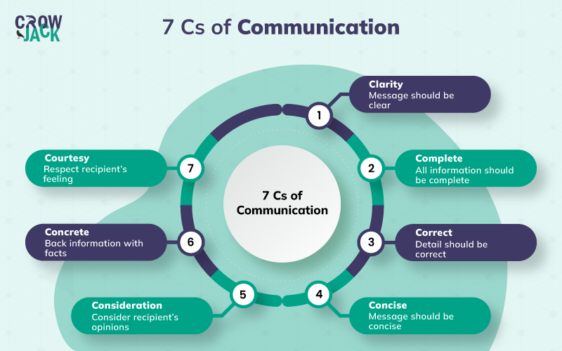
Introduction to the 7C's of Communication
The 7C's of communication are essential guidelines for effective message delivery.
They help ensure clarity, coherence, and impact in communication.
Understanding these principles improves both personal and professional interactions.
Notes:
Image source: https://crowjack.com

Slide 3
Clarity
Clarity means expressing your message in a simple and straightforward manner.
Avoid ambiguous words and complex sentences to prevent misunderstandings.
Clear communication helps your audience easily grasp your intended message.
Notes:
Image source: https://crowjack.com

Slide 4
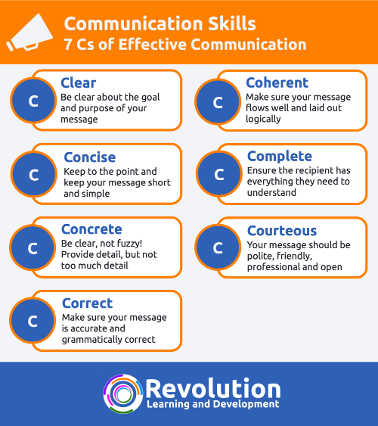
Conciseness
Conciseness involves conveying information in as few words as necessary.
It eliminates unnecessary details that may distract from the main point.
Being concise keeps the audience engaged and focused on the key message.
Notes:
Image source: https://www.revolutionlearning.co.uk

Slide 5
Completeness
Completeness ensures your message provides all necessary information.
It answers the who, what, where, when, why, and how questions.
Complete communication builds trust and reduces the need for follow-up questions.
Notes:
Image source: https://crowjack.com

Slide 6
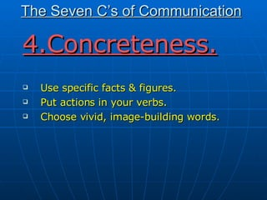
Concreteness
Concreteness involves using specific facts, figures, and details.
It makes your message more tangible and persuasive.
Avoid vague language to ensure your message is supported and credible.
Notes:
Image source: https://image.slidesharecdn.com

Slide 7
Correctness
Correctness refers to using accurate language, facts, and grammar.
It enhances your credibility and prevents misunderstandings.
Always proofread and verify information before sharing to maintain correctness.
Notes:
Image source: https://crowjack.com

Slide 8
Courtesy
Courtesy involves being respectful, considerate, and polite.
It fosters positive relationships and encourages open dialogue.
Always consider your audience’s feelings and perspectives in your communication.
Notes:
Image source: https://crowjack.com

Slide 9
Coherence
Coherence means your message is logical and well-organized.
Use clear structure and transitions to connect ideas smoothly.
Coherent communication helps your audience follow and understand your message.
Notes:
Image source: https://www.revolutionlearning.co.uk

Slide 10
The Importance of the 7C's
Applying the 7C's improves clarity and reduces miscommunication.
They enhance your ability to persuade and influence others effectively.
Mastering these principles leads to more successful and meaningful interactions.
Notes:
Image source: https://crowjack.com

Slide 11
Conclusion
The 7C's of communication are vital tools for effective message delivery.
Regular practice of these principles can significantly improve communication skills.
Strive to incorporate all 7C's in your daily interactions for better understanding and relationships.
Notes:
Image source: https://crowjack.com

