Slide 1
How to run N Map Scan
NAME : K.Ranjith Reddy
CLASS : CSE - B
ROLL NO : 247R5A0506

Slide 2
Introduction to Nmap
Nmap (Network Mapper) is an open-source tool used for network discovery and security auditing.
It helps administrators identify active devices, open ports, and services running on hosts within a network.
Learning to run Nmap effectively enhances network security and management capabilities.
Notes:
Image source: https://miro.medium.com

Slide 3
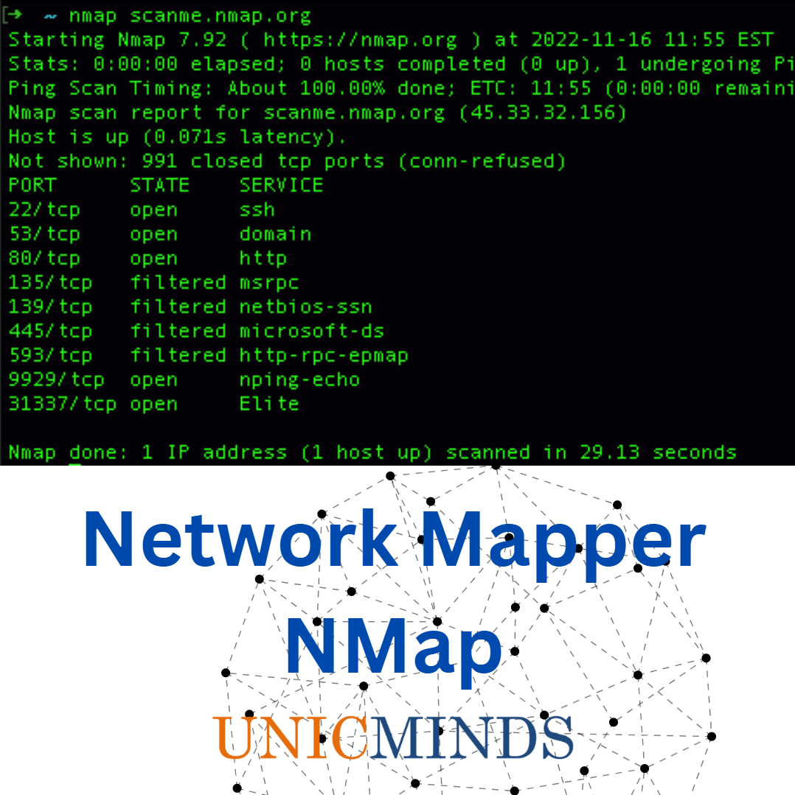
Installing Nmap
Nmap can be installed on various operating systems including Windows, Linux, and macOS.
Download the installer from the official Nmap website and follow the installation instructions specific to your OS.
Ensure that you have administrative privileges to install and run Nmap properly.
Notes:
Image source: https://unicminds.com

Slide 4
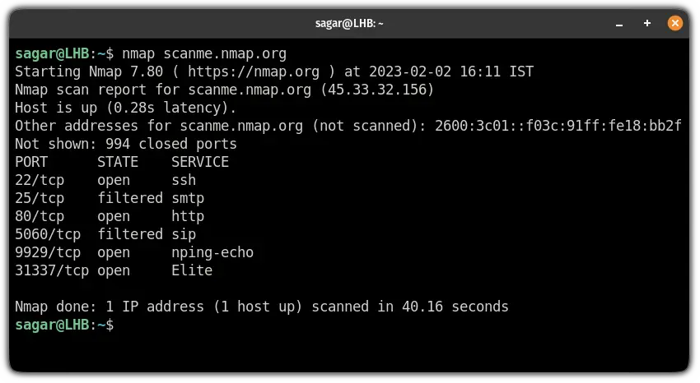
Basic Nmap Syntax
The basic command format is `nmap [options] [target]`.
The target can be a single IP address, a hostname, or a range of IPs.
Running `nmap 192.168.1.1` scans the specified IP address for open ports and services.
Notes:
Image source: https://linuxhandbook.com

Slide 5
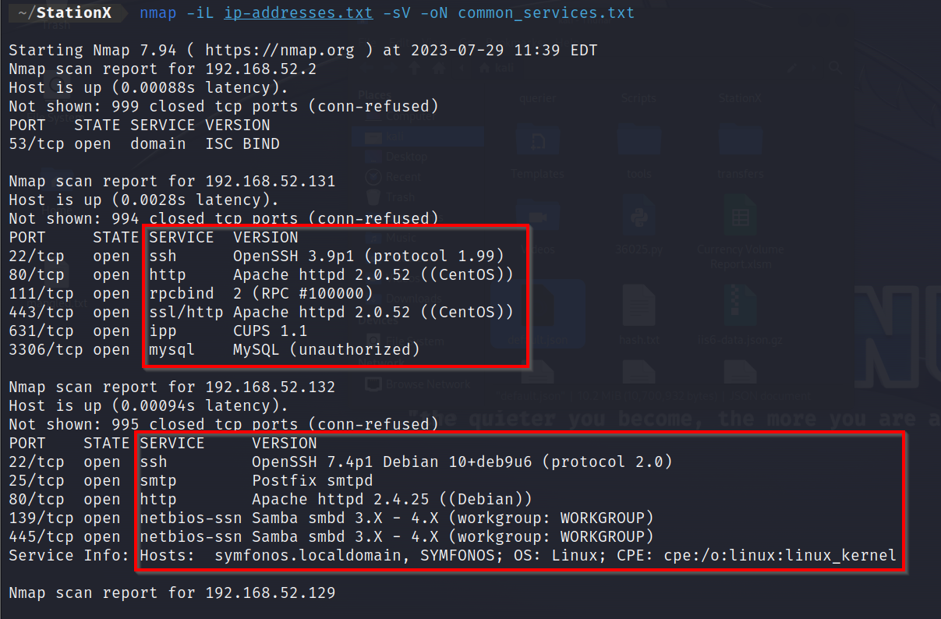
Conducting a Simple Scan
To perform a basic scan, use the command `nmap [target]`.
For example, `nmap 192.168.1.1` scans the specified host for open ports.
This scan provides information about which ports are open and what services they might be running.
Notes:
Image source: https://www.stationx.net

Slide 6
Scanning Multiple Targets
Nmap allows scanning multiple hosts by specifying multiple IPs or ranges separated by spaces or commas.
Example: `nmap 192.168.1.1 192.168.1.2` or `nmap 192.168.1.1-50`.
This feature is useful for assessing entire subnets quickly and efficiently.
Notes:
Image source: https://linuxhandbook.com

Slide 7
Output Formats and Saving Results
Nmap can output results in formats such as normal, XML, or grepable using `-oN`, `-oX`, or `-oG`.
Example: `nmap -oN output.txt 192.168.1.1` saves the scan results to a text file.
Saving output is useful for documentation, analysis, and reporting purposes.
Notes:
Image source: https://linuxhandbook.com

Slide 8

Ethical and Legal Considerations
Always ensure you have permission to scan a network to avoid legal issues or network disruptions.
Unauthorized scanning can be considered malicious activity and may lead to legal penalties.
Use Nmap responsibly and within the scope of authorized security assessments.
Notes:
Image source: https://www.enterprisestorageforum.com

Slide 9
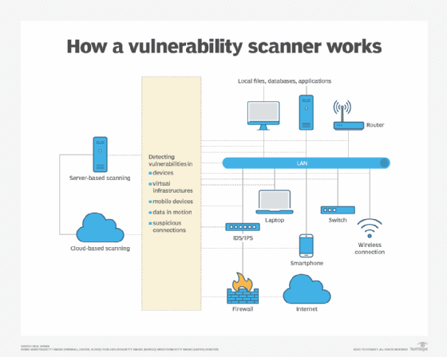
Practical Tips for Effective Scanning
Use specific target ranges to minimize unnecessary network traffic.
Combine different scan options for thorough security assessments.
Regularly update Nmap to access the latest features and vulnerability detection capabilities.
Notes:
Image source: https://cdn.ttgtmedia.com

Slide 10
Conclusion
Nmap is a powerful tool for network discovery and security auditing when used properly.
Practice running various scans in controlled environments to improve your skills.
Refer to the official Nmap documentation and community forums for additional guidance and updates.
Notes:
Image source: https://miro.medium.com

