Slide 1
Issues In Multilingual Syntactic Analysis In NLP
K. Ranjith Reddy
247R5A0506
CSE-B

Slide 2
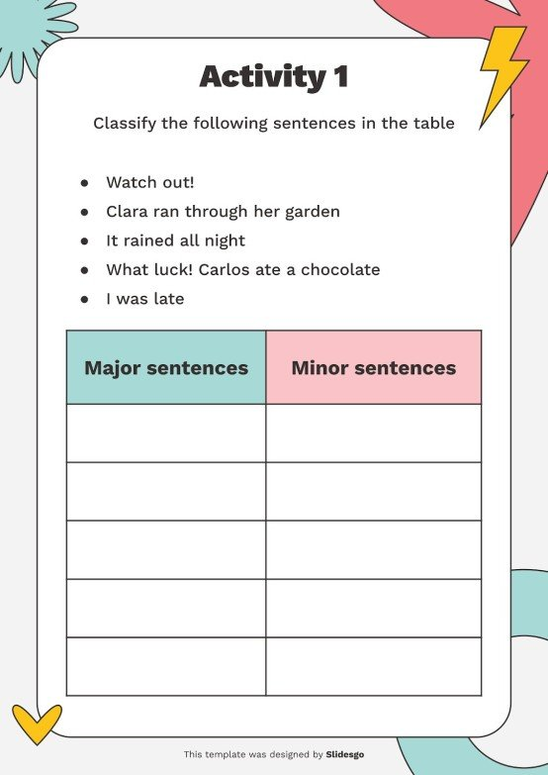
Introduction to Multilingual Syntactic Analysis
Multilingual syntactic analysis aims to understand sentence structure across diverse languages.
It is essential for multilingual NLP applications such as translation, information extraction, and question answering.
The diversity of languages presents unique challenges that complicate the development of universal syntactic models.
Notes:
Image source: https://media.slidesgo.com

Slide 3
Linguistic Diversity and Its Impact
Languages vary significantly in syntax, morphology, and word order, affecting analysis approaches.
Some languages are highly inflected, while others rely more on word order, requiring adaptable parsing techniques.
This diversity makes it difficult to create one-size-fits-all syntactic parsers that perform equally well across languages.
Turkish is highly inflected: “Evlerimizden” means “from our houses,” where the root word “ev” (house) gets multiple suffixes for plurality, possession, and case.
Notes:
Image source: https://dayposts.com

Slide 4
Data Scarcity for Low-Resource Languages
Many languages lack large annotated corpora needed for training effective syntactic parsers.
The scarcity of data impedes the development of robust models for underrepresented languages.
Transfer learning and multilingual models are promising but still face limitations in low-resource settings.
The Universal Dependencies project offers thousands of annotated sentences for English but very few for endangered African languages. Training robust syntactic parsers for Yoruba, for instance, is difficult due to limited annotated data
Notes:
Image source: https://www.slidemake.com

Slide 5

Annotation Schemes and Standardization
Different languages often use different syntactic annotation schemes, complicating cross-lingual analysis.
Lack of standardized, universal annotation frameworks hampers the development of multilingual parsers.
Efforts like Universal Dependencies aim to address this, but inconsistencies still exist across datasets.
English treebanks often use the Penn Treebank style, while French or Arabic treebanks might use different conventions.
Notes:
Image source: https://www.gnani.ai

Slide 6
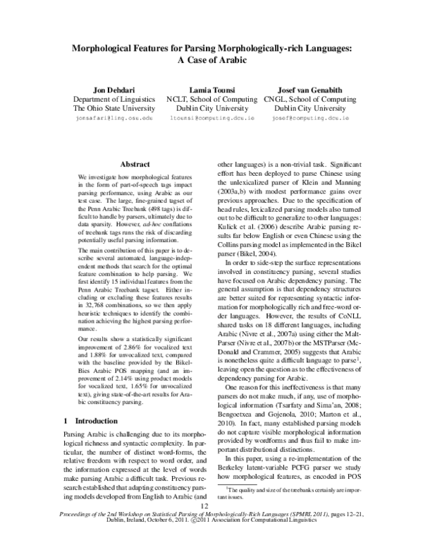
Morphological Complexity and Its Challenges
Morphologically rich languages present complex word forms that challenge syntactic analysis.
Failing to account for morphology can lead to incorrect parsing and misinterpretation of syntactic relations.
Accurate morphological analysis is often a prerequisite for effective syntactic parsing in such languages.
In Finnish, the word “taloissanikinko” means “even in my houses?” with several suffixes attached.
Notes:
Image source: https://0.academia-photos.com

Slide 7
Word Order Variability and Syntactic Ambiguity
Languages with flexible or free word order introduce ambiguity into syntactic analysis.
Parsing models must handle multiple possible structures, increasing computational complexity.
Contextual cues and semantic information are often needed to resolve ambiguities effectively.
In Russian, “Bob gave Alice a book” could be written “Bob dal Alice knigu,” “Knigu dal Bob Alice,”.
Notes:
Image source: https://www.slidemake.com

Slide 8
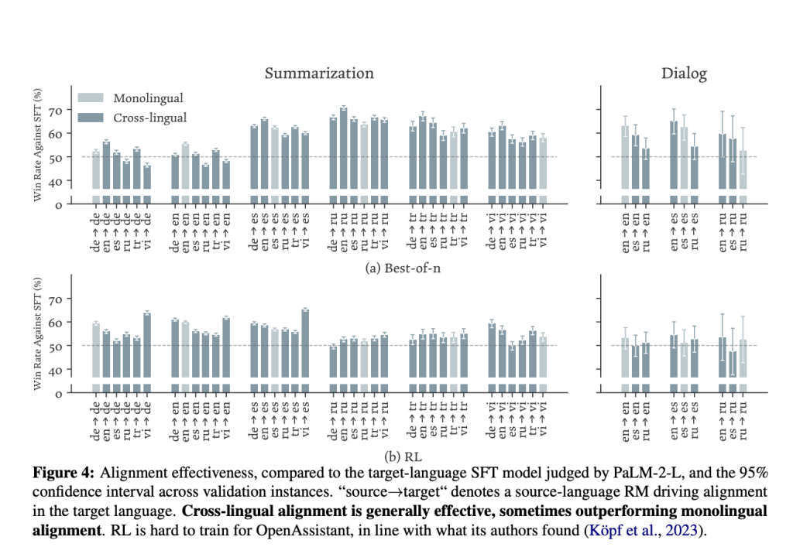
Cross-Lingual Transfer and Model Generalization
Leveraging models trained on high-resource languages for low-resource languages is a common strategy.
However, structural differences can limit the effectiveness of transfer learning approaches.
Ensuring models generalize well across languages remains an ongoing research challenge.
Notes:
Image source: https://www.marktechpost.com

Slide 9
Handling Multiword Expressions and Idioms
Multiword expressions often do not conform to standard syntactic rules, complicating analysis.
Idiomatic expressions require models to understand context beyond surface structure.
Properly modeling these expressions is critical for accurate syntactic parsing and downstream tasks.
English phrase “kick the bucket” means “to die” (not literally to kick a bucket). Idioms like this can confuse models that analyze sentences word by word.
Notes:
Image source: https://www.slidemake.com

Slide 10
Conclusion
Addressing issues in multilingual syntactic analysis is vital for the advancement of NLP applications globally.
Continued research is needed to overcome linguistic, data, and computational challenges.
Collaboration across linguistic and computational disciplines will drive progress toward more inclusive NLP systems.
Notes:
Image source: https://www.slidemake.com

