Slide 1
Framing In Computer Networks
NAME : K.Ranjith Reddy
CLASS : CSE - B
ROLL NO : 247R5A0506

Slide 2
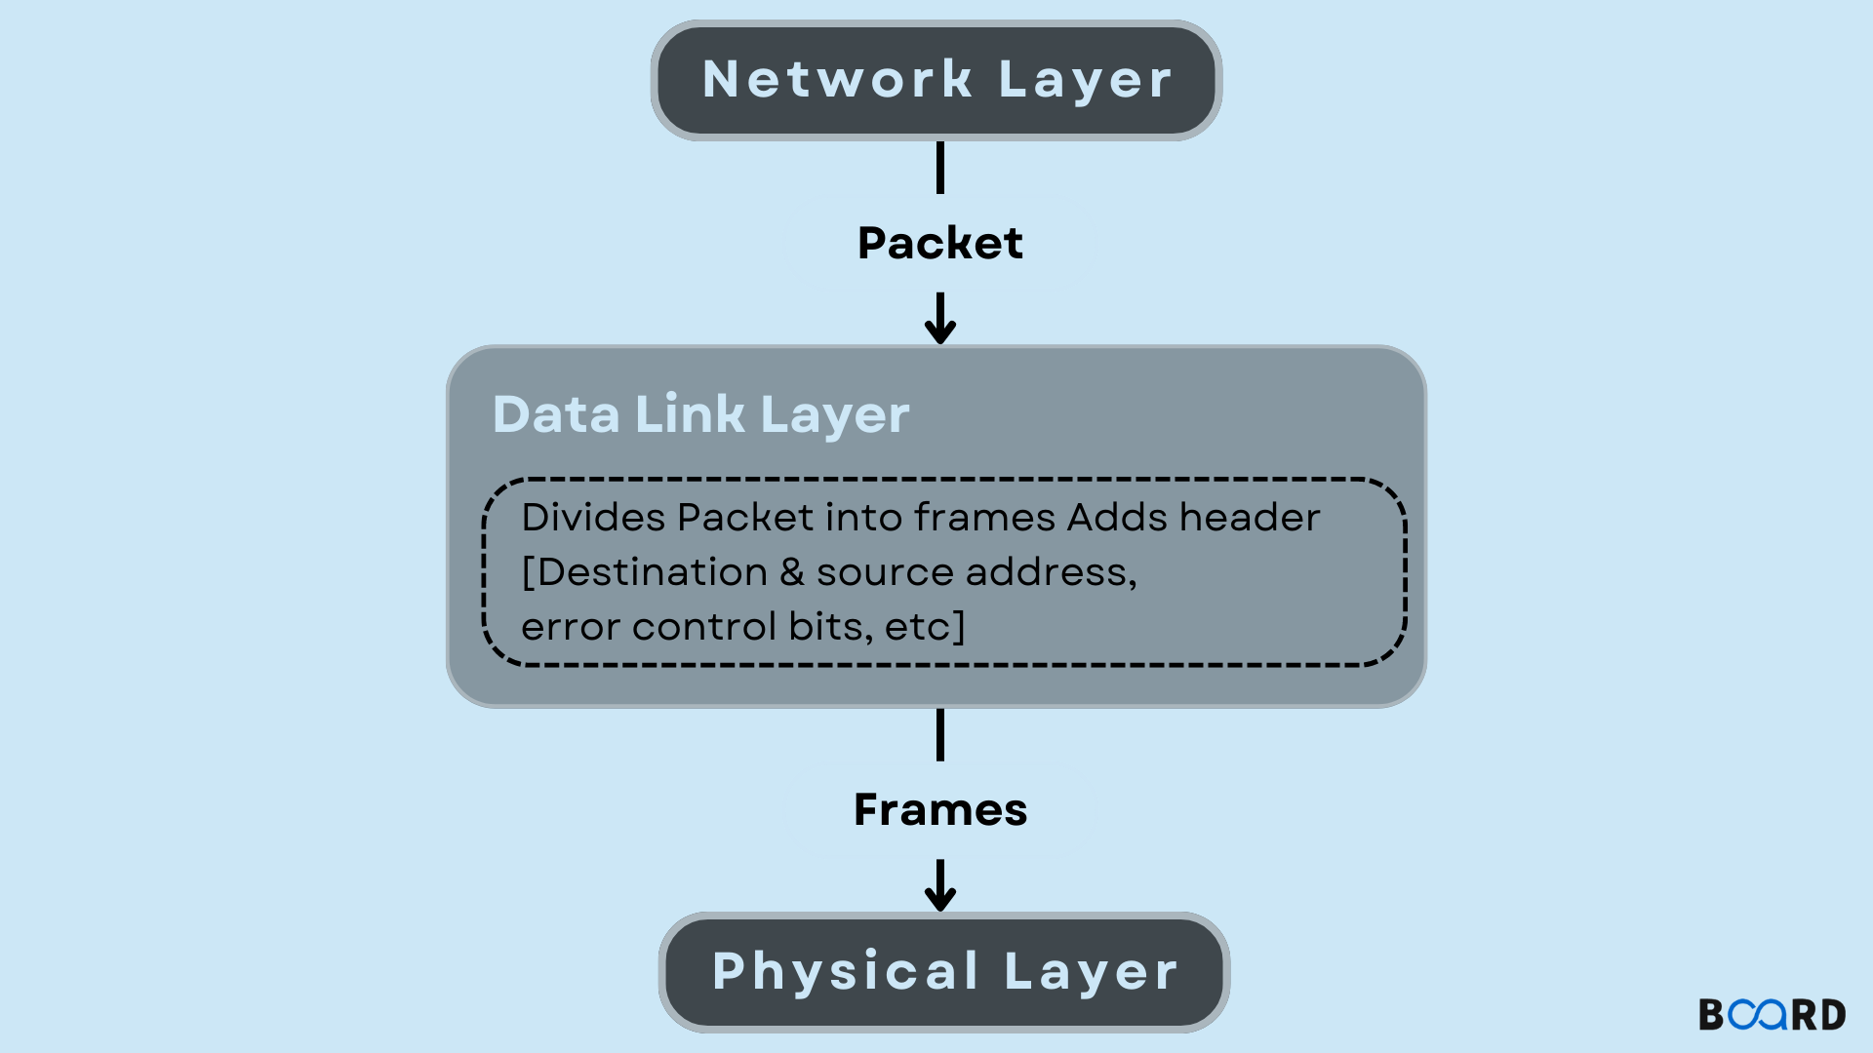
Introduction to Framing in Computer Networks
Framing is a fundamental process in data link layer communication.
It involves dividing data into manageable units called frames for transmission.
Proper framing ensures accurate data transfer and error detection.
Notes:
Image source: https://www.boardinfinity.com

Slide 3
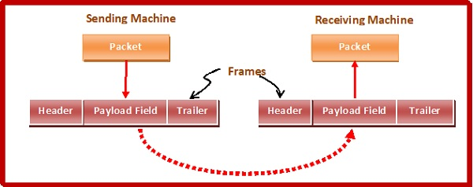
What is a Frame?
A frame is a structured data packet used for communication between network devices.
It contains control information, payload data, and error-checking components.
Frames are essential for organizing data and facilitating reliable transmission.
Notes:
Image source: https://www.tutorialspoint.com

Slide 4
Types of Framing Techniques
Character count framing uses a count of characters to define frame size.
Flag byte framing uses special flag sequences to mark frame boundaries.
Bit stuffing involves inserting non-data bits to prevent confusion with control flags.
Notes:
Image source: https://a5theory.com

Slide 5
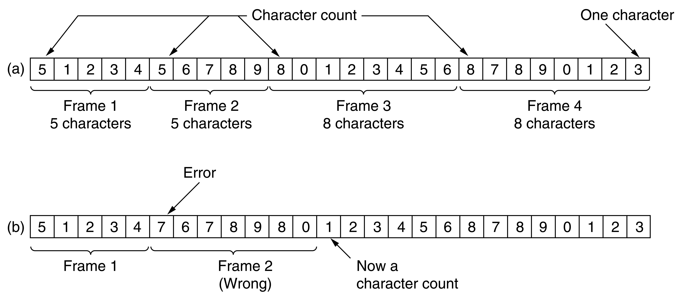
Character Count Framing
Utilizes a count field at the beginning of the frame to specify length.
It is simple but can be inefficient if data size varies significantly.
Errors in the count field can lead to misinterpretation of frames.
Notes:
Image source: https://humphryscomputing.com

Slide 6
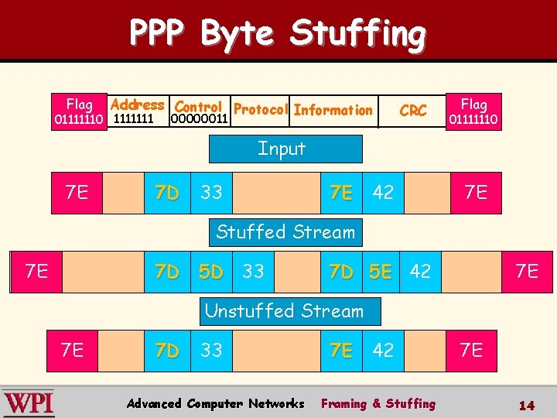
Flag Byte Framing
Uses special flag sequences (e.g., 01111110) to mark frame boundaries.
Data transparency is maintained via techniques like bit stuffing.
This method is widely used in protocols like HDLC and PPP.
Notes:
Image source: https://slidetodoc.com

Slide 7
Bit Stuffing Technique
Bit stuffing involves inserting a '0' after five consecutive '1's in data.
It prevents accidental flag sequences within the data.
The receiver removes the stuffed bits to recover the original data.
Notes:
Image source: https://img.dokumen.tips

Slide 8

Error Detection in Framing
Cyclic Redundancy Check (CRC) is commonly used for error detection.
CRC appends a checksum to the frame, which is verified upon receipt.
Accurate error detection helps maintain data integrity during transmission.
Notes:
Image source: https://data-recovery.wiki

Slide 9
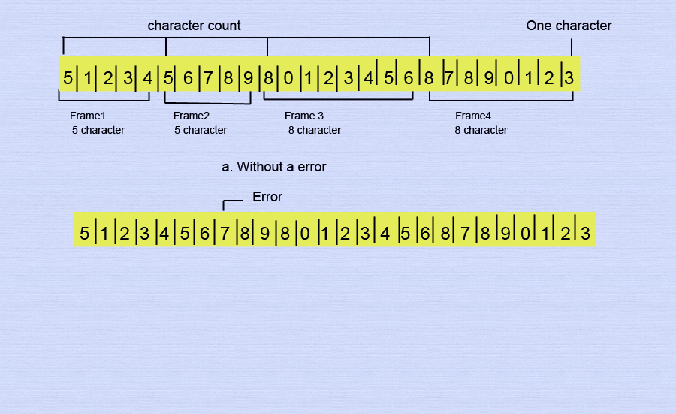
Challenges in Framing
Data transparency issues can occur if special flag sequences appear in data.
Proper implementation of framing techniques is crucial to avoid data misinterpretation.
Handling errors and frame synchronization remains a critical aspect of network design.
Notes:
Image source: https://a5theory.com

Slide 10
Conclusion
Framing is a critical process that ensures reliable and organized data transfer.
Different framing techniques are suited for various network protocols and scenarios.
Understanding framing mechanisms is essential for designing robust computer networks.
Notes:
Image source: https://a5theory.com

