Slide 1
Pixel-Oriented Visualization Techniques
NAME : K.Ranjith Reddy
CLASS : CSE - B
ROLL NO : 247R5A0506

Slide 2
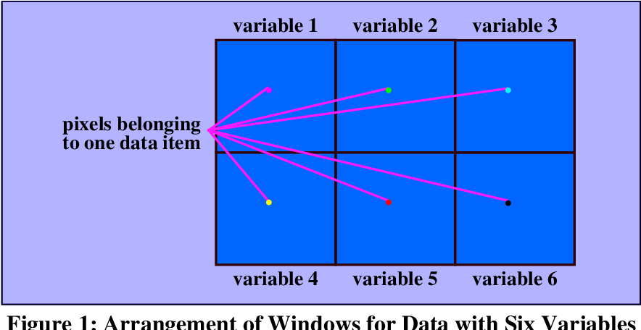
Introduction to Pixel-Oriented Visualization
Pixel-oriented visualization focuses on representing data through individual pixels or small groups of pixels.
This technique emphasizes detailed visual representation, often used in high-resolution images and displays.
It enables precise analysis of data by examining the visual properties at the pixel level, facilitating detailed insights.
Notes:
Image source: https://d3i71xaburhd42.cloudfront.net

Slide 3
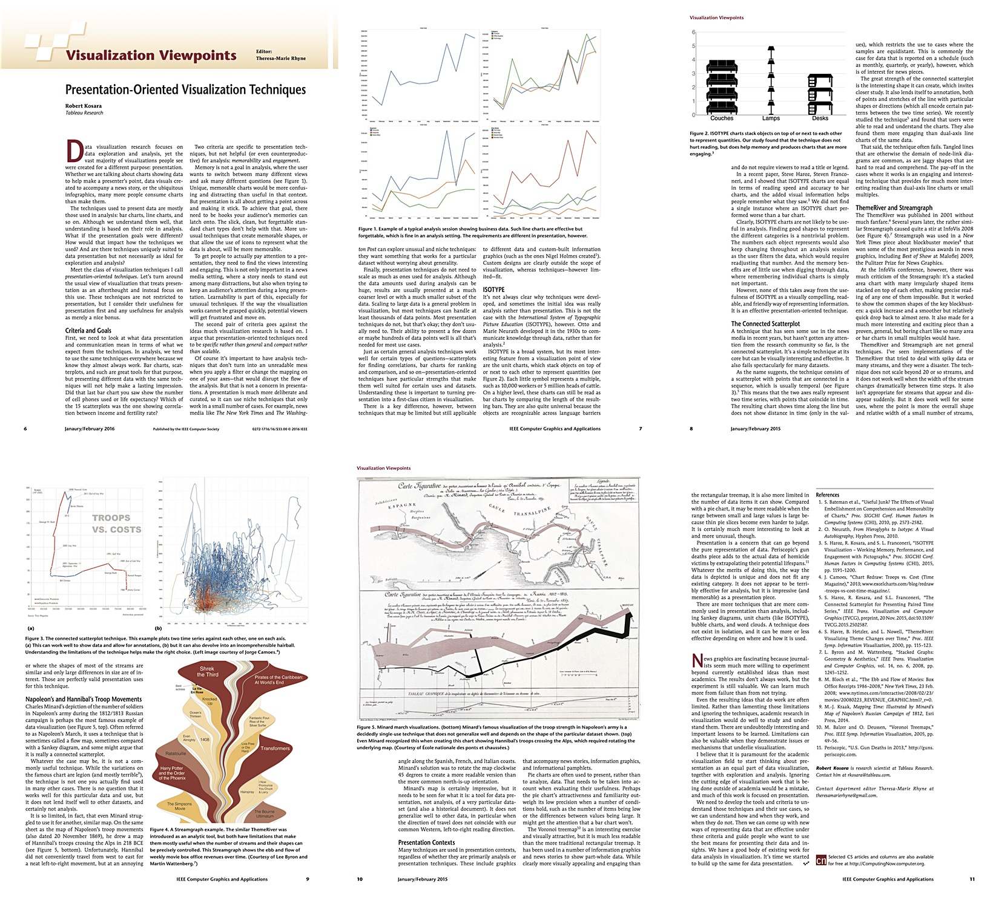
Importance of Pixel-Level Detail
Pixel-level detail allows for accurate visualization of subtle variations within data sets.
It is crucial for applications requiring high fidelity, such as medical imaging and scientific visualization.
Enhancing pixel detail can improve user understanding and support more informed decision-making processes.
Notes:
Image source: https://media.eagereyes.org

Slide 4
Basic Principles of Pixel-Oriented Techniques
These techniques rely on mapping data attributes directly onto pixel properties like color and intensity.
Color encoding and shading are commonly used to represent multiple data dimensions simultaneously.
Spatial resolution is key, with higher resolutions enabling more detailed and informative visualizations.
Notes:
Image source: https://www.slidemake.com

Slide 5
Common Pixel-Oriented Visualization Methods
Image-based visualization uses pixel data to display complex images derived from scientific or statistical data.
Heatmaps employ color gradients to represent data density or intensity at the pixel level.
Raster graphics techniques manipulate pixel arrays to create detailed visual representations of data.
Notes:
Image source: https://www.slidemake.com

Slide 6
Advantages of Pixel-Oriented Visualization
It provides high precision, capturing subtle variations that might be missed in other visualization methods.
Pixel-based images are easily scalable and can be manipulated digitally with minimal loss of detail.
This approach supports the visualization of large data volumes efficiently through pixel aggregation.
Notes:
Image source: https://www.slidemake.com

Slide 7
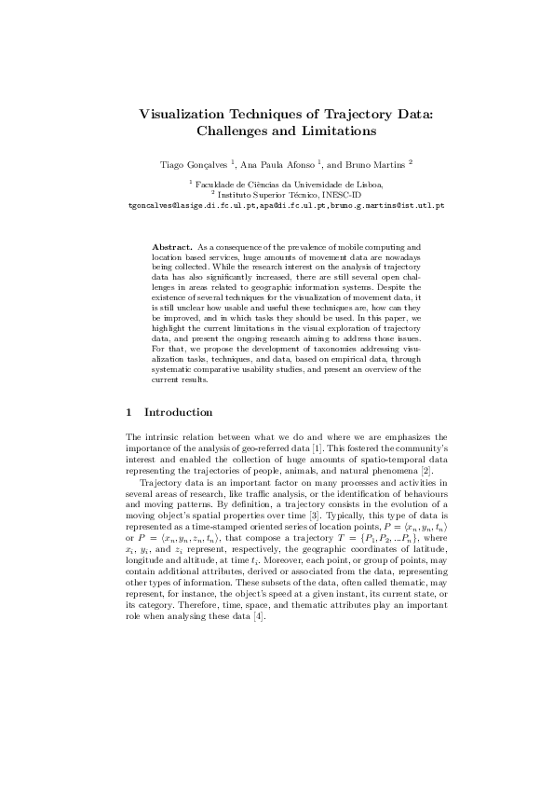
Limitations of Pixel-Based Techniques
High-resolution pixel data can demand significant computational resources for processing and rendering.
Visual clutter may occur when too many detailed pixels are displayed, reducing clarity.
Interpreting pixel-level data often requires specialized knowledge and can be less intuitive for general audiences.
Notes:
Image source: https://0.academia-photos.com

Slide 8

Applications in Scientific Visualization
Used extensively in medical imaging for detailed visualization of MRI and CT scan data.
Employed in remote sensing to analyze satellite imagery with high pixel resolution.
Useful in fluid dynamics simulations where detailed flow patterns are visualized at the pixel level.
Notes:
Image source: https://img.freepik.com

Slide 9
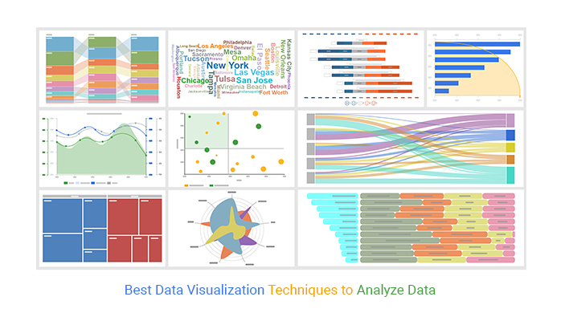
Applications in Data Analysis and Business Intelligence
Heatmaps visualize user interactions on websites, revealing behavior patterns at the pixel level.
Pixel-based visualizations help identify data clusters and outliers in large datasets.
They assist in geographic information systems (GIS) for detailed spatial data analysis.
Notes:
Image source: https://chartexpo.com

Slide 10
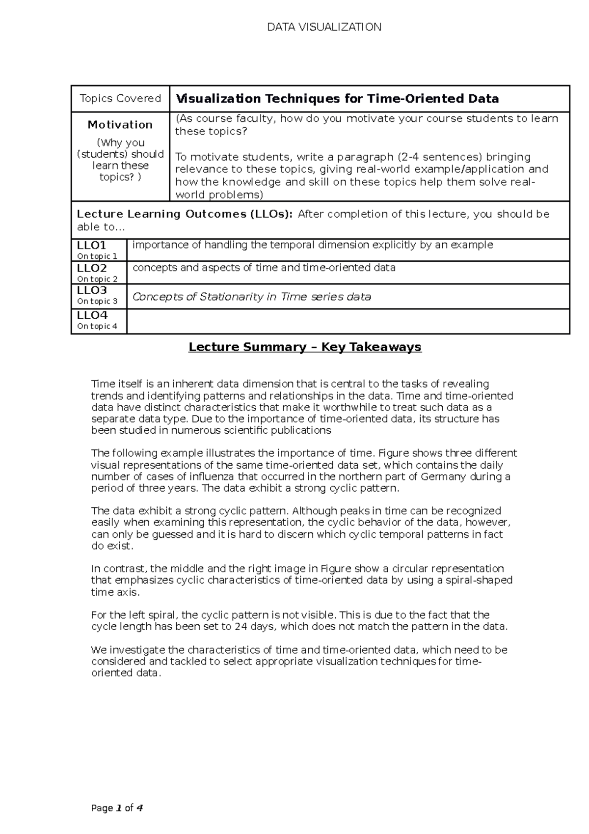
Conclusion and Summary
Pixel-oriented visualization techniques offer detailed and precise ways to represent complex data.
They are essential in fields requiring high-resolution imaging and detailed analysis.
Ongoing technological advancements will continue to expand their capabilities and applications.
Notes:
Image source: https://d20ohkaloyme4g.cloudfront.net

