Slide 1
Data Analysis And Algorithms
NP-Complete Classes
K.Ranjith Reddy
247R5A0506

Slide 2
Introduction to NP-Complete Classes
NP-Complete classes are a set of decision problems that are both in NP and as hard as any problem in NP.
They play a crucial role in understanding the computational complexity of various problems in data analysis and algorithms.
Identifying NP-Complete problems helps determine the feasibility of finding efficient solutions for large instances.
Notes:
Image source: https://slideplayer.com

Slide 3
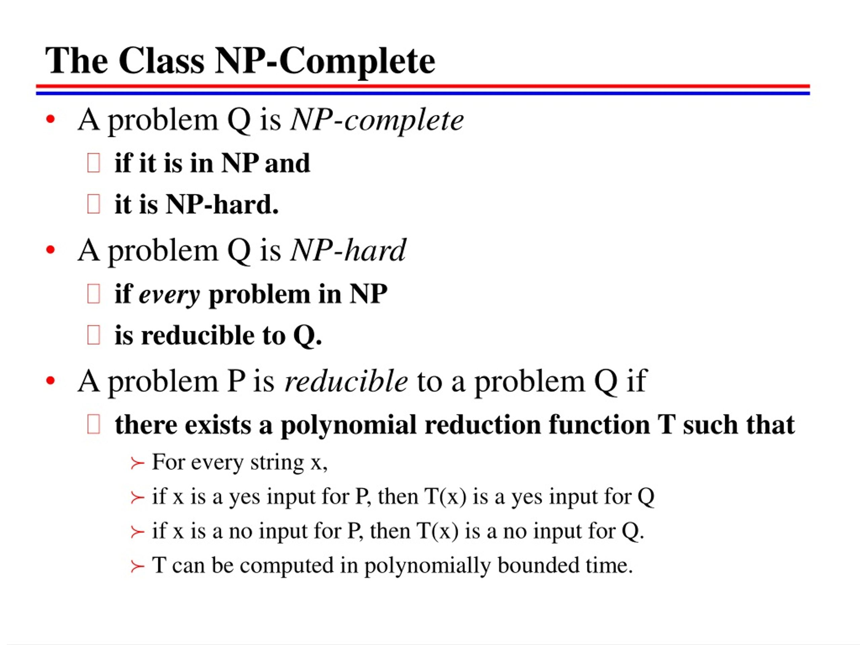
What is NP and NP-Complete?
NP (Nondeterministic Polynomial time) consists of problems for which solutions can be verified quickly.
NP-Complete problems are the hardest problems in NP, meaning if one NP-Complete problem is solved efficiently, all NP problems can be.
The concept of NP-Completeness was introduced by Stephen Cook in 1971, forming the basis of computational complexity theory.
Notes:
Image source: https://image4.slideserve.com

Slide 4
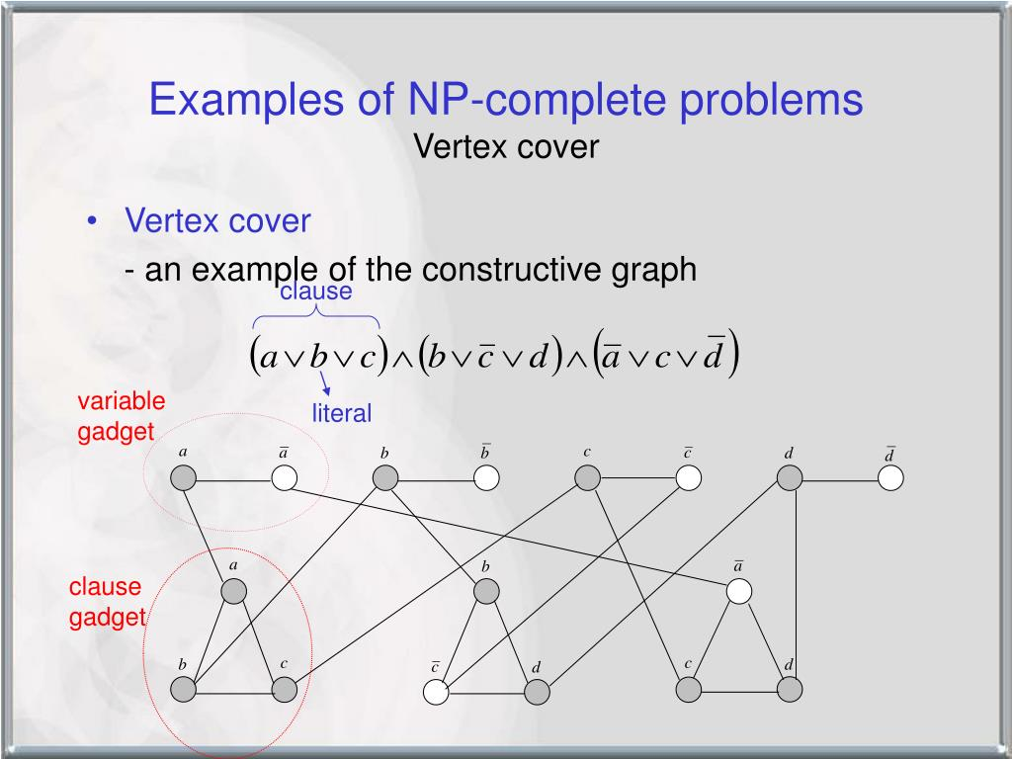
Examples of NP-Complete Problems in Data Analysis
Notes:
Image source: https://image2.slideserve.com

Slide 5
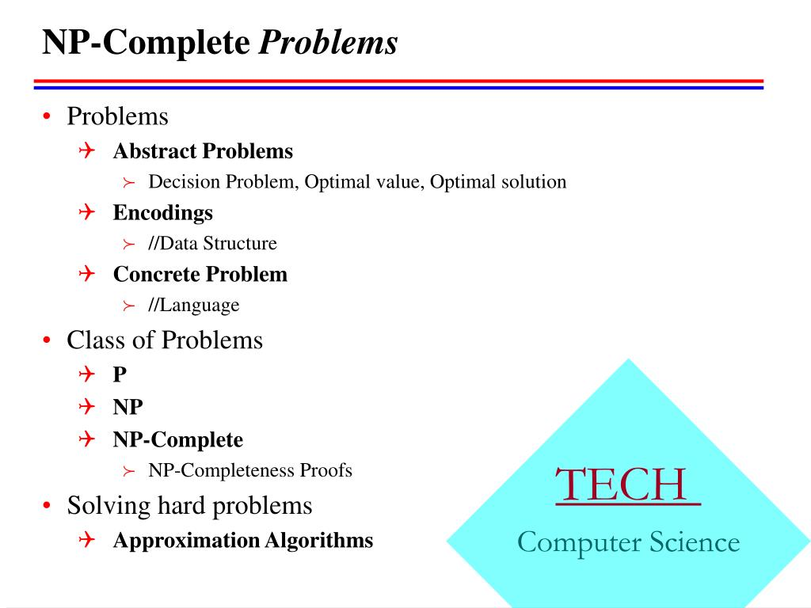
Key Algorithms and Reductions
Many NP-Complete problems are solved approximately or heuristically due to their complexity.
Polynomial-time reductions are used to prove NP-Completeness by transforming one problem into another.
For example, the reduction from 3-SAT to the Traveling Salesman Problem demonstrates the interconnectedness of NP-Complete problems.
Notes:
Image source: https://image.slideserve.com

Slide 6
Recent Advances and Research Directions
Researchers are exploring quantum computing's potential to address NP-Complete problems efficiently.
Machine learning approaches are being investigated for generating approximate solutions to complex problems.
The development of better heuristics and approximation algorithms continues to be a vibrant area of research.
Notes:
Image source: https://www.researchgate.net

Slide 7

Conclusion and Future Outlook
Understanding NP-Complete classes is essential for assessing the complexity of problems in data analysis.
Advances in algorithms and computational techniques will help manage NP-Complete challenges more effectively.
Ongoing research aims to discover new methods to approximate or solve NP-Complete problems in practical applications.
Notes:
Image source: https://www.slideteam.net

Slide 8
THANK YOU

