Slide 1
SALTSTAK in Devop’s
NAME : K.Ranjith Reddy
CLASS : CSE - B
ROLL NO : 247R5A0506

Slide 2
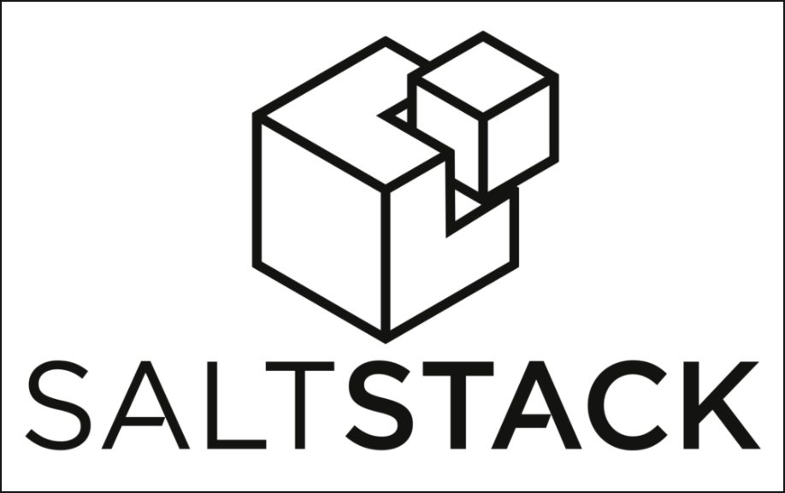
Introduction to Salt Stack
Salt Stack is an open-source configuration management and remote execution tool.
It is designed to manage large-scale infrastructures efficiently.
Salt Stack enables automation and orchestration of IT tasks across diverse systems.
Notes:
Image source: https://www.tastingtable.com

Slide 3
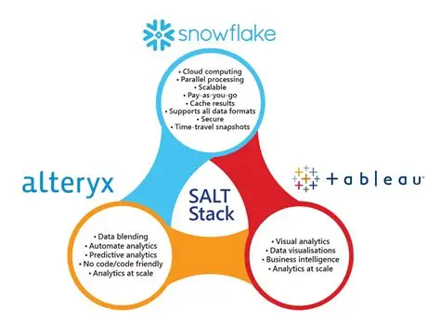
Core Features of Salt Stack
Salt provides fast remote execution capabilities for managing multiple servers simultaneously.
It uses a declarative language to define system states and configurations.
Salt supports event-driven automation to respond to real-time system changes.
Notes:
Image source: https://www.tastingtable.com

Slide 4
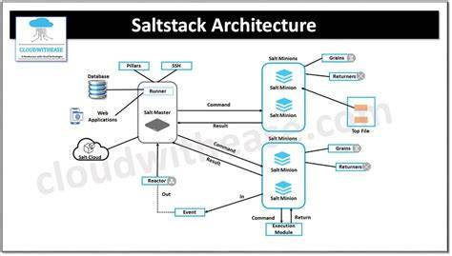
Architecture of Salt Stack
Salt follows a master-minion architecture where the master controls minions.
Minions are lightweight agents installed on managed systems.
The communication between master and minions is secure and encrypted.
Notes:
Image source: https://www.tastingtable.com

Slide 5
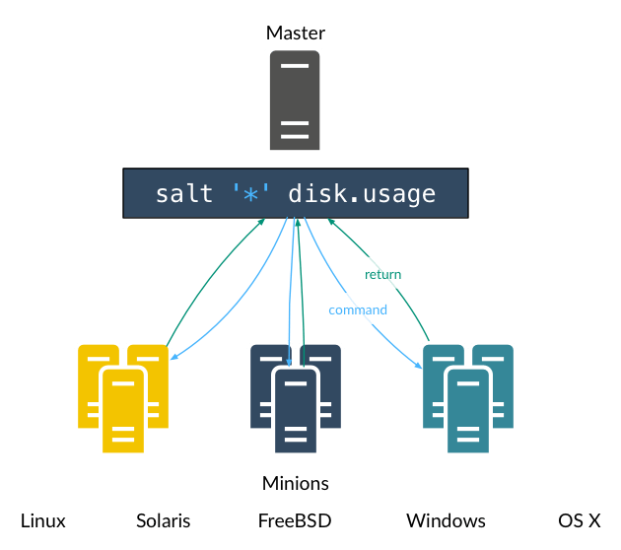
Salt Modules and States
Modules are functions that perform specific tasks like package installation or service management.
States describe the desired configuration of a system, ensuring consistency.
Combining modules and states allows for comprehensive system automation.
Notes:
Image source: https://www.tastingtable.com

Slide 6
Salt's Remote Execution System
Salt's remote execution allows commands to be run across many minions simultaneously.
It provides real-time feedback and results for efficient management.
Commands can be targeted using various selection criteria like grains, globbing, or lists.
Notes:
Image source: https://www.tastingtable.com

Slide 7
Salt Orchestration and Automation
Salt orchestration automates complex workflows involving multiple systems.
It enables sequential or conditional execution of tasks for deployment pipelines.
Orchestration improves reliability and reduces manual intervention.
Notes:
Image source: https://www.tastingtable.com

Slide 8
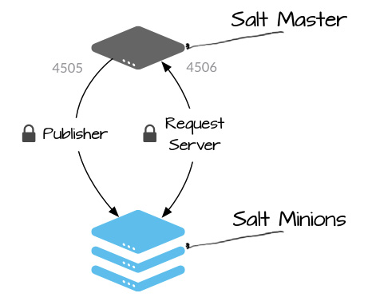
Security and Compliance in Salt Stack
Salt uses SSL/TLS encryption for secure communication between master and minions.
Role-based access control (RBAC) manages permissions for different users.
Audit logs and reporting features help maintain compliance and traceability.
Notes:
Image source: https://www.tastingtable.com

Slide 9
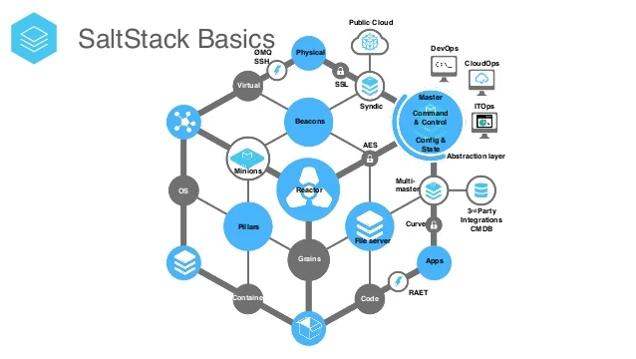
Use Cases and Applications
Salt Stack is used for server provisioning, configuration management, and application deployment.
It supports hybrid environments combining on-premises and cloud resources.
Many organizations leverage Salt for continuous integration and continuous deployment (CI/CD).
Notes:
Image source: https://www.tastingtable.com

Slide 10
Conclusion and Future Outlook
Salt Stack continues to evolve with features for better scalability and usability.
Its flexibility makes it suitable for diverse infrastructure management needs.
Ongoing development aims to enhance security, performance, and integration capabilities.
Notes:
Image source: https://www.tastingtable.com

