Slide 1
Installing Jenkins in windows
NAME : K.Ranjith Reddy
CLASS : CSE - B
ROLL NO : 247R5A0506

Slide 2

Introduction to Jenkins on Windows
Jenkins is an open-source automation server used for continuous integration and continuous delivery.
Installing Jenkins on Windows allows developers to automate build and deployment processes easily.
This presentation will guide you through the step-by-step installation process on a Windows machine.
Notes:
Image source: https://i.pinimg.com

Slide 3
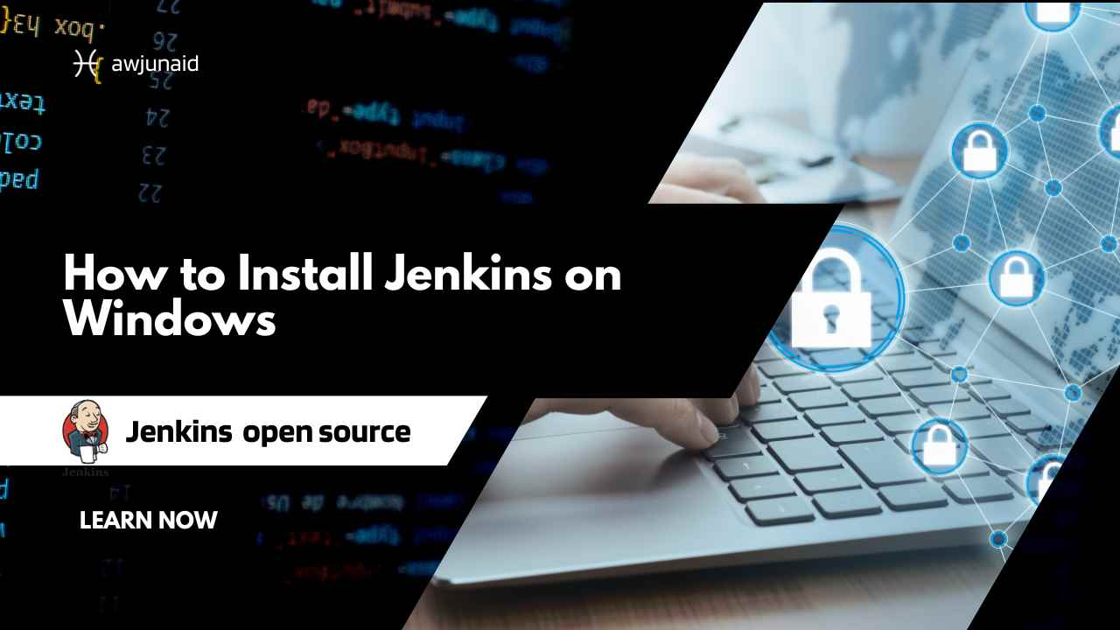
Prerequisites for Installing Jenkins
Ensure your Windows system meets the minimum hardware and software requirements.
Install Java Development Kit (JDK) because Jenkins runs on Java platform.
Download the latest stable version of Jenkins from the official Jenkins website.
Notes:
Image source: https://awjunaid.com

Slide 4
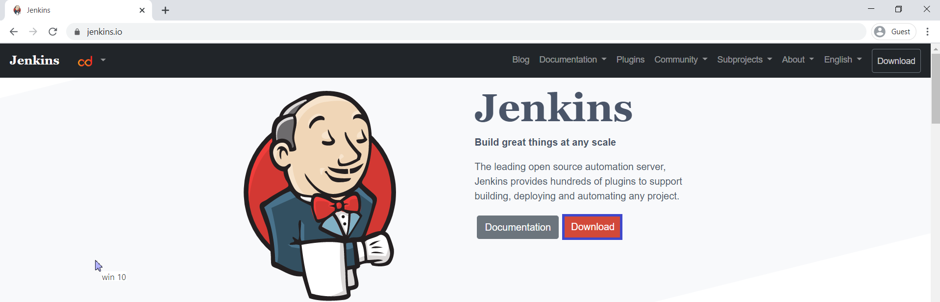
Downloading Jenkins for Windows
Visit the official Jenkins download page at https://www.jenkins.io/download/.
Choose the Windows installer package (.msi file) suitable for your system architecture.
Save the installer file to a known location on your computer for easy access.
Notes:
Image source: https://www.ktexperts.com

Slide 5
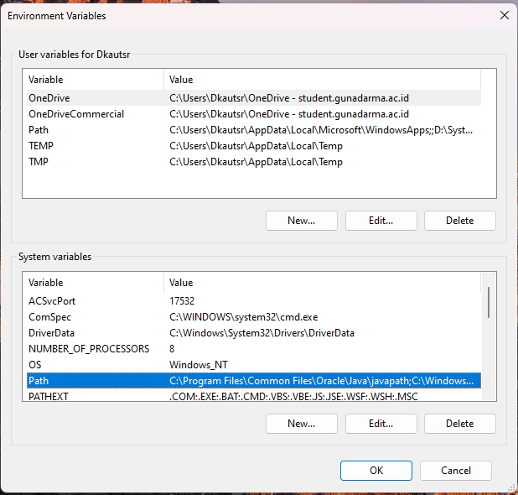
Installing Java on Windows
Download the latest JDK from the official Oracle or OpenJDK website.
Follow the installation prompts to complete the Java setup on your system.
Set the JAVA_HOME environment variable to the Java installation directory for Jenkins compatibility.
Notes:
Image source: https://cdn.hashnode.com

Slide 6
Running the Jenkins Installer
Double-click the downloaded Jenkins installer (.msi) file to start the setup wizard.
Follow the on-screen instructions to proceed with the installation.
Choose the default port (8080) or specify a different port if necessary during setup.
Notes:
Image source: https://www.slidemake.com

Slide 7
Configuring Jenkins during Installation
Select the installation directory or accept the default path provided by the installer.
Decide whether to run Jenkins as a service or manually start it later.
Complete the installation process and allow the setup to finish copying files.
Notes:
Image source: https://www.slidemake.com

Slide 8
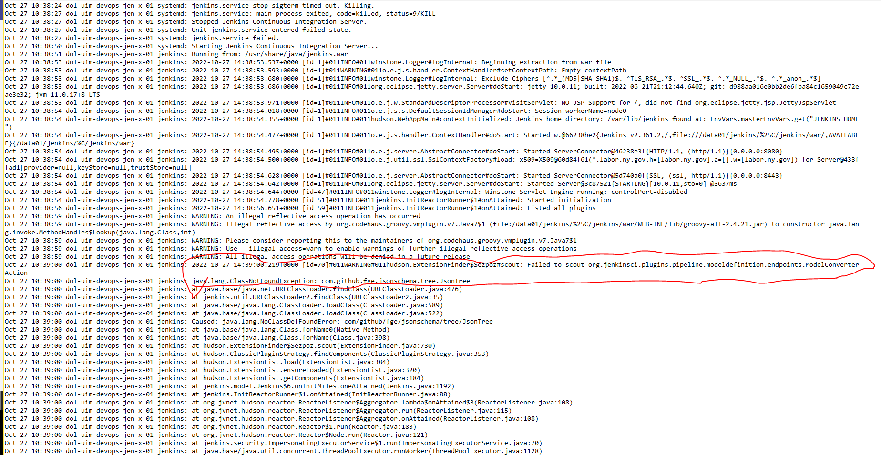
Starting Jenkins Service on Windows
If Jenkins was installed as a service, it should start automatically after installation.
To manually start Jenkins, open the Services app from the Control Panel.
Locate the Jenkins service and click 'Start' to run the server.
Notes:
Image source: https://community.jenkins.io

Slide 9

Accessing Jenkins Web Interface
Open a web browser and navigate to http://localhost:8080 (or your custom port).
The Jenkins unlock screen will appear, prompting you for an initial admin password.
Retrieve the password from the specified file in the installation directory.
Notes:
Image source: https://file.labex.io

Slide 10
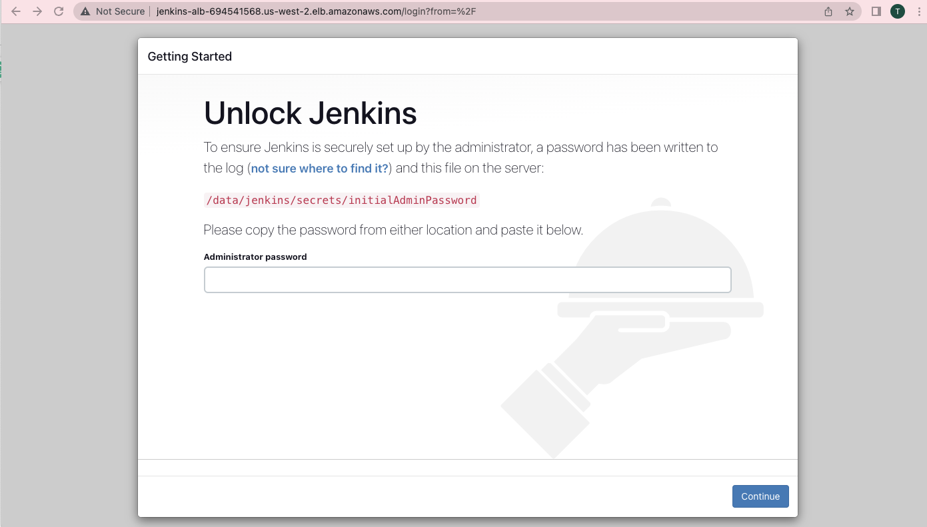
Unlocking Jenkins and Completing Setup
Open the file located at C:\Program Files\Jenkins\secrets\initialAdminPassword.
Copy the password and paste it into the Jenkins unlock page.
Follow the prompts to install recommended plugins and create the first admin user.
Notes:
Image source: https://devopscube.com

Slide 11
Conclusion and Resources
Installing Jenkins on Windows is straightforward with proper prerequisites and steps.
Always keep Jenkins updated to benefit from the latest features and security patches.
For additional help, refer to the official Jenkins documentation and community forums.
Notes:
Image source: https://wiki.jenkins.io

