Slide 1

GIT
BRIJESH KOTHARI

Slide 2
Brief History of Git
Came out of Linux development community
Linus Torvalds, 2005
Initial goals:
Speed
Support for non-linear development (thousands of parallel branches)
Fully distributed
Able to handle large projects like Linux efficiently

Slide 3
What is Git?
Git is a distributed version control system where each developer has a copy of the source repository on their dev machine.
Developers can commit each set of changes on their dev machine and perform version control operations such as history and compare without a network connection.
Branches are lightweight. When you need to switch contexts, you can create a private local branch. You can quickly switch from one branch to another to pivot among different variations of your codebase. Later, you can merge, publish, or dispose of the branch.

Slide 4
Centralized VCS
Traditional version control system
Server with database
Clients have a working version
Examples
CVS
Subversion
Visual Source Safe
Challenges
Multi-developer conflicts
Client/server communication

Slide 5
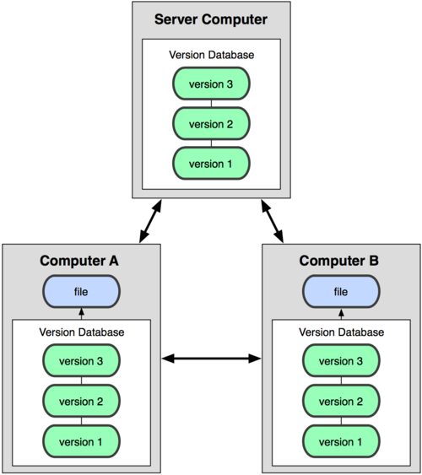

Git uses a distributed model
Centralized Model
Distributed Model
(CVS, Subversion, TFS)
(Git, Mercurial)
Result: Many operations are local

Slide 6
Git Advantages
Resilience
No one repository has more data than any other
Speed
Very fast operations compared to other VCS
Space
Compression can be done across repository not just per file
Minimizes local size as well as push/pull data transfers
Simplicity
Object model is very simple
Large userbase with robust tools

Slide 7
Some GIT Disadvantages
Definite learning curve, especially for those used to centralized systems
Can sometimes seem overwhelming to learn
Conceptual difference
Huge amount of commands

Slide 8
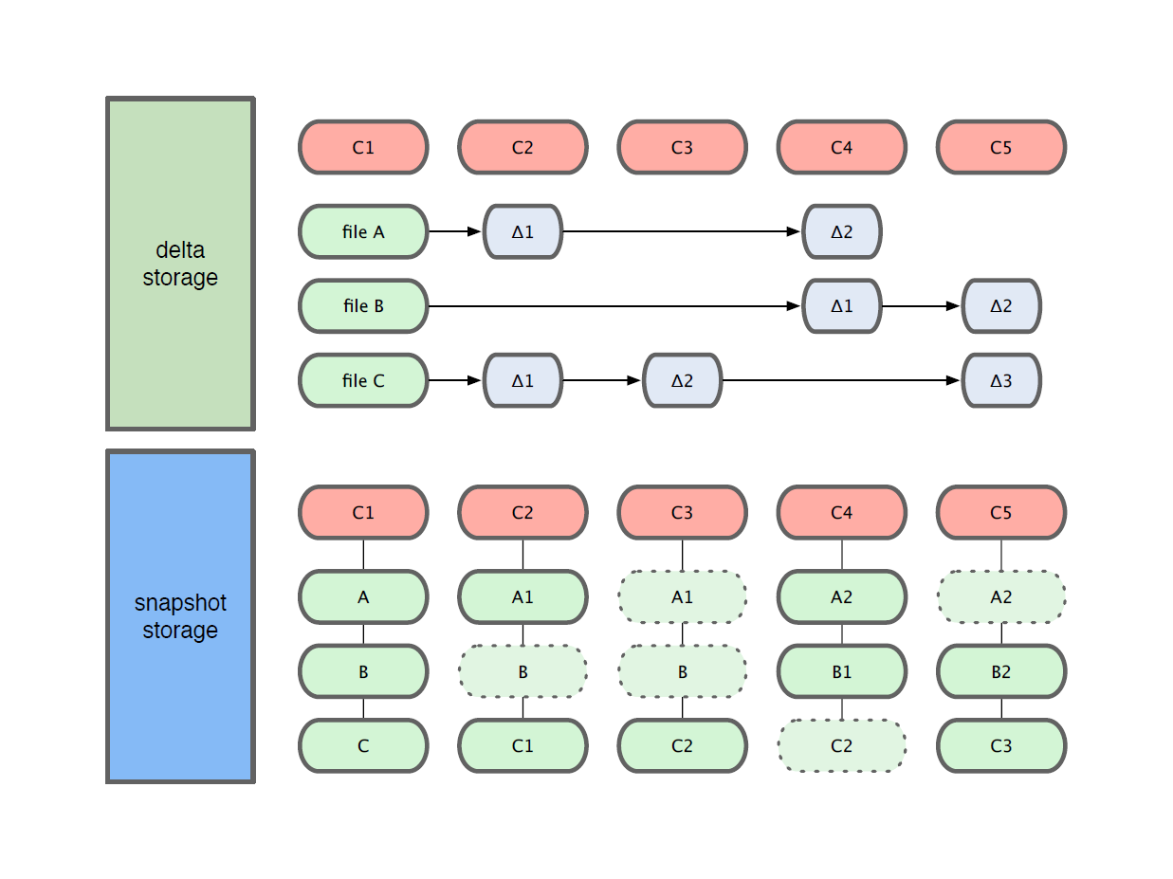
Getting Started
Git use snapshot storage

Slide 9
Git uses checksums
In Subversion each modification to the central repo incremented the version # of the overall repo.
How will this numbering scheme work when each user has their own copy of the repo, and commits changes to their local copy of the repo before pushing to the central server?????
Instead, Git generates a unique SHA-1 hash – 40 character string of hex digits, for every commit. Refer to commits by this ID rather than a version number. Often we only see the first 7 characters:
1677b2d Edited first line of readme
258efa7 Added line to readme
0e52da7 Initial commit

Slide 10

A Local Git project has three areas
Unmodified/modified Files
Staged Files
Committed Files
Note: working directory sometimes called the “working tree”, staging area sometimes called the “index”.

Slide 11
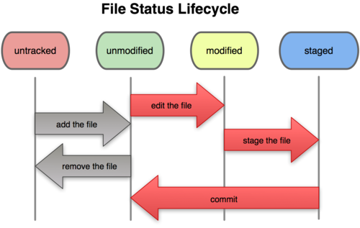
Git file lifecycle

Slide 12
Basic Workflow
Basic Git workflow:
Modify files in your working directory.
Stage files, adding snapshots of them to your staging area.
Do a commit, which takes the files as they are in the staging area and stores that snapshot permanently to your Git directory.
Notes:
If a particular version of a file is in the git directory, it’s considered committed.
If it’s modified but has been added to the staging area, it is staged.
If it was changed since it was checked out but has not been staged, it is modified.

Slide 13
Git features
Merge/Diff
Comparing the repositories
Branching and Merging
Rebasing
Stashing
Tagging

Slide 15


