Slide 1
CMPE 260 Project
Reinforcement Learning based Book Recommendations
Presented by:
Neetha Sherra
Ananya Joshi
Sanjana Kothari

Slide 2
Introduction
Recommendation systems play a pivotal role in any content based industry. A variety of techniques like collaborative filtering, matrix factorization based methods etc have been used. However there are two prevalent challenges:
The dynamic interaction between users and recommender systems is ignored and recommendation is seen as a static activity.
They ignore the long-term advantages in favour of focusing primarily on the instant reaction from recommended books.
In this project, we tackle these challenges by modeling the user interactions with the system by treating recommendation as sequential decision making process. We use Actor-critic reinforcement technique hence taking into account the long term benefits and dynamic adaptation.

Slide 3
Role of Reinforcement Learning
In our project, Reinforcement Learning (RL), specifically the "Actor-Critic" framework, plays a pivotal role in enhancing recommendation performance.
Here’s how RL contributes to make a better recommendation:
Dynamic interaction modeling
Sequential decision making
Continuous learning and adaptation

Slide 4
Dataset
To build the recommendation system for books, the dataset used comprises the following:
Book ISBN
Book Title
Author
User ID
Rating
Best Seller
User Country
User Age
0.2 million books rated by 0.1 million users with ratings between 0 and 10.

Slide 5
Methodology
Approach:
Algorithm - Deep Deterministic Policy Gradient (concurrently learns the Q-function and the policy).
Sequential decision making procedure using “Actor-Critic” technique.
Agent outputs deterministic actions.
Addition of noise to balance exploration and exploitation, and introduce randomness in the actions of the agent.
Target actor and critic network to improve stability during training.
Reply buffer to store and randomly sample past experiences.
Reward based on whether the book was previously rated by the user or is a best seller.

Slide 6
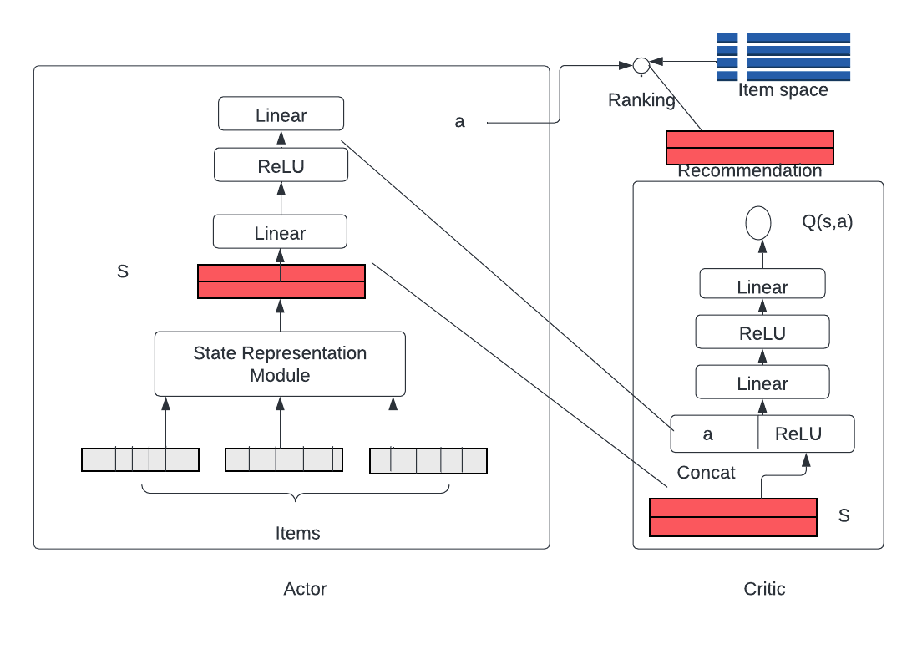
Architecture
The Actor network generates an action based on user state. The user state is a summarized representation obtained from the state representation module.
The Critic network is a Deep Q-Network that approximates the true state-action value function Qπ (s, a). It reflects the merits of the action policy generated by the Actor. The input of the Critic is the user state and the action, and the output is the Q-value. According to the Q-value, the parameters of the Actor are updated in the direction of improving the performance.

Slide 7
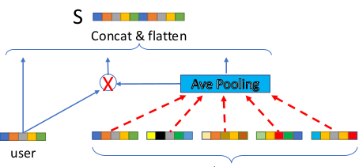
Architecture
The state representation module captures the interaction between books and users.
The embeddings of books are transformed by a weighted average pooling layer. The resulting vector is used to model the interactions with the input user. Finally, the user embedding, the interaction vector, and the average pooling result of books are concatenate into a vector to denote the state.
Reference: https://arxiv.org/pdf/1810.12027.pdf

Slide 8
Algorithm
At timestep t, the agent
Observes the current state that is calculated by the state representation module
Generates an action at = πθ(state) according to the current policy πθ with ε-greedy exploration
Recommends an book it according to the action
Reward is calculated and the user state is updated
Stores the transition (st, at, rt, st+1) into the replay buffer
Samples a minibatch of 8 transitions from the replay buffer
Updates the parameters of the Actor network and Critic network
Updates the target networks’ parameters.

Slide 9
Variations
Base - uses user and book embeddings to model user-book interactions
Base + user demographic features - incorporates user features like location and age
Base + OU (Ornstein-Uhlenbeck ) noise - time-correlated noise is added to the actions taken by the policy
Base + Gaussian noise - gaussian noise is added to the actions taken by the policy

Slide 10
Evaluation metrics
Hit metric - Checks whether the recommended book was either previously rated by the user or if it is is a best seller.
DCG metric - Takes into account the position of each book in the ranked list of recommendations. It assigns higher scores to relevant books appearing higher in the list.

Slide 11
Results on test set
Method | Hit metric | DCG metric
Vanilla | 0.961 | 0.477
Vanilla + user demographic features | 0.965 | 0.477
Vanilla + OU noise | 0.968 | 0.481
Vanilla + gaussian noise | 0.974 | 0.483

Slide 12
Demo

Slide 13
References
Paper -
Deep Reinforcement Learning based Recommendation with Explicit User-Item Interactions Modeling
Implementation -
Github
Github

