Slide 1

EV CHARGER LOCATOR ANDROID
TEAM MEMBERS: 02
Yogeshwar Reddy Ceemarla
Omprakash Reddy Chamala
Pallavi Pokuri
Rakesh Gopal Karadi
Sravani Kotha

Slide 2

AGENDA
Introduction
Core Functionalities & Database Integration
App Navigation & Trip Planner
Chat Feature & Filters
Profile and Payments
Conclusion
Any Queries

Slide 3
INTRODUCTION
Locate nearby EV charging stations
Real-time Firebase + Google Maps integration
Filters, pricing, plug type, navigation
Push Notifications, FAQs, Chat Functionality

Slide 4
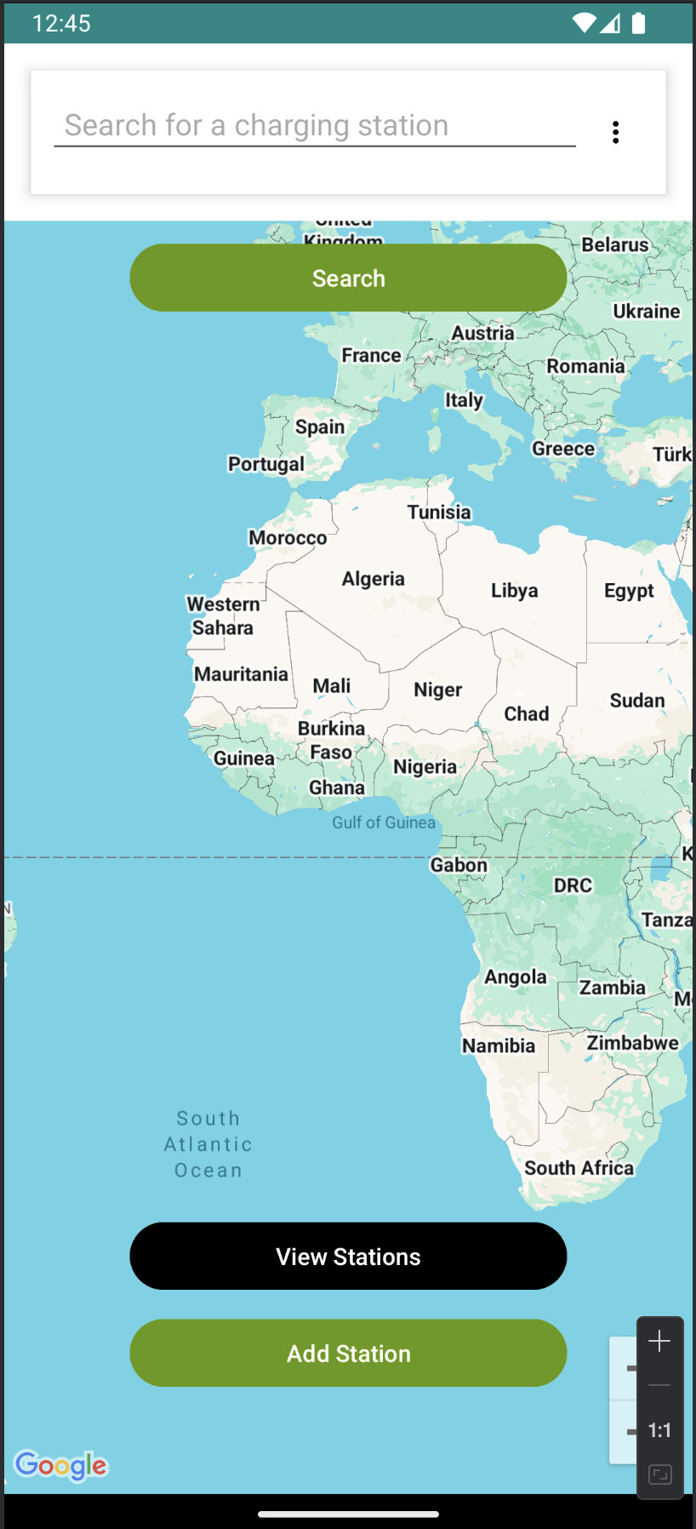
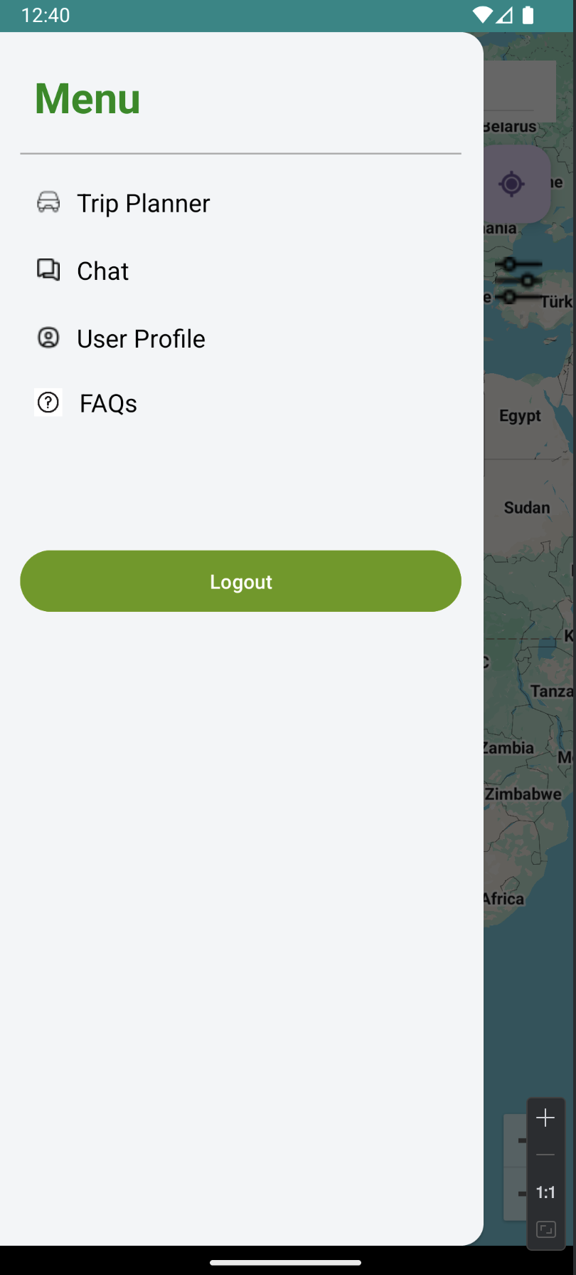
CORE FUNCTIONALITIES & DATABASE INTEGRATION
📍 Google Maps Integration
🔌 Real-time Pricing Info
💳 Google Pay, PayPal, Card Support
🛠️ User Dashboard & Admin Dashboard
Firebase Realtime Database
Nodes: ChargingStations, Users, SavedCards, Trips, Chats
Secure Authentication

Slide 5
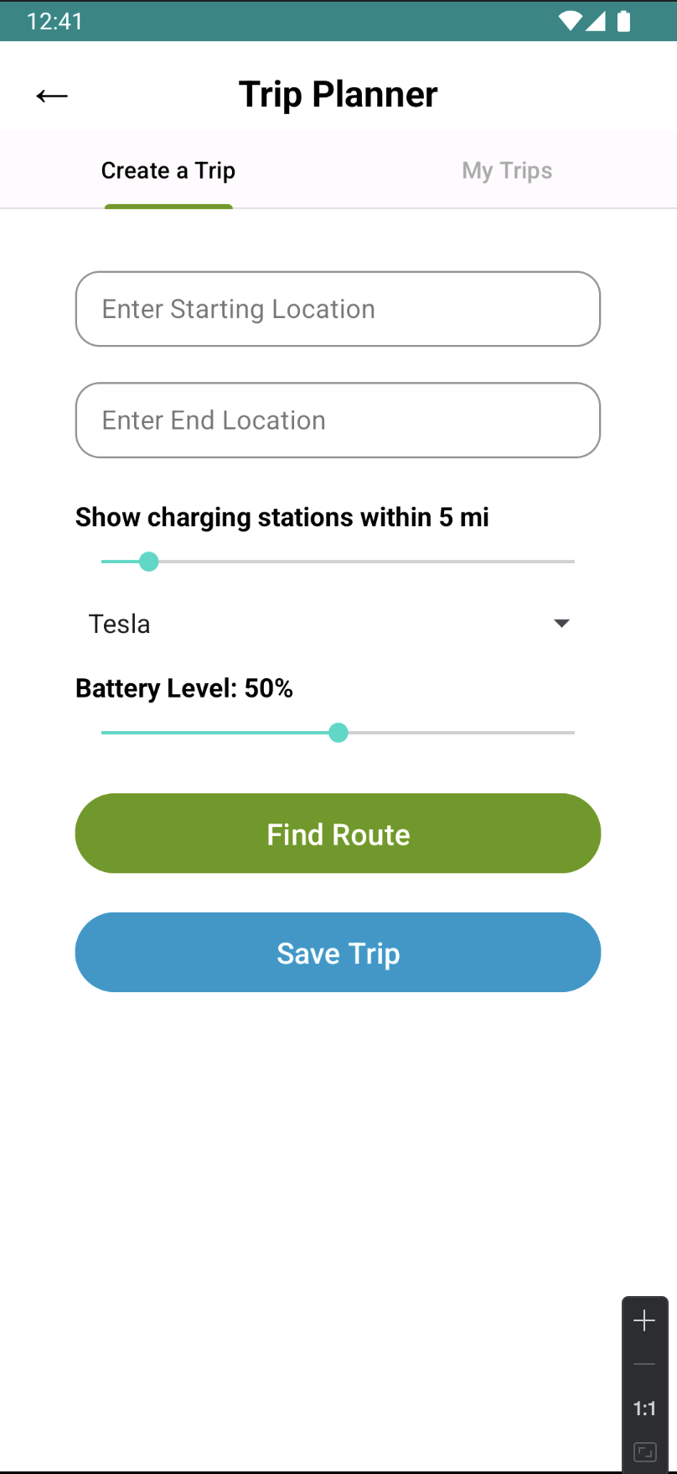
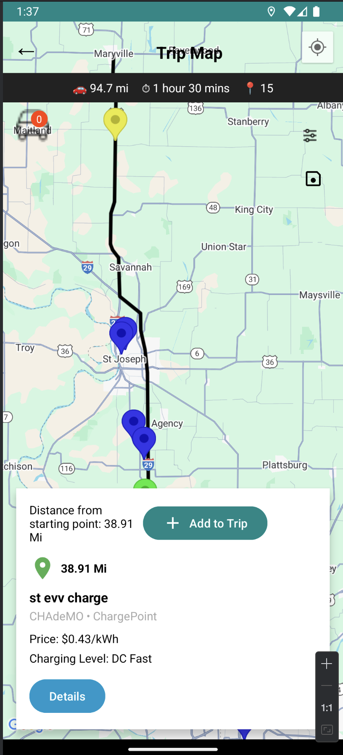
APP NAVIGATION & TRIP PLANNER
Navigation drawer for easy access
Trip Planner supports custom range + battery level
My Trips
Simple, intuitive UI

Slide 6
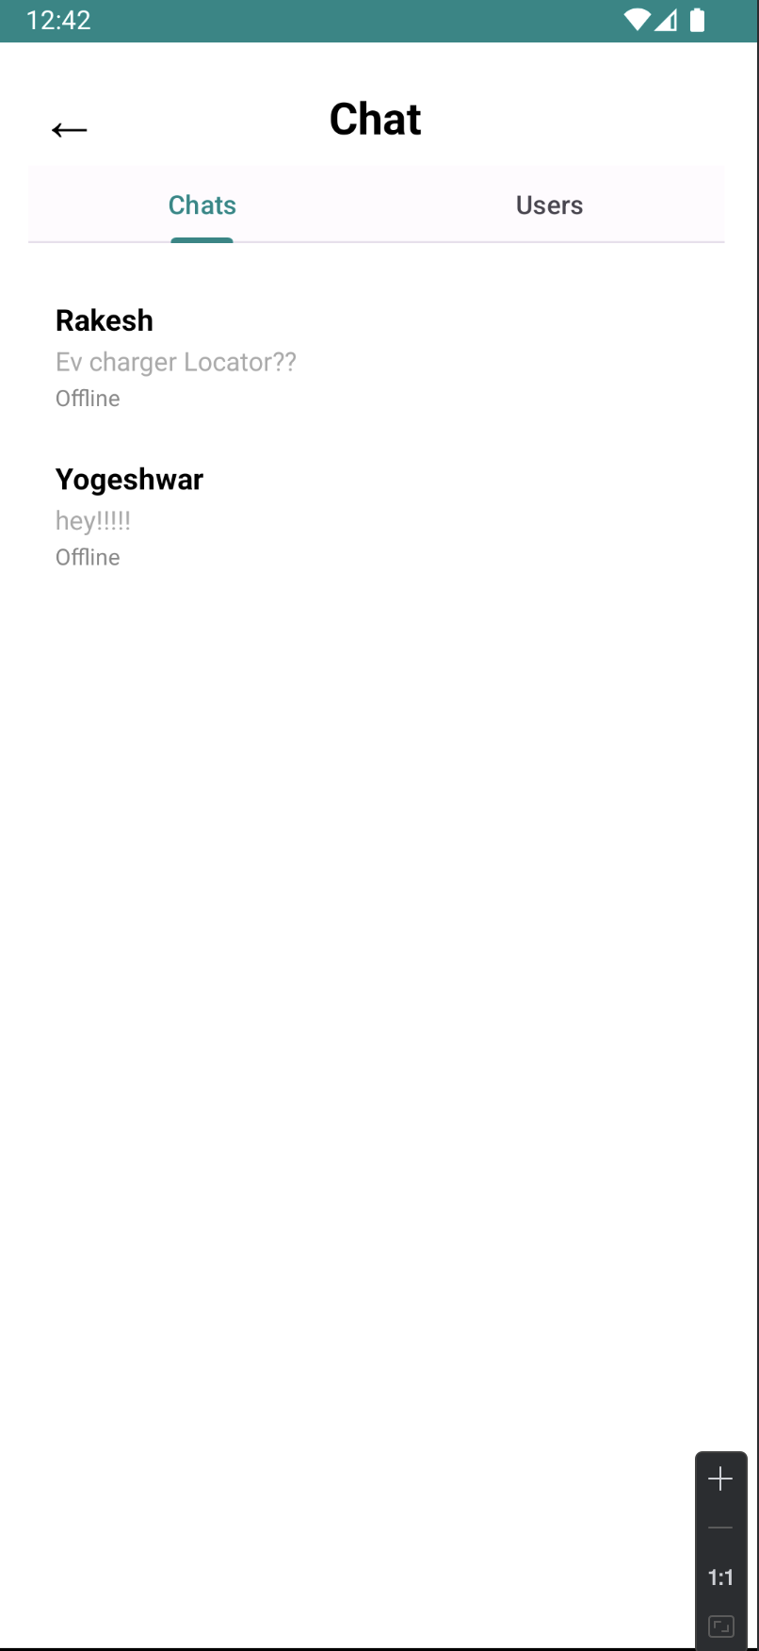
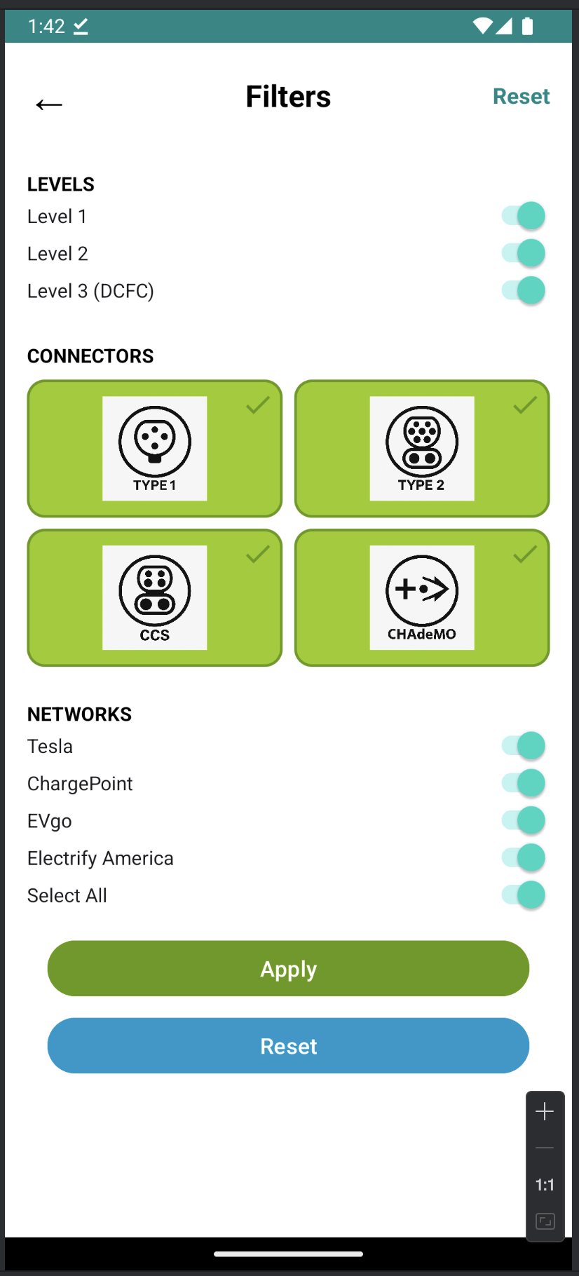
CHAT FEATURE & FILTERS
Navigation drawer for easy access
Built-in chat system between users
Simple, intuitive UI

Slide 7
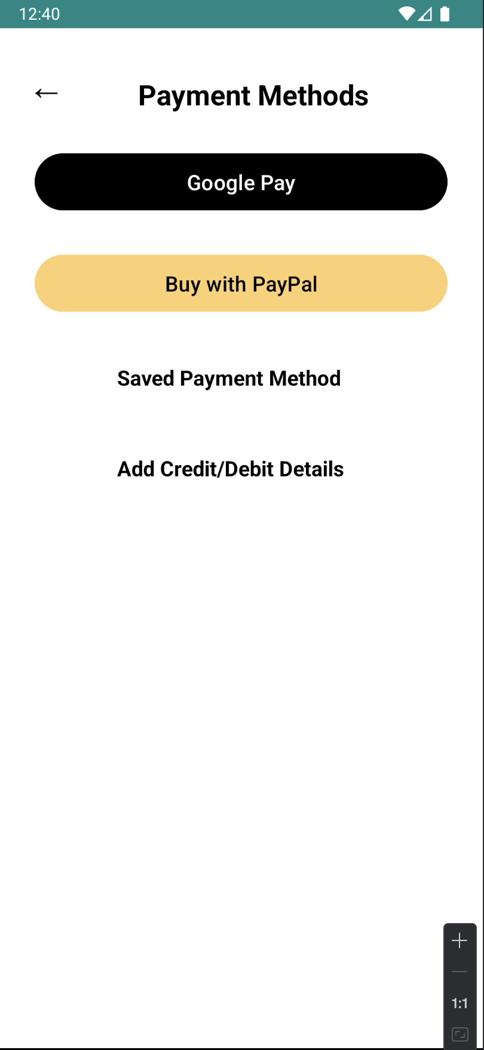
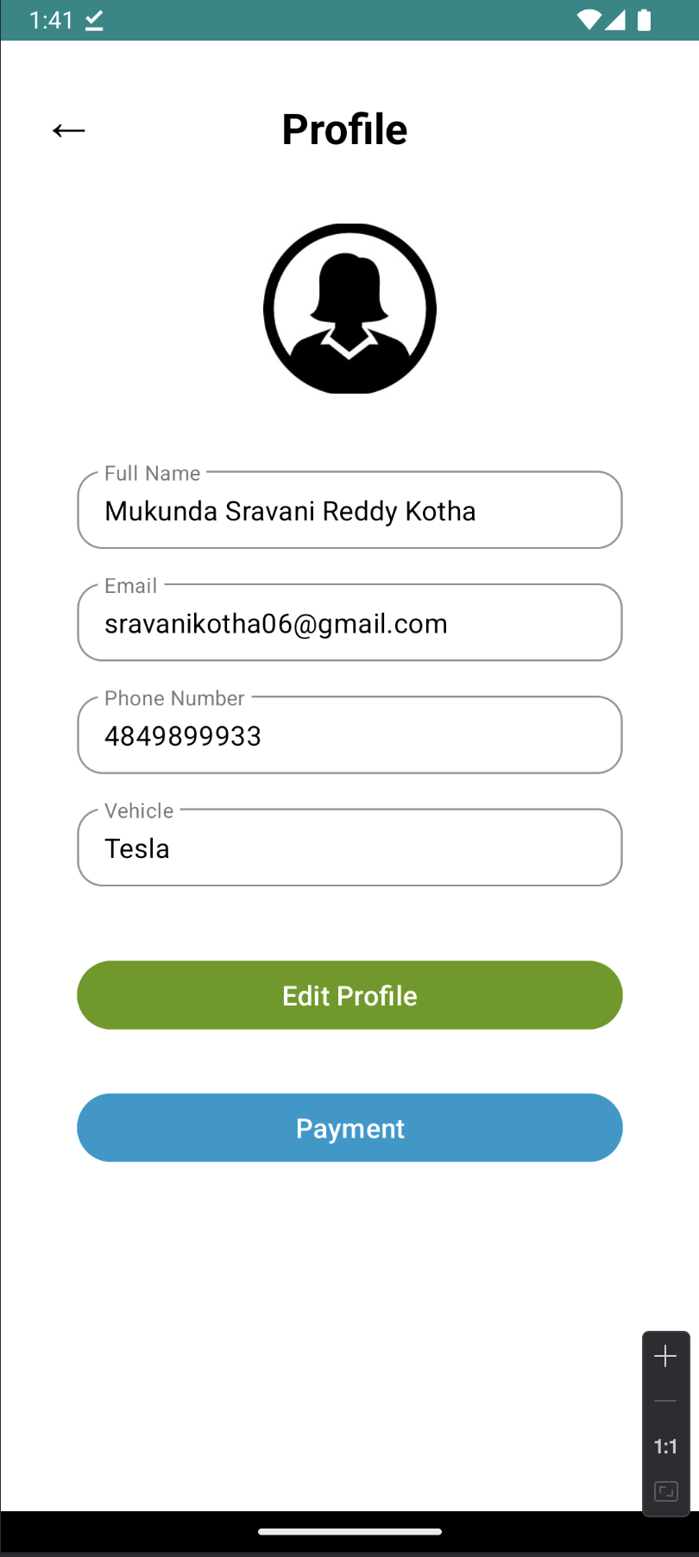
PROFILE AND PAYMENTS
Price = energyUsed × pricePerKWh
Choose from GPay, PayPal, Saved Cards
Debit/Credit Cards

Slide 8
DEMO & CONCLUSION
✅ Our app bridges the gap between EV drivers and accessible charging infrastructure.
🚗 Built with real-time Firebase integration and Google Maps API to ensure accurate, location-based service.
💳 Offers a secure, multi-method payment system including Google Pay, PayPal, and saved cards.
📱 Intuitive design with features like Trip Planning, Chat, and FAQs for enhanced user support.
🔒 Scalable, secure, and ready for future enhancements like AI-based charger recommendations and route optimization.

Slide 9

ANY QUERIES
Group: 02
Yogeshwar Reddy Ceemarla
Omprakash Reddy Chamala
Pallavi Pokuri
Rakesh Gopal Karadi
Sravani Kotha

