Slide 1

Front End DEVLOPMENT
By
Sreekanth Reddy

Slide 2
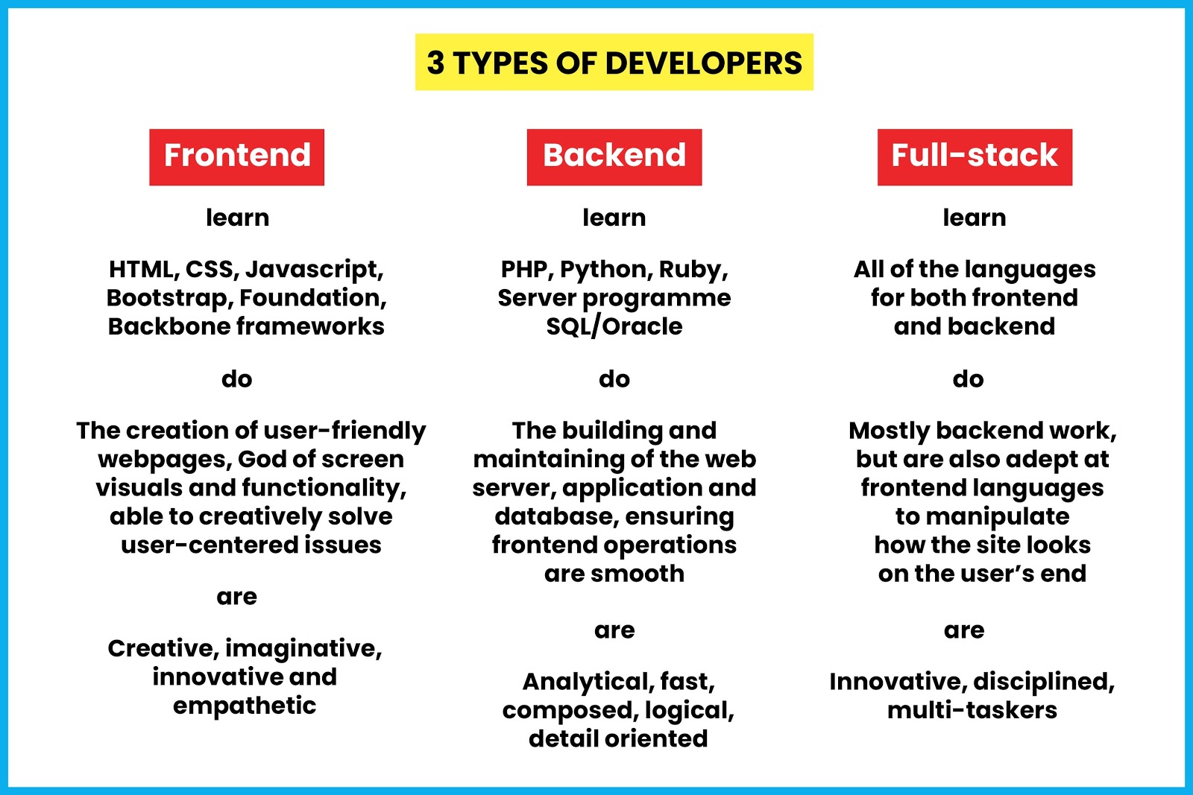

Slide 3
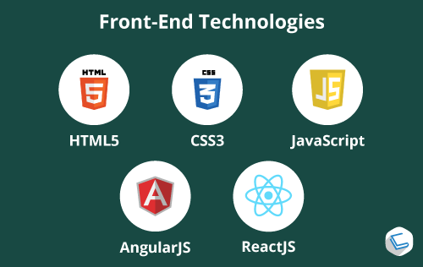
Agenda
HTML
CSS
JavaScript
jQuery
React Js
Angular Js

Slide 4
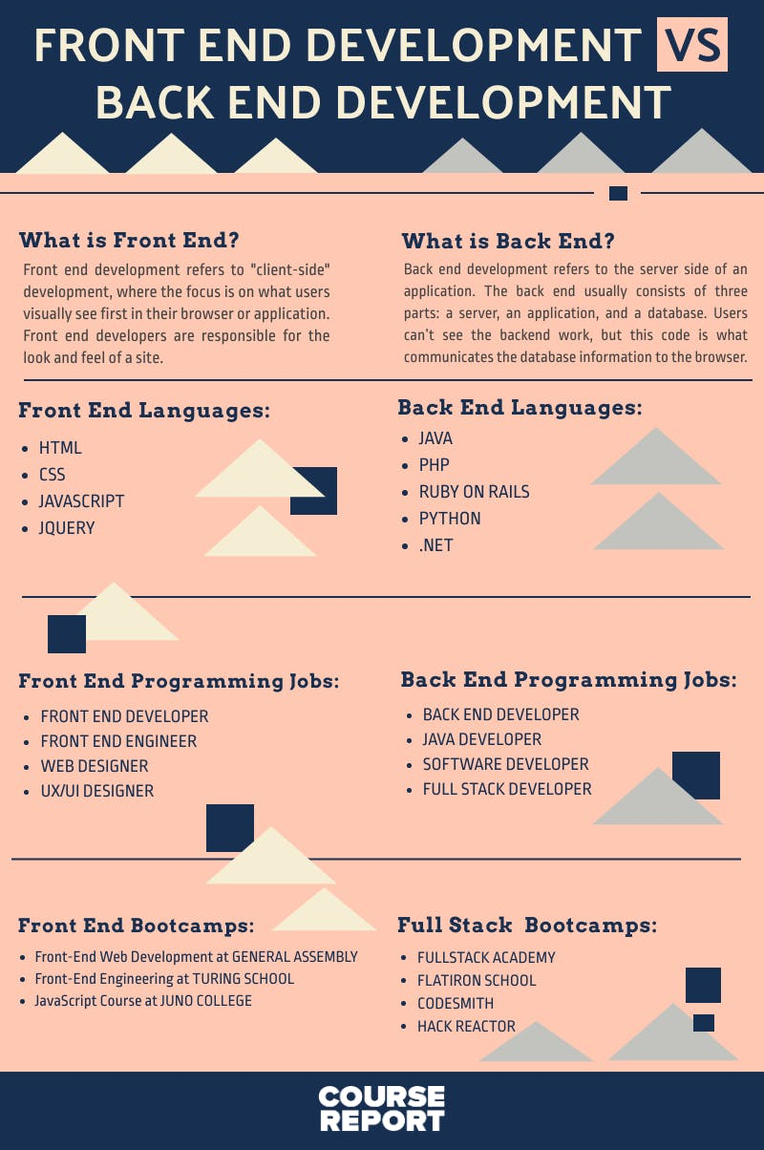


Slide 5
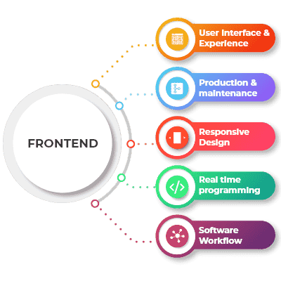
Roles of Front End Developer

Slide 6
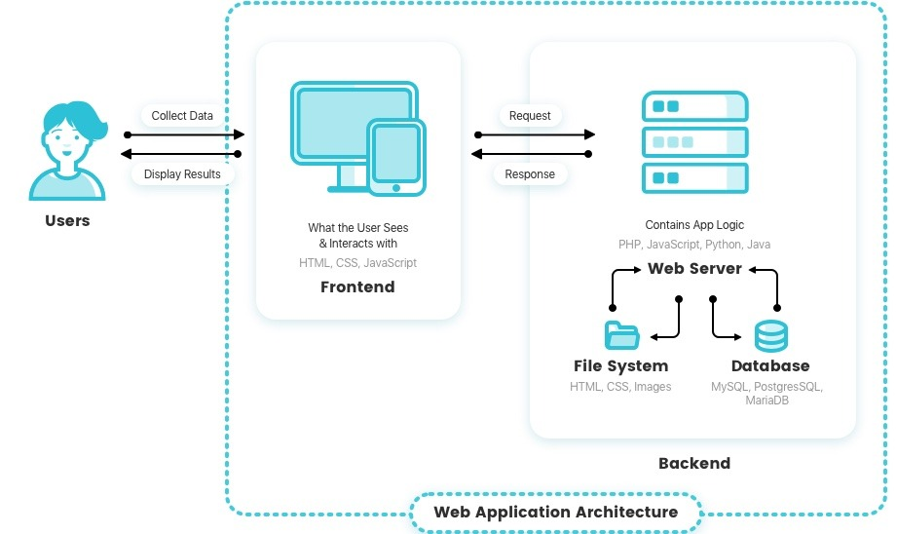
Web Application Architecture

Slide 7

Software Requirements
Notepadd++
Visual Studio Code
NodeJs
GIT

Slide 8
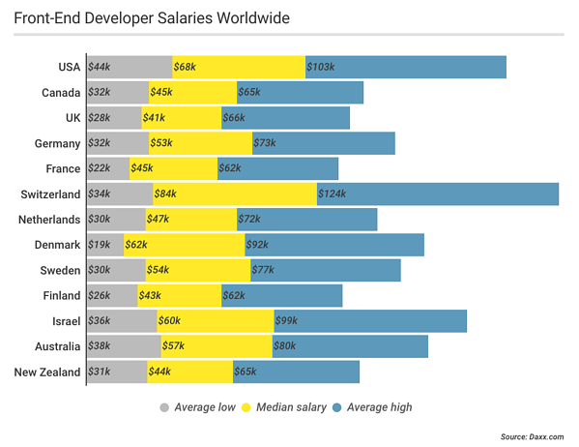
Front end developer Salaries

Slide 9
Questions Time ?

Slide 10
Query Time

