Slide 1


HTML Tutorial
By
Sreekanth Reddy

Slide 2



Agenda
Elements
Attributes
Headings
Paragraphs
Styles
Images, Tables and List Values

Slide 3

Software Requirements
Notepadd++
Visual Studio Code
NodeJs
GIT

Slide 4
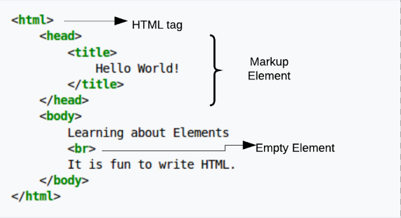


Introduction To HTML ELEMENTS

Slide 5

HTML Attributes
ID
CLASS
SRC
TITLE
HREF

Slide 6

Work Shop

Slide 7
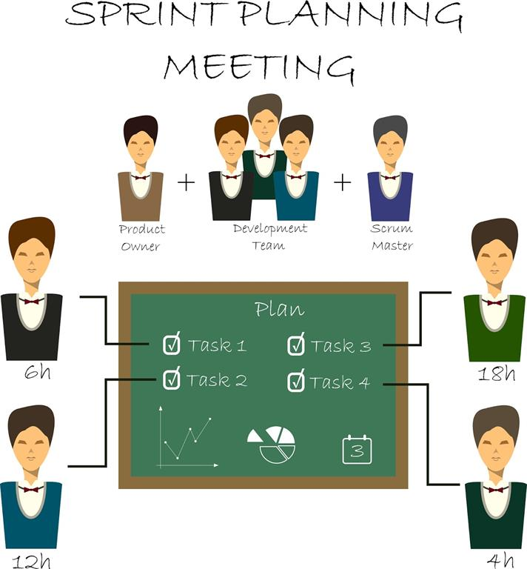
Sprint Planning

Slide 8


Slide 9


Thank You
Sreekanth Reddy
kothasreekanth2022@gmail.com
Futureappdevelopers.com

