Slide 1
HTML Layout Elements
Sreekanth Reddy

Slide 2
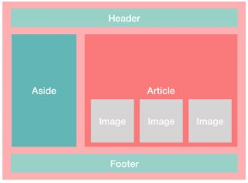
Agenda
HTML Layout
HTML Responsive
HTML Semantic Elements
HTML Tables
HTML List Views

Slide 3
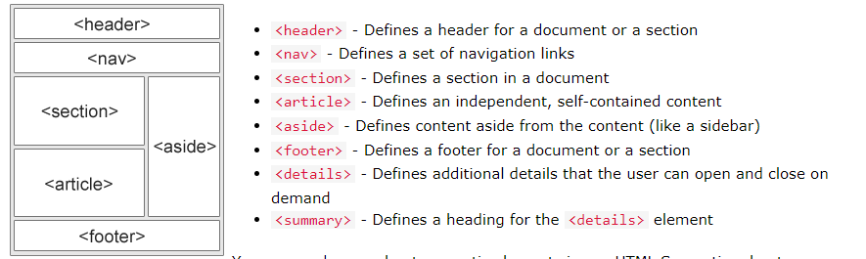
HTML Layout

Slide 4
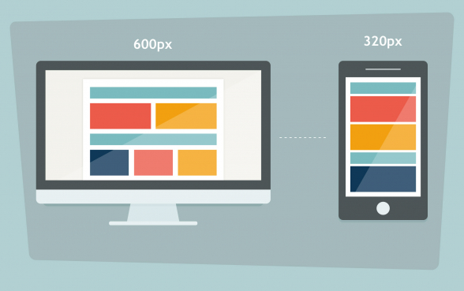
HTML Responsive

Slide 5
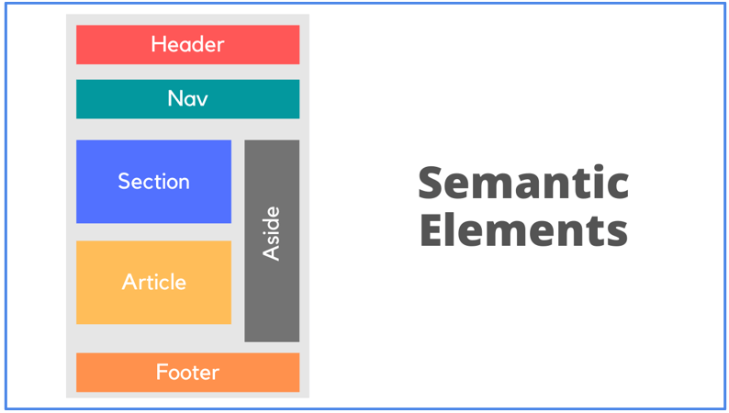
HTML Semantic Elements

Slide 6
HTML Table
 | Category 1 | Category 2 | Category 3 | Category 4
Item 1 | 4.5 | 2.3 | 1.7 | 5
Item 2 | 3.2 | 5.1 | 4.4 | 3
Item 3 | 2.1 | 1.7 | 2.5 | 2.8
Item 4 | 4.5 | 2.2 | 1.7 | 7

Slide 7
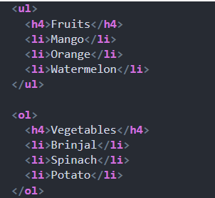
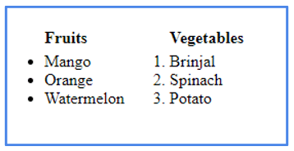
HTML List View

Slide 8

Thank you
Sreekanth Reddy
kothasreekanth2022@gmail.com
Futureappdevelopers.com

