Slide 1
HTML Layout Elements
Sreekanth Reddy

Slide 2
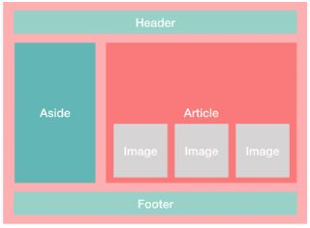
Agenda
HTML Layout
HTML Responsive
HTML Semantic Elements
HTML Tables
HTML List Views

Slide 3
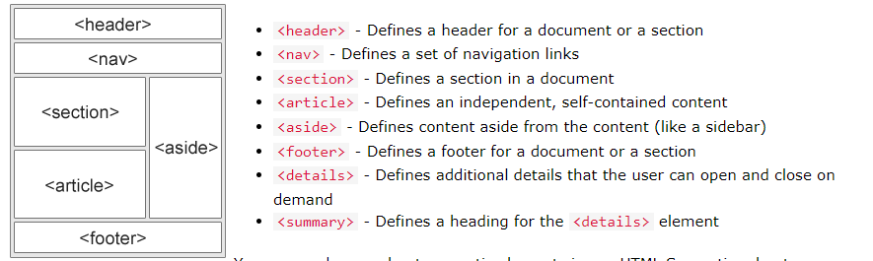
HTML Layout

Slide 4
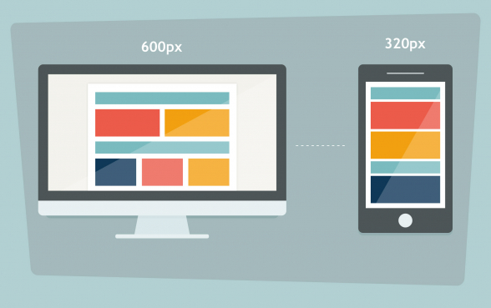
HTML Responsive

Slide 5
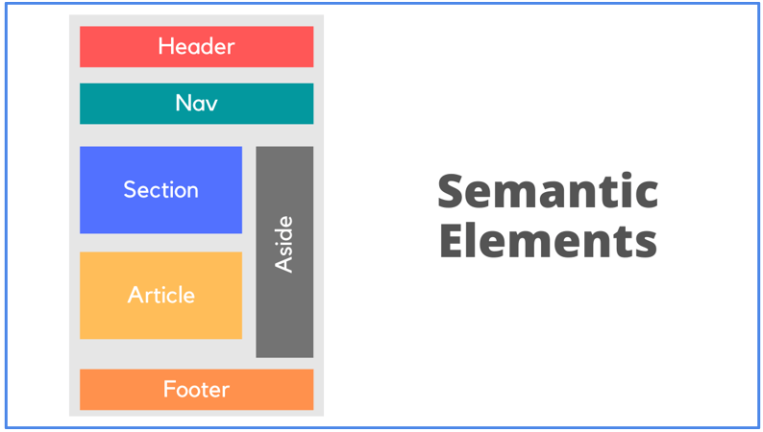
HTML Semantic Elements

Slide 6
HTML Table
 | Category 1 | Category 2 | Category 3 | Category 4
Item 1 | 4.5 | 2.3 | 1.7 | 5
Item 2 | 3.2 | 5.1 | 4.4 | 3
Item 3 | 2.1 | 1.7 | 2.5 | 2.8
Item 4 | 4.5 | 2.2 | 1.7 | 7

Slide 7
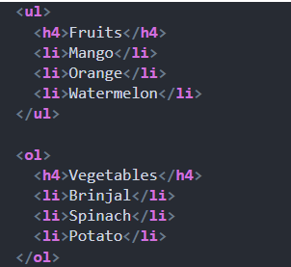
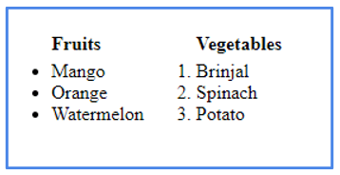
HTML List View

Slide 8

Thank you
Sreekanth Reddy
kothasreekanth2022@gmail.com
Futureappdevelopers.com

Slide 9
What Is AJAX?
AJAX stands for Asynchronous JavaScript and XML. AJAX is a technique in web development used to update content on a website without having to reload the entire page.
In an AJAX application, JavaScript is used to make real-time updates on parts of a page as the user interacts with it, thereby turning an otherwise static HTML page into a dynamic one.
Social networking web applications such as Facebook and Twitter use AJAX to update user feeds and notifications.
Let's take the Twitter web app as an example. After a specified time interval, the Twitter app makes an AJAX request to the server requesting new information. That is how the user receives the latest tweets on their feeds without having to reload the page.
All of this happens asynchronously; the user can continue to use the application while it requests information from the web server in the background. That's precisely why a user can scroll through their feed and react to tweets while the feed gets updated with new tweets.
In a traditional client-server request, the user will have to reload the page to get any new information from the server.

Slide 10
Benefits of AJAX
AJAX uses client-side JavaScript to fetch and display content in the background. This technique greatly improves the user experience, since the page doesn't have to be reloaded every time fresh content is needed.
Using AJAX leads to faster page renders because it can be used to update only the parts of the page that need to change, as opposed to reloading the entire page.
That also reduces the frequency of requests to the web server, which in turn leads to faster response times.

Slide 11
What Is a POST Request?
When performing API requests from the browser, the two HTTP methods you'll use for data transport are GET and POST. The main difference between these two methods lies in the way data gets sent to the web server application.
HTTP GET passes data to the server application in name and value pairs. These request parameters are appended to the URL. For example, the following is a URL for a GET request containing two request parameters that will be sent to the server:
www.mysite.com/id=12&name="chris"
Since data is visible in the URL, the GET method should never be used to transport sensitive information such as passwords and bank details.
Instead, the POST method should always be used to transport sensitive data. The POST method transports data in the request body. Data can be transported in JSON and XML formats.

Slide 12
How to Make an AJAX POST Request With XHR
You can use the XMLHttpRequest object (XHR) to communicate with a web server using the AJAX technique. This is the classic way to do AJAX, but it's not the best way now that the Fetch API is supported in modern browsers. In the next section, I'll show you a better way to make a POST request using fetch().
Now suppose we want to post the following data (a blog post) to a web server:

Slide 13
/* Data which will be sent to server */
let postObj = {
id: 1,
title: "What is AJAX",
body: "AJAX stands for Asynchronous JavaScript..."
}

Slide 14
let post = JSON.stringify(postObj)
const url = "https://jsonplaceholder.typicode.com/posts"
let xhr = new XMLHttpRequest()
xhr.open('POST', url, true)
xhr.setRequestHeader('Content-type', 'application/json; charset=UTF-8')
xhr.send(post);
xhr.onload = function () {
if(xhr.status === 201) {
console.log("Post successfully created!")
}
}

Slide 15
How to Make an AJAX POST Request With fetch()
Another way to make AJAX calls in JavaScript is with the fetch() method. fetch() is an API utility method built into the web browser environment. It's a newer API than XMLHttpRequest, with modern features making it easier to use. I recommend you use fetch() for AJAX.
The following code makes a POST request to the server using fetch():

