Slide 1



Job Apply Agent
PRODUCT DEMO
Upload your resume
Jobs found and scored
Your daily job search on autopilot: Naukri, LinkedIn and Monster in one place.
Applications sent daily
Notes:
Welcome. In the next 10 minutes: what the agent does, how you set it up, how it decides which jobs to apply for, and how you keep control.

Slide 2



Job hunting is repetitive
Same portals, every day
Search Naukri, LinkedIn and Monster again and again
Same steps.
Every day.
Every portal.
Long descriptions
Read each one to judge whether you really fit
The same forms
Retype your details on every company career site
Notes:
Anyone who has searched for a job knows the loop. The agent takes over the routine part so you only spend time on interviews and decisions.

Slide 3



One agent, four steps
1. Upload
2. Search
3. Apply
4. Track
Add your resume once. Skills, roles and experience are detected.
Every day the agent searches your portals for matching roles.
Each job gets a match %. Good matches are applied to.
See every job, its status and its description on the dashboard.
Notes:
Four steps. The only manual part is step one. After that the agent runs on its own at the time you choose.

Slide 4
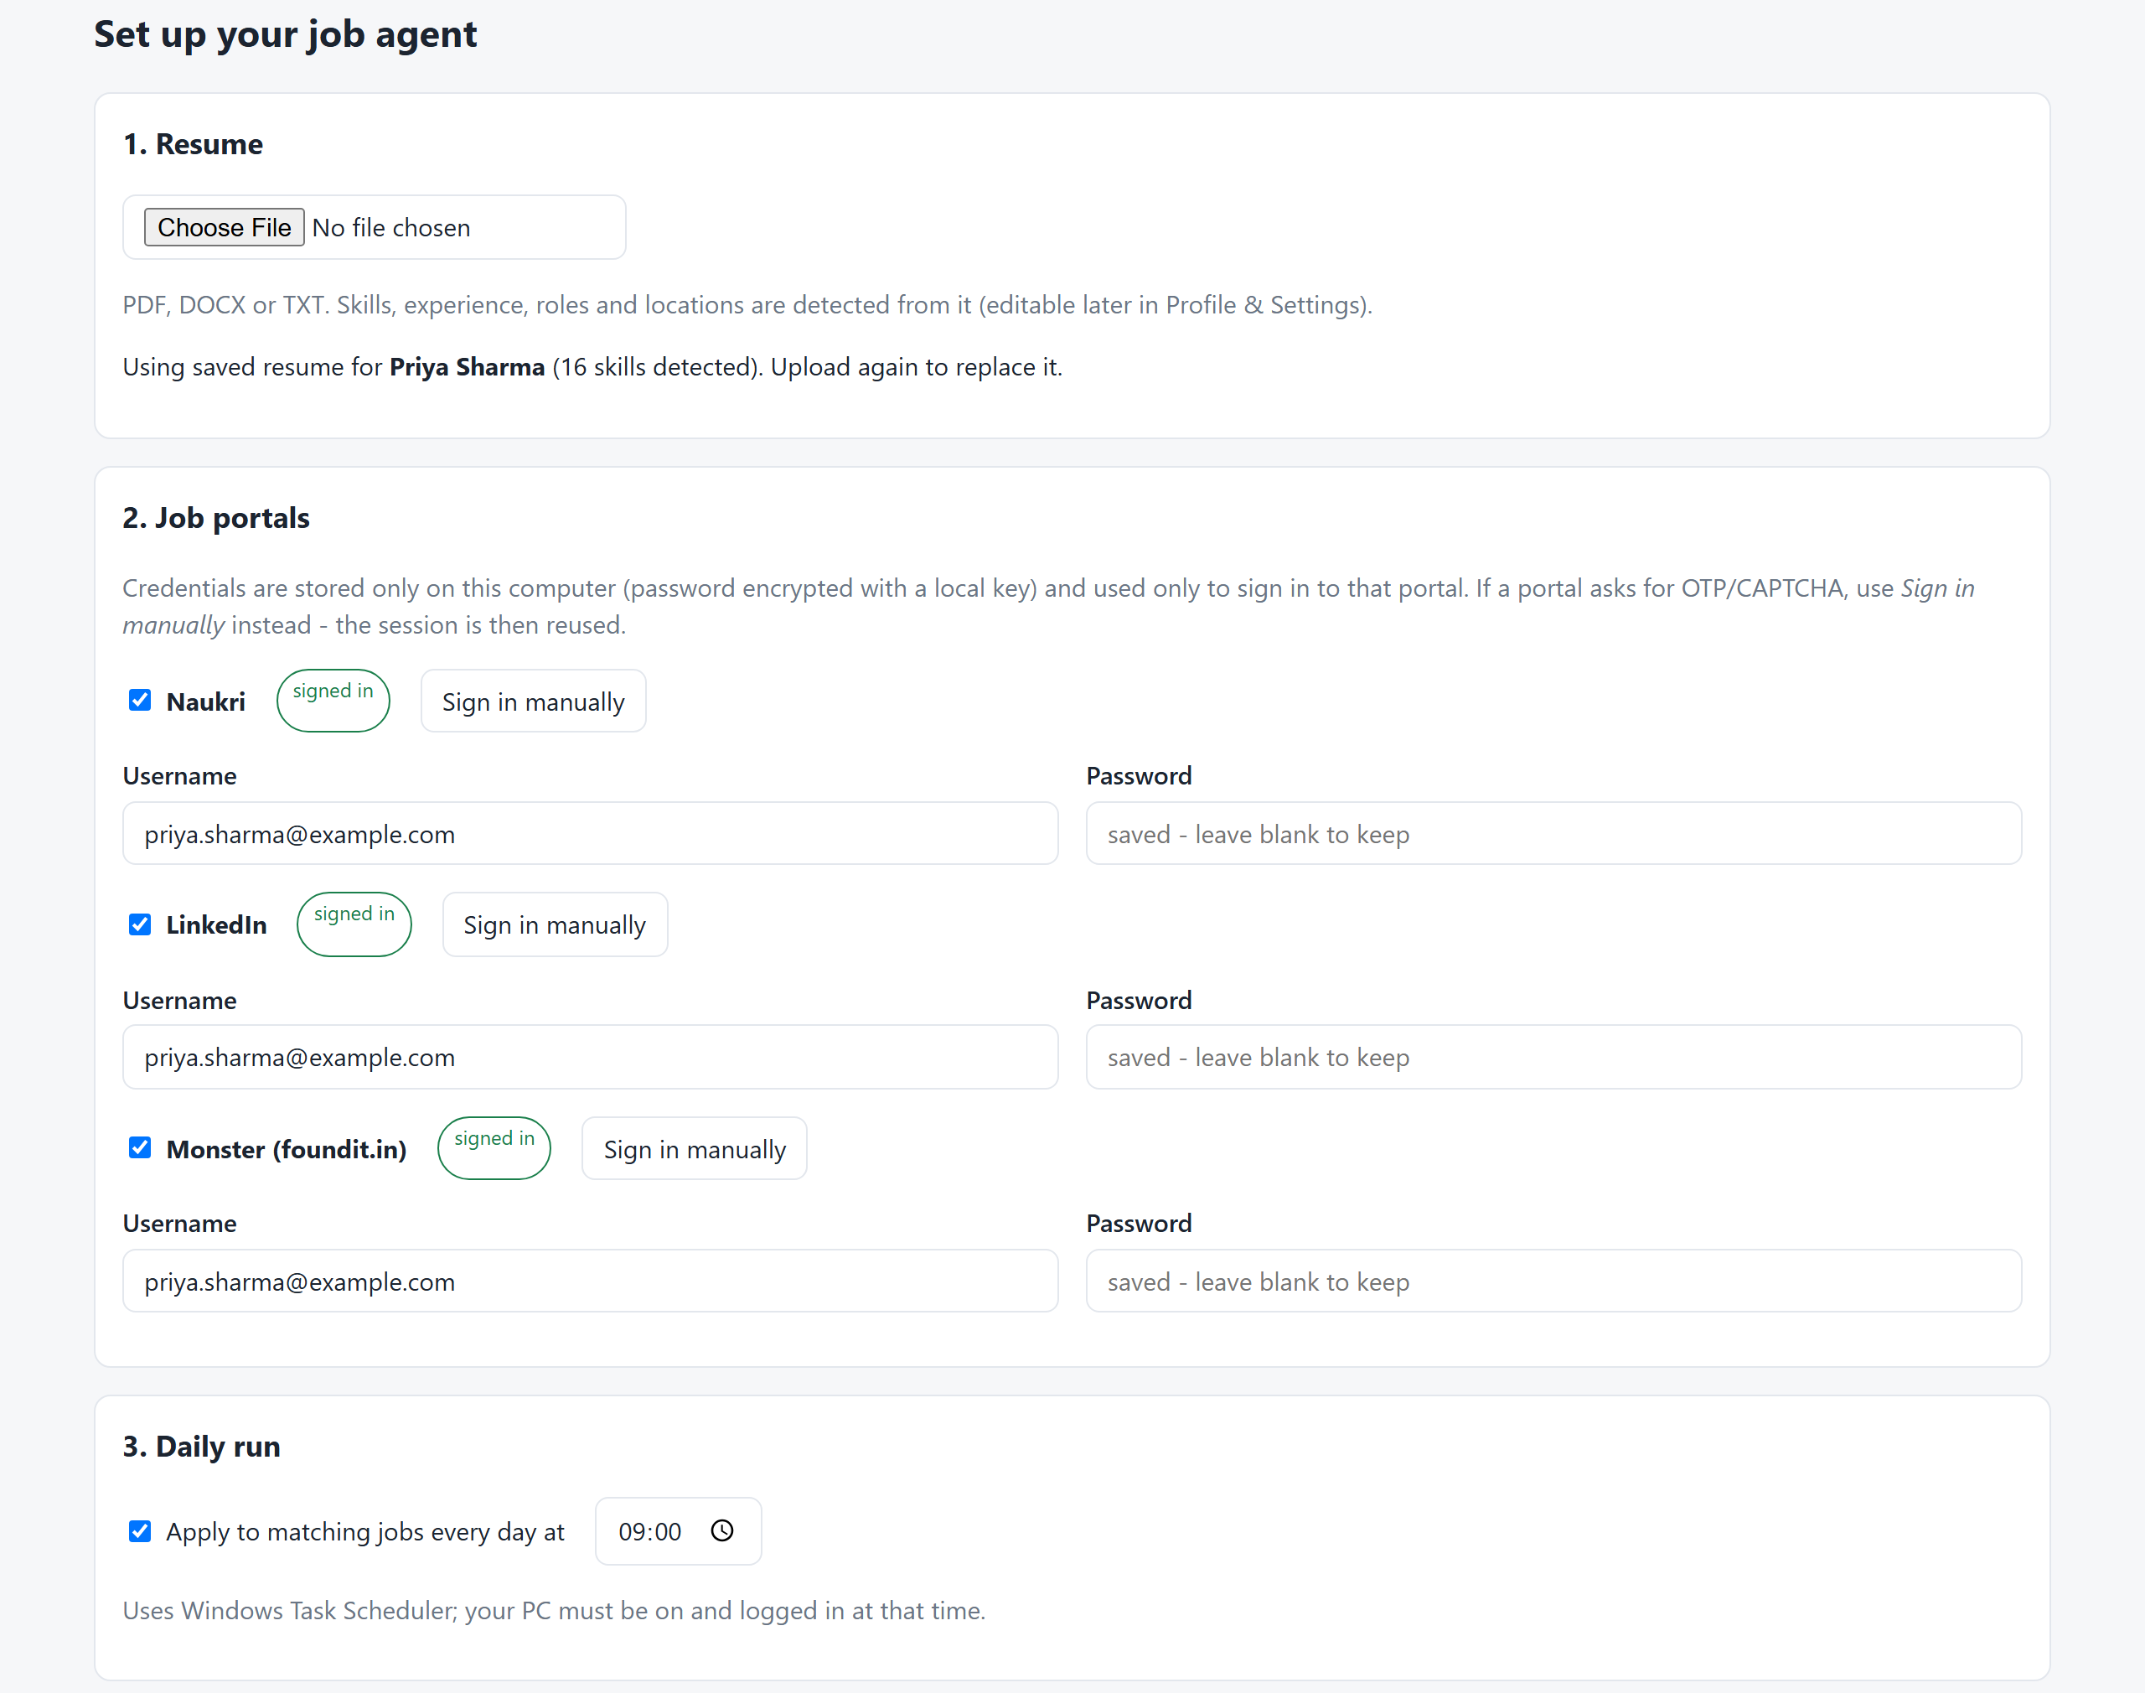


Set up in minutes
Upload your resume
PDF, DOCX or TXT. Profile fills itself in.
Add portal logins
Stored only on your PC, password encrypted.
Pick a daily time
The agent runs by itself at that time.
Notes:
Show the Setup page. Upload a resume and point out the detected skills. Credentials never leave the machine. If a portal asks for OTP or CAPTCHA, use the Sign in manually button once.

Slide 5



Every job gets a match score
70% Skills coverage
Share of the job's skills that you have
20% Job title
How closely it matches your target roles
Match
score
10% Experience fit
Penalty if the job needs far more years
The agent only applies above your minimum match % (you set it).
Notes:
Explain the score in one sentence: mostly skills, plus title and experience. Jobs above the threshold you choose get an application. Everything else is logged as skipped so you can see why.

Slide 6


Applies where it can
And clearly flags everything else for you.
Portal apply
Company website
Needs you
Naukri Apply, LinkedIn Easy Apply and Monster Apply are clicked for you.
The agent opens the employer's form, fills your saved details, attaches your resume and submits.
Extra questions, sign-in walls or CAPTCHA: it stops and tells you why. It never guesses.
Every job ends with one clear status:
Applied
Needs manual apply
Skipped (low match)
Notes:
Be upfront: the agent applies when it can do so safely. On company sites it fills the form only if it can answer every required field from your saved details. Otherwise it stops without submitting and tells you what it needs.

Slide 7
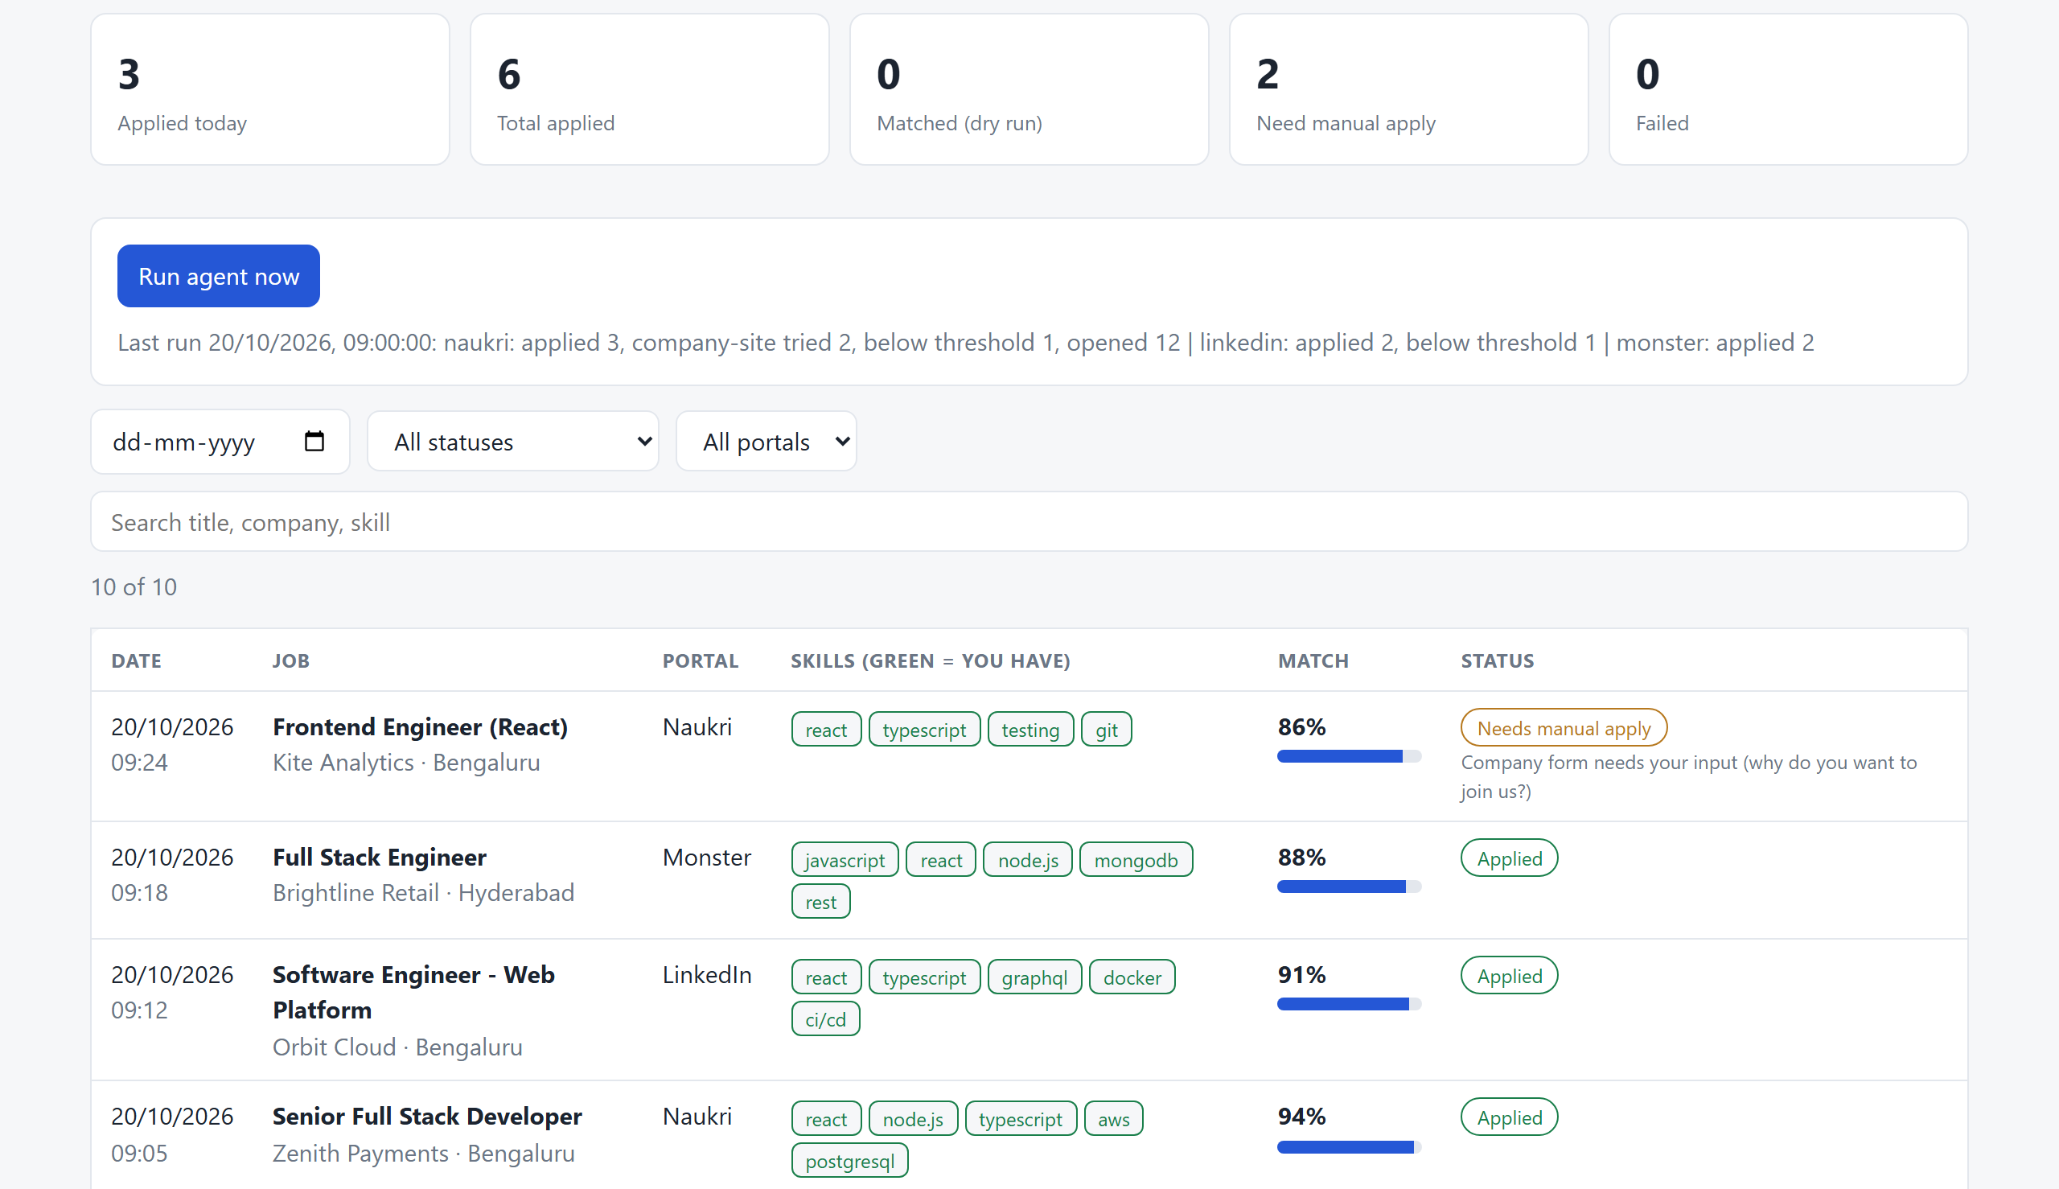
Track every application
Date and status
When and how it ended
Job and skills
Green = a skill you have
Match %
Why it was (not) applied to
Filters
Date, status, portal, search
Notes:
Open the Applications page. Walk left to right: date, job and company, portal, skills (green means you have it), match percent, status. Use the filters to show only today or only Needs manual apply. The summary line shows what the last run did. (Sample data.)

Slide 8
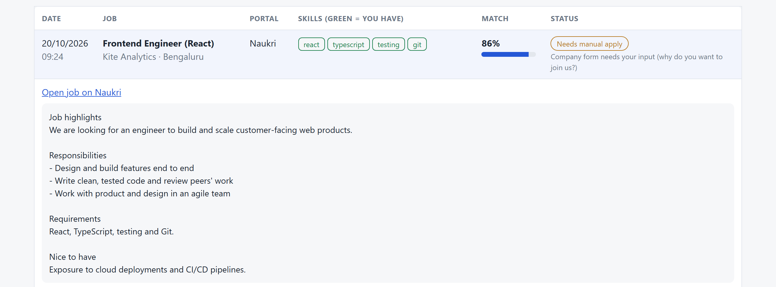


Full job details, saved
Click any row
Full description kept
Link to the original job
Notes:
Click a row to expand it. The full description is stored so you can review why a job was chosen, and the link opens the original posting, which is how you finish any Needs manual apply job.

Slide 9





You stay in control
Dry run first
Your limits
Data stays local
Preview matches before anything is submitted.
Minimum match % and a cap per portal per run.
Resume, logins and history live on your PC.
Stops when unsure
No workarounds
Consent is opt-in
A required question it can't answer is left to you.
It never solves CAPTCHAs or creates accounts.
Privacy boxes are ticked only if you allow it.
Notes:
This is the trust slide. Start in dry run. Set conservative limits. Nothing leaves the machine, and the agent never bypasses CAPTCHA or account creation. When it is unsure it stops and hands the job to you.

Slide 10
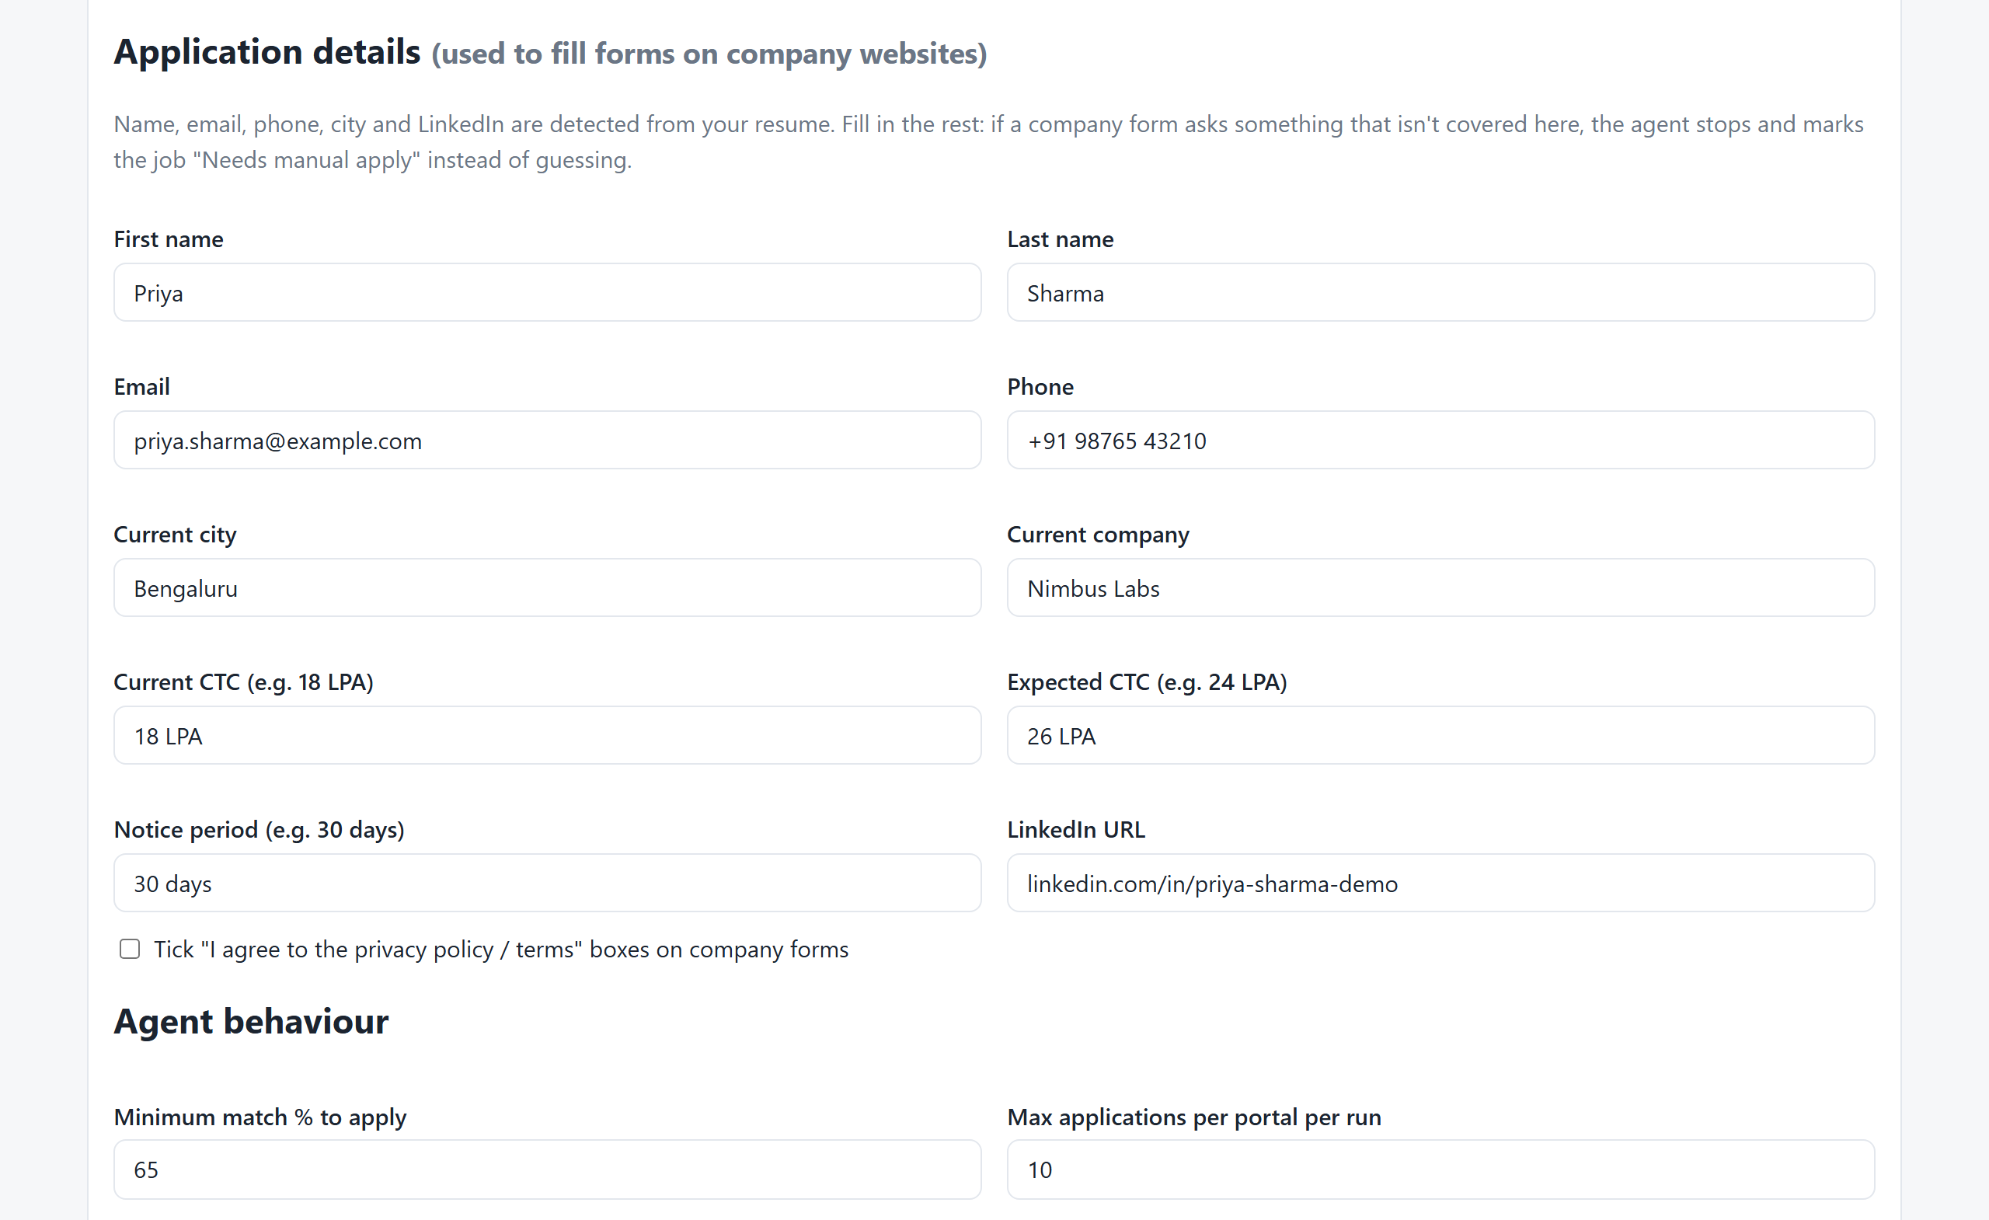



Tune it to your profile
Application details
Used to fill company forms.
Minimum match %
Raise it for fewer, better fits.
Daily cap
Maximum applications per portal.
Notes:
Profile and Settings is where you tune behaviour. Application details are used on company sites: name, contact, notice period and salary expectations. Raise the minimum match to be pickier.

Slide 11




Good to know
Portal terms
Automated applying may breach a portal's terms. Use modest limits.
Sites change
Portal pages change; the agent's page selectors need occasional updates.
Some steps stay manual
OTP, CAPTCHA and account-only career sites are finished by you.
PC must be on
Daily runs happen on your Windows PC at the time you choose.
Notes:
Set honest expectations. This is a productivity tool, not a guarantee of interviews. Portals change, and some steps need a human. We recommend modest daily limits.

Slide 12
Start with a dry run
1
2
3
4
Upload resume
Connect portals
Review the dry run
Switch to live
Questions?
github.com/kothasreekanthreddy25/JobsApplyByAI
Notes:
Close with the recommended rollout: dry run first, review matches, then go live with modest limits. Invite questions.

