Slide 1
ECO-BYTES
Domain Name
Sustainability & Climate action
Team Name
Team Members
K HARSHITH
B BHUMIKA

Slide 2
Software Name
Greenledger I Smart campus sustainability
GreenLedger: Campus Resource Optimisation
A laptop-based prototype for electricity, solar, water and waste insights
ECO-BYTES

Slide 3
The Problem
Greenledger I Smart campus sustainability
Electricity, water and waste records may be stored in different places.
Unusual increases can be missed when readings are reviewed manually.
Teams need a clear alert, an investigation step and a record follow-up.
Greenledger brings the workflow into one dashboard.
ECO-BYTES

Slide 4
Our Solution
Greenledger I Smart campus sustainability
We Upload campus readings from CSV or Enter readings manually.
Compare each zone’s current reading with its baseline average.
Flag unusual increases using an adjustable threshold.
Recommend actions and we can export the readings for review
ECO-BYTES

Slide 5
How our system works
Greenledger I Smart campus sustainability
Collect readings from authorized meters, logs or campus records.
Validate dates, units, zone names and missing values.
Calculate baseline averages and compare later readings.
Create alerts and recommend an investigation.
Record the responses and review results overtime
If we connect it smart integration system it can automatically shutdown if unusual usage is detected.
ECO-BYTES

Slide 6
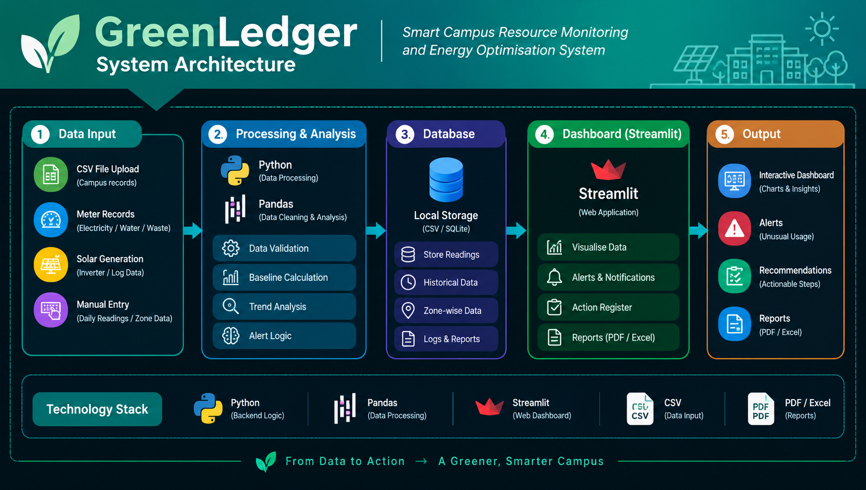
Project Architecture
Greenledger I Smart campus sustainability
ECO-BYTES

Slide 7
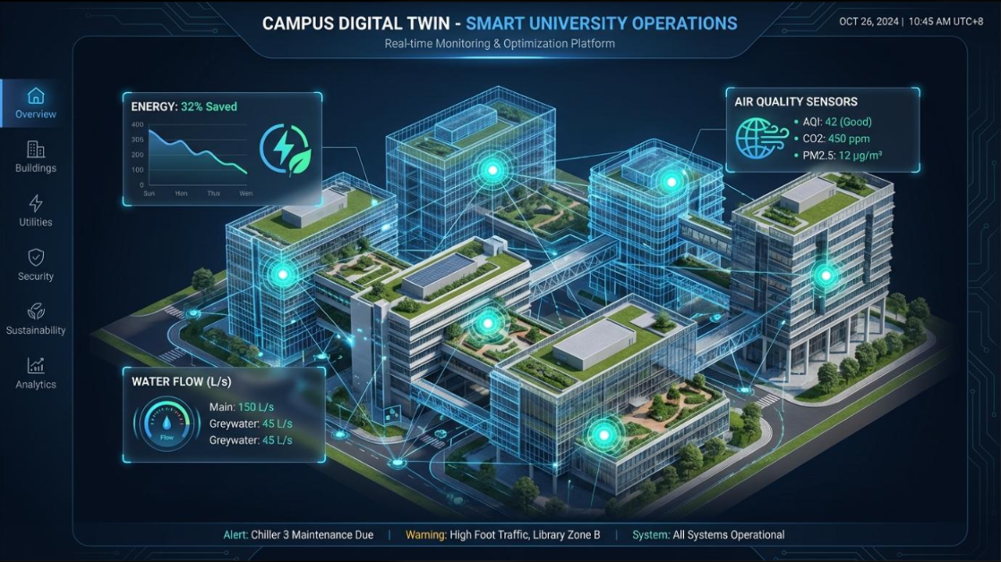
Innovation-What makes greenledger different ?
Greenledger I Smart campus sustainability
One dashboard for electricity, solar generation, water and waste.
Compares current usage against a baseline.
Flags unusual increases automatically.
Suggests actions instead of merely displaying numbers.
Designed to start with uploaded data—no sensors required for the first prototype.
ECO-BYTES

Slide 8
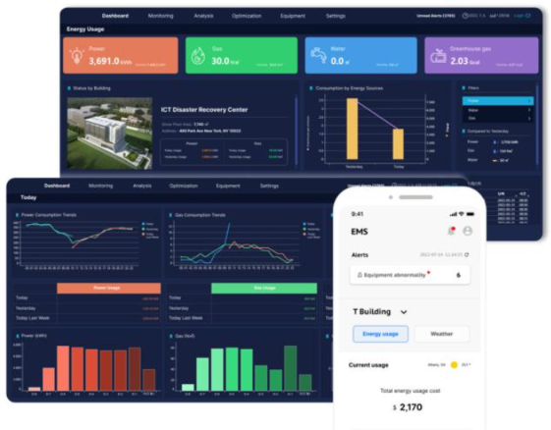

Smart Alert Example
Greenledger I Smart campus sustainability
Reading Electricity
Base line 100 kwh
Current reading 130 kwh
Increase 30%
System result Alert
Formula : $\%\text{ increase}=\frac{\text{Current}−\text{Baseline}}{\text{Baseline}}×100$
If we choose threshold is 25%, the system flags the 30% increase for investigation. The alert identifies an unusual reading; it does not prove the cause.
ECO-BYTES

Slide 9
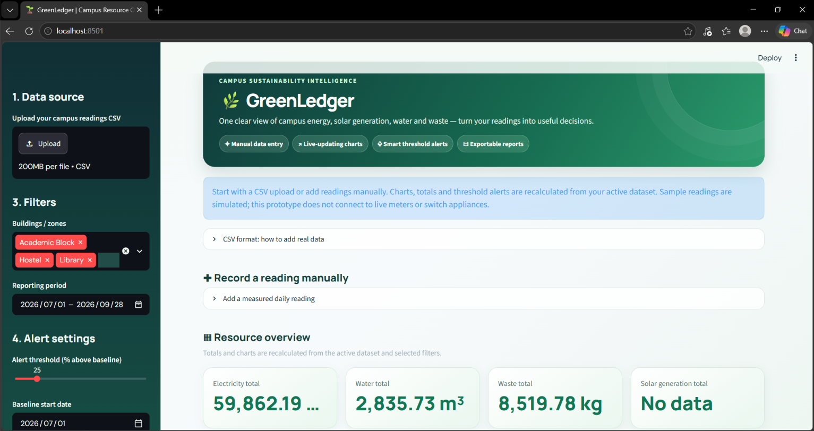
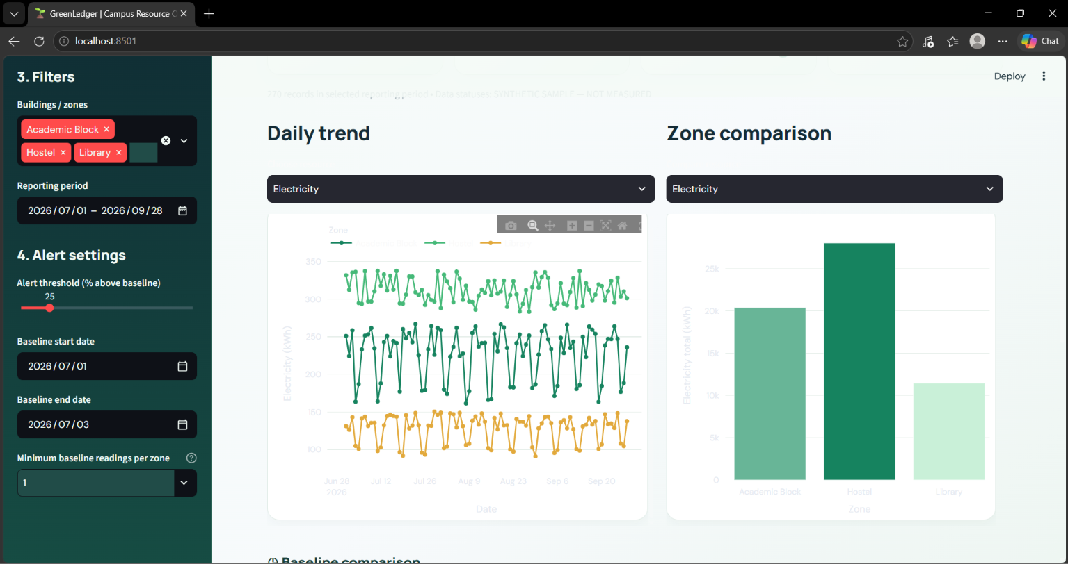
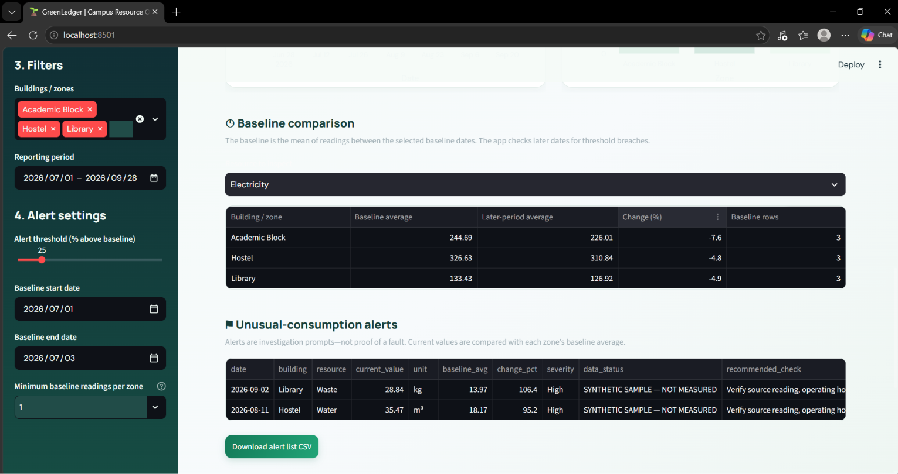
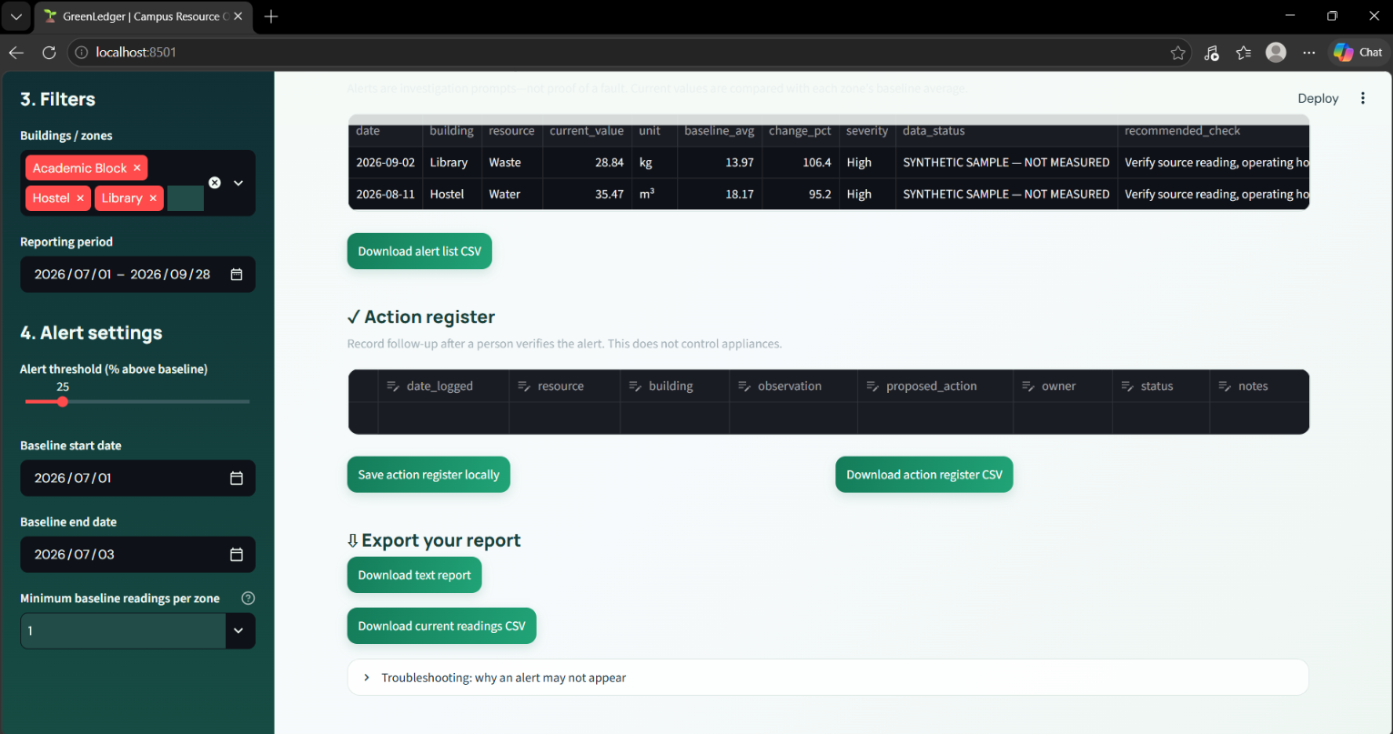
Dashboard preview with live example
Greenledger I Smart campus sustainability
ECO-BYTES

Slide 10

Benefits and Expected Impact
Greenledger I Smart campus sustainability
Helps staff identify unusual resource consumption.
Support data-based solutions.
Encourages responsible electricity, water and waste management.
Can reduce avoidable waste if recommendations acted upon.
Provide for future sustainability planning.
“Designed to help reduce waste, “rather than claiming a specific percentage of savings before testing.
ECO-BYTES

Slide 11
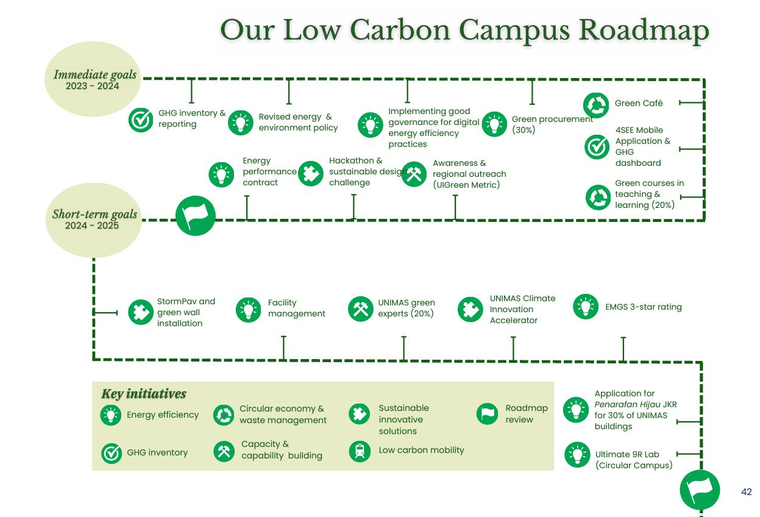
Feasibility, limitations and future scope
Greenledger I Smart campus sustainability
Current prototype
Runs on laptop.
Uses uploaded data and software based analysis.
Requires no purchased sensors for the initial demonstration.
Future Development
Connect to actual electricity and water meter records.
Add automated daily reports and notifications.
Forecast usage trends.
Integrate compatible monitoring devices after approval and safety review.
ECO-BYTES

Slide 12
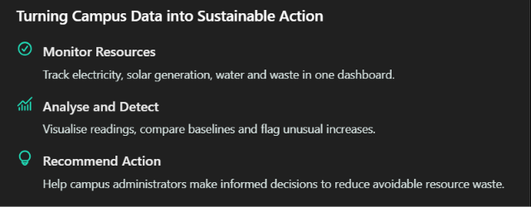
Conclusion
Greenledger I Smart campus sustainability
Turning Campus Data into Sustainable Action
Monitor Resources
Track electricity, Water and waste in one dashboard
ECO-BYTES

Slide 13
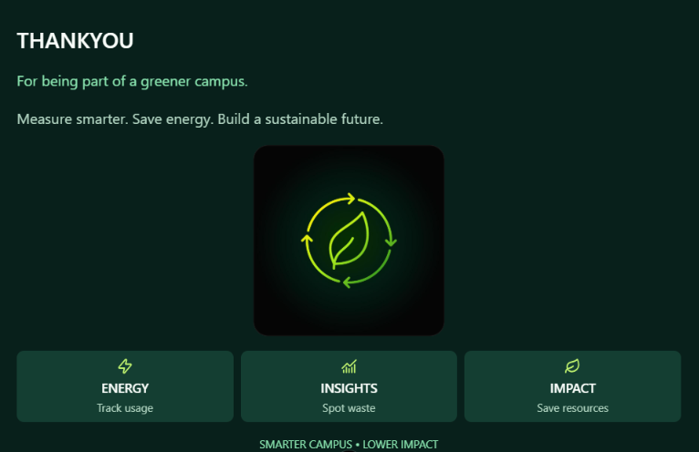
Greenledger
Campus resource intelligence
ECO-BYTES

