Slide 1
SMART INDIA
HACKATHON 2026
SIH
RESONANT
MANAKMITRA
AI-Powered BIS Standards Compliance Assistant
for Indian MSMEs and Manufacturers
YOUR GUIDE TO BUREAU OF INDIAN STANDARDS
28
22
25+
5
IS Standards
Languages
BIS Offices
Certifications

Slide 2
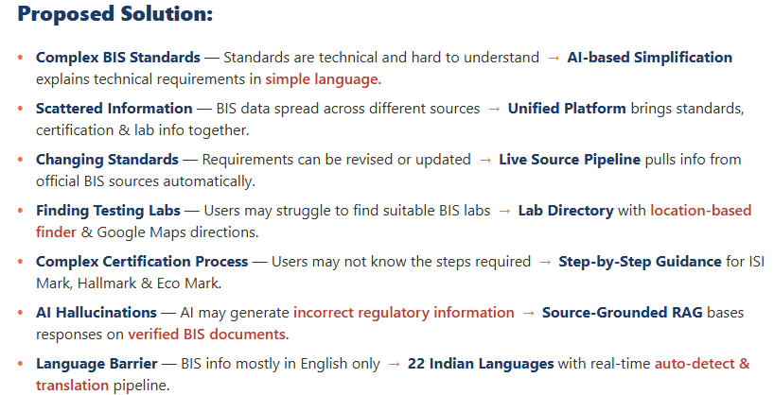
Resonant
MANAKMITRA
SMART INDIA
HACKATHON 2026
SIH
System Architecture:
👤 User Query
🌐 Auto-Detect → Translate (22 Languages)
⚡ RAG Engine (ONNX + FAISS)
🧠 ONNX Embeddings
all-MiniLM-L6-v2
📊 FAISS Vector Store
28 Standards
🤖 Gemini 3.6 Flash (LLM)
How it addresses the problem:
Innovation and Uniqueness:
▸ Live BIS Pipeline — Auto-fetches new standards, knowledge base always current
▸ 22 Indian Languages — Auto-detect → translate → RAG → translate-back
▸ 6-Section Responses — Standards, testing, offices, legal, QC, documents
▸ Unified Ecosystem — Standards + certification + labs + AI in one platfrm
📚 BIS Standards 28 IS Codes
📍 25+ BIS Office Geolocation
🔄 Auto-Fetch
Live BIS Pipeline
SIMPLIFY
COMPLEX
STANDARDS
UNIFIED
COMPLIANCE
PLATFORM
MULTILINGUAL
AI (22 Lang)
✅ 6-Section Structured ResponseResponse
MANAK
MITRA
💬 Chat | 📚 Standards Library | 🏢 Testing Centres | 📋 Certifications
2

Slide 3
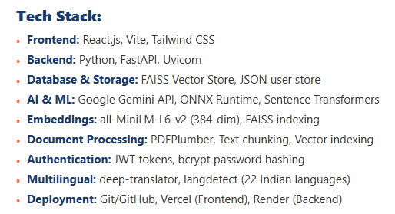
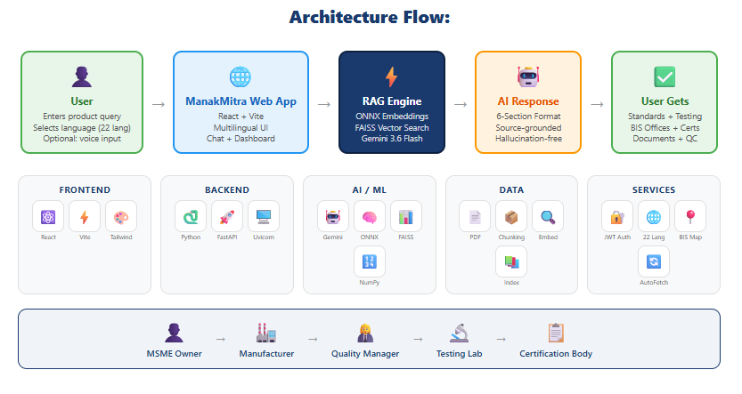
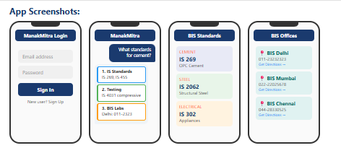
Resonant
MANAKMITRA
SMART INDIA
HACKATHON 2026
SIH
> Live Prototype: https://sih2026-bis-assistant-ebon.vercel.app/
Key Differentiators
3

Slide 4
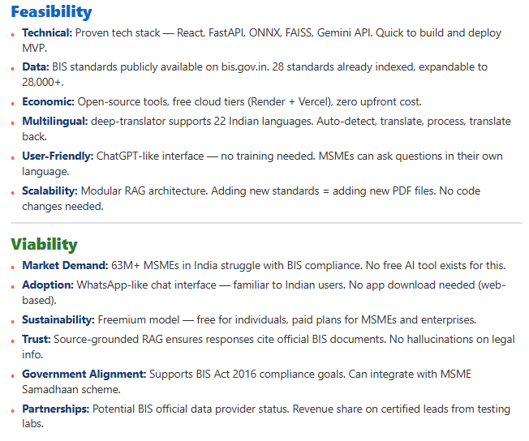
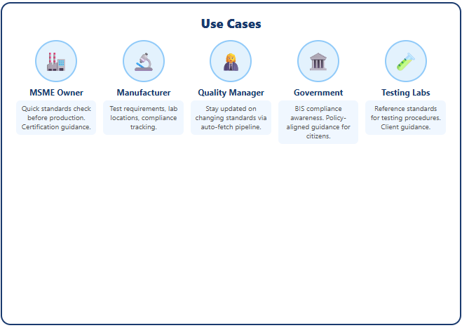
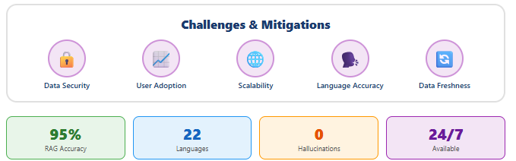
Resonant
MANAKMITRA
SMART INDIA
HACKATHON 2026
SIH
📚 BIS Standards Library — 28 Standards Indexed
4

Slide 5
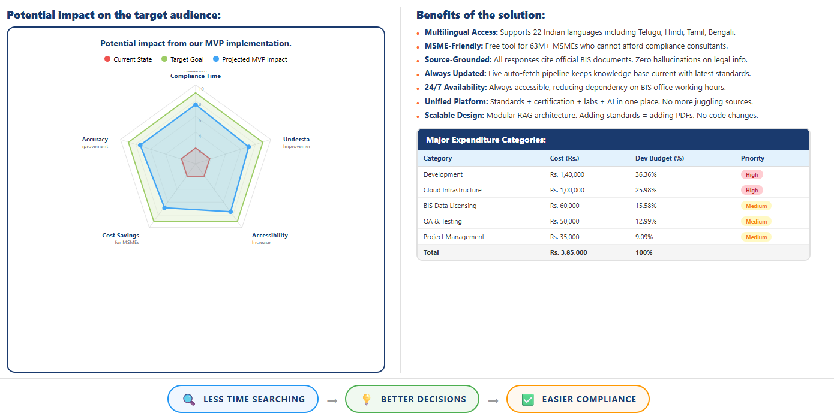
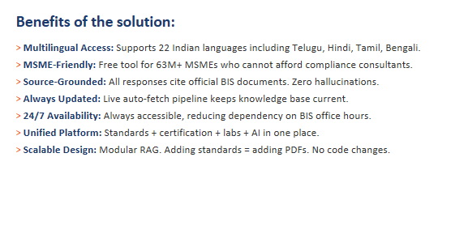
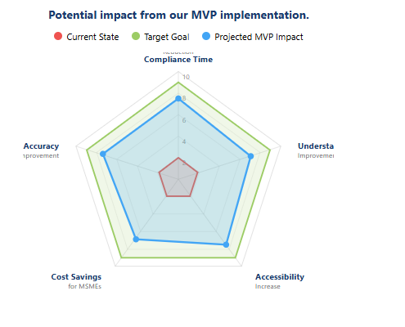
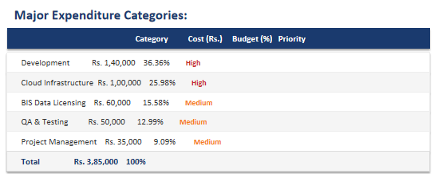
Resonant
MANAKMITRA
SMART INDIA
HACKATHON 2026
SIH

Slide 6
SMART INDIA
HACKATHON 2026
SIH
THANK YOU
ManakMitra — Making BIS Standards Accessible
to Every Indian Manufacturer
👨‍💻
Pavan Kumar
Team Lead / Full Stack Developer
Try live at manakmitra-frontend.vercel.app
@SIH Idea submission — Team Resonant

