Slide 1
SMART INDIA
HACKATHON 2026
SIH
RESONANT
MANAKMITRA
AI-Powered BIS Standards Compliance Assistant
for Indian MSMEs and Manufacturers
YOUR GUIDE TO BUREAU OF INDIAN STANDARDS
28
22
25+
5
IS Standards
Languages
BIS Offices
Certifications

Slide 2
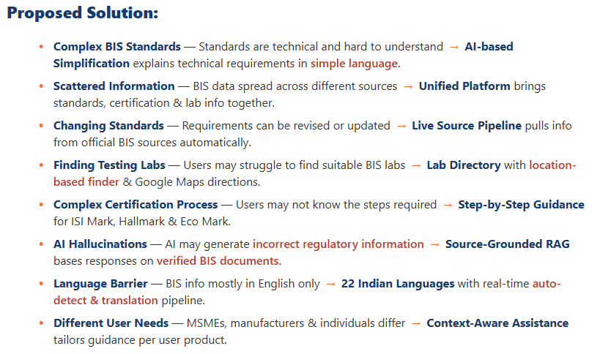
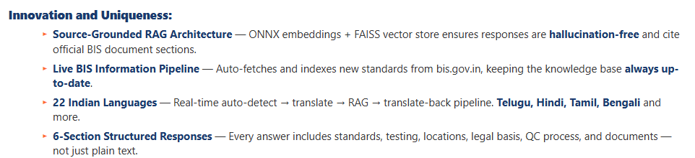
Resonant
MANAKMITRA
SMART INDIA
HACKATHON 2026
SIH
System Architecture:
User Query
Auto-Detect, Translate (22 Lang)
RAG Engine (ONNX + FAISS)
ONNX Embeddings
all-MiniLM-L6-v2
FAISS Vector Store
28 Standards
Gemini 3.6 Flash (LLM)
BIS Standards (28)
25+ BIS Offices
Certifications
6-Section Structured Response
Chat | Standards | Offices | Certs
How it addresses the problem:
SIMPLIFY
COMPLEX
STANDARDS
UNIFIED
COMPLIANCE
PLATFORM
MULTILINGUAL
AI (22 Lang)
MANAK
MITRA
2

Slide 3
Resonant
MANAKMITRA
SMART INDIA
HACKATHON 2026
SIH
TECHNICAL APPROACH
Tech Stack:
Architecture Flow:
> Frontend: React.js, Vite, Tailwind CSS
> Backend: Python, FastAPI, Uvicorn
> Database & Storage: FAISS Vector Store, JSON user store
> AI & ML: Google Gemini API, ONNX Runtime, Sentence Transformers
> Embeddings: all-MiniLM-L6-v2 (384-dim), FAISS indexing
> Document Processing: PDFPlumber, Text chunking, Vector indexing
> Authentication: JWT tokens, bcrypt password hashing
> Multilingual: deep-translator, langdetect (22 Indian languages)
> Deployment: Git/GitHub, Vercel (Frontend), Render (Backend)
User
Enters product query
Selects language
Voice input (opt)
ManakMitra App
React + Vite
Multilingual UI
Chat + Dashboard
RAG Engine
ONNX + FAISS
Vector search
Context retrieval
BIS Retrieval
Fetch standards from
bis.gov.in
Auto-fetch pipeline
Gemini LLM
Generate 6-section
structured response
Source-grounded
Response
Standards + Testing
Offices + Certs
Documents + QC
Standards
Library
BIS Office
Finder
Certification
Guide
Analytics
Dashboard
Tech Used:
Live prototype: manakmitra-frontend.vercel.app
App Screenshots:
Key Features:
Frontend
React
Vite
Tailwind
Backend
Python
FastAPI
Uvicorn
AI/ML
Gemini
ONNX
FAISS
NumPy
Data
PDF
Chunk
Embed
Index
Services
JWT
22Lang
Maps
Fetch
> 22 Indian Languages
> 6-Section AI Response
> Hallucination-Free RAG
> Live Auto-Fetch
> BIS Office Finder
> Certification Guide
> Multi-User Auth (JWT)
> Dark/Light Mode
BIS Offices
BIS Offices Dark
Auto-Fetch
Auto-Fetch Dark
@SIH Idea submission
3

Slide 4
Resonant
MANAKMITRA
SMART INDIA
HACKATHON 2026
SIH
Live Demo - Key Features
App Screenshots:
Multilingual AI Chat
Ask in Hindi, Telugu, Tamil, Bengali or 18 other Indian languages
ManakMitra
What standards for cement?
6-Section Response
Standards, testing, offices, legal basis, QC, documents - every time
1. IS Standards: IS 269, IS 455, IS 8112
Live Auto-Fetch
Scrapes bis.gov.in for new standards and indexes automatically
2. Testing: Compressive strength per IS 4031
3. Where to Test: BIS Lab Delhi 011-2323
BIS Office Finder
GPS-based nearest centre with directions and phone numbers
4. Mandatory: Yes, under BIS Act 2016
Certification Guide
Step-by-step for ISI Mark, Hallmark, Eco Mark, CMVR, MSME Udyam
BIS Standards Library - 28 Standards
CEMENT
IS 269
OPC
STEEL
IS 2062
Structural
ELECTRICAL
IS 302
Appliances
FOOD
IS 14543
Water
ELECTRICAL
IS 15556
LED
LEATHER
IS 3289
Finished
@SIH Idea submission
4

Slide 5
Resonant
MANAKMITRA
SMART INDIA
HACKATHON 2026
SIH
FEASIBILITY AND VIABILITY
Feasibility
Use Cases
> Technical: Proven tech stack - React, FastAPI, ONNX, FAISS, Gemini API. Quick to build and deploy MVP.
> Data: BIS standards publicly available on bis.gov.in. 28 standards indexed, expandable to 28,000+.
> Economic: Open-source tools, free cloud tiers (Render + Vercel), zero upfront cost.
> Multilingual: deep-translator supports 22 Indian languages. Auto-detect, translate, process, translate back.
> User-Friendly: ChatGPT-like interface - no training needed. MSMEs can ask in their own language.
> Scalability: Modular RAG architecture. Adding new standards = adding new PDF files. No code changes.
🏭
🔬
👩‍💼
🏛️
🧪
MSME Owner
Manufacturer
Quality Manager
Government
Testing Labs
Quick standards check
Certification guidance
Test requirements
Lab locations
Standards updates
Compliance tracking
BIS compliance awareness
Policy-aligned guidance
Reference standards
Client guidance
Challenges & Mitigations
Viability
🔒
📈
🌐
🗣️
🔄
> Live Prototype: https://sih2026-bis-assistant-ebon.vercel.app/
Data Security
User Adoption
Scalability
Language Accuracy
Data Freshness
JWT auth + bcrypt
No PII stored server-side
WhatsApp-like UI
No training needed
Modular RAG design
Add standards = add PDFs
Auto-detect + translate
22 Indian languages
Live auto-fetch pipeline
Scrapes bis.gov.in
@SIH Idea submission
5

Slide 6
Resonant
MANAKMITRA
SMART INDIA
HACKATHON 2026
SIH
Impact & Target Users
Development Roadmap
63M+
MSMEs in India
28K+
BIS Standards
2.5L Cr
Compliance Market
DONE
MVP - 28 standards, 22 languages, RAG, auth
NOW
Scale - All 28,000+ standards, PDF viewer, WhatsApp bot
Who Benefits?
MSMEs & Manufacturers
Quick standards + cert answers
Construction Companies
Steel, cement compliance
FUTURE
Production - PostgreSQL, mobile app, voice, BIS integration
Testing Labs
Reference standards
Quality Managers
Stay updated via auto-fetch
Business Model
> Free Tier: 10 queries/day for individuals
> MSME (Rs.499/mo): Unlimited + compliance calendar
> Enterprise (Rs.4,999/mo): API + bulk check + support
> BIS Partnership: Official data provider
> Govt Grant: MSME Samadhaan scheme
@SIH Idea submission
5

Slide 7
SMART INDIA
HACKATHON 2026
SIH
THANK YOU
ManakMitra - Making BIS Standards Accessible
to Every Indian Manufacturer
Pavan Kumar
Team Lead / Full Stack Developer
Try live at manakmitra-frontend.vercel.app
@SIH Idea submission - Team Resonant

