Slide 1
DJango

Slide 2
Objectives
What is Django
History
Django implementations
Features
Installation Steps
Django Architecture
MVC
MVT

Slide 3
What is DJango
Django is the framework for python.
Django used for developing web application with python script.
Using Django we can build web application in less time.
Django supports for focusing on application development.

Slide 4
History of Django
Django developed by Lawrence journal word in 2005 and released in July-2005.
Django Software foundation maintains DARL.

Slide 5
Django used in
Django is widely accepted and used by various well-known sites such as:
Instagram
Mozilla
Disqus
Pinterest
Bitbucket
The Washington Times

Slide 6
Features
Django was designed with the intention to make a framework which takes less time to build web application.
Rapid Development
Secure
Scalable
Fully loaded
Versatile
Open Source
Vast and Supported Community
Its user authentication system provides a secure way to manage user accounts and passwords.
Django is scalable in nature and has ability to quickly and flexibly switch from small to large scale application project.
Django includes various helping task modules and libraries which can be used to handle common Web development tasks.
content management systems, social networks sites or scientific computing platforms etc.
Open source web application framework. It is publicly available without cost.
It has widely supportive community and channels to share and connect.

Slide 7
How do I install Django
visit to django site https://www.djangoproject.com than download
Pip is a package manager system which is used to install and manage packages written in python.
pip3 install django==2.0.3
Django is efficient from 2.x version onwards with python 3.x version

Slide 8
Django Architecture
Django follows a Model-View-Controller(MVC) architecture.
M-V-C is split up into three different parts.
With MVC, your application will revolve around the model—either displaying it or manipulating it.
View
Model
Controller

Slide 9
Model
The Model is the logical data structure behind the entire application and is represented by a database.

Slide 10
View
what you see in your browser when you visit a website.
These are represented by
HTML
CSS
Javascript files.

Slide 11
Controller
Controller connects the view and model together, meaning that it is the one passing data from the model to the view.
There is no separate controller and complete application is based on Model View and Template.

Slide 12
Django MVT
The MVT (Model View Template) is one of the software design pattern.
Template is a presentation layer which handles User Interface part completely.
The View is used to execute the business logic and interact with a model to carry data and renders a template.
Although Django follows MVC pattern but maintains it’s own conventions.
So, control is handled by the framework itself.

Slide 13
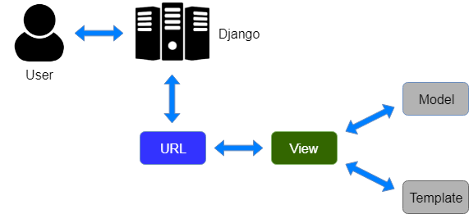
Django Architecture
user requests for a resource to the Django, Django works as a controller and check to the available resource in URL.
Django responds back to the user and sends a template as a response.
If URL maps, a view is called that interact with model and template, it renders a template.

Slide 14
Summary
We understood what is Django
What type of applications developed
Rapid application development
How securitiy implementations are made in Django
Architecture of Django using MVC and MVT

