Slide 1
Django Project

Slide 2
Objective
Steps to create Project
Folder Hierarchy
Under stand M-V-C, M-V-T
URL configuration File
Django project files
Execution of Project
Creating Admin Page

Slide 3
Steps to create project
create a Django project, we can use the following command.
Syntax: django-admin startproject projectname
Locate into project
cd djangpapp
To View files in your folder
Use dir command from window
Use ls command from Linux

Slide 4
Create Application
You create myapp application and like project:
python manage.py startapp myapp

Slide 5
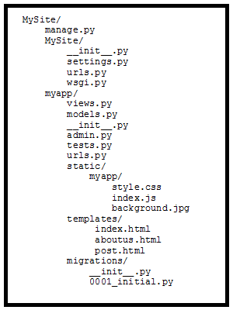
Folder Hierarchy of Django

Slide 6
What is Model
myapp/models.py is the Model, or where you define your database.
Take a blogging website for example.
At its very minimum, you would have a table of blog posts and a table of comments.
Each blog post has a title, author, date, and its contents, while comments have the same thing too.

Slide 7
Where is Controller
myapp/views.py is the Controller.
Inside views.py you will define different functions/classes( Django offers support for both but most people still use functions)
A function defines what happens when a certain URL is accessed and an HTTP request is made the server.

Slide 8
template
Files under myapp/templates/myapp/ are templates, HTML files that defines the View.
Within each template, you can get static files like CSS, Javascript files, or images to give the webpage life.

Slide 9
url configuration
urls.py is the URL configuration file.
This is the file that allows you to map a certain URL to a certain function in views.py.
Let’s say you have a server receiving requests from the domain mydomain.com.
If you go to mydomain.com/about-us, a certain function such as aboutus() will generate a response.
Django will also allow you include important information in the URL.

Slide 10
Django project Files
manage.py:
It is a command-line utility which allows us to interact with the project in various ways and also used to manage an application that we will see later on in this tutorial.
A directory (djangpapp) :
located inside, is the actual application package name. Its name is the Python package name which we'll need to use to import module inside the application.
__init__.py:
It is an empty file that tells to the Python that this directory should be considered as a Python package.
settings.py:
This file is used to configure application settings such as database connection, static files linking etc.
urls.py:
This file contains the listed URLs of the application. In this file, we can mention the URLs and corresponding actions to perform the task and display the view.
wsgi.py:
It is an entry-point for WSGI-compatible web servers to serve Django project.

Slide 11
Execute Django Project
To run the application, we can use the following command:
python3 manage.py runserver

Slide 12
Create Admin Interface
Before launching your server, to access your Admin Interface, you need to initiate the database:
python manage.py migrate
If you already have a superuser or have forgotten it, you can always create one using the following code:
python manage.py createsuperuser
It will prompt for username
Email
password

Slide 13
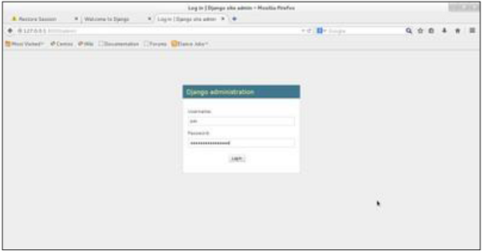
Admin Page view
Execute as http://localhost:8000/admin

Slide 14
Summary
We could able to follow the steps to create project
We could able find the M-V-C and M-V-T
Executed project
Generated Admin module for Login

