Slide 1
DJango
Database Connectivity

Slide 2
Objectives

Slide 3
Editing settings.py
The settings.py file contains all the project settings along with database connection details.
By default, Django works with SQLite database and allows configuring for other databases as well.

Slide 4
Connecting with MySQL
To connect with MySQL database we need call engine resource django.db.backends.mysql
Add the following int settings.py
DATABASES = {
'default': {
'ENGINE': 'django.db.backends.mysql',
'NAME': 'djangoApp',
'USER':'root',
'PASSWORD':'mysql',
'HOST':'localhost',
'PORT':'3306'
}
}

Slide 5
Migrate settings
After providing details, check the connection using the migrate command.
python manage.py migrate

Slide 6
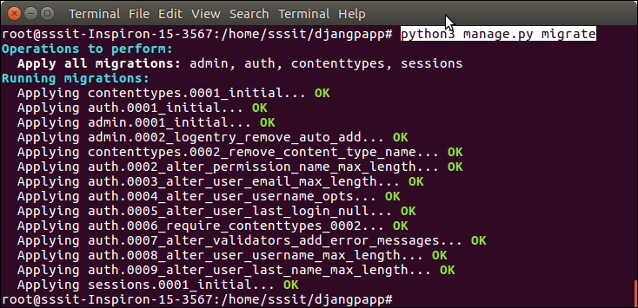
During migration

Slide 7
Migrating Model
From model.py
from django.db import models
class Employee(models.Model):
eid = models.CharField(max_length=20)
ename = models.CharField(max_length=100)
econtact = models.CharField(max_length=15)
class Meta:
db_table = "employee"

Slide 8
Migrating model
python manage.py makemigrations

Slide 9
Migration Model
Open your migration folder you will find 0000_initial.py file
Open and find the steps of it
Again apply the following command
python manage.py migrate

Slide 10
Installated_apps
If you find challenge in makemigration
Update settings.py file with your table name as follows:
INSTALLED_APPS = [
'django.contrib.admin',
'django.contrib.auth',
'django.contrib.contenttypes',
'django.contrib.sessions',
'django.contrib.messages',
'django.contrib.staticfiles',
'employee'
]

Slide 11
Database Migration

