Slide 1
Database connectivity

Slide 2
Objectives
In this session we are learning about:
Types of databases supported in python
We focus on Mysql and learn download plug-ins
Install MySQLdb plug-in for python
Add plug-in to Netbeans
Loading database through our code
ACID properties
Read operations of python

Slide 3
Python with DB
DB-API is the standard for the python to connect database.
Most Python database interfaces adhere to this standard.
Python supports databases like:
GadFly
mSQL
MySQL
PostgreSQL
Microsoft SQL Server 2000
Informix
Interbase
Oracle
Sybase

Slide 4
Standards of DB
DB Api provides minimal standards to connect with database.
Stadards are as follows
Importing the API module.
Acquiring a connection with the database.
Issuing SQL statements and stored procedures.
Closing the connection

Slide 5
How do I Install MySQLdb?
Download MySQLdb plugins from the following link: http://www.codegood.com/archives/129

Slide 6
How do I Install MySQLdb?
connection 1:
pip install mysql-connector-python
connection2:
pip install mysqlclient
or use
pip install MySQL-python

Slide 7
Install oracle plug-in
python -m pip install cx_Oracle --upgrade

Slide 8
Python oracle Configuration
import cx_Oracle
db=cx_Oracle.connect("hr","hr","localhost:1521/xe")
cursor=db.cursor()

Slide 9
How to Attach MySQLdb to NETBEAN
Right click on your python project → properties
Select python from categories → click Add button
Select “c:\python2.7\Lib\site-packages\MySQLdb” folder and click open→ok

Slide 10
Loading database from your code
import MySQLdb
con = MySQLdb.Connect(host="127.0.0.1", port=3306, user="root", passwd="root", db="mydb")
# prepare a cursor object using cursor() method
cursor = con.cursor()
#execute SQL query using execute() method.
cursor.execute("SELECT VERSION()")
#Fetch a single row using fetchone() method.
data = cursor.fetchone()
print "Database version : %s " % data
#disconnect from server
con.close()

Slide 11
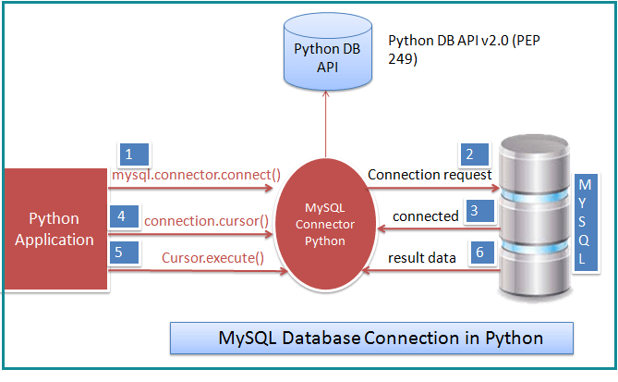
Execution flow

Slide 12
Connection arguments
= MySQLdb.Connect(host="127.0.0.1", port=3306, user="root", passwd="root", db="mydb")
Username – The default username for the MySQL database is root
Password –If you are using root then you won’t need the password.
Host Name –if you are running on localhost, then you can use localhost, or it’s IP, i.e. 127.0.0.1
Database Name – Database name to which you want to connect here we are using Database named ‘mydb’ because we have already created this for our example.

Slide 13
How to insert record
cursor = connection.cursor(prepared=True)
sql_insert_query = """ INSERT INTO `python_users` (`id`, `name`, `birth_date`, `age`) VALUES (%s,%s,%s,%s)"""
insert_tuple = (userId, userName, joinDate, age)
result = cursor.execute(sql_insert_query, insert_tuple)
connection.commit()

Slide 14
Multiple rows to insert
records_to_insert = [ (2,'Jon','2018-01-11', 26) ,
(3,'Jane','2017-12-11', 27),
(4,'Bill','2018-03-23', 26) ]
sql_insert_query = """ INSERT INTO python_users (id, name, birth_date, age) VALUES (%s,%s,%s,%s) """
cursor = connection.cursor(prepared=True)
#used executemany to insert 3 rows
result = cursor.executemany(sql_insert_query, records_to_insert)
connection.commit()

Slide 15
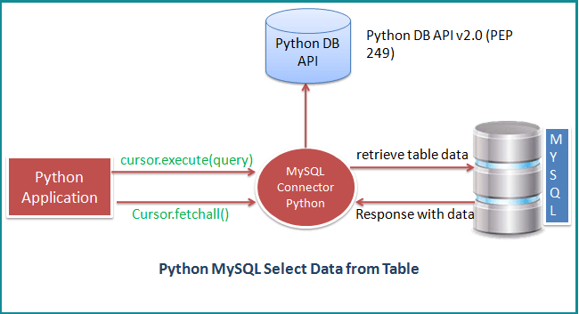
View Data from table

Slide 16
Select records
sql_select_Query = "select * from myTable"
cursor = mySQLconnection .cursor()
cursor.execute(sql_select_Query)
records = cursor.fetchall()
print("Total number of rows - ", cursor.rowcount)
print ("Printing each row's column values i.e. developer record")
for row in records:
print("Id = ", row[0], )
print("Name = ", row[1])
print("JoiningDate = ", row[2])
print("Salary = ", row[3], "\n")
cursor.close()

Slide 17
Query by condition
cursor = mySQLConnection.cursor(prepared=True)
sql_select_query = """select * from myTable where id = %s"""
cursor.execute(sql_select_query, (ID, ))
record = cursor.fetchall()
for row in record:
print("Id = ", row[0], )
print("Name = ", row[1])
print("Join Date = ", row[2])
print("Salary = ", row[3], "\n")

Slide 18
Configure fetch size
rows = cursor.fetchmany(size=1)
Example
sql_select_Query = "select * from myTable"
cursor = connection.cursor(buffered=True)
#need to set buffered=True to avoid MySQL Unread result error
cursor.execute(sql_select_Query)
fetching_size = 2
records = cursor.fetchmany(fetching_size)

Slide 19
Read operations
fetchone() − It fetches the next row of a query result set. A result set is an object that is returned when a cursor object is used to query a table.
fetchall() − It fetches all the rows in a result set. If some rows have already been extracted from the result set, then it retrieves the remaining rows from the result set.
rowcount − This is a read-only attribute and returns the number of rows that were affected by an execute() method.

Slide 20
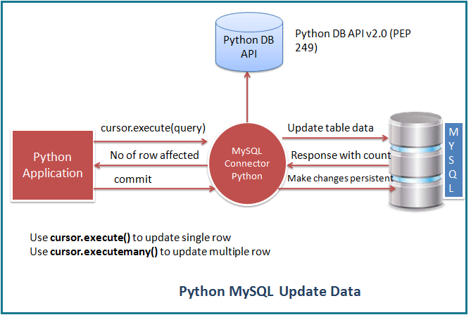
Updatable records

Slide 21
Update
#Update single record now
sql_update_query = """Update computers set ram = 10 where id = 1"""
cursor.execute(sql_update_query)
connection.commit()
print ("Record Updated successfully ")

Slide 22
Multiple row update
cursor = connection.cursor(prepared=True)
#Update query rows
sql_update_query = """Update computers set ram = %s where id = %s"""
# multiple records to be updated in tuple format
records_to_update = [ (30, 1), (15, 2) ]
cursor.executemany(
sql_update_query, records_to_update )
connection.commit()

Slide 23
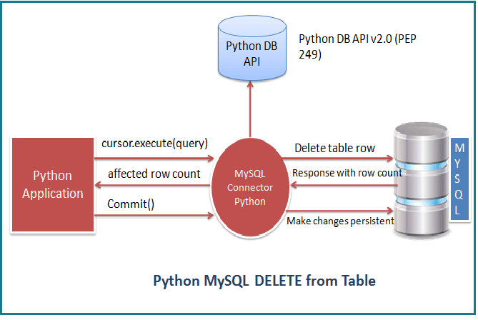
Delete record

Slide 24
Delete Record
# Delete record now
sql_Delete_query = """Delete from mobile where id = %s"""
mobile_id = 3
cursor.execute(sql_Delete_query,(mobile_id,))
print("\n Record Deleted successfully ")

Slide 25
Delete multiple rows
sql_Delete_query = """Delete from mobile where id = %s"""
records_to_be_deleted = [(1,),(2,)]
cursor.executemany(sql_Delete_query , records_to_be_deleted)
conn.commit()

Slide 26
ACID properties
Atomicity − Either a transaction completes or nothing happens at all.
Consistency − A transaction must start in a consistent state and leave the system in a consistent state.
Isolation − Intermediate results of a transaction are not visible outside the current transaction.
Durability − Once a transaction was committed, the effects are persistent, even after a system failure.

Slide 27
Database Errors
Error Type | Description
Warning | Used for non-fatal issues. Must subclass StandardError
Error | Base class for errors. Must subclass StandardError.
InterfaceError | Used for errors in the database module, not the database itself. Must subclass Error.
DatabaseError | Used for errors in the database. Must subclass Error.
DataError | Subclass of DatabaseError that refers to errors in the data.
OperationalError | These errors are generally outside of the control of the Python scripter.
IntegrityError | uniqueness constraints or foreign keys violation.
InternalError | Cursor nolonger be active
ProgrammingError | bad table name and other things that can safely be blamed on you.
NotSupportedError | Subclass of DatabaseError that refers to trying to call unsupported functionality.

Slide 28
Summary
We understood from the current session
how to connect db in python
Types of databases are connected
Configuration of python in netbean
Connection code
All about ACID properties

