Slide 1
Python

Slide 2
Why python
Python is an interpreted high-level programming language for general-purpose programming.
Created by Guido van Rossum and first released in 1991.
An important goal of Python's developers is keeping it fun to use.

Slide 3
What is Python
Python is a general purpose Object oriented programming.
Python is an interpreted, interactive High level programming Language.
Python is derived from languages including ABC, Modula-3, C, C++, Algol-68, SmallTalk, and Unix shell and many other scripting languages.

Slide 4
Features of python
Easy to learn
Easy to read
Easy to maintain
Portable and Extendable
Support for Database programming like Java

Slide 5
Easy to Learn and READ
Python allow you to express concepts without writing additional code.
Unlike other programming languages, emphasizes on code readability.
Allows you to use English keywords instead of punctuations.

Slide 6
Maintainance
Python also supports several programming paradigm.
supports object oriented and structured programming fully.
Python also features a dynamic type system and automatic memory management.

Slide 7
Portable and Extensible
Python is supports many operating systems.
You can even use Python interpreters to run the code on specific platforms and tools.
It allows you to you to run the same code on multiple platforms without recompilation.

Slide 8
Support for Database Programing
It supports for the persistence of the data with the integration of database.
We can connect with any database with it’s base configuration.

Slide 9

Implementations from Python

Slide 10
Who can learn Python
Python for developing complex scientific and numeric applications.
Python is designed with features to facilitate data analysis and visualization.
Python supports it’s script for Machine learning.

Slide 11
Python setup for our machine
This can be installed on any operating systems like:
Unix (Solaris, Linux, FreeBSD, AIX, HP/UX, SunOS, IRIX, etc.)
Win 9x/NT/2000
Macintosh (Intel, PPC, 68K)
OS/2
DOS (multiple versions)
PalmOS
Nokia mobile phones
Windows CE
Acorn/RISC OS
BeOS
Amiga
VMS/OpenVMS
QNX
VxWorks
Psion
Python has also been ported to the Java and .NET virtual machines

Slide 12
Installation steps for UNIX
Open a Web browser and go to https://www.python.org/downloads/.
Follow the link to download zipped source code available for Unix/Linux.
Download and extract files.
Editing the Modules/Setup file if you want to customize some options.
run ./configure script
make
make install

Slide 13
Installation on Windows
Open a Web browser and go to https://www.python.org/downloads/.
Follow the link for the Windows installer python-XYZ.msi file where XYZ is the version you need to install.

Slide 14
Python test run
$python # Unix/Linux
or
python% # Mac
or
C:> python # Windows/DOS

Slide 15
Command Options
SNo. | Option & Description
1 | -d It provides debug output.
2 | -O It generates optimized bytecode (resulting in .pyo files).
3 | -S Do not run import site to look for Python paths on startup.
4 | -v verbose output (detailed trace on import statements).
5 | -X disable class-based built-in exceptions (just use strings); obsolete starting with version 1.6.
6 | -c cmd run Python script sent in as cmd string
7 | file run Python script from given file

Slide 16
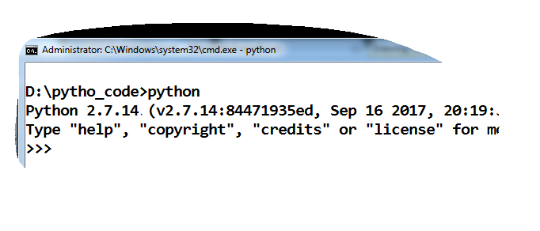
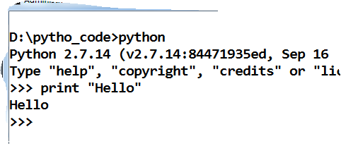
Testing Environment

Slide 17
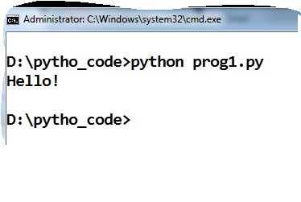
Programming in PYTHON
Create textfile with extension .py
You can edit code with any text editor
Execute program using “python yourfile.py”
Example:

Slide 18
Assigning values & multiple assignments
Ex1:
a=b=c=1
Ex2:
a,b,c =10,45.60,”Sudha”
where “a” assigned with 10, “b” as 45.60 and “c” is “Sudha”.

Slide 19
Deleting variables
Ex1:
x=10
print x
del x
Ex2:
x=10
y=“Harish”
print x
print y
del x, y
here, at a time it will delete both x and y

Slide 20
Format specifiers
Specifier | Data type
%s | String
%d | Int
%c | Charcter
%f | Float
%ld | Long
%lf | Double

