Slide 1
Python
OOP

Slide 2
Objectives
What is OOP
Class Handling
Constructor
Destructor

Slide 3
Features of OOP
Class
Object
Encapsulation
Abstraction
Inheritance
Polymorphism.

Slide 4
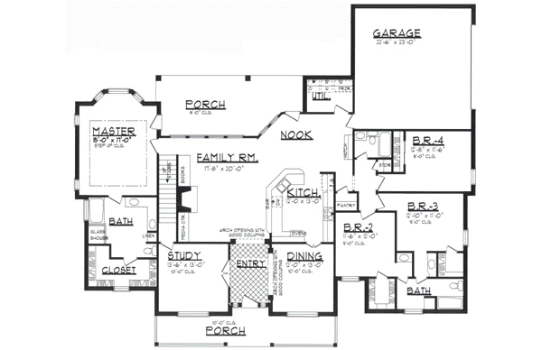
What is a class
It is an Blue-print of an application.
This can be even be called as logical representation of an entity or thing.

Slide 5

What is an Object
It is an instance of the class.
It has it’s identification,
State and behavior.

Slide 6
Encapsulation
This is an wrapper model, resource wrapped by it’s wrapper.
This will hide all it’s properties.

Slide 7
Abstraction
This will reveal the necessary properties by avoiding hidden features.

Slide 8
Inheritance
This will create new resource by acquiring properties from it’s parent.
Only common properties of parent can be shared with child.

Slide 9
Polymorphism
This can be called as molding of functionality as per requirement.
This is of two types:
Overload (python will not support overload)
Override

Slide 10
Constructor
Constructor is a special member of the class
This will be initialized at the time of creation of class object
In Python constructor is define with the signature as __init__(self) or __init__(self, args)

Slide 11
Destructor
De-allocation of memory of the class is done by destructor.
In python it is represented with method as __del__(self)

