Slide 1
1/5 · STREET FOOD FESTIVAL ON MONGODB ATLAS
Street Food Festival back end
Which stalls earn most · when queues peak · how fast we warn about an allergen
12
9
300
5
275 → 0
VENDORS
CUISINES
ORDERS
PIPELINES
DOCS EXAMINED
Team: [Member 1] · [Member 2] · [Member 3]
Free Atlas M0 cluster · database festival · collections vendors & orders

Slide 2
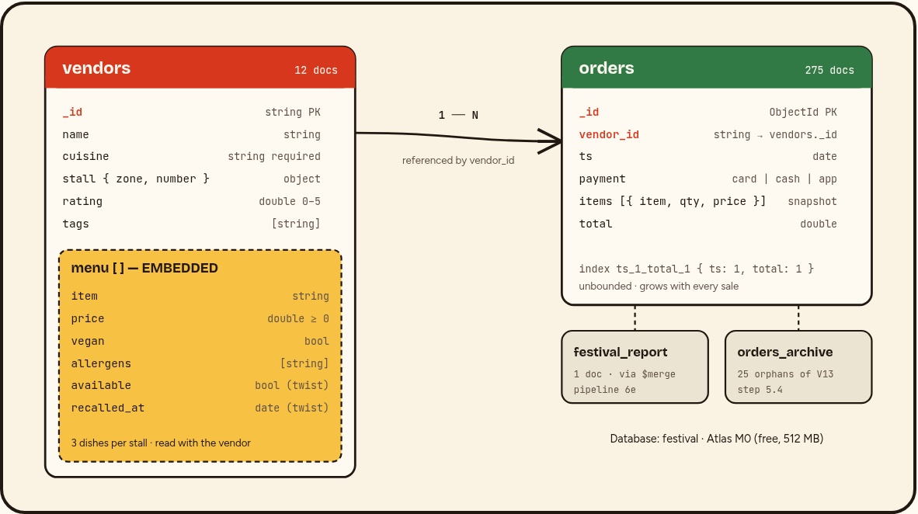
2/5 · DATA MODEL
Embed the menu, reference the orders
Menu embedded: small, bounded, always read with the vendor, rarely changes → one read gives every price and allergen.
Orders referenced by vendor_id: unbounded, would grow vendors toward 16 MB and rewrite them on every sale.
Orders can be indexed by time and aggregated across all vendors; each keeps a price snapshot.
Size: order ≈ 150 B → ~3 M orders fit in 512 MB.

Slide 3
3/5 · AGGREGATION PIPELINES
What the organisers learn
6a Revenue per vendor
6b Busiest hour per day
6c Best dish per cuisine
6d Payment share
Sushi Wave 448.50 €
Napoli Slice 389.00 €
Tbilisi Fire 379.00 €
Total 3 782 € · 275 orders
20 Jun 12:00–13:00 (11)
21 Jun 15:00–16:00 (13)
22 Jun 14:00–15:00 (16)
→ staff up at lunch
Mexican: Chicken quesadilla 26
Georgian: Khachapuri 25
Ukrainian: Varenyky 22
Japanese: Avocado maki 21
Card 35.3 %
App 32.4 %
Cash 32.4 %
6e report → $merge
$group · $sort · $hour · $dayOfMonth · $unwind · $lookup · $first · $facet · $merge

Slide 4
4/5 · PERFORMANCE & DATA QUALITY
Index { ts: 1, total: 1 } → covered query
explain("executionStats") on pipeline 6b
$jsonSchema on vendors
required: [_id, name, cuisine,
stall, menu]
menu.items.price: { minimum: 0 }
insertOne({ ... price: -2.5 })
→ REJECTED: Document failed validation
itemIndex 0, minimum 0
insertOne({ no cuisine })
→ REJECTED: missingProperties
['cuisine']
275
0
docs before · COLLSCAN
docs after · IXSCAN covered
ts carries the range filter; total is added so the index holds every field the pipeline reads — no document is opened.

Slide 5
5/5 · TWIST — SESAME RECALL AT 19:00
One updateMany, nine safe stalls
db.vendors.updateMany(
{ "menu.allergens": "sesame" },
{ $set: { "menu.$[dish].available": false } },
{ arrayFilters: [{ "dish.allergens": "sesame" }] })
// matched 3 · modified 3 · 7 dishes recalled
db.vendors.find({ "menu.allergens": { $ne: "sesame" } })
Safe for sesame allergy
Taco Loco A1 · Napoli Slice A2
Pelmeņi Express A3 · Rīgas Kūpinātava A5
Tbilisi Fire B1 · Bombay Street B3
Supra Grill B4 · Borsch & Co C1 · El Fuego C5
Avoid: Tokyo Ramen Bar, Sushi Wave, Beirut Bites (cross-contamination risk).
Bonus: 11 recalled portions sold after 19:00 → visitors to contact. Deleting a vendor leaves orphan orders → we archive them.

