Slide 1
Web Development

Slide 2
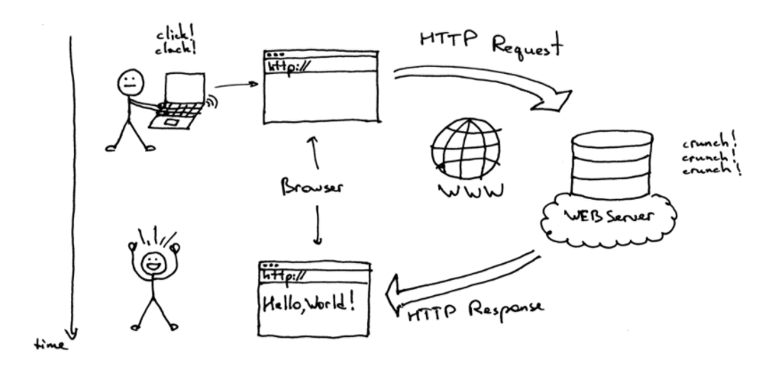
How does a Website works?

Slide 3
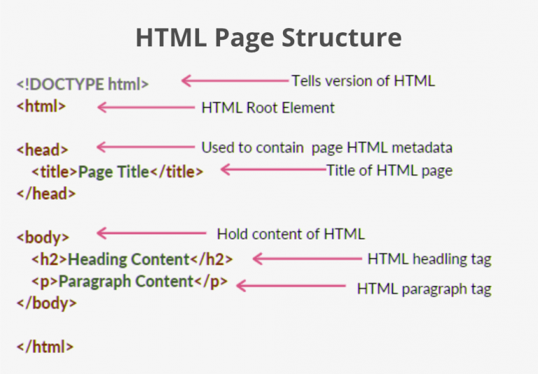
HTML and CSS

Slide 4
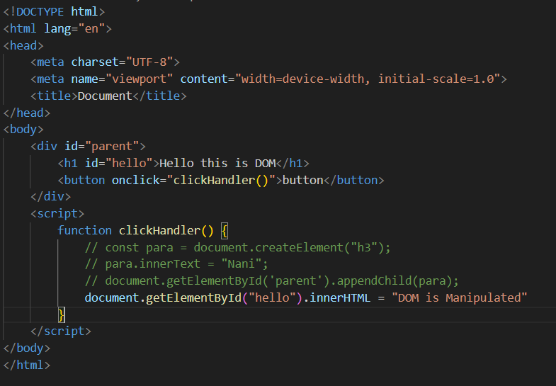
JavaScript

Slide 5
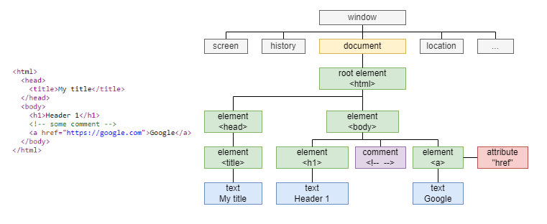
DOM and DOM Manipulation

Slide 6
DOM and DOM Manipulation

Slide 7
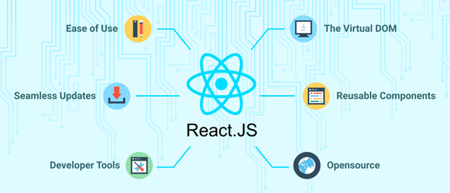
Why React

Slide 8
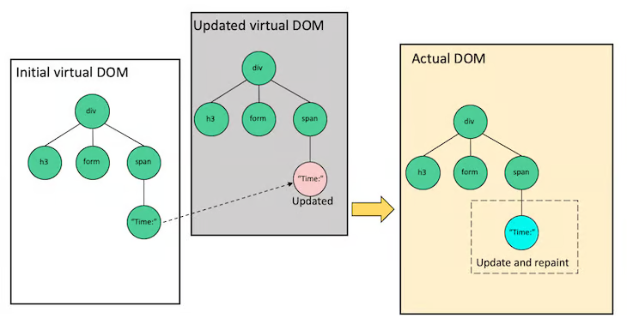
Virtual DOM

Slide 9
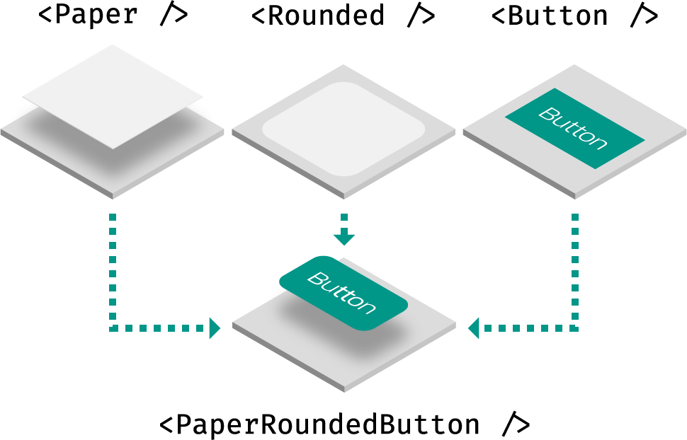
Reusable Components

