Slide 1
Week-1
Topics
GraphQl
Neo4j
Jwt
React

Slide 2
What is GraphQL?
A query language for APIs and a runtime for executing those queries.
Key Features:
Clients specify exactly what data they need.
Single endpoint (unlike REST’s multiple).
Reduces over-fetching and under-fetching.
Example Query:
{ user(id: "1") {
name
email }
}

Slide 3
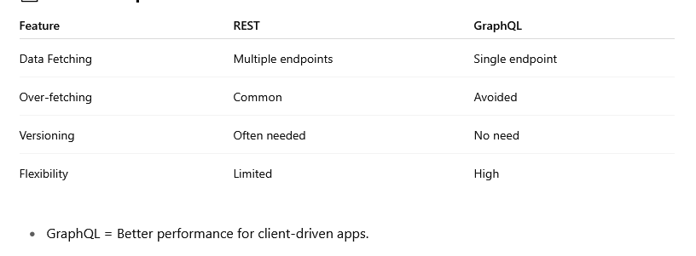
GraphQL vs REST

Slide 4
Schema: Defines data types and relationships.
Query: Asks for specific data.
Mutation: Modifies data (e.g., addUser).
Resolver: Function that returns data for a field.

Slide 5
What is Neo4j?
A native graph database built to store and query data as graphs.
Core Concepts:
Nodes (entities), Relationships (edges), Properties (attributes).
Uses Cypher query language (similar to SQL but for graphs).
Use Cases: Social networks, recommendation systems, fraud detection.
Example Cypher Query:
MATCH (a:Person)-[:FRIENDS_WITH]->(b:Person)RETURN a.name, b.name

Slide 6
Why Use Neo4j?
Performance: Efficient for complex queries.
Flexibility: No rigid schema.
Visualization: Intuitive graph views of data.
Cypher Language: SQL-like, easy to learn.
Use Case: Fraud detection – trace connected accounts through transactions.

Slide 7
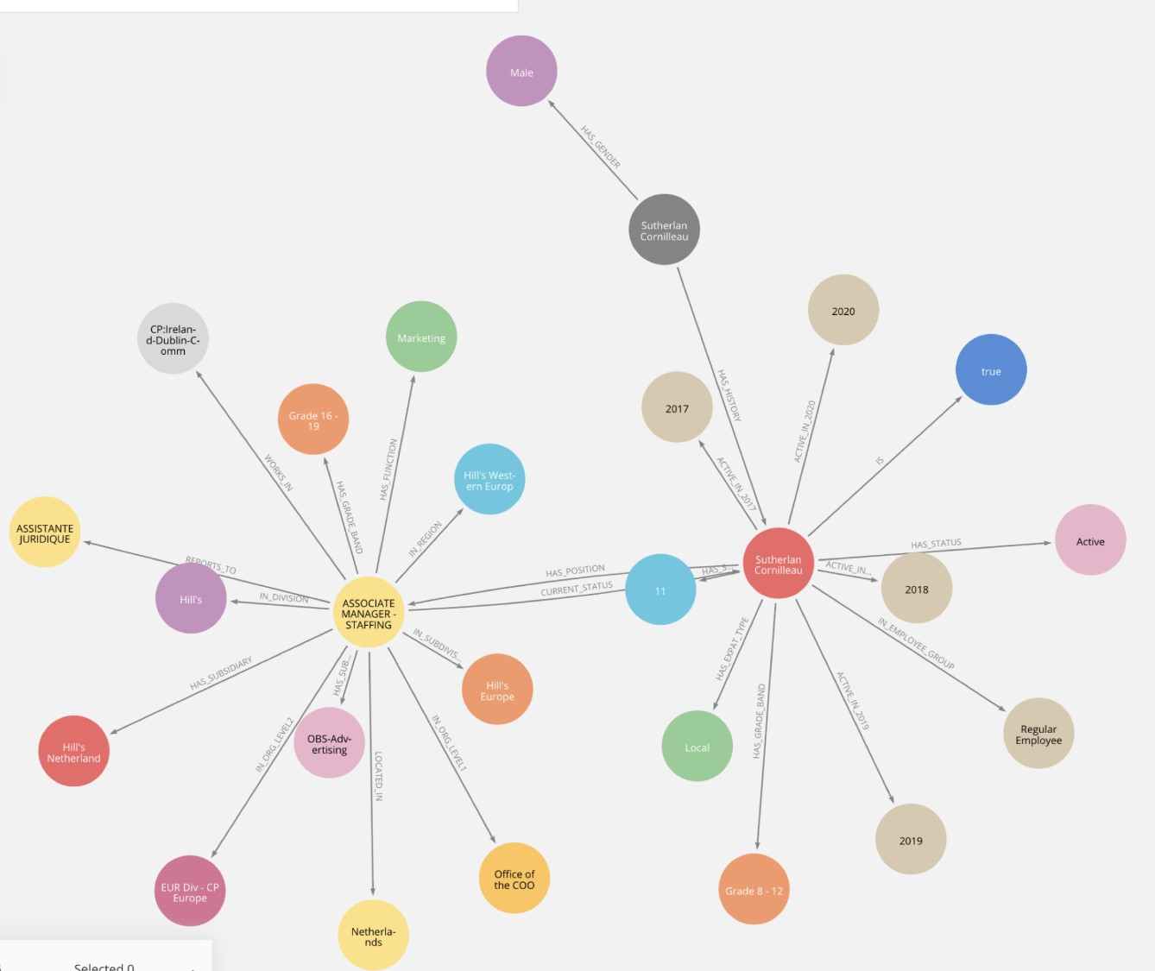
Example

Slide 8
Use Cases
Fraud Detection & Risk Analysis
Knowledge Graphs & Semantic Search
Recommendation Engines
Network & IT Operations
Bioinformatics & Drug Discovery
Neo4j was used in COVID-19 response projects to track virus mutation networks and potential drug matches.

Slide 9
What is JWT (JSON Web Token)?
A compact and self-contained way to securely transmit information between parties as a JSON object.
Structure:
Header – Type & Algorithm
Payload – Claims (data)
Signature – Verifies integrity
Usage:
Stateless authentication in web applications.
Example Use Case:
User login → returns token → token used in API requests

Slide 10
🧱 JWT Structure
A JWT has three parts, separated by dots (.):
HEADER.PAYLOAD.SIGNATURE

Slide 11
Header (Base64-encoded JSON)
{
"alg": "HS256",
"typ": "JWT“
}

Slide 12
Payload (Base64-encoded JSON): Contains the claims — user data or other metadata.
{
"sub": "1234567890",
"name": "John Doe",
"admin": true,
"iat": 1620000000,
"exp": 1620003600
}

Slide 13
Signature: Used to verify the token has not been tampered with.
HMACSHA256(
base64UrlEncode(header) + "." + base64UrlEncode(payload),
secret_key
)

Slide 14
React
React is a JavaScript library developed by Meta (Facebook) for building user interfaces, especially single-page applications (SPAs).
Focuses on the view layer (UI).
Uses components to build reusable UI blocks.
Efficient via virtual DOM and reactive rendering.

Slide 15
1. Components
Building blocks of UI.
Can be functional or class-based.
Accept props (inputs) and can manage state.
2. JSX (JavaScript XML)
Syntax extension that looks like HTML in JavaScript.
Transpiled to React.createElement() under the hood.
3. State & Lifecycle
State: Internal data for components.
Lifecycle methods (in class components) or hooks (in functional ones) manage behavior over time.

Slide 16
Virtual DOM
A lightweight copy of the actual DOM.
React updates only the changed parts, making it fast.
Process:
UI change triggers re-render.
New virtual DOM is created.
React diffs the new and old virtual DOM.
It updates the real DOM efficiently.

Slide 17
React Hooks (Modern Way to Handle State & Side Effects)
useState Add state to functional components
useEffect Side effects (API calls, subscriptions)

