Slide 1
Assignment AIML Model DIscussion

Slide 2

Problem Statement
Sales Forecasting The task involves predicting the quantity of Coca-Cola each customer will purchase in the next month.
The following code was created by another department and the stakeholders have raised a few concerns regarding the model's accuracy and the clarity of the existing code, as well as potential improvements for future models.
Objective: Predict the quantity of Coca-Cola each customer will purchase in the next month1.
Stakeholder Concerns: High error rate, unclear code, and potential for additional features to improve predictions.

Slide 3
Solution

Slide 4
Overall Steps
Understanding problem statement
Understanding data
EDA and preprocessing
Feature Engineering and Feature Selection using RFE
Split the data
Model training and hyper-parameter tuning
Model evaluation
Business recommendation and conclusion

Slide 5
Data Overview

Slide 6
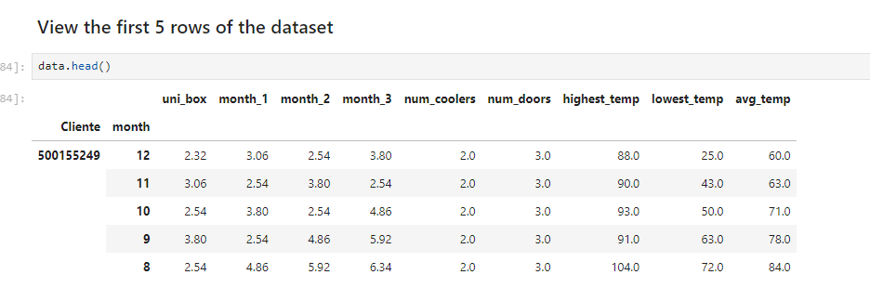
Data Overview
Datasets: Sales, coolers, and weather data.
Features: Sales data (uni_box), previous months’ sales, number of coolers, number of doors, and temperature data.

Slide 7
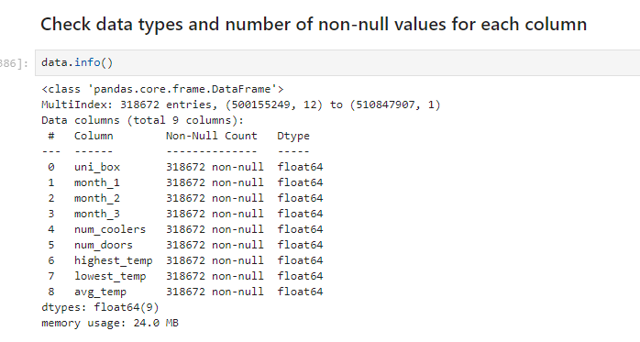
Data Overview
We can see that there are total of 8 columns and 318,672 rows in the dataset.
The number of non-null values of each column is equal to the number of total rows in the dataset i.e. no null value.

Slide 8
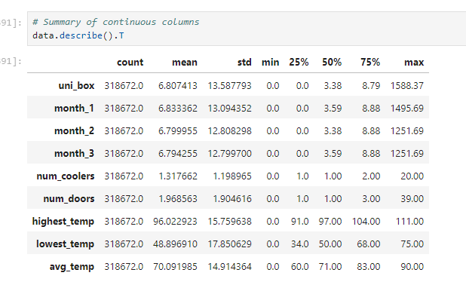
Statistical Summary

Slide 9
Statistical Summary

Slide 10
Exploratory data analysis

Slide 11
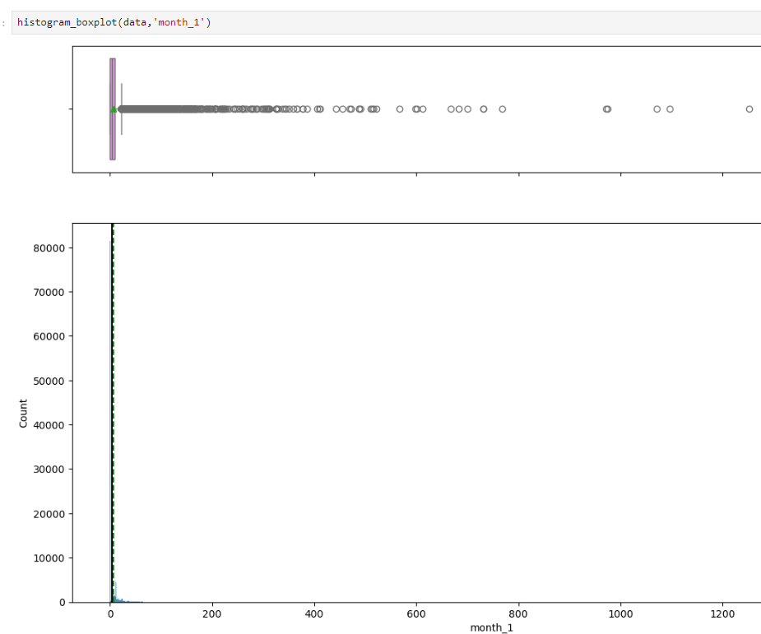
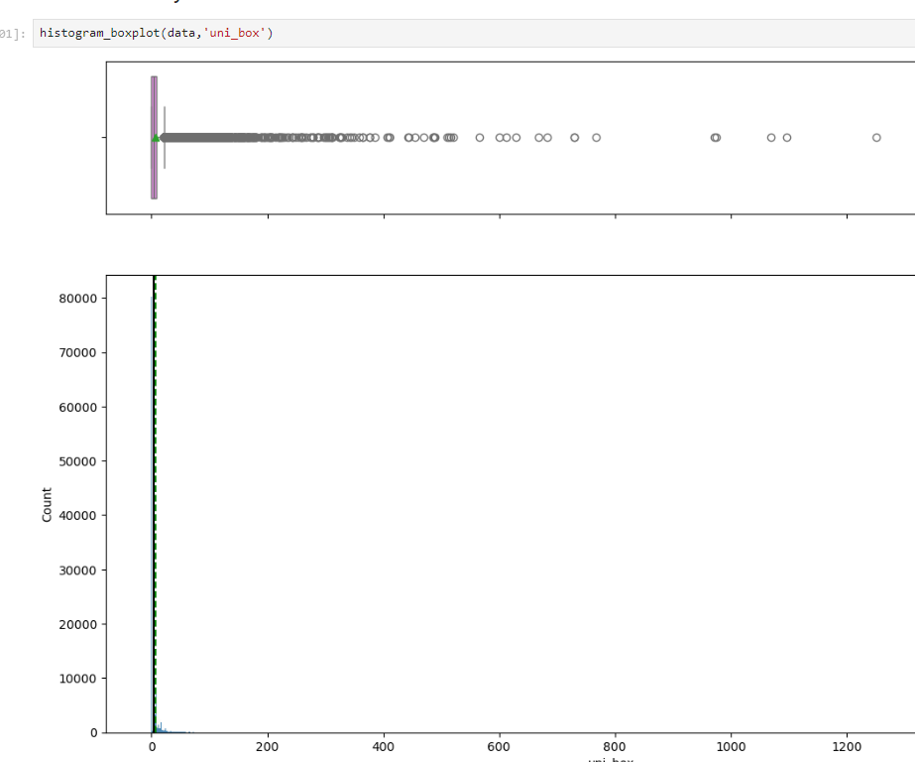
Univariate analysis

Slide 12
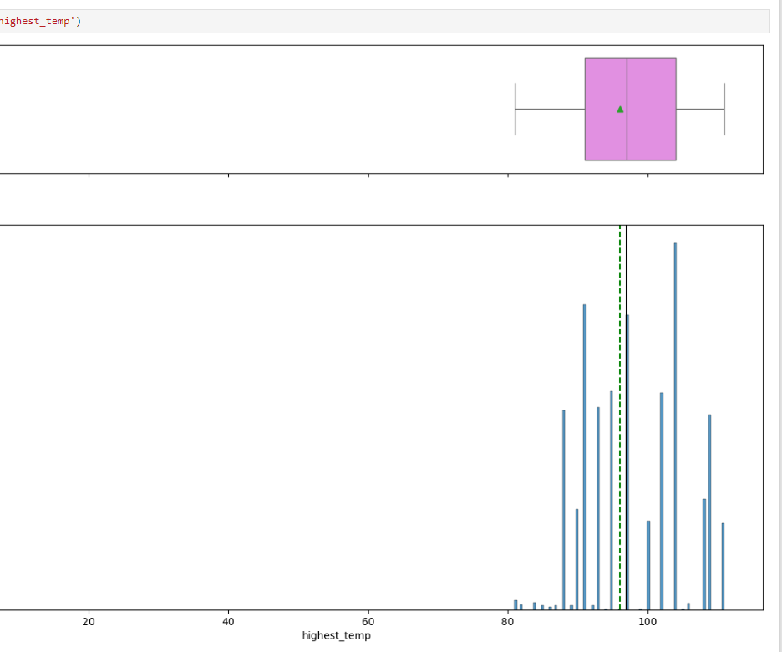
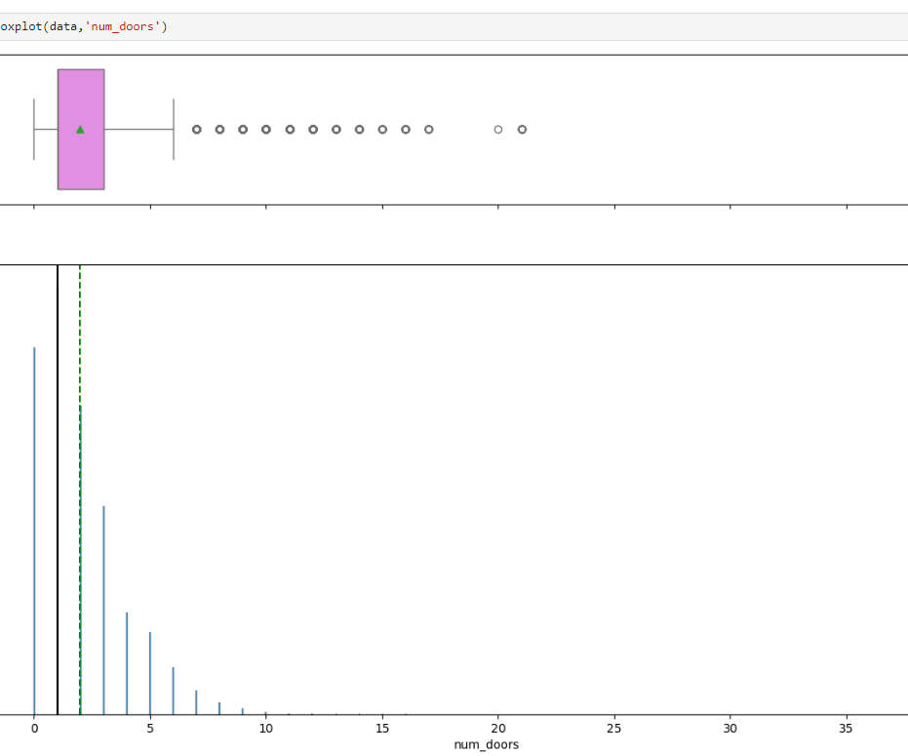
Univariate analysis

Slide 13
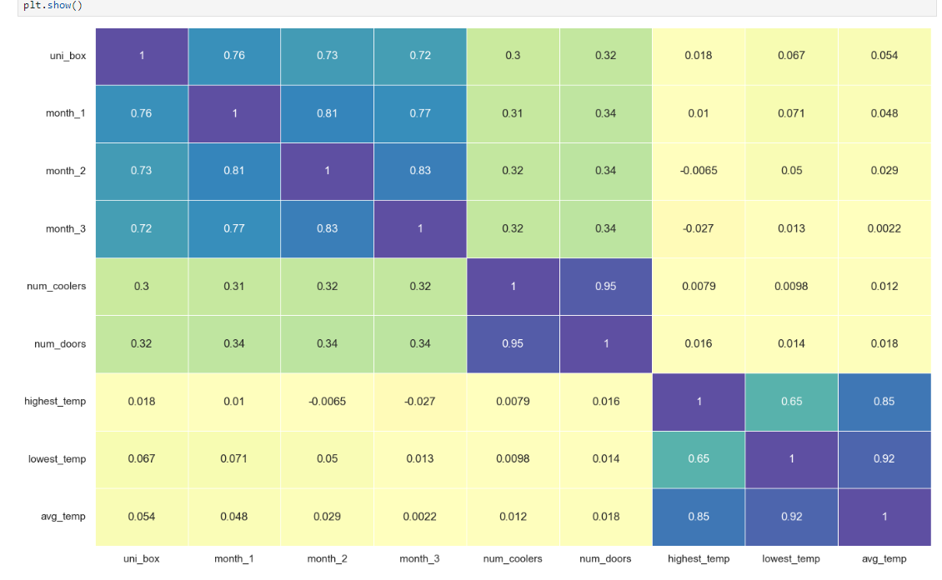
BI-variate analysis

Slide 14
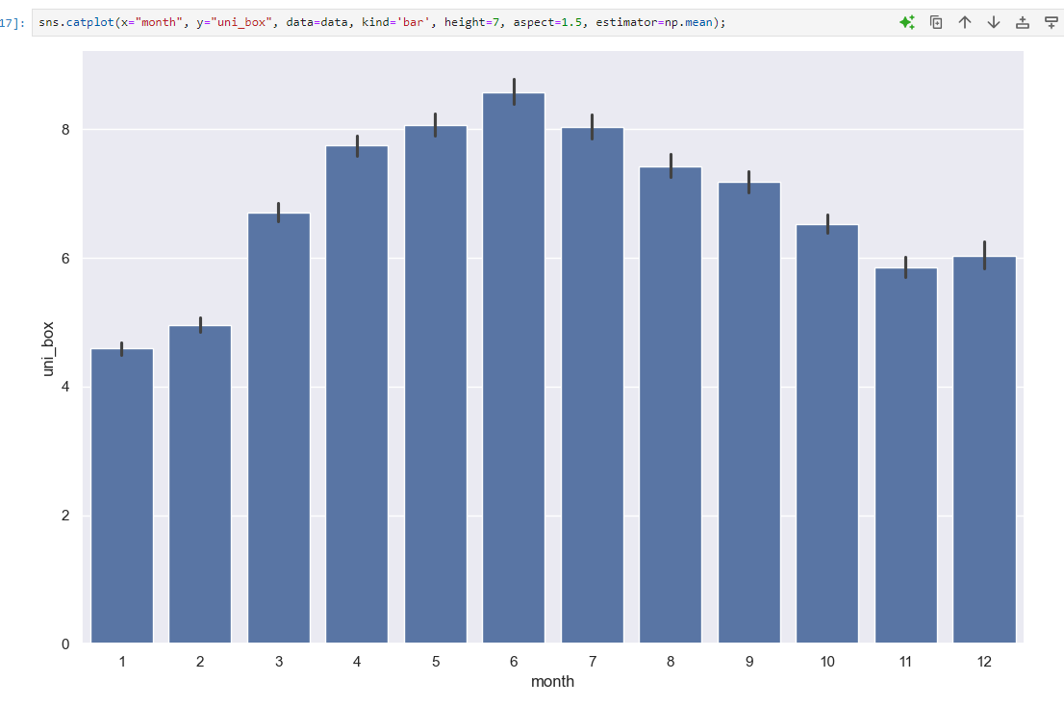
BI-variate analysis
We can see the average number of sales is high for April to Aug month, this can be due to peak season.
The average number of sales is very low for Jan and Feb

Slide 15
Outlier detection

Slide 16
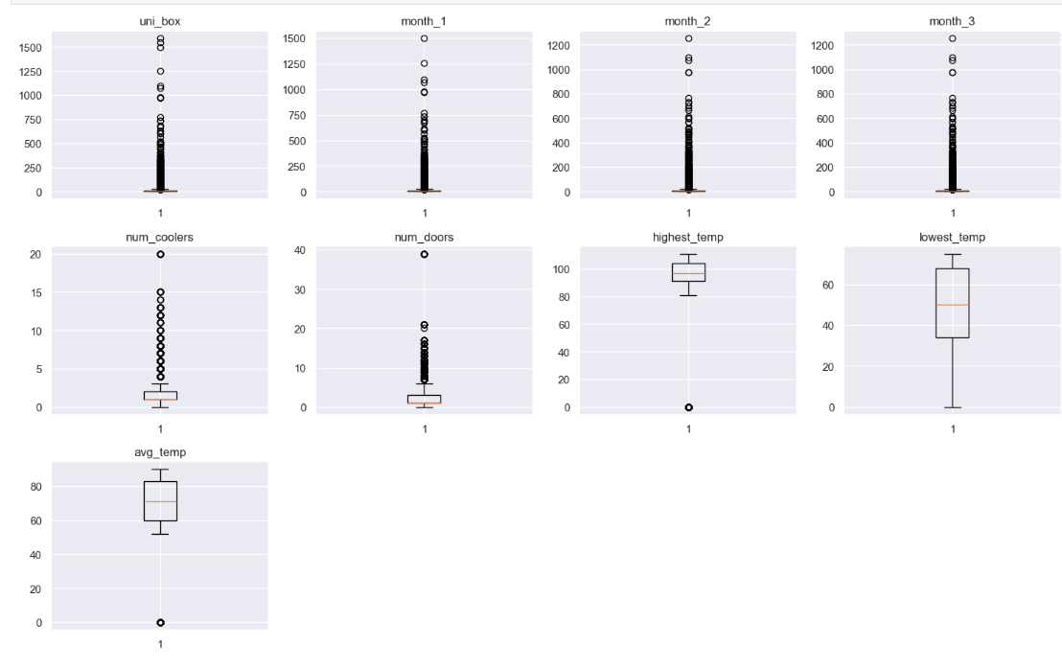
BI-variate analysis

Slide 17
Feature engineering and feature selection

Slide 18
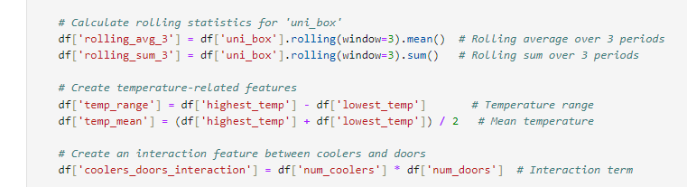
Feature engineering (interaction variables)

Slide 19
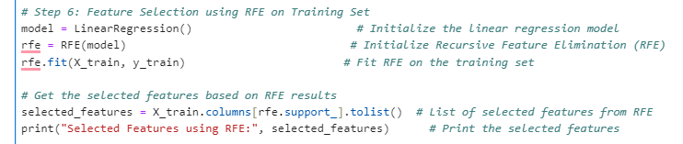
Reverse feature elimination

Slide 20
Model building - Decision tree - Decision tree tuned - random forest - random forest tuned - adaboost - adaboost tuned
- Gradient boosting - GBM tuned - Xgboost - XGB tuned - Stacking ensemble

Slide 21
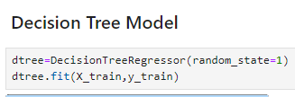



DT and DT-tuned performance (on test data)

Slide 22
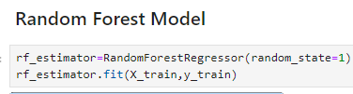


RF and RF-tuned performance (on test data)

Slide 23



adb and adb-tuned performance (on test data)

Slide 24
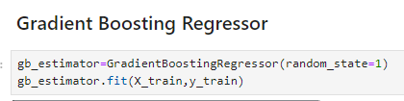


GBM and GBM-tuned performance (on test data)

Slide 25



XGB and xgb-tuned performance (on test data)

Slide 26
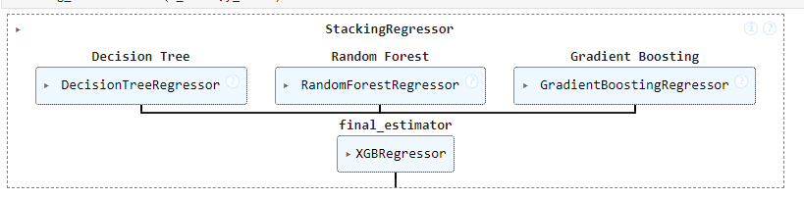

Stacking performance (on test data)

Slide 27
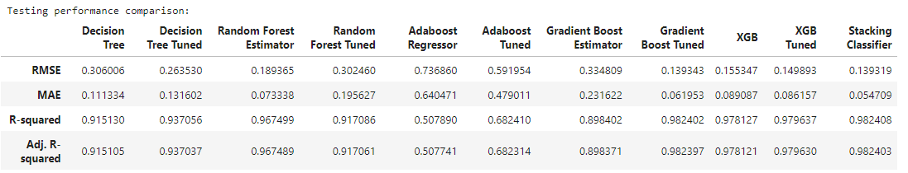
Model comparison on test data

Slide 28
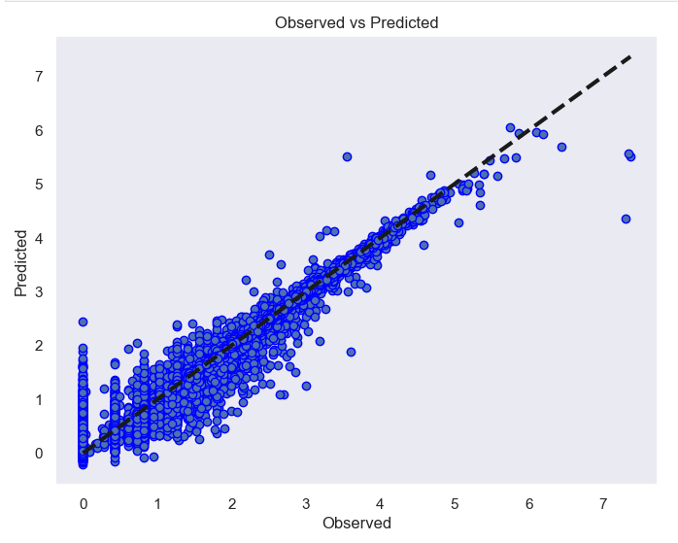
Observed vs predicted

Slide 29
Conclusion & business recommendations
Model Improvements:
- We can use this predictive model for sales forecasting. The predictive model has been refined, leading to a significant reduction in error rates. Enhanced algorithms and additional features have contributed to more reliable sales forecasts. Incorporated additional lag features and rolling statistics to capture trends and seasonality.
- Used techniques like RandomizedSearchCV to optimize model parameters for better performance
Business Recommendations:
- Focus marketing efforts during peak sales months (April to August) to maximize revenue
- Optimize the number of coolers and doors per store to enhance sales, as these features significantly correlate with sales volume.
- Monitor and adjust sales strategies based on weather conditions, as temperature variations may affect sales.

Slide 30

Thank you

