Slide 1
Single Layer Perceptron
Linear Classifier
Miloš Kotlar 2012/115
kotlarmilos@gmail.com

Slide 2
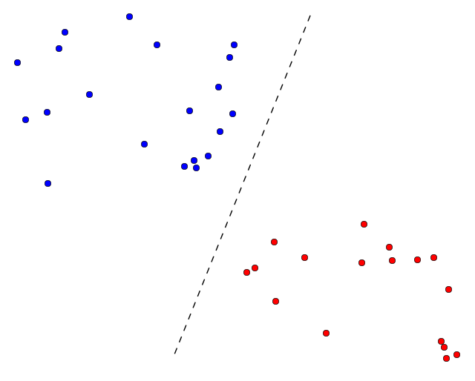
Perceptron Classifier
Algorithm for supervised learning of binary classifiers.
Goal: Construct linear decision boundaries that separate the data into different classes.
Approach: Given a dataset of (x,y,class) values.
Classifier makes predictions based on a linear predictor function combining a set of weights with the feature vector.
The algorithm allows for online learning, in that it processes elements in the training set one at a time.
2/10

Slide 3
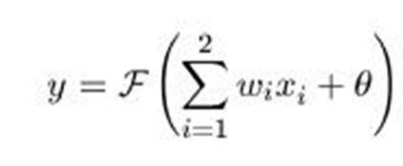
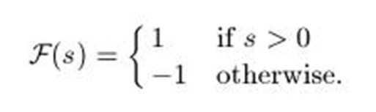
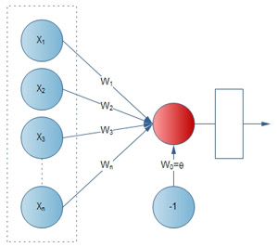
Simple Perceptron Classifier
A function that maps its input x to an output value f(x):
For every input on the perceptron there is a corresponding weight:
3/10

Slide 4
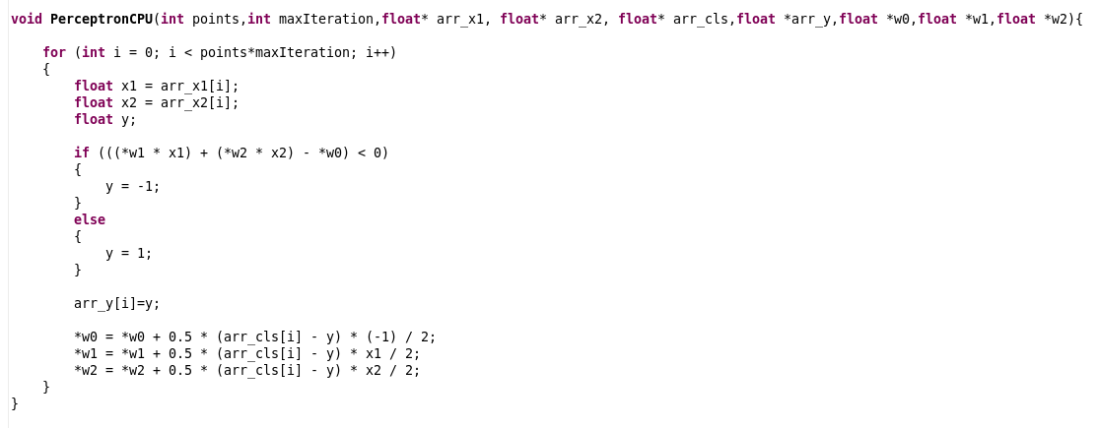
A Simple Software Implementation
points - number of points in dataset
maxIteration - number of iterations that reduces errors
4/10

Slide 5
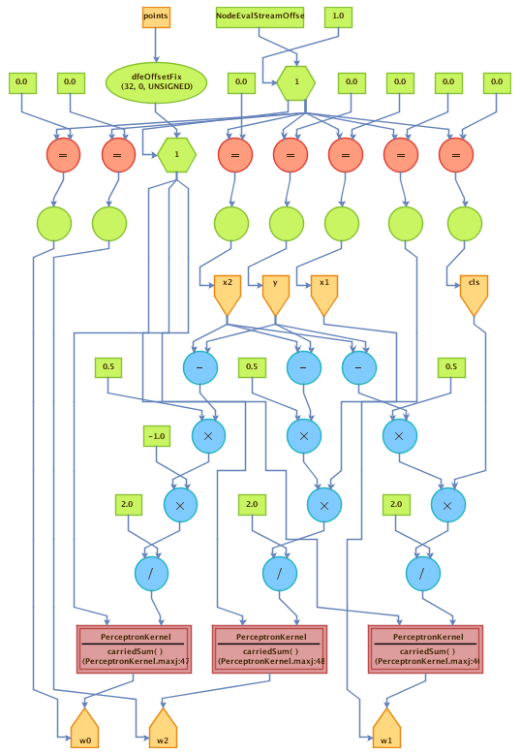
DFE Implementation
void DFE(int size,
float* arr_x1,float* arr_x2, float* arr_cls, float* arr_y
float *w0_dfe,float* w1_dfe,float* w2_dfe)
Scalar input
Streaming input
Streaming output
CPU
Feedback loops for carried sums:
w0 += 0.5 * (cls - y) * (x0) / 2
Wait 13 cycles before adding next element
5/10

Slide 6
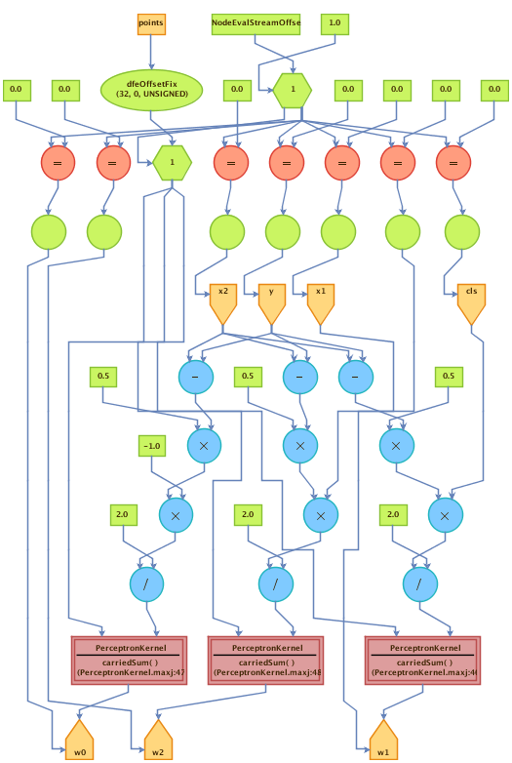
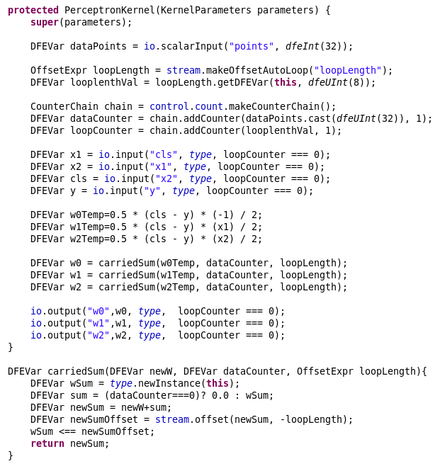
DFE Implementation
6/10

Slide 7
Speedup
Maxeler: One new result in each cycle
Clock = 200MHz
One result every 10ns
Intel: One new result after each operation
Clock = 4GHz
One result every 0.25ns
Achieved speedup: ~2.0x
Data size | Maxeler | Intel | Speedup
10M | 0.66s | 01.26s | 1.91x
100M | 6.40s | 13.05s | 2.04x
7/10

Slide 8
Power efficiency
Intel i7 - 76W under workload
Maxeler - 42W under workload
8/10

Slide 9
Summary
Separate input vectors from the two classes.
Iterative processing accelerated by DFE.
Speedup: 2.0x
Possible improvements:
Larger dataset
Parallel processing
Utilize idle cycles of accumulators
9/10

Slide 10
References
Milutinovic, V., at al, “Guide to DataFlow SuperComputing”, Springer, 2015.
Flynn, M., Mencer, O., Milutinovic, V., at al, “Moving from PetaFlops to PetaData”, Communications of the ACM, May 2013.
Trifunovic, N., Milutinovic, V., Salom, J., Kos, A., “Paradigm Shift in Big Data SuperComputing: DataFlow vs ControlFlow”, Journal of Big Data, 2015, 2:4 (10 May 2015).
Milutinovic, V., Salom, J., Trifunovic, N., Giorgi, R., “Guide to DataFlow SuperComputing”, Springer, 2015.
10/10

