Slide 1
Single Layer Perceptron
Linear Classifier
Miloš Kotlar 2012/115
kotlarmilos@gmail.com

Slide 2
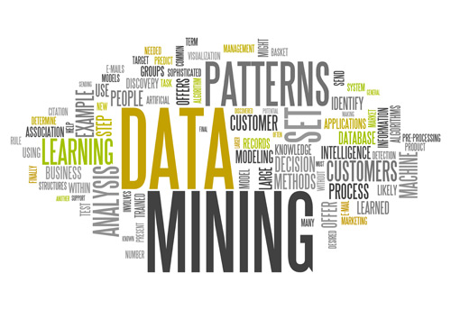
Use case: Data Mining
Prediction - Use some variables or fields in the database to predict unknown or future values of other variables of interest.
Classification - Classify a data item into one of several predefined classes.
2/4

Slide 3
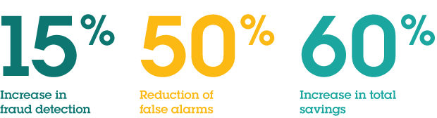
Use case: Banking System
Stock Market Prediction - Predict the future movement of the security using the historical data of that security.
Credit Rating - Assign credit ratings to companies or individuals based on their financial state.
Fraud Detection - Detect and automatically decline fraudulent insurance claims, client transactions, and taxes.
A large U.S. bank used machine learning technologies to analyze credit card transactions.
It resulted in following:
3/4

Slide 4
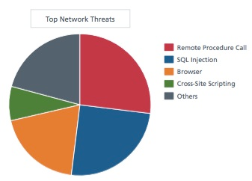
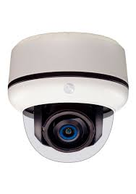
Use case: Security
Network security - Real-time detection of network security threads based on traffic content.
Video Surveillance System – Real-time prediction of objects in video based on features extracted by computer vision algorithms.
4/4

