Slide 1
Introduction to ComplexHeatmap
BRP seminar Yuri Kotliarov
November 21, 2023

Slide 2
ComplexHeatmap package
Powerful visualization method for revealing associations between multiple sources of information
The richest toolset for constructing highly customizable heatmaps
Modular design
Automatically concatenates a list of heatmaps with proper row/column ordering
Automatic legends
Comprehensive annotations and decorations
Additional functions and add-on packages for specific visualization tasks

Slide 3
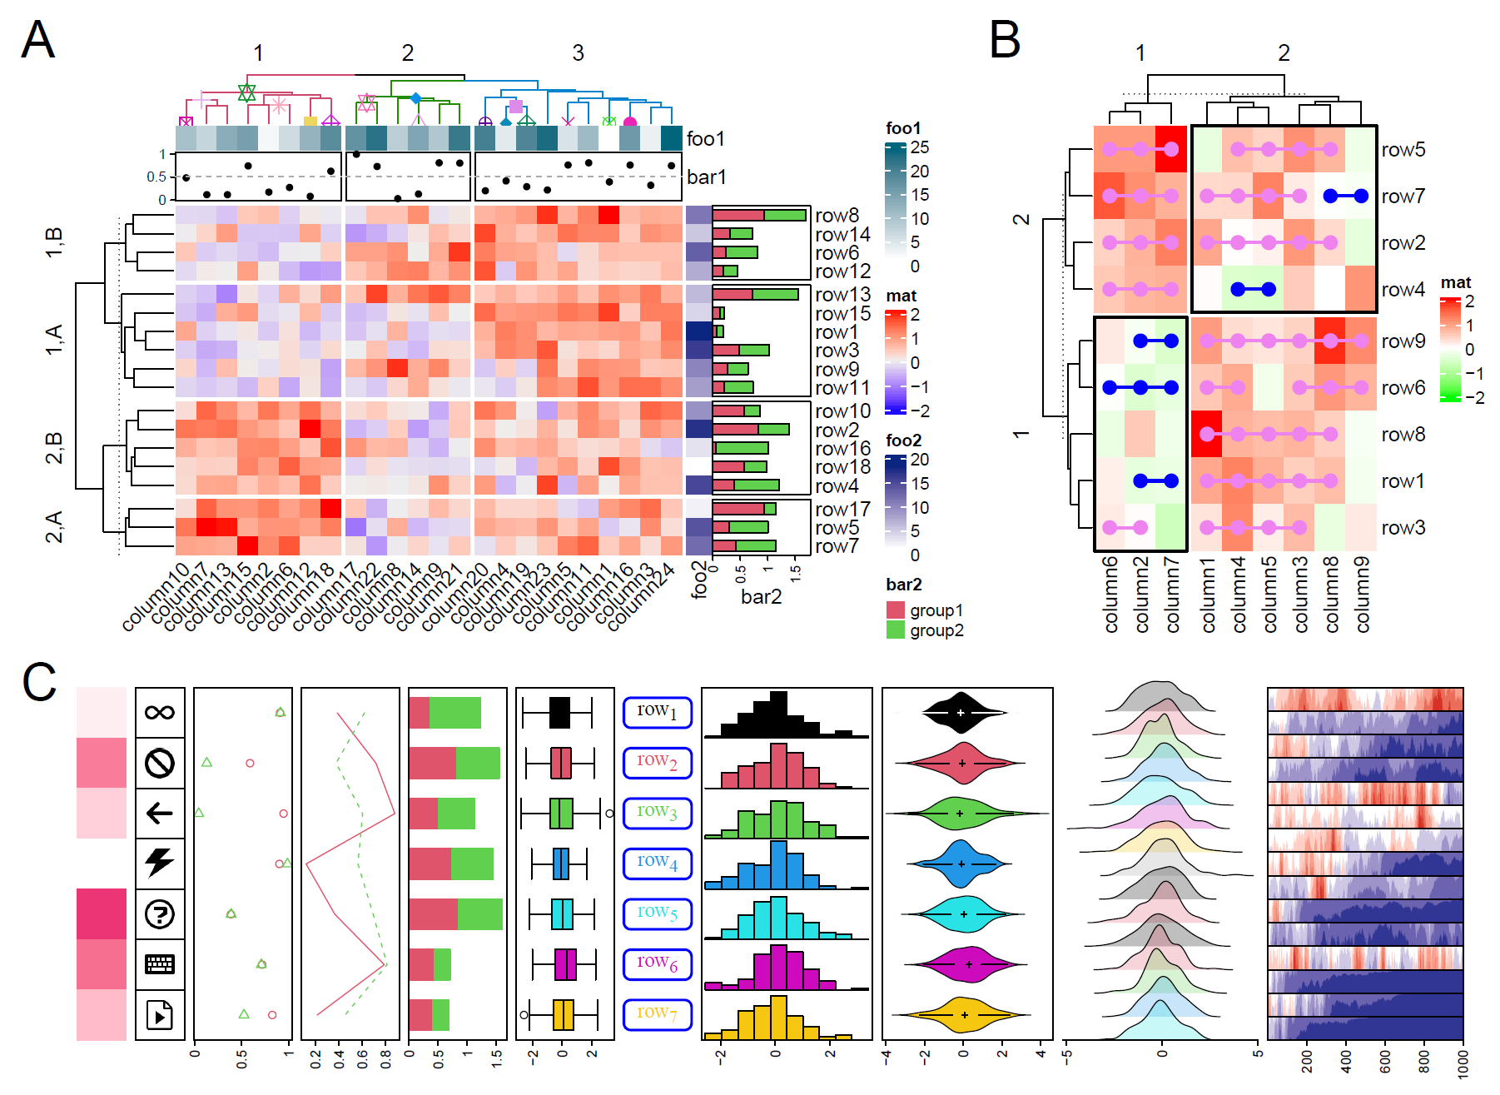
Examples

Slide 4
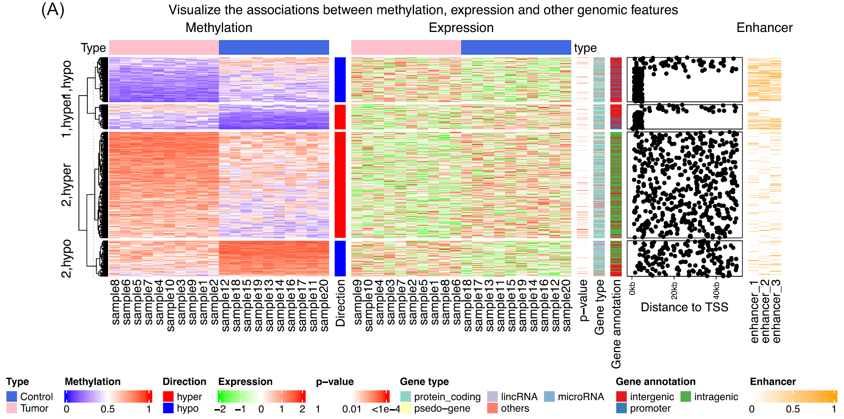
More Examples
Visualization of the association between DNA methylation, gene expression, and related genomic features

Slide 5
Installation
Install a stable version from Bioconductor:
if (!requireNamespace("BiocManager", quietly = TRUE)) install.packages("BiocManager") if (!requireNamespace("ComplexHeatmap", quietly = TRUE)) BiocManager::install("ComplexHeatmap")
or the most up-to-date version from github:
if (!requireNamespace("ComplexHeatmap", quietly = TRUE)) devtools::install_github("jokergoo/ComplexHeatmap")
Load the ComplexHeatmap package:
library(ComplexHeatmap)

Slide 6
Three major classes
Heatmap - defines a complete heatmap with multiple components
HeatmapAnnotation - defines a list of annotations with specific graphics
HeatmapList - manages a list of heatmaps and heatmap annotations. It automatically adjusts the correspondence of rows or columns in multiple heatmaps and annotations

Slide 7
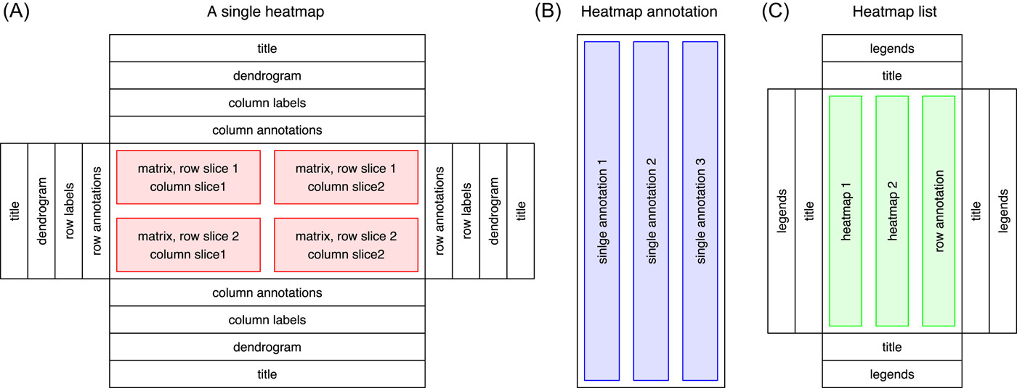
Modular design

Slide 8
Generate input matrix with random data
set.seed(123) nr1 = 4; nr2 = 8; nr3 = 6; nr = nr1 + nr2 + nr3 nc1 = 6; nc2 = 8; nc3 = 10; nc = nc1 + nc2 + nc3 mat = cbind(rbind(matrix(rnorm(nr1*nc1, mean = 1, sd = 0.5), nrow = nr1), matrix(rnorm(nr2*nc1, mean = 0, sd = 0.5), nrow = nr2), matrix(rnorm(nr3*nc1, mean = 0, sd = 0.5), nrow = nr3)), rbind(matrix(rnorm(nr1*nc2, mean = 0, sd = 0.5), nrow = nr1), matrix(rnorm(nr2*nc2, mean = 1, sd = 0.5), nrow = nr2), matrix(rnorm(nr3*nc2, mean = 0, sd = 0.5), nrow = nr3)), rbind(matrix(rnorm(nr1*nc3, mean = 0.5, sd = 0.5), nrow = nr1), matrix(rnorm(nr2*nc3, mean = 0.5, sd = 0.5), nrow = nr2), matrix(rnorm(nr3*nc3, mean = 1, sd = 0.5), nrow = nr3)) ) mat = mat[sample(nr, nr), sample(nc, nc)] # random shuffle rows and columns rownames(mat) = paste0("row", seq_len(nr)) colnames(mat) = paste0("column", seq_len(nc)) dim(mat)
[1] 18 24

Slide 9
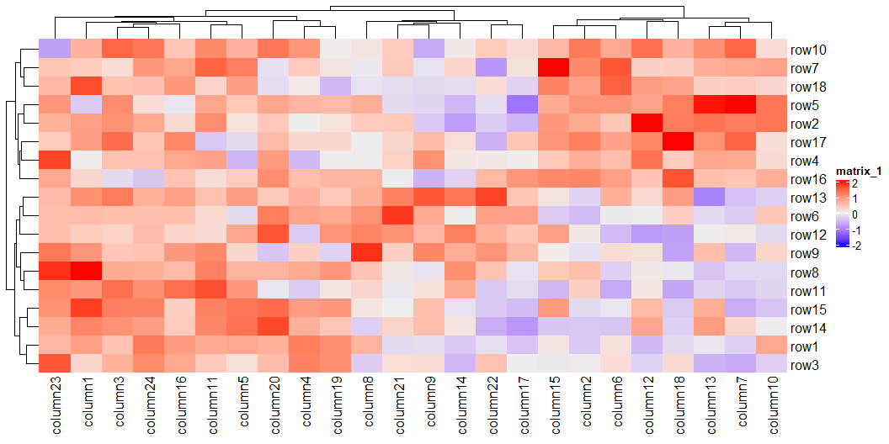
A Single Heatmap
Heatmap(mat)

Slide 10
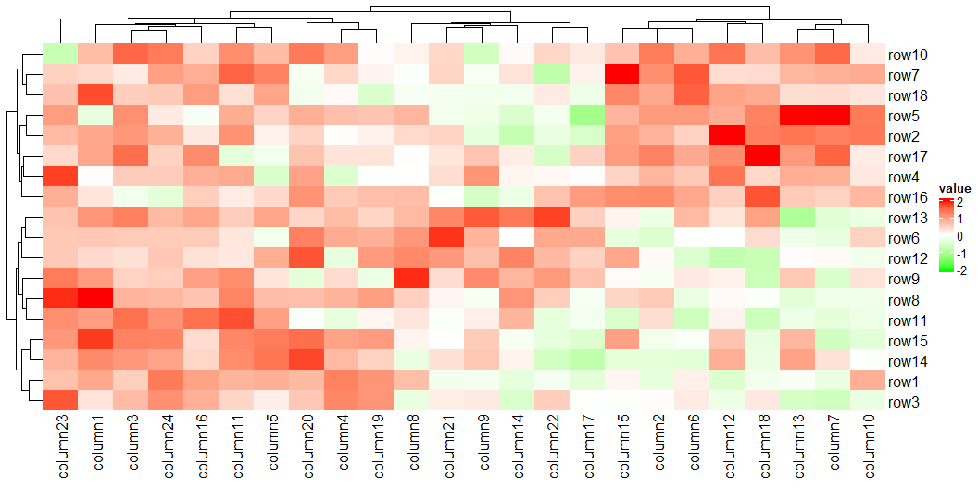
Changing heatmap colors
library(circlize) col_fun = colorRamp2(c(-2, 0, 2), c("green", "white", "red")) col_fun(seq(-3, 3))
[1] "#00FF00FF" "#00FF00FF" "#B1FF9AFF" "#FFFFFFFF" "#FF9E81FF" "#FF0000FF" [7] "#FF0000FF"
Heatmap(mat, name = "value", col = col_fun)

Slide 11
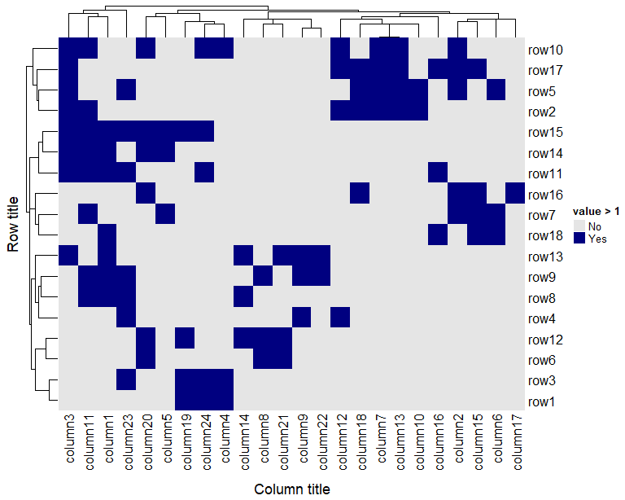
Binary matrix
binary_mat = +(mat > 1) colors = c("0" = "grey90", "1" = "navy") hm = Heatmap(binary_mat, col = colors, row_title = "Row title", row_title_side = "left", column_title = "Column title", column_title_side = "bottom", heatmap_legend_param = list( title = "value > 1", at = 0:1, labels = c("No", "Yes"))) draw(hm)
row_order(hm)
[1] 10 17 5 2 15 14 11 16 7 18 13 9 8 4 12 6 3 1
column_order(hm)
[1] 3 11 1 23 20 5 19 24 4 14 8 21 9 22 12 18 7 13 10 16 2 15 6 17

Slide 12
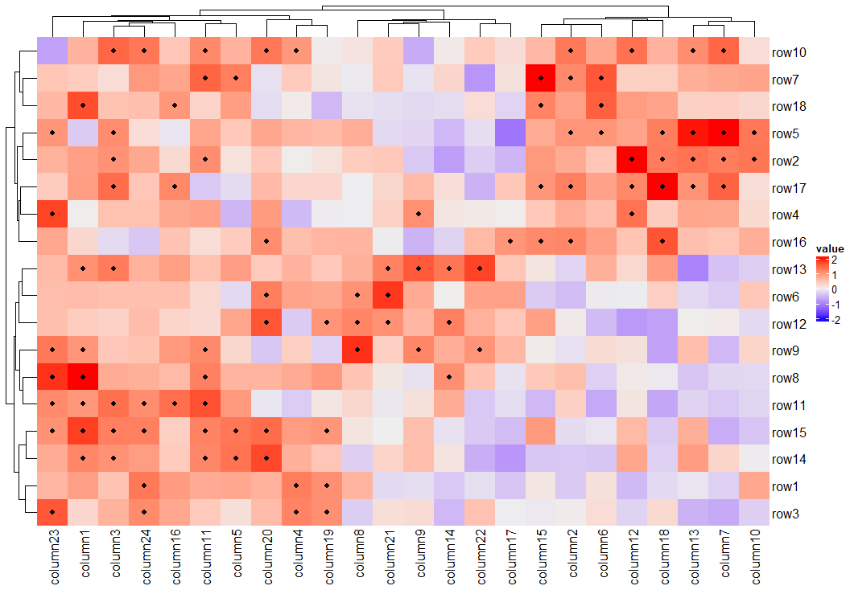
Combining Heatmaps with binary data
We can customize the heatmap cells with cell_fun argument. Let’s indicate values larger than 1.
Heatmap(mat, name = "value", cell_fun = function(j, i, x, y, width, height, fill) { if (mat[i, j] > 1 & !is.na(mat[i, j])) grid.points(x, y, pch = 20, size = unit(3, "mm")) } )
The matrix doesn’t need to be the same. For example, we can use matrix of p-values to show values with there significance (even with multiple levels - *, **, ***).

Slide 13
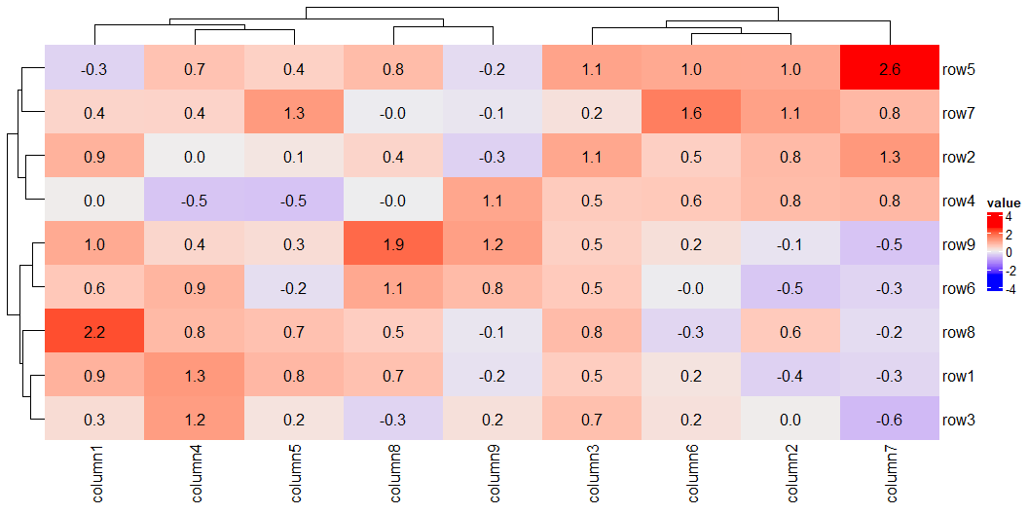
Show values on the heatmap
The similar technique can be used to visulize matrix values (for a relatively small matrix)
small_mat = mat[1:9, 1:9] Heatmap(small_mat, name = "value", cell_fun = function(j, i, x, y, width, height, fill) { grid.text(sprintf("%.1f", small_mat[i, j]), x, y, gp = gpar(fontsize = 12)) } )
See also layer_fun argument for additional heatmap customization techniques.

Slide 14
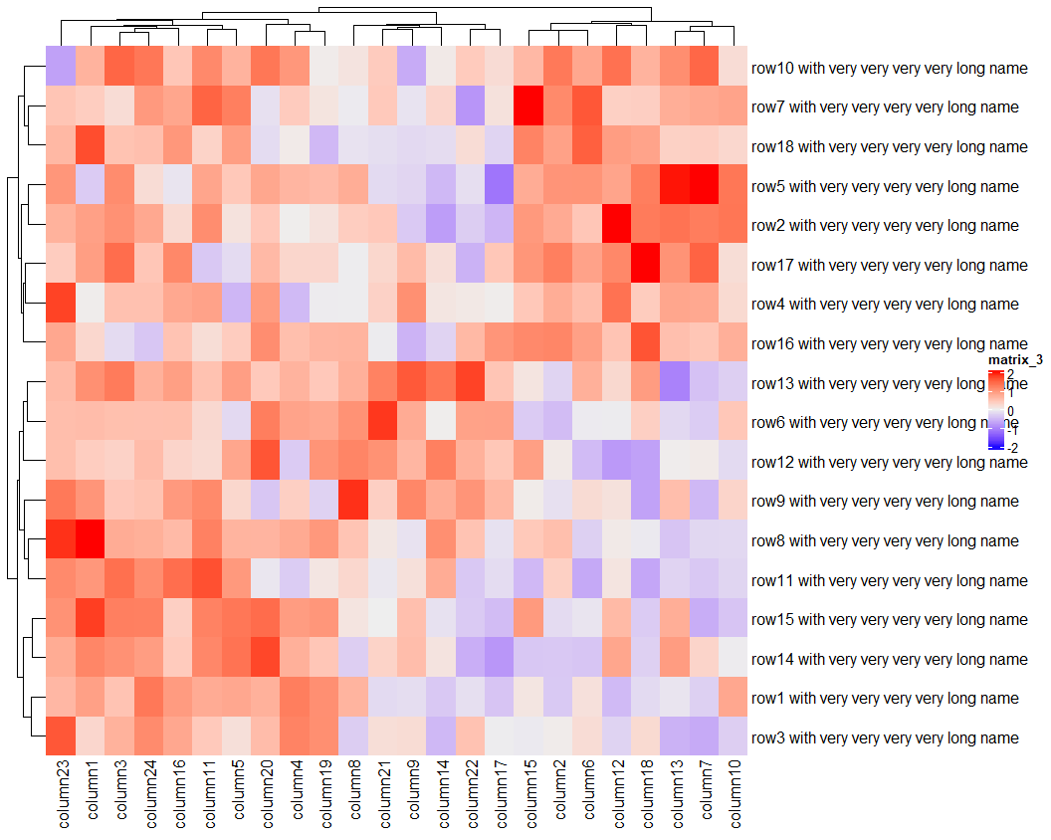
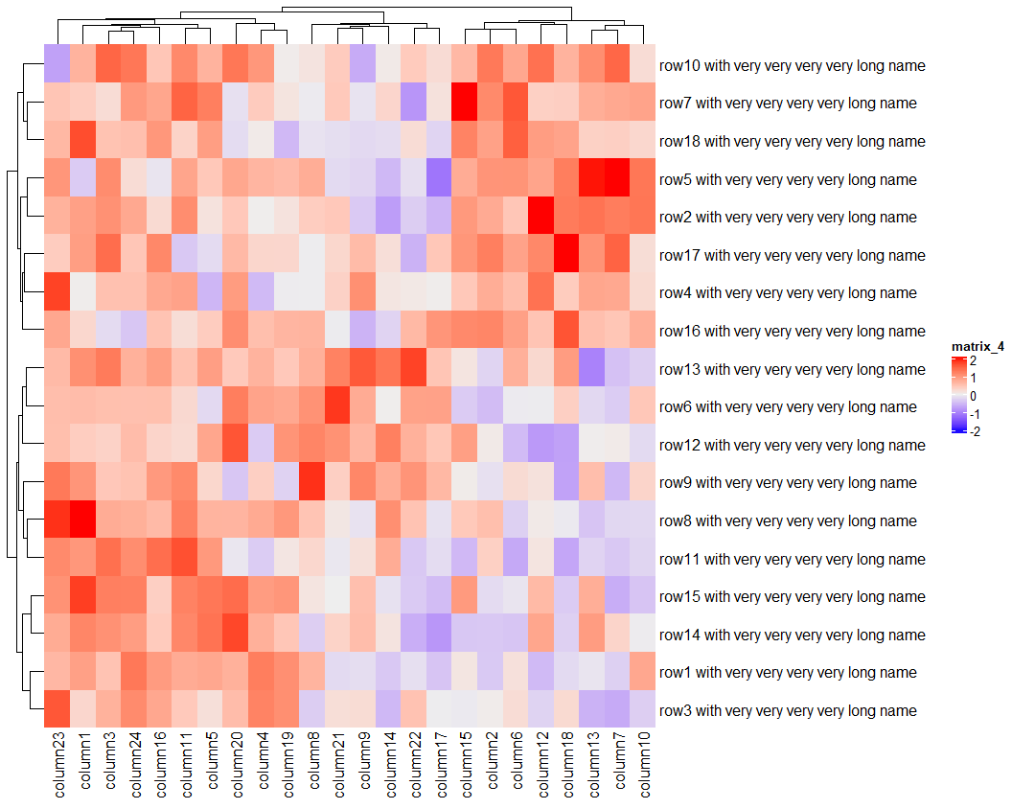
Hint: long row/column names
mat2 = mat rownames(mat2) = paste(rownames(mat), "with very very very very long name") Heatmap(mat2)
Heatmap(mat2, row_names_max_width = max_text_width(rownames(mat2)))

Slide 15
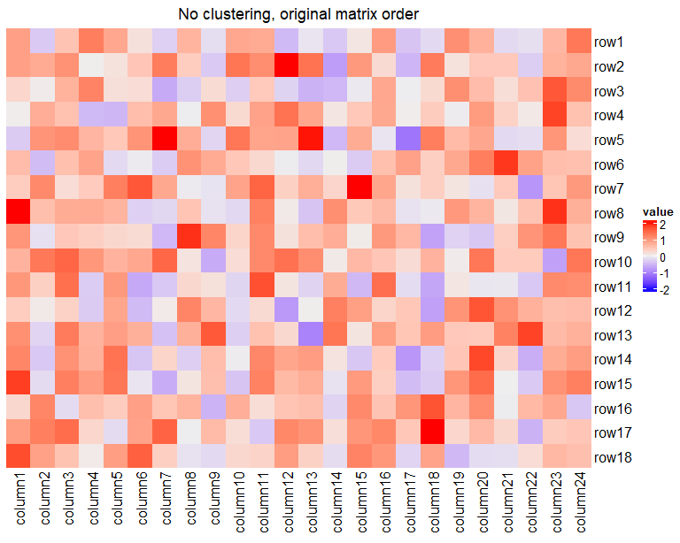
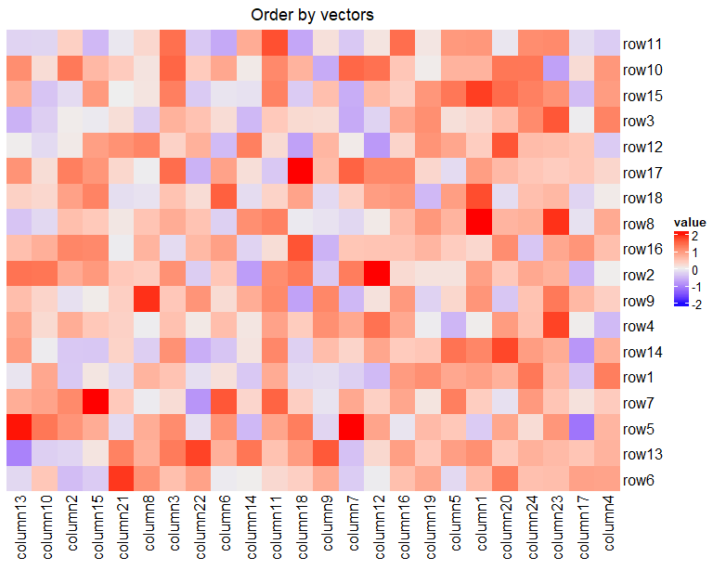
Row and column ordering (without clustering)
No clustering (original order)
Order by vectors
Heatmap(mat, name = "value", cluster_rows = F, cluster_columns = F, column_title = "No clustering, original matrix order")
row_vec = sample(1:nrow(mat)) column_vec = sample(1:ncol(mat)) Heatmap(mat, name = "value", row_order = row_vec, column_order = column_vec, column_title = "Order by vectors")

Slide 16
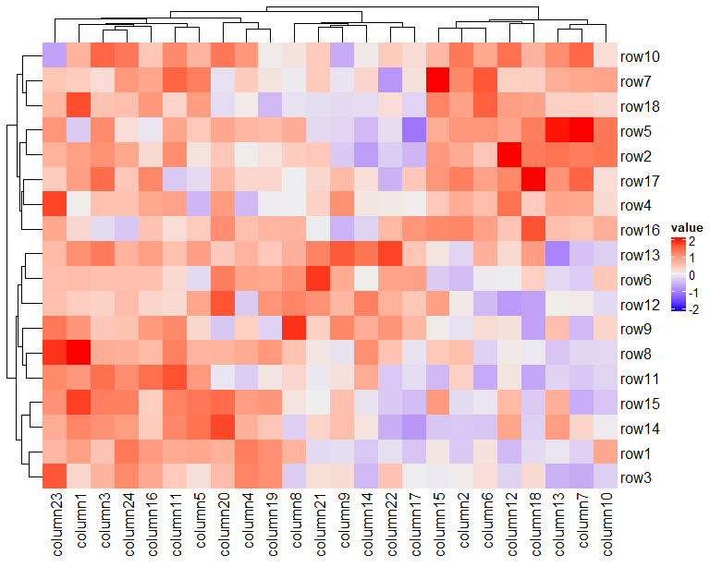
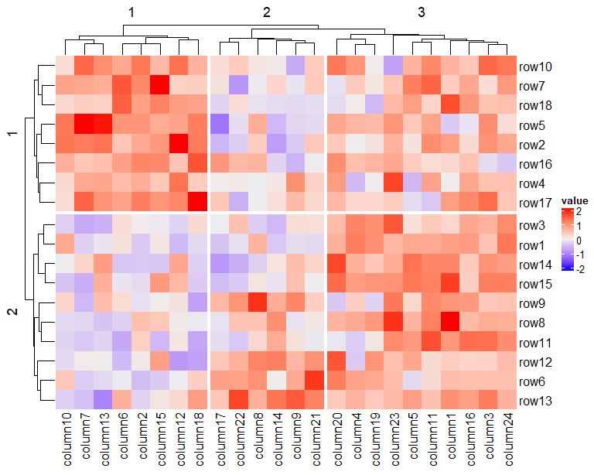
Clustering and splitting
You can specify clustering distance (clustering_distance_X) and linkage method (clustering_method_X), dendrogramm reordering function (X_dend_reorder) as well as a different clustering function (cluster_X).
Default clustering
Split dendrogramm branches
Heatmap(mat, name = "value", cluster_rows = T, cluster_columns = T)
Heatmap(mat, name = "value", row_split = 2, column_split = 3)

Slide 17
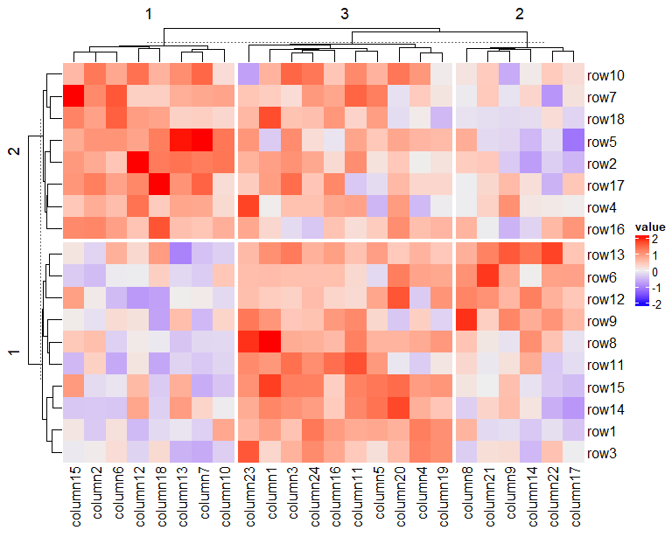
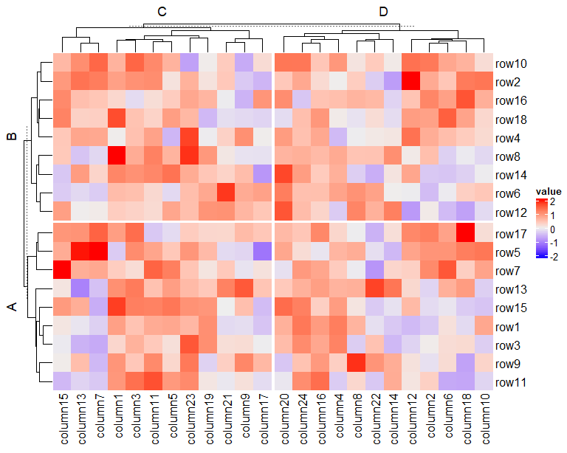
Splitting the Heatmap
K-mean clustering
Categorical vector(s)
Heatmap(mat, name = "value", row_km = 2, column_km = 3)
row_group = rep(c("A", "B"), 9) column_group = rep(c("C", "D"), 12) Heatmap(mat, name = "value", row_split = row_group, column_split = column_group)

Slide 18
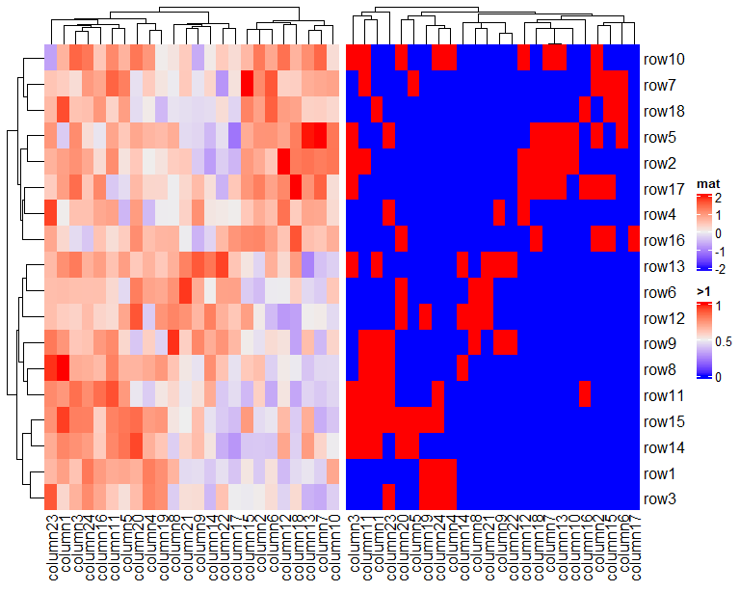
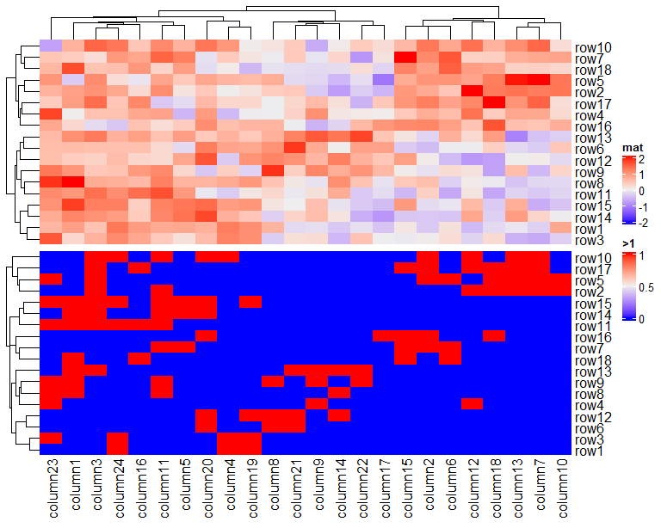
Heatmaps concatenation
Horizontal concatenation
The number of rows of all matrices have to match.
Vertical concatenation
The number of columns of all matrices have to match.
Heatmap(mat, name = "mat") + Heatmap(binary_mat, name = ">1")
Heatmap(mat, name = "mat") %v% Heatmap(binary_mat, name = ">1")

Slide 19
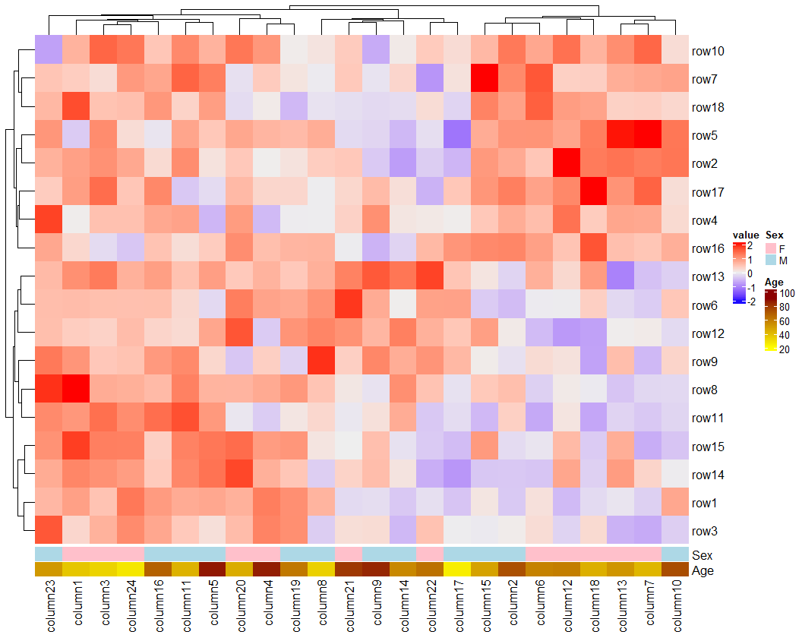
Heatmap annotations
Use HeatmapAnnotation function for column annotation, and rowAnnotation - for row annotation.
Data frame as data source for color bar annotation
df.samp = data.frame( Sex = sample(c("M", "F"), 24, replace = T), Age = sample(20:90, 24)) col_map = list( Sex = c(F = "pink", M = "lightblue"), Age = colorRamp2(c(20, 90), c("yellow", "darkred"))) ha = HeatmapAnnotation(df = df.samp, col = col_map) Heatmap(mat, name = "value", bottom_annotation = ha)

Slide 20
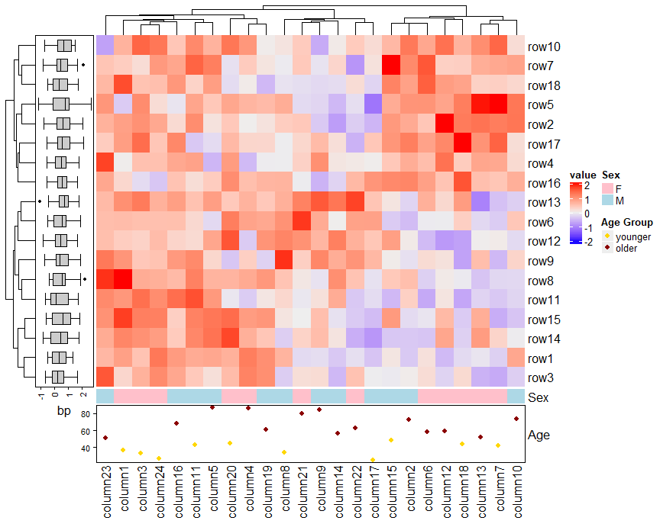
Helper functions and legends
Instead of data frame you can use vectors and matrices (numeric or categorical).
For annotations other than color bar (anno_simple) the legends need to be created explicitly, but it’s pretty simple.
df.samp$Age_group = ifelse( df.samp$Age > 50, "older", "younger") col_sex = c(F = "pink", M = "lightblue") col_age = c(younger = "gold", older = "darkred") ha = HeatmapAnnotation( Sex = df.samp$Sex, col = list(Sex = col_sex), Age = anno_points(df.samp$Age, gp = gpar(col = col_age[df.samp$Age_group]), height = unit(20,"mm"))) ha_row = rowAnnotation(bp = anno_boxplot(mat)) lgd_list = list( Legend(labels = c("younger", "older"), title = "Age Group", type = "points", pch = 16, legend_gp = gpar(col = col_age))) hm = Heatmap(mat, name = "value", bottom_annotation = ha, left_annotation = ha_row) draw(hm, annotation_legend_list = lgd_list)

Slide 21
Annotation helper functions
anno_simple (default)
anno_points
anno_lines
anno_barplot
anno_numeric
anno_text
anno_textbox
anno_boxplot
anno_histogram
anno_density
anno_joyplot
anno_horizon
anno_summary
anno_image
For more details: https://jokergoo.github.io/ComplexHeatmap-reference/book/heatmap-annotations.html

Slide 22
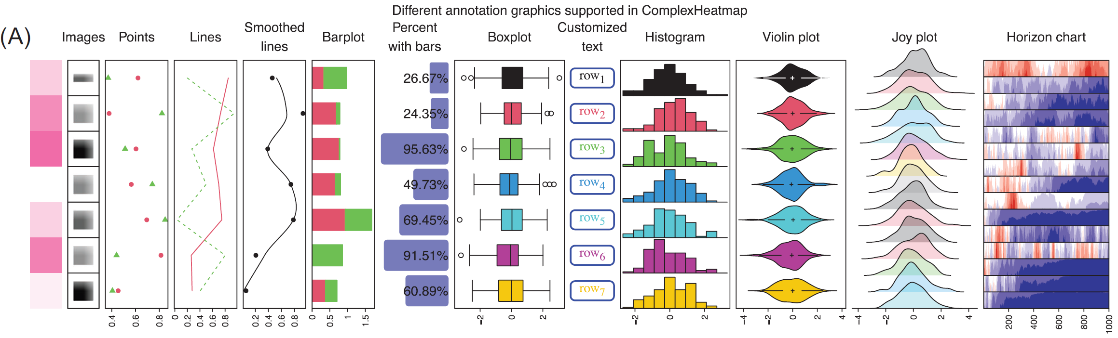
Examples of annotation

Slide 23
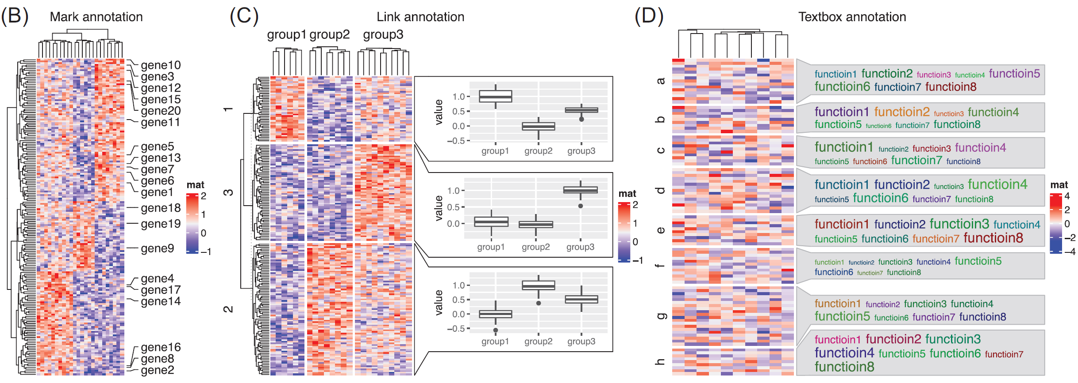
More advanced annotations

Slide 24
Heatmap Decoration
After Heatmap is created you can still add some decorating elements (text, lines, symbols, etc.) to different parts of the Heatmap (heatmap body, annotations, dendrograms, titles, row and column names).
decorate_heatmap_body
decorate_annotation
decorate_dend
decorate_title
decorate_dimnames
…
For more information and examples: https://jokergoo.github.io/ComplexHeatmap-reference/book/heatmap-decoration.html

Slide 25
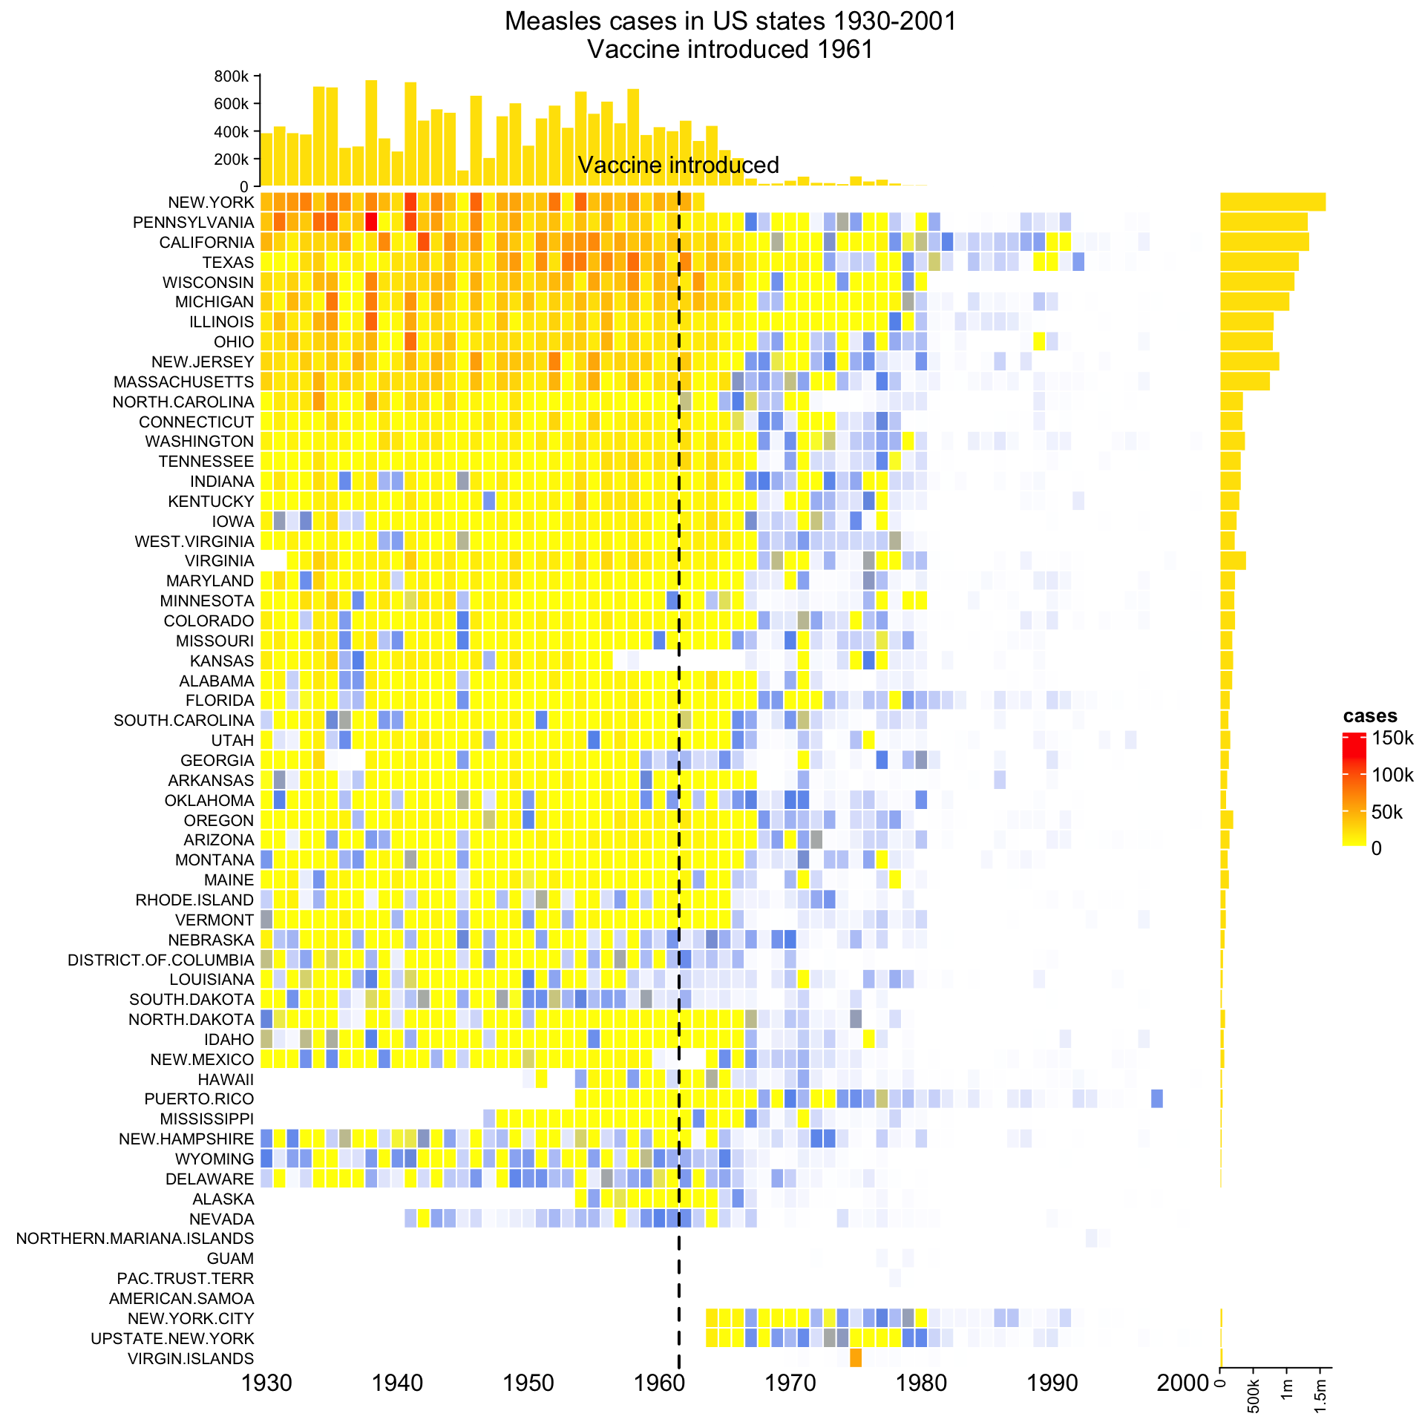
Example: Measles cases in US

Slide 26
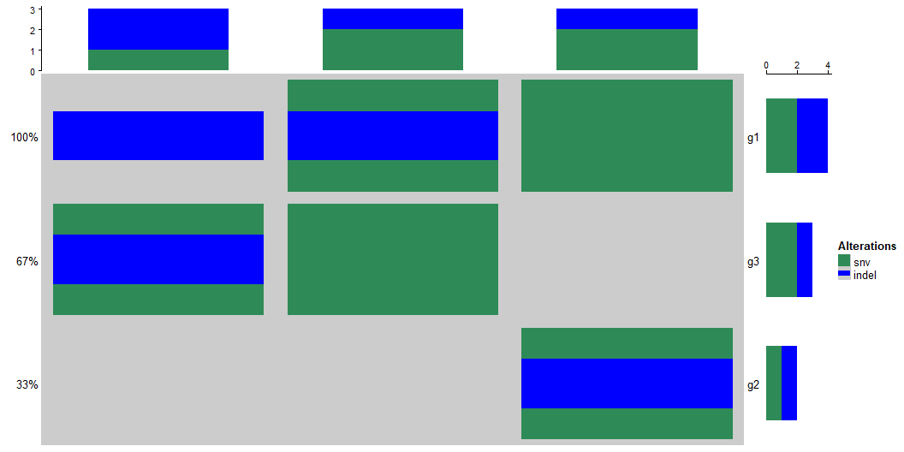
Oncoprint - visualizaing genomic alterations
mut = read.table(textConnection( "s1,s2,s3 g1,snv;indel,snv,indel g2,,snv;indel, g3,snv,,indel;snv"), row.names = 1, header = TRUE, sep = ",", stringsAsFactors = FALSE) mut = as.matrix(mut) mut
s1 s2 s3 g1 "snv;indel" "snv" "indel" g2 "" "snv;indel" "" g3 "snv" "" "indel;snv"
get_type_fun = function(x) strsplit(x, ";")[[1]] get_type_fun(mut[1, 1])
[1] "snv" "indel"
col = c(snv = "seagreen", indel = "blue") alter_fun = list( snv = function(x, y, w, h) grid.rect(x, y, w*0.9, h*0.9, gp = gpar(fill = col["snv"], col = NA)), indel = function(x, y, w, h) grid.rect(x, y, w*0.9, h*0.4, gp = gpar(fill = col["indel"], col = NA)) ) oncoPrint(mut, alter_fun = alter_fun, col = col)

Slide 27
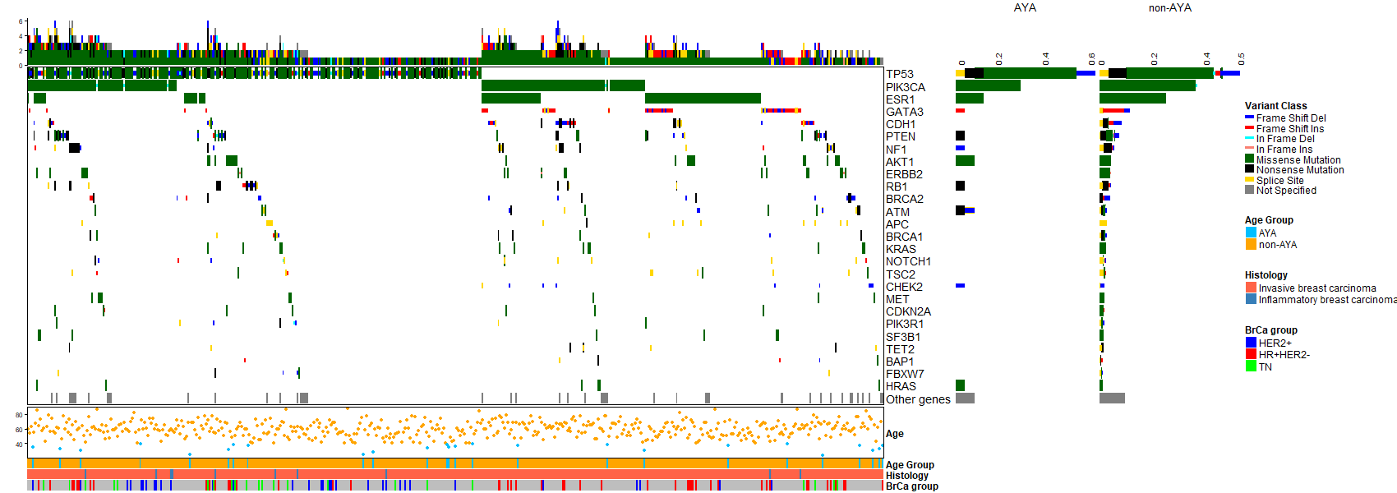
Oncoprint for AYA project
This Oncoprint represents 533 NCI-MATCH Breast cancer patients (including 25 AYA patients below 40 y.o.) and 26 oncogenic genes that were mutated in 6 or more patients.

Slide 28
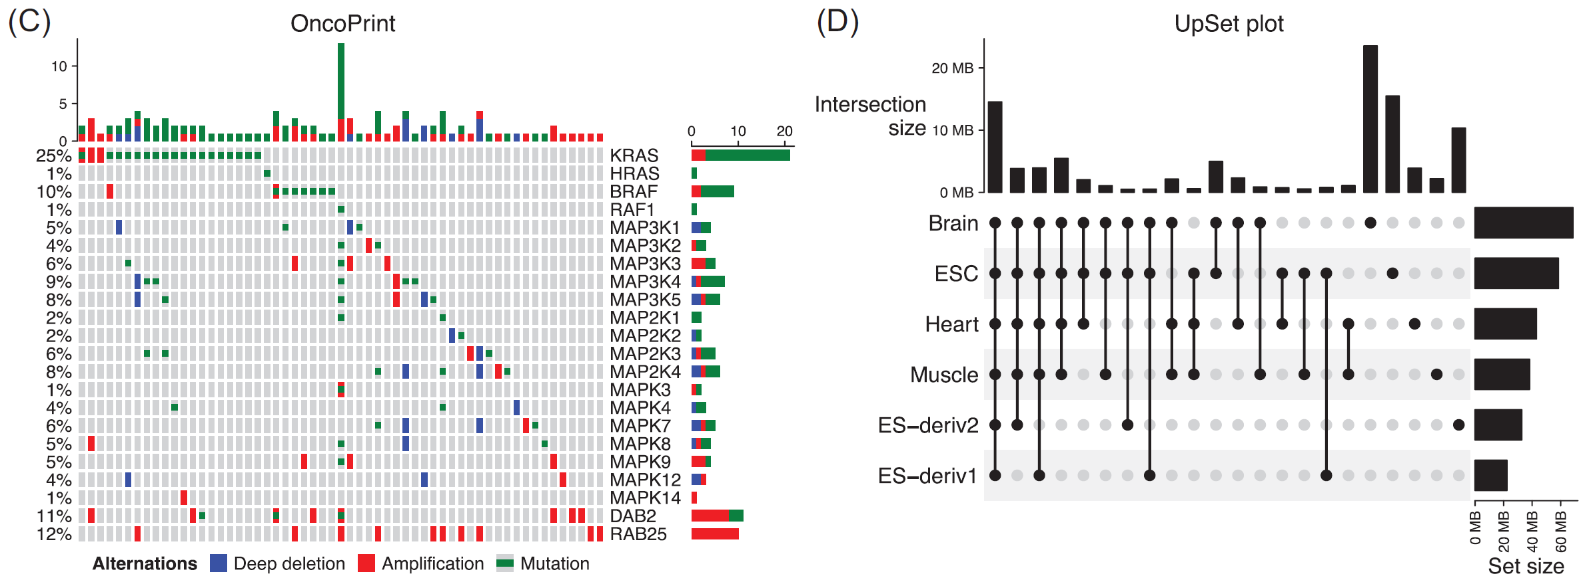
More ComplexHeatmap plots
C. The lung adenocarcinoma carcinoma dataset from cBioPortal (a subset)
D. The H3K4me3 ChIP-seq peaks from six human tissues are from the Roadmap project

Slide 29
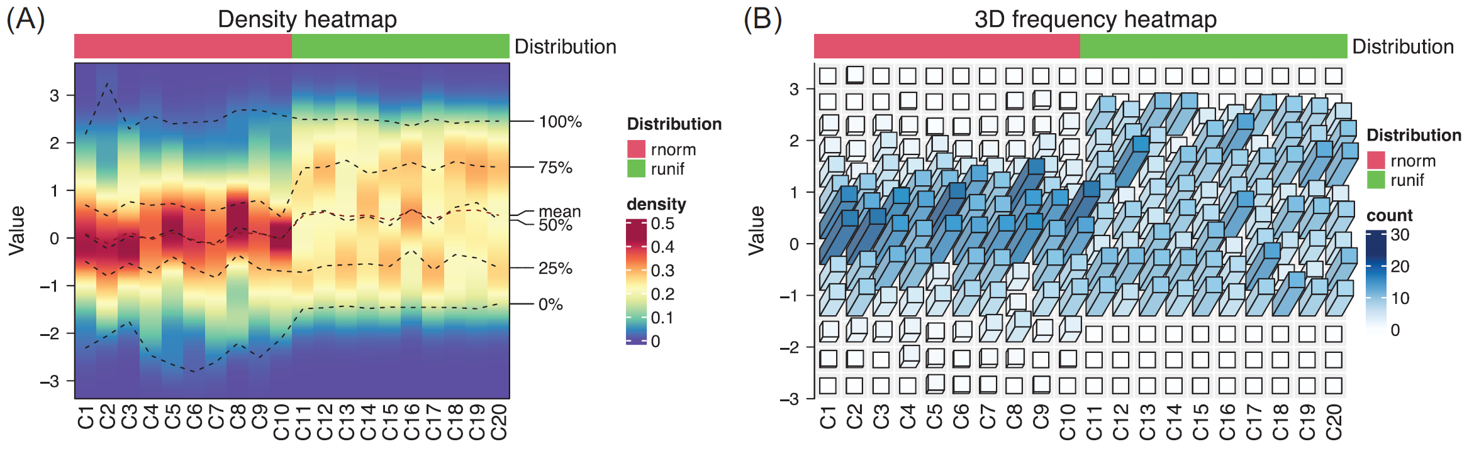
More ComplexHeatmap plots
Values in the first 10 columns are generated from the normal distribution, and values in the second 10 columns are generated from the uniform distribution.

Slide 30
Related packages
InteractiveComplexHeatmap - converts a Heatmap into a Shiny app
simplifyEnrichment - summarizes gene lists with gene enrichment analysis
EnrichedHeatmap - visualizes the enrichment of a certain type of genomic signal on a list of genomic features of interest. For example, how chromatin modifications are enriched around gene TSSs, or how DNA is lowly methylated around CGIs.
Some Helper packages
circlize - color functions
cluster, seration, biclust - additional clustering algorithms
dendextend - color and other rendering options for dendrograms
dendsort - dendrogram reordering
magick - rastering Heatmap
gridtext - customized text annotation

Slide 31
Reference and Help
To learn about ComplexHeatmap and related packages see https://jokergoo.github.io/ComplexHeatmap-reference/book.
Github: https://github.com/jokergoo/ComplexHeatmap
Ask questions, report bugs in the issues section of the Github.
Citations
Zuguang Gu, et al., Complex heatmaps reveal patterns and correlations in multidimensional genomic data, Bioinformatics, 2016.
Zuguang Gu. Complex Heatmap Visualization, iMeta, 2022.

