Slide 1
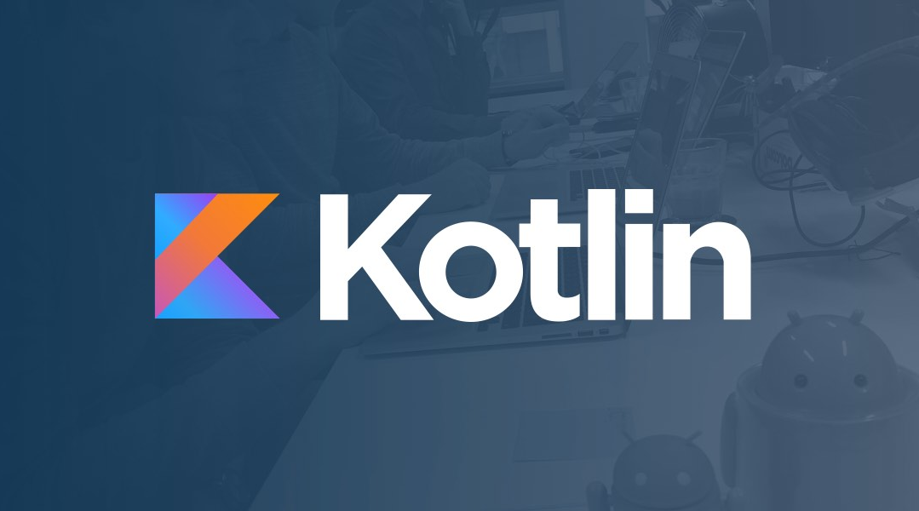
Kotlin Devlab Darmstadt Kickoff
Kotlin Devlab Darmstadt Kickoff
Powered by axxessio
Powered by axxessio

Slide 2






Kotlin Devlab Darmstadt
Kotlin Developer Community
to learn the essential and
best practices of Kotlin.
…

Slide 3

Introdution to Kotlin
What is Kotlin?
Basic Features of Kotlin
Demo: Android Development in Kotlin
Demo: Coroutines & Kotlin Multi-platform

Slide 4

Kotlin is an open source and statically typed programming language
Inspired by Java, C#, JavaScript, Scala and Groovy
Start Development
1.5 M + Users
96,000 repositories
Open Sourced
Released 1.01 – 1.07
2010
2011
2012
2016
2016 Q2 – Q4
2017
2018
JetBrains unveiled Project Kotlin
Q1: Released 1.0 (15th Feb)
Released 1.1
(1st March)
What is Kotlin?

Slide 5






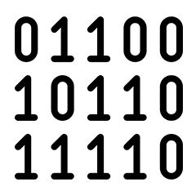

Builds Applications For
What can we do with Kotlin?

Slide 6

Pinterest
Uber
used by 150M people every month
for building internal tools
Gradle
Atlassian
language for writing build scripts
Trello Android app is in Kotlin.
Evernote
Coursera
integrated Kotlin into their Android client
App is partially written in Kotlin
Kotlin Usage Highlights

Slide 7
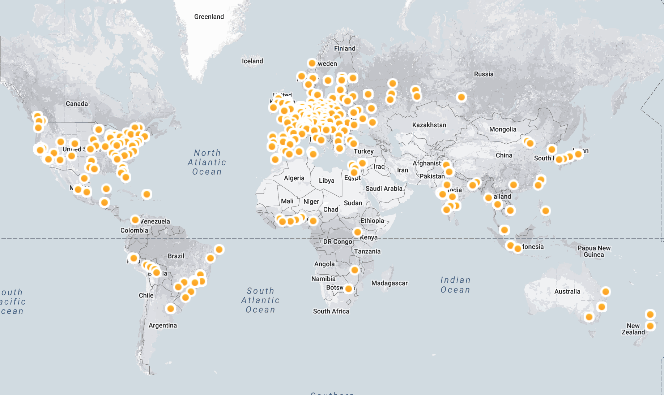
Most Loved Languages (2019)
Kotlin Usage Highlights

Slide 8
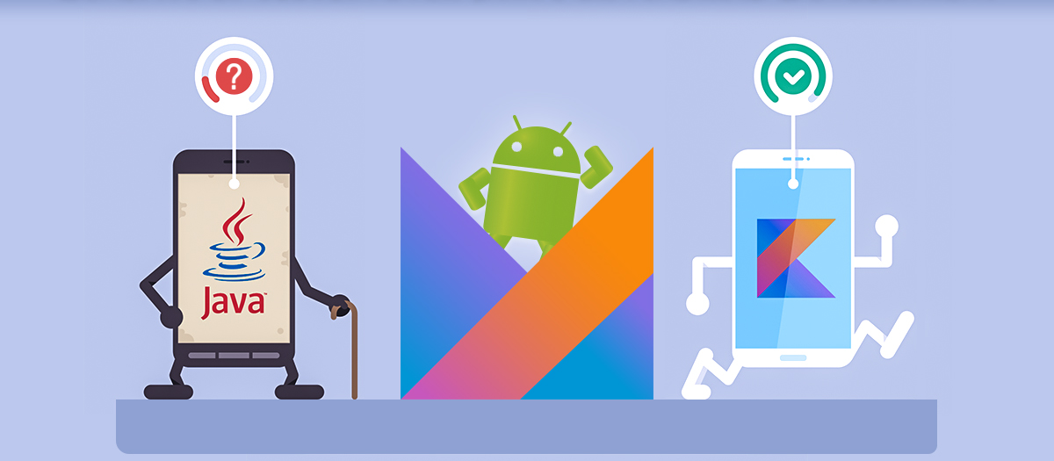
Basic Features of Kotlin

Slide 9
Tool-Friendly
Open Source
Versatile
Safe
Lean Syntax and Concise
Concise
Why Kotlin?

Slide 10
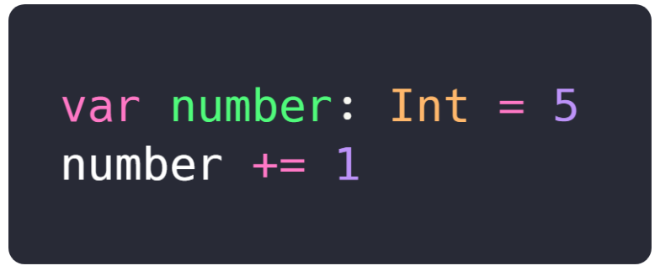
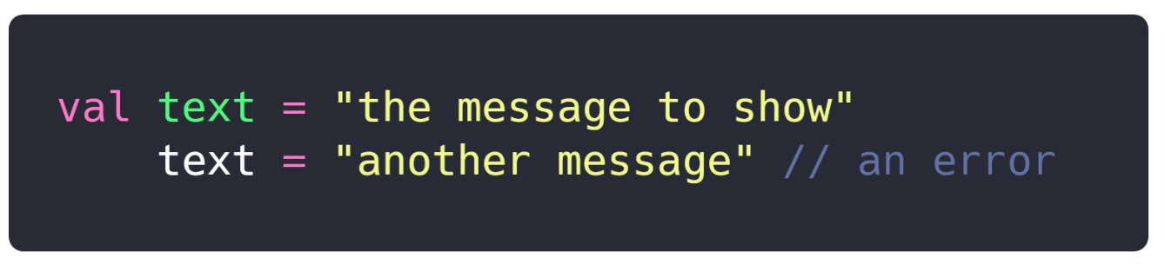
Variables
var and val keywords
var for variables that can be reassigned
val for variables which will be assigned only once

Slide 11
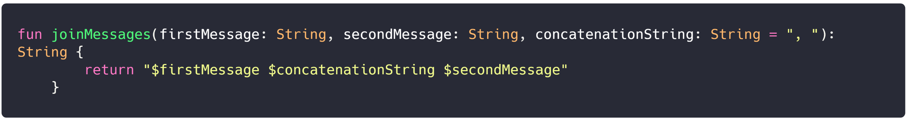
Functions
Declare function
Return type Unit used for functions with no return value

Slide 12
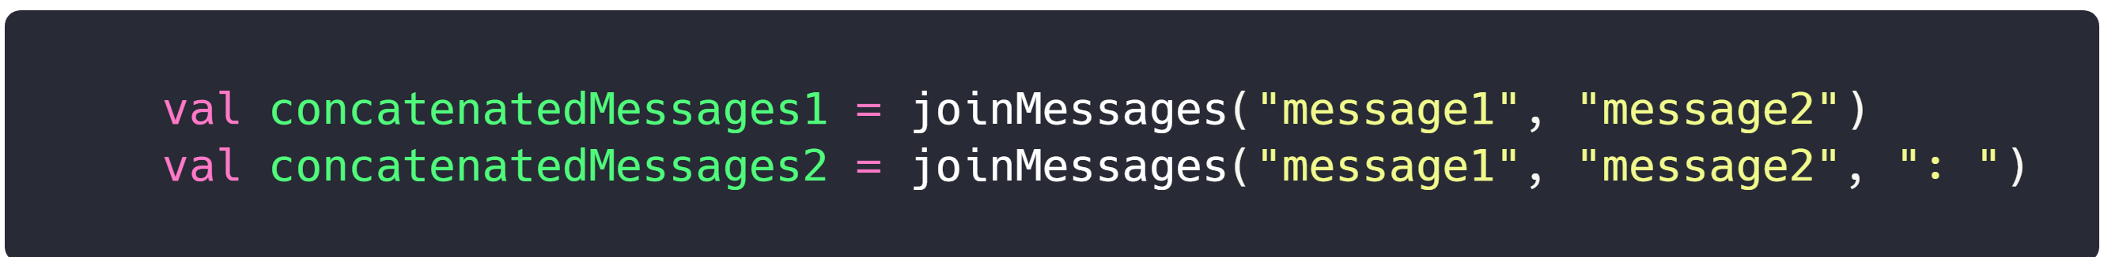
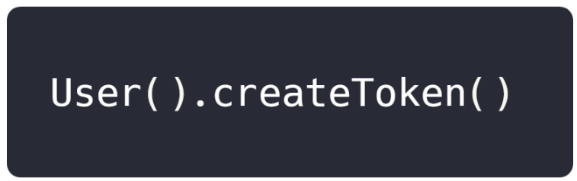
Functions
Call a function
Calling a function of a class

Slide 13
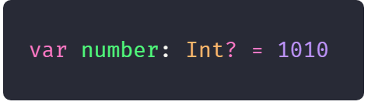
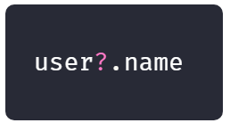
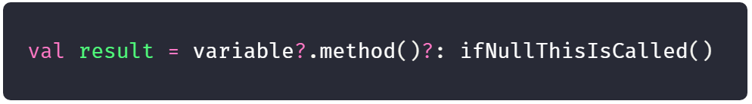
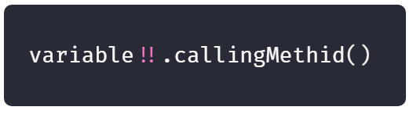
Null safety
All variables are non-nullable by default
If there is a need to set a null for a variable, it should be declared nullable explicitely:
Safe call operator ?.
Elvis operator
The !! operator denotes that a property is not a null

Slide 14
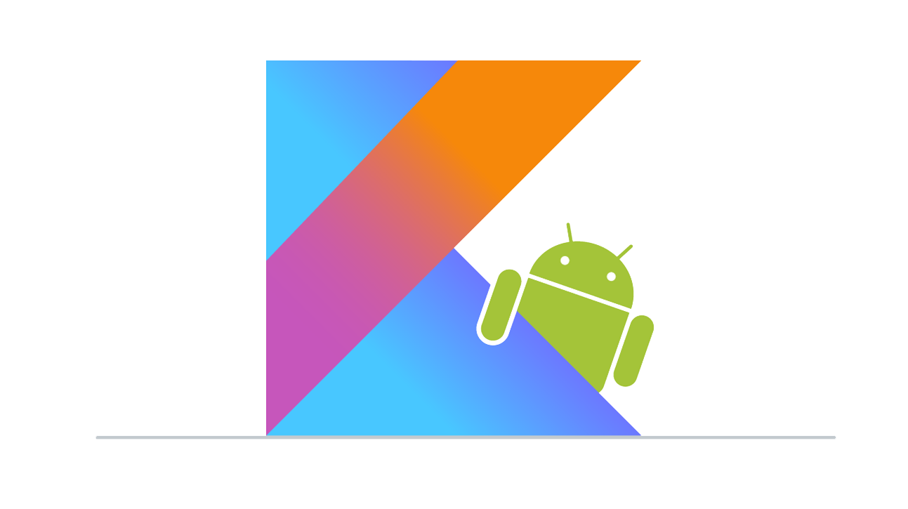
Demo: Android Development in Kotlin

Slide 15

Demo:
Coroutines
and
Kotlin Multiplatform

Slide 16


Feedback & Next Meetup
2 Months

Slide 17
What are you looking for next meetups in KOTLIN?
Focus on the programming language.
Android development
Applying Machine Learning / Voice

Slide 18
Thank you for your attention
Kotlin Devlab Darmstadt Kickoff
Kotlin Devlab Darmstadt Kickoff
Powered by axxessio
Powered by axxessio

