Slide 1
FANCY MECHANICAL FLOWER
DIGIFAB6
TRAN CHI LAN – ANNASTASIYA- NGUYEN NGOC QUOC DUNG - NGO TRUNG KIEN

Slide 2
Idea to created some surprise object which is easy to make and beautiful looking for decoration
https://sites.google.com/view/pdf-flower-project/home

Slide 3
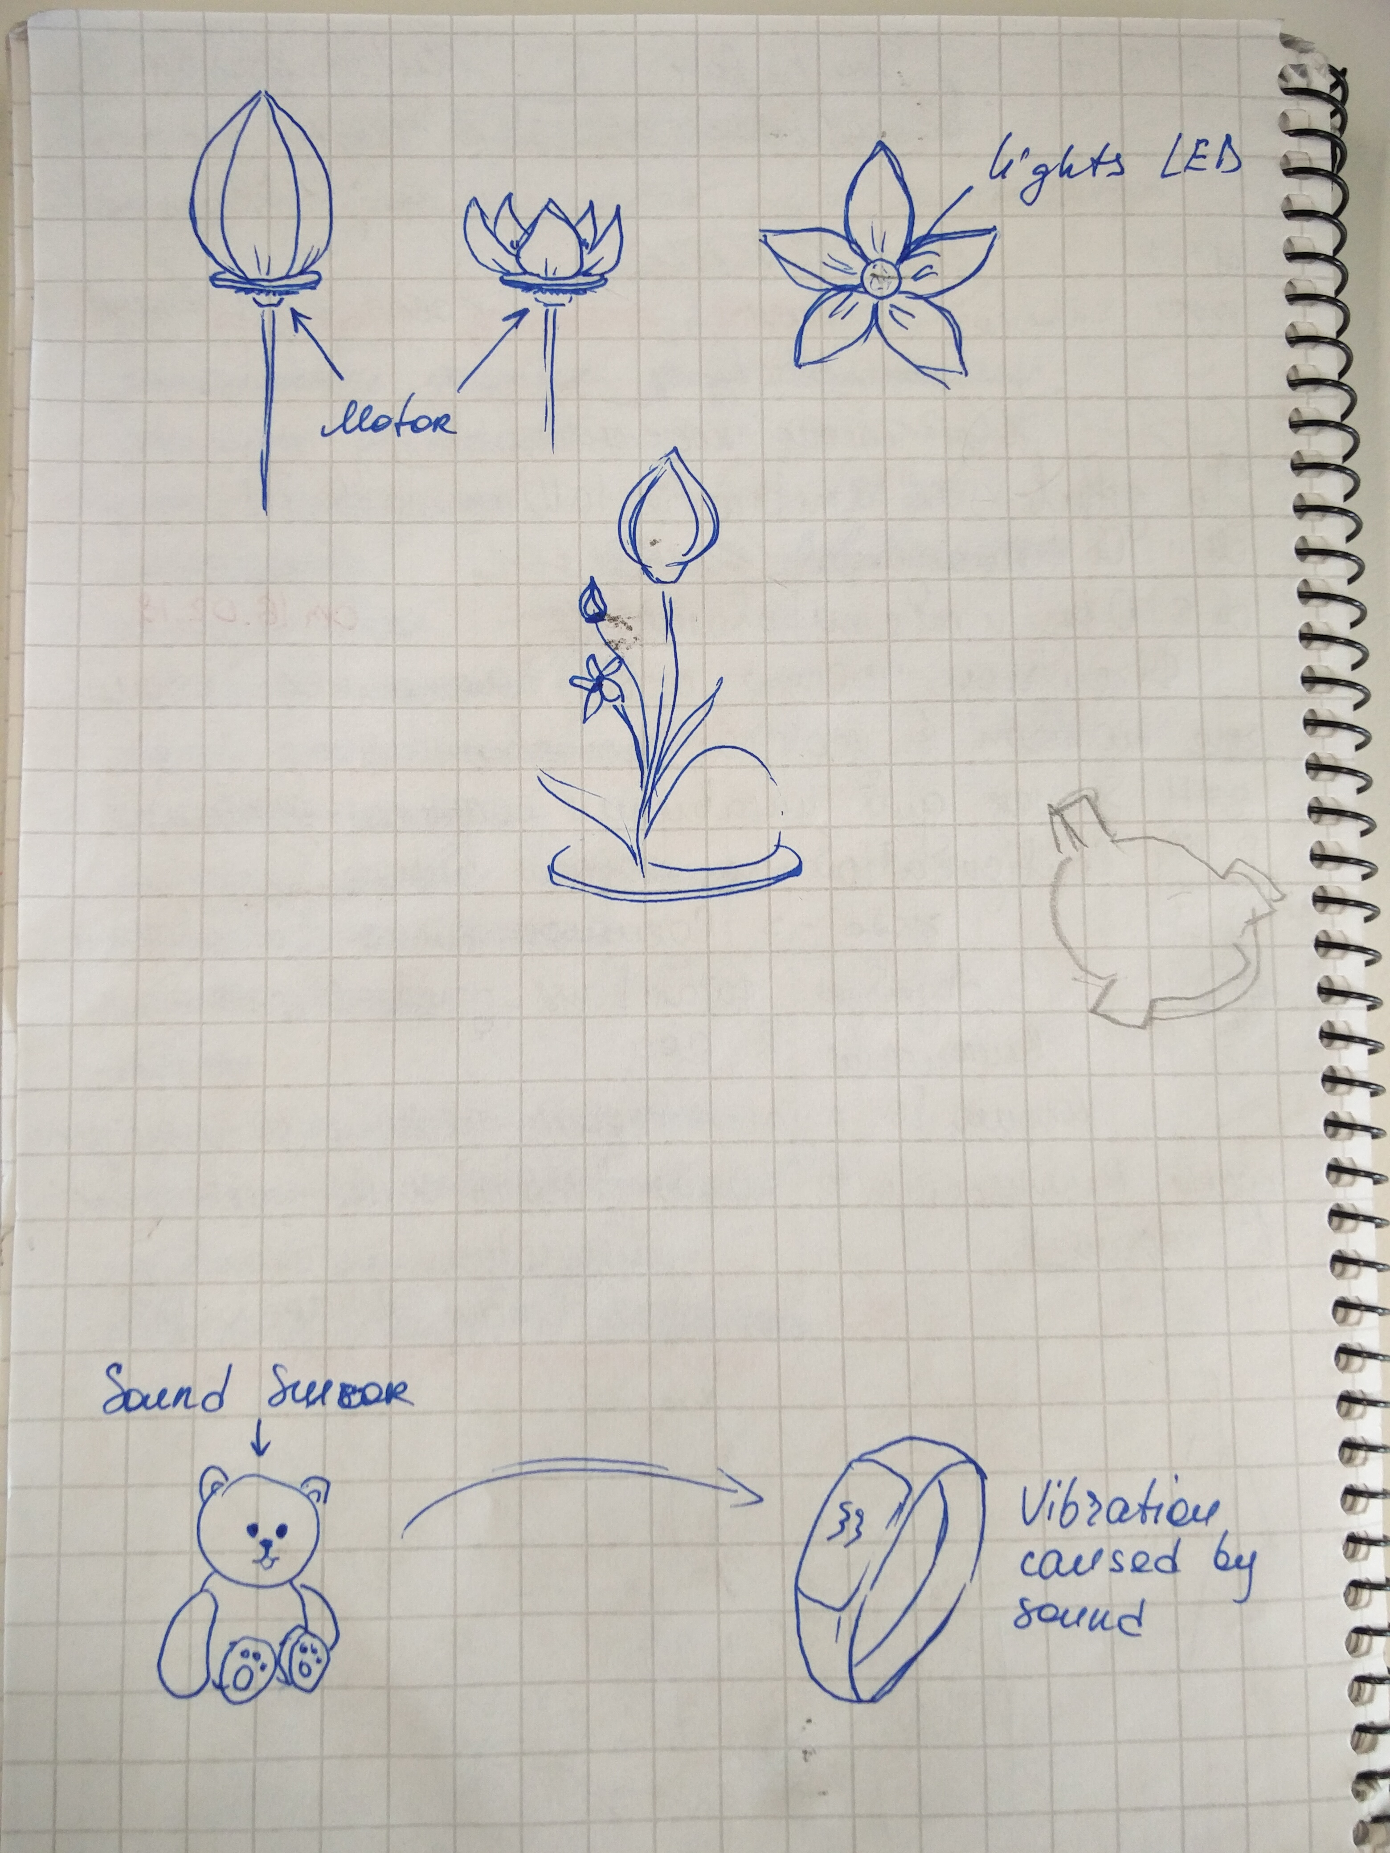
Arduino and Flower is two main concept of own project. Flower blooming when people touch it.
https://sites.google.com/view/pdf-flower-project/home

Slide 4
Future Plan We will testing the first prototype this week with all the parts of flower and Arduino rotation control. Testing coming up with activate part If we have more time, we will try replace Arduino UNO with Arduino LilyPad.
https://sites.google.com/view/pdf-flower-project/home

Slide 5
THANK YOU FOR YOUR ATTENTION
https://sites.google.com/view/pdf-flower-project/home

