Slide 1
Enon Kawatani
Created by Kotone Hayashi

Slide 2

Enon Kawatani
He is a musician

Slide 3
Overview
His background
His works
The influence of his works on me

Slide 4
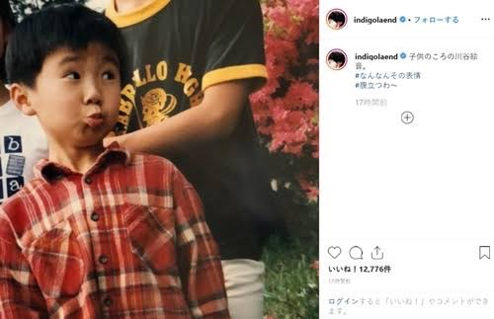
His background
He was born on December 3, 1988

Slide 5
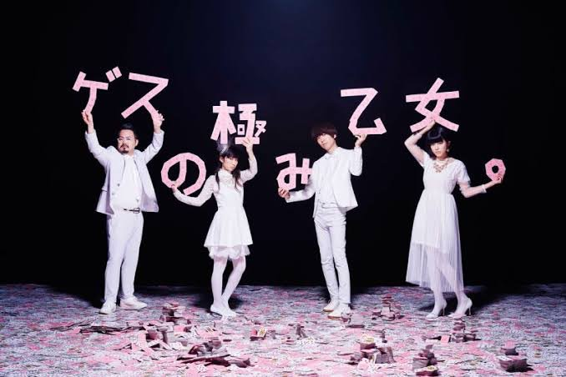

There were twists and turns …
Gesu no kiwami otome.
Indigo la End
And more …

Slide 6

His works
He makes cool songs anyway

Slide 7


Especially my favorite song
”Natsuyo no magic“ by indigo la End

Slide 8
The influence of his works on me
A period of time to think about your life
High School Graduation
Entered DHU

Slide 9

A period of time to
think about your life
I will continue to listen to the songs
made by "Enon Kawatani".

Slide 10

Conclusion
Enon Kawatani
He makes cool and
fashionable songs anyway.
Please listen to
the songs he made.

Slide 11
Thank you for listening my presentation

