Slide 1




Slide 2
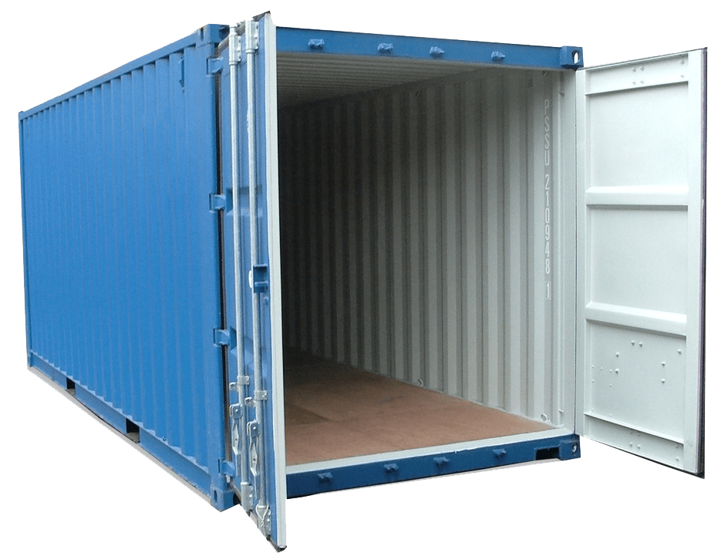
To be able be added to container net to meet requirements

Slide 3
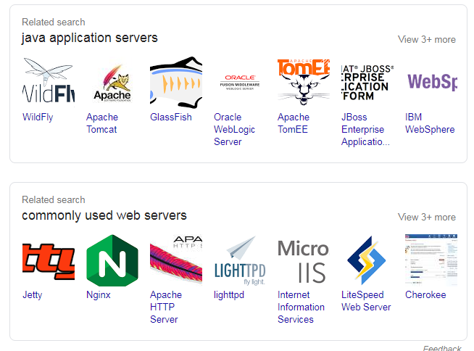
Web Containers/App Server

Slide 4
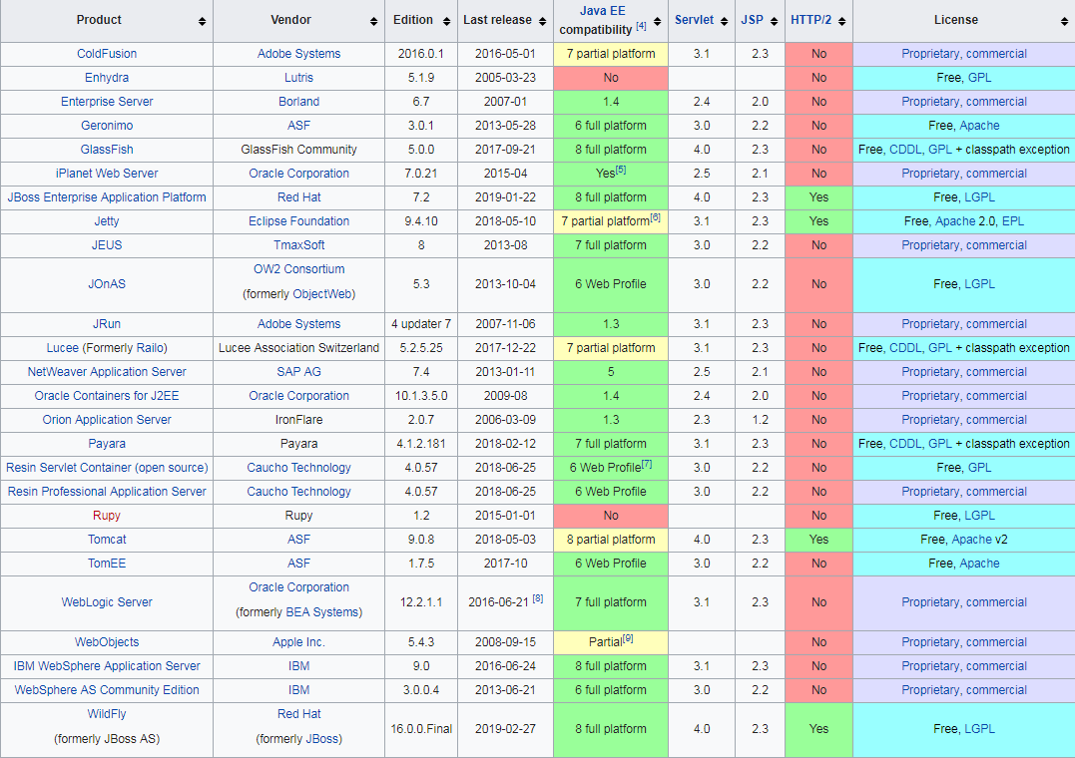
Notes:
JBoss AS/WildFly is the name for the community project that you can test. This community project will eventually become JBoss EAP. "WildFly" is just the new name for "AS", which stood for Application Serve
An application server is a software framework that provides both facilities to create web applications and a server environment to run them. Application Server Frameworks contain a comprehensive service layer model.
Tomcat is merely an HTTP server and Java servlet container. JBoss and GlassFish are full-blown Java EE application servers, including an EJB container and all the other features of that stack

Slide 5
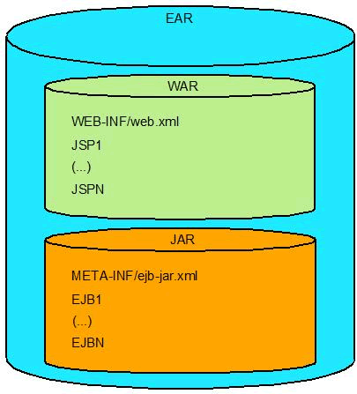
project
|-- pom.xml
`-- src
`-- main
`-- webapp
|-- WEB-INF
| `-- web.xml
`-- index.jsp

Slide 6
Questions
1. What is difference between ZIP and JAR ?
2. What server / container is better ?
3. Do tomcat support JEE2 ?
4. Do tomcat7 support Java 9 ?
5. Can I deploy ZIP to tomcat if it contains structure correct structure ?
6. Can maven do us a .war file ?

Slide 7
project
|-- pom.xml
`-- src
`-- main
`-- webapp
|-- WEB-INF
| `-- web.xml
`-- index.jsp

Slide 8
https://github.com/swampus/SDI_TRAINING_14_april

