Slide 1
Predicting the activity of a molecule
Our Dataset
2,594 molecules
169 binary features indicating the presence or absence of chemical substructures
Classified into three levels:
0: Not active
1: Weakly active
2: Strongly active
Our Goal
Is to discover which features most accurately predict molecular activity

Slide 2
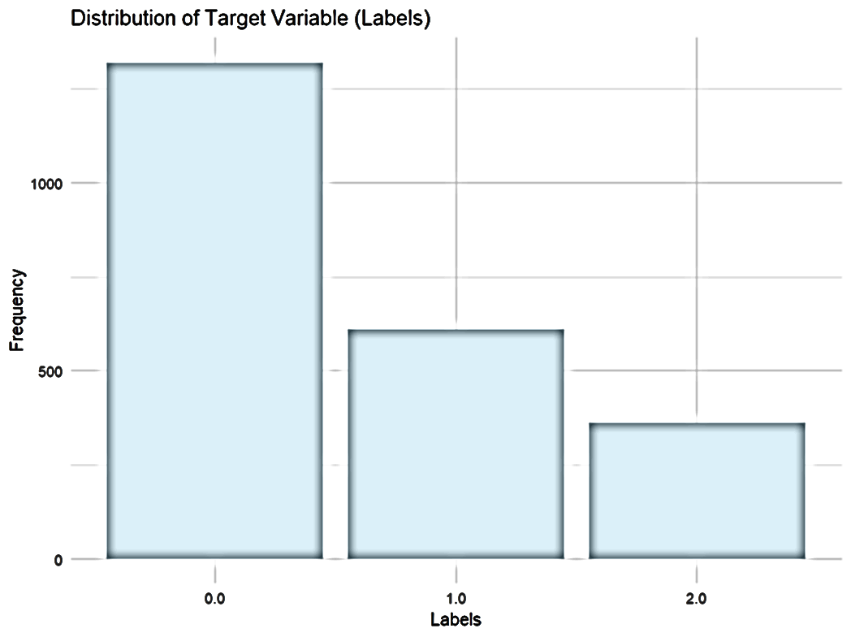
Distribution of the activity
Class | Count | Percentage
not active (0) | 1,506 | 58.1%
weakly active (1) | 674 | 26.0%
strongly active (2) | 414 | 15.9%

Slide 3
Preprocessing and Cleaning
No missing values
Average values for most features are very close to zero
Variances are low for most features
Removed molecules: 301 duplicates
Removed features: 9 zero-variance
20 highly correlated > 0.9
139 features remaining after cleaning

Slide 4
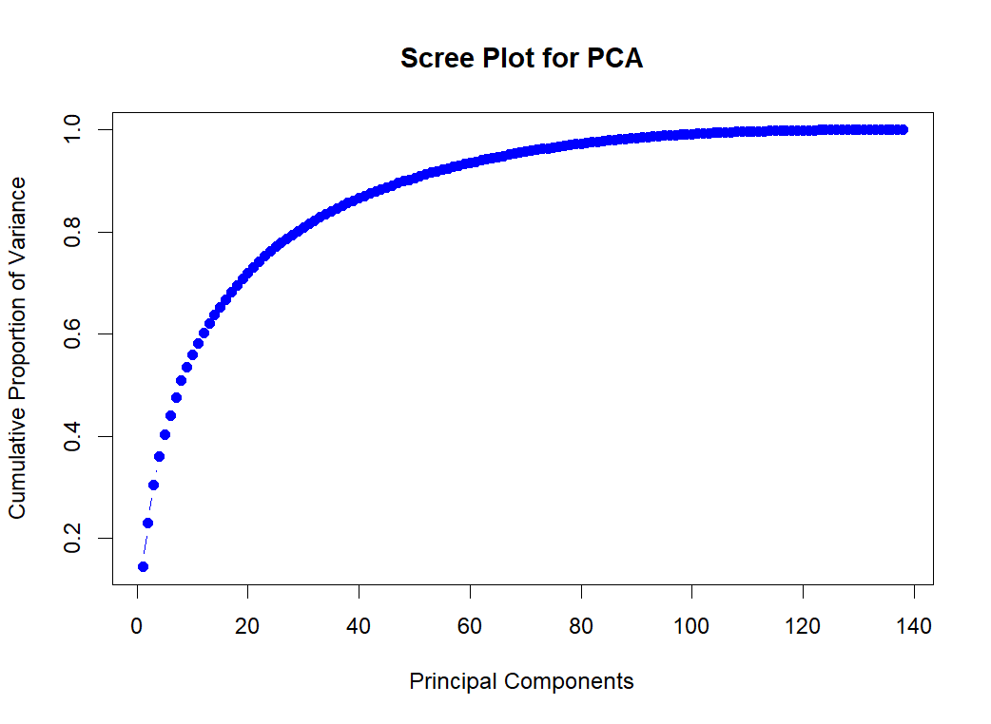
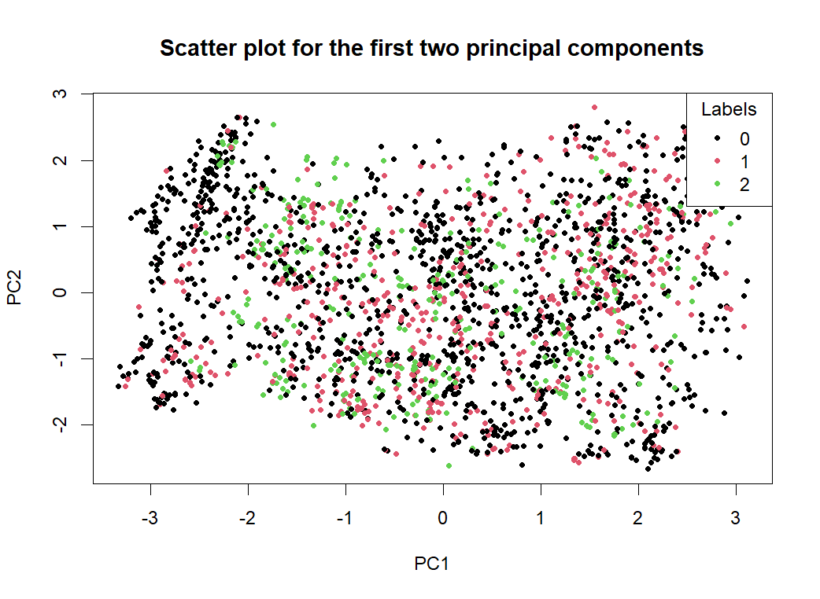
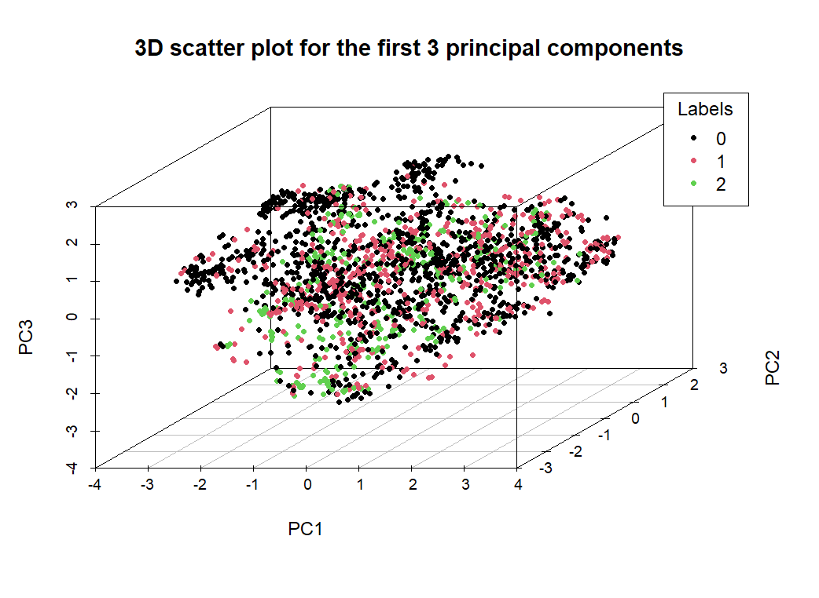
Principal Component Analysis (PCA)
PCA: Low class separation, ineffective for dimension reduction
70 principal components to explain at least 95% of the variance
It seems that molecular activity is not easily captured in a low-dimensional space

Slide 5
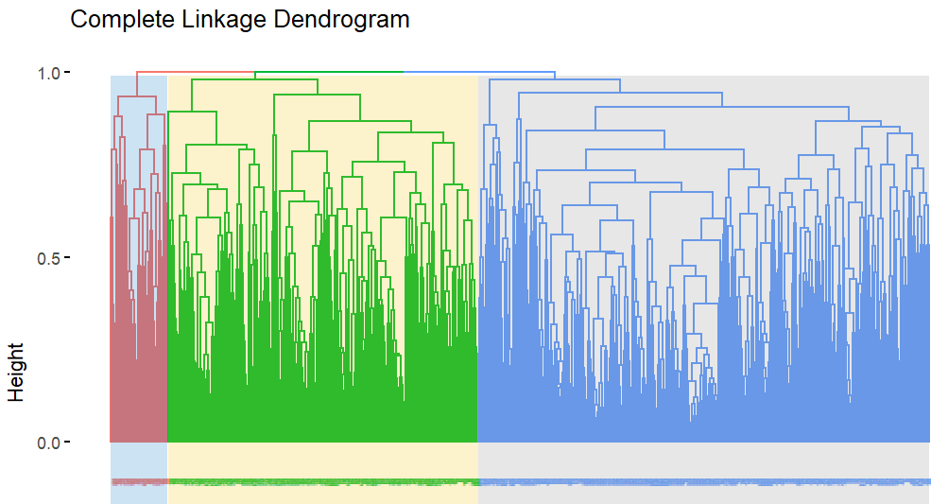
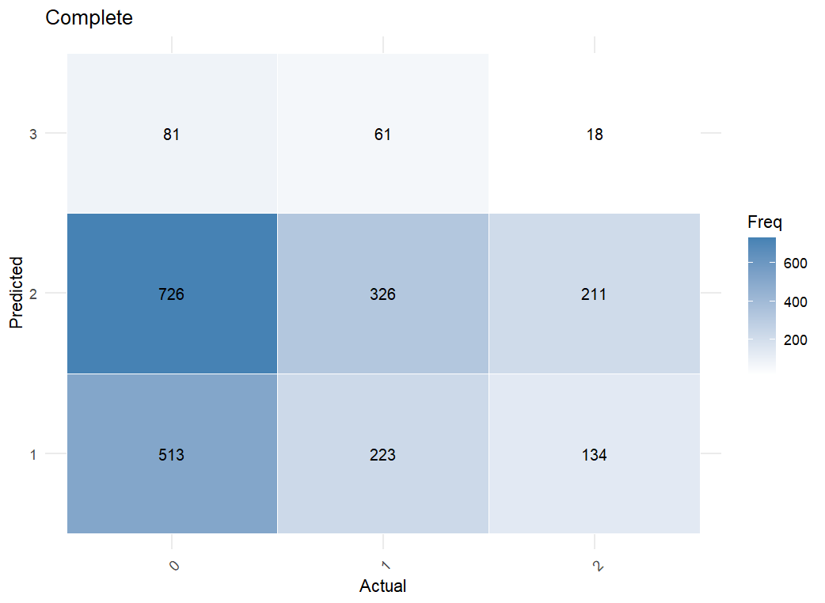
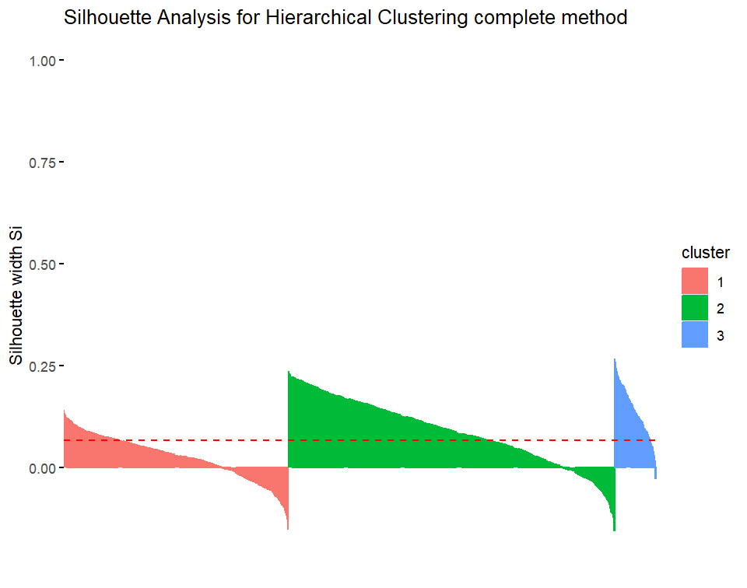
Complete linkage with jaccard distance appears to best match with actual classes.
Silhouette scores are low, especially in one cluster indicating overlap
Clustering quality is not strong
Clustering Analysis
Hierarchical Clustering

Slide 6
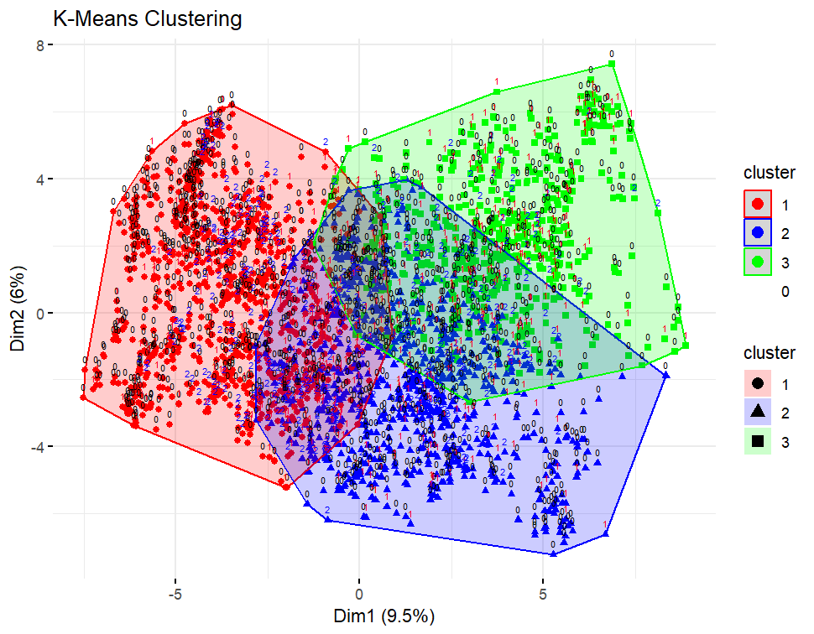
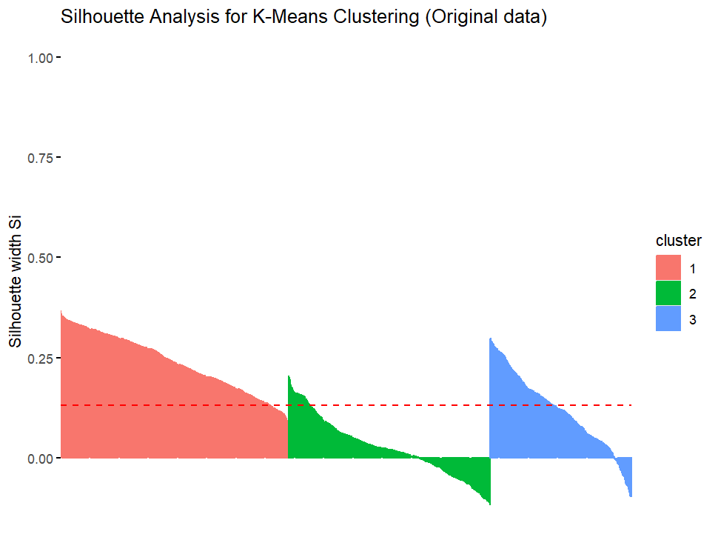
Silhouette scores are low, especially in cluster 2.
Clusters overlap heavily with no clear boundaries.
True labels are mixed across clusters, suggesting weak correspondence to actual class structure.
Despite some separation, K-Means does not reveal a strong 3-cluster pattern in this dataset.
Clustering Analysis
K-MEANS clustering

Slide 7
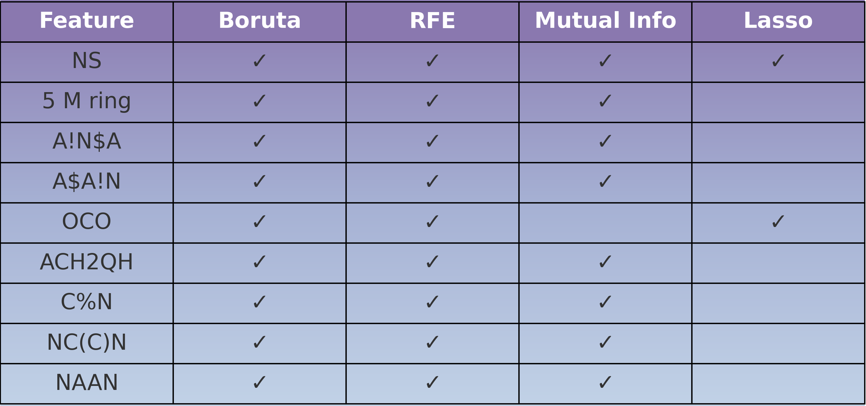
Feature Selection
Methods: Lasso, Boruta, RFE, Mutual Info
While Boruta, RFE, and Mutual Information consistently agree on key features, LASSO selects a completely different set.
NS and OCO pop up everywhere, so they seem like solid features.

Slide 8
Classification
Models
Support Vector Machines (SVM)
Multinomial Logistic Regression (MLR)
Random Forest with ranger (RF ranger)
Feature Count Tuning
Tested different numbers of top mutual features (20–120) using two strategies for ranking.
Best results at 70–90 features.
Class Weighting
Applied weights to handle class imbalance:
Class 0 → 0.7, Class 1 → 1.1, Class 2 → 1.8

Slide 9
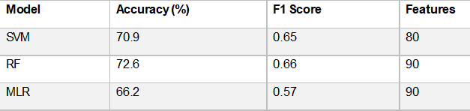
Classification
Model Performance Metrics
Random Forest consistently outperformed the others in Accuracy, Macro F1, and Kappa
MLR excluded from comparison due to lack of class weight support

Slide 10
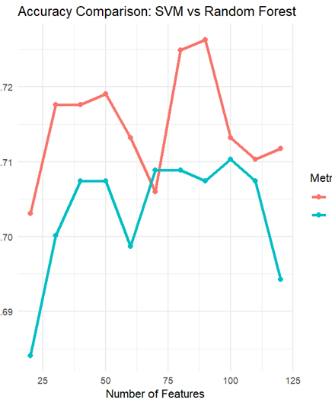
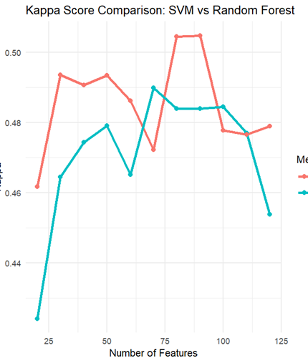
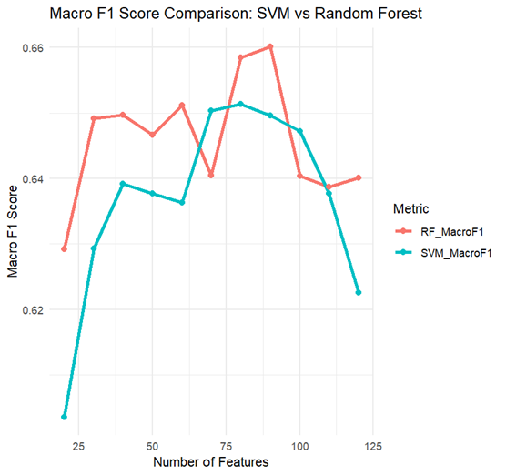
Classification
Best model :
Random Forest with 90 features
Accuracy: 72.6%, Macro F1: 0.66, Kappa: 0.50
The plots make it super clear that the random forest algorithm (red line) totally beats the Support Vector Machines (SVM) (blue line) in all metrics.

Slide 11
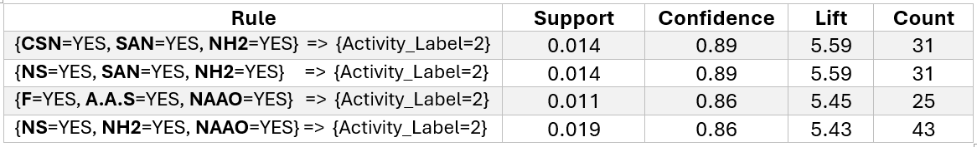
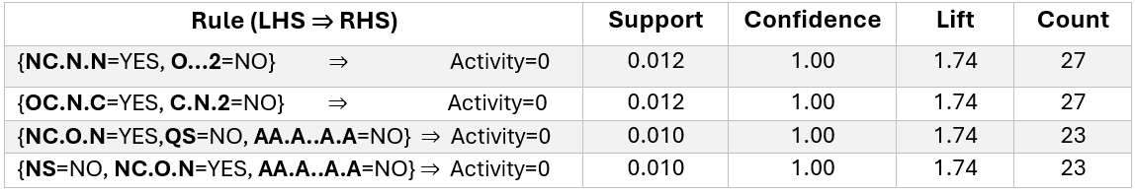
Association Rules
Class 2 (strong): NH2, NS, CSN, SAN
Class 0 (inactive): Some rules predicted inactivity with 100% confidence, though with low support

