Slide 1
Asymptotic Notations
Lecture 03

Slide 2
Learning Outcome
After completion of today’s session you will be able to:
Define asymptotic notations
Describe various properties of asymptotic notations

Slide 3
Asymptotic Complexity
In this course, we care most about asymptotic performance
  How does the algorithm behave as the problem size gets very large?
    Running time
    Memory/storage requirements
    Bandwidth/power requirements/logic gates/etc.
Asymptotic Notations are languages that allow us to analyze an algorithm’s running time by identifying its behavior as the input size for the algorithm increases.
This is also known as an algorithm’s growth rate.

Slide 4
Analysis of Algorithms
Analysis is performed with respect to a computational model
We will usually use a generic uniprocessor random-access machine (RAM)
  All memory equally expensive to access
  No concurrent operations
  All reasonable instructions take unit time
    Except, of course, function calls
  Constant word size
    Unless we are explicitly manipulating bits

Slide 5
Input Size
Time and space complexity
  This is generally a function of the input size
    E.g., sorting, multiplication
  How we characterize input size depends:
    Sorting: number of input items
    Multiplication: total number of bits
    Graph algorithms: number of nodes & edges
    Etc

Slide 6
Space complexity
The space Complexity of an algorithm is the total space taken by the algorithm with respect to the input size.
Space complexity includes both Auxiliary space and space used by input.
Auxiliary Space is the extra space or temporary space used by an algorithm.

Slide 7
Running Time
Number of primitive steps that are executed
  Except for time of executing a function call most statements roughly require the same amount of time
    y = m * x + b
    c = 5 / 9 * (t - 32 )
    z = f(x) + g(y)
We can be more exact if need be

Slide 8
Analysis
Worst case
  Provides an upper bound on running time
  An absolute guarantee
Average case
  Provides the expected running time
  Very useful, but treat with care: what is “average”?
    Random (equally likely) inputs
    Real-life inputs
    Best case

Slide 9
Asymptotic Notation
Θ, O, Ω, o, ω
Defined for functions over the natural numbers.
  Ex: f(n) = Θ(n²).
  Describes how f(n) grows in comparison to n².
Define a set of functions; in practice used to compare two function sizes.
The notations describe different rate-of-growth relations between the defining function and the defined set of functions.

Slide 10

O-notation
For function g(n), we define O(g(n)), big-O of n, as the set:
O(g(n)) = {f(n) :
∃ positive constants c and n_{0,} such that ∀n ≥ n₀,
we have 0 ≤ f(n) ≤ cg(n) }
Intuitively: Set of all functions whose rate of growth is the same as or lower than that of g(n).
g(n) is an asymptotic upper bound (Worst case) for f(n).
f(n) = Θ(g(n)) ⇒ f(n) = O(g(n)).
Θ(g(n)) ⊂ O(g(n)).

Slide 11

Θ-notation
For function g(n), we define Θ(g(n)), big-Theta of n, as the set:
Θ(g(n)) = {f(n) :
∃ positive constants c₁, c₂, and n_{0,} such that ∀n ≥ n₀,
we have 0 ≤ c₁g(n) ≤ f(n) ≤ c₂g(n)
}
Intuitively: Set of all functions that
have the same rate of growth as g(n).
g(n) is an asymptotically tight bound (Avg case) for f(n).

Slide 12

Ω -notation
For function g(n), we define Ω(g(n)), big-Omega of n, as the set:
Ω(g(n)) = {f(n) :
∃ positive constants c and n_{0,} such that ∀n ≥ n₀,
we have 0 ≤ cg(n) ≤ f(n)}
Intuitively: Set of all functions whose rate of growth is the same as or higher than that of g(n).
g(n) is an asymptotic lower bound (best case) for f(n).
f(n) = Θ(g(n)) ⇒ f(n) = Ω(g(n)).
Θ(g(n)) ⊂ Ω(g(n)).

Slide 13
Relations Between Θ, O, Ω

Slide 14
Relations Between Θ, Ω, O
Theorem : For any two functions g(n) and f(n),
f(n) = Θ(g(n)) iff
f(n) = O(g(n)) and f(n) = Ω(g(n)).

Slide 15
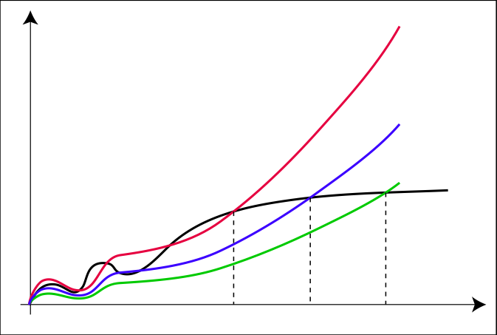
o-notation
For a given function g(n), the set little-o:
o(g(n)) = {f(n): ∀ c > 0, ∃ n₀ > 0 such that
∀ n ≥ n₀, we have 0 ≤ f(n) < cg(n)}.
c₃ ⋅ g
c₂ ⋅ g
c₁ ⋅ g
f
n₁
n₂
n₃

Slide 16
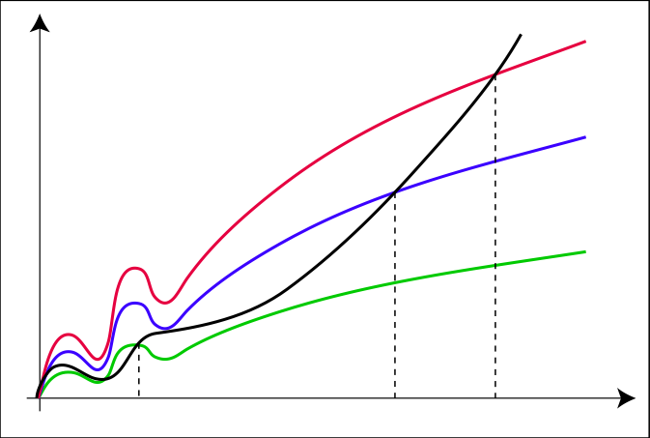
ω -notation
For a given function g(n), the set little-omega:
ω(g(n)) = {f(n): ∀ c > 0, ∃ n₀ > 0 such that
∀ n ≥ n₀, we have 0 ≤ cg(n) < f(n)}.
f
c₃ ⋅ g
c₂ ⋅ g
c₁ ⋅ g
n₁
n₂
n₃

Slide 17
Properties
Transitivity
f(n) = Θ(g(n)) & g(n) = Θ(h(n)) ⇒ f(n) = Θ(h(n))
f(n) = O(g(n)) & g(n) = O(h(n)) ⇒ f(n) = O(h(n))
f(n) = Ω(g(n)) & g(n) = Ω(h(n)) ⇒ f(n) = Ω(h(n))
f(n) = o (g(n)) & g(n) = o (h(n)) ⇒ f(n) = o (h(n))
f(n) = ω(g(n)) & g(n) = ω(h(n)) ⇒ f(n) = ω(h(n))
Reflexivity
f(n) = Θ(f(n))
f(n) = O(f(n))
f(n) = Ω(f(n))

Slide 18
Properties
Symmetry
f(n) = Θ(g(n)) iff g(n) = Θ(f(n))
Complementarity
f(n) = O(g(n)) iff g(n) = Ω(f(n))
f(n) = o(g(n)) iff g(n) = ω ((f(n))

Slide 19
Properties
If f(n) = O(g(n)) and
d(n) = O(h(n))
then
f(n)+d(n)=O(max(g(n),h(n)))
f(n).d(n)=O(g(n).h(n))
If f(n)=O(g(n))
then
f(n).h(n)=O(g(n).h(n))

Slide 20
Thank You

