Slide 1


NEXT GEN EMPLOYABILITY PROGRAM
CREATING A FUTURE-READY WORKFORCE

Slide 2
Student Name :Vaibhav Ramachandra Kottari
Student ID :STU65203c5194c231696611409
College Name :St Joseph Engineering College , Mangalore

Slide 3
CAPSTONE PROJECT SHOWCASE
Project Title : HealthCare Prediction on Diabetic Patients using Python
Abstract | Problem Statement | Project Overview | Proposed Solution | Technology Used | Modelling & Results | Conclusion | Q&A

Slide 4
Abstract
This study focuses on utilizing machine learning and predictive analytics to enhance diabetes management.
The project involves developing models to analyze patient data, including glucose levels, BMI, and family history, aiming for early detection of diabetes.
Machine learning algorithms will be implemented to stratify diabetic patients based on their risks of complications, allowing for prioritized interventions.
The project emphasizes the customization of personalized treatment plans by utilizing predictive analytics. This includes consideration of individual factors such as age, lifestyle, etc.
Additionally, the research aims to develop models for predicting blood glucose levels in diabetic patients to empower proactive management and informed decision-making.
The overall contribution of this research lies in advancing healthcare practices through a comprehensive approach to diabetes care, encompassing early detection, risk stratification, personalized treatment, and predictive modeling.

Slide 5
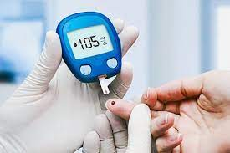
Problem Statement
In response to the pressing need for improved diabetes management, this project seeks to develop models that accurately predict the likelihood of diabetes in patients. The project aims to enable proactive interventions and personalized treatment plans, ultimately enhancing healthcare outcomes for individuals at risk or already diagnosed with diabetes.

Slide 6
Project Overview
The project is centered around the transformative application of advanced data analytics and machine learning techniques to revolutionize diabetes management.
The primary goal is to develop accurate predictive models by analyzing a comprehensive healthcare dataset, with a specific focus on early detection of diabetes.
This initiative aims to enable proactive intervention and facilitate personalized treatment plans for individuals at risk or already diagnosed with diabetes.
The project encompasses various crucial aspects, ranging from meticulous data preprocessing to the implementation of sophisticated machine learning algorithms.
The overarching objective is to significantly improve healthcare outcomes for the target population, emphasizing the importance of early detection and tailored interventions in the realm of diabetes care.

Slide 7
Proposed Solution
The proposed solution encompasses a multifaceted approach, leveraging advanced analytics and machine learning techniques to revolutionize diabetes care.
Comprehensive Data Analysis: Conduct in-depth analysis of a comprehensive healthcare dataset, integrating key medical predictor variables related to diabetes.
Predictive Model Development: Employ advanced machine learning algorithms to develop accurate predictive models for early detection of diabetes.
Proactive Intervention: Enable proactive intervention strategies based on predictive insights, ensuring timely and targeted healthcare measures.
Personalized Treatment Plans: Tailor treatment plans for individuals at risk or diagnosed with diabetes by considering unique patient profiles.
Data Preprocessing Excellence: Implement rigorous data preprocessing methodologies to ensure dataset integrity and quality.
Ethical Considerations: Address ethical considerations, including bias mitigation in algorithms, to ensure fairness and equity in healthcare technology.

Slide 8

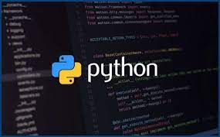
Technology Used
Jupyter Notebook : Jupyter Notebooks were employed to create an interactive and collaborative coding environment. Jupyter Notebooks serve as effective documentation tools, allowing the integration of code, visualizations, and explanatory text in a single document. This aids in creating a comprehensive and understandable record of the entire data analysis process.
Python :Python was chosen as the primary programming language for its versatility and extensive ecosystem in the field of data analysis and machine Through libraries like Pandas, provided robust functionality for data preprocessing tasks. This included handling missing values, transforming variables, and ensuring the dataset's readiness for analysis. The implementation of machine learning algorithms, such as those provided by Scikit-Learn, was seamless due to Python's clean syntax and the availability of well-documented libraries. This enabled efficient model development and evaluation. Python facilitated EDA using tools like Matplotlib and Seaborn for visualizing data distributions.

Slide 9
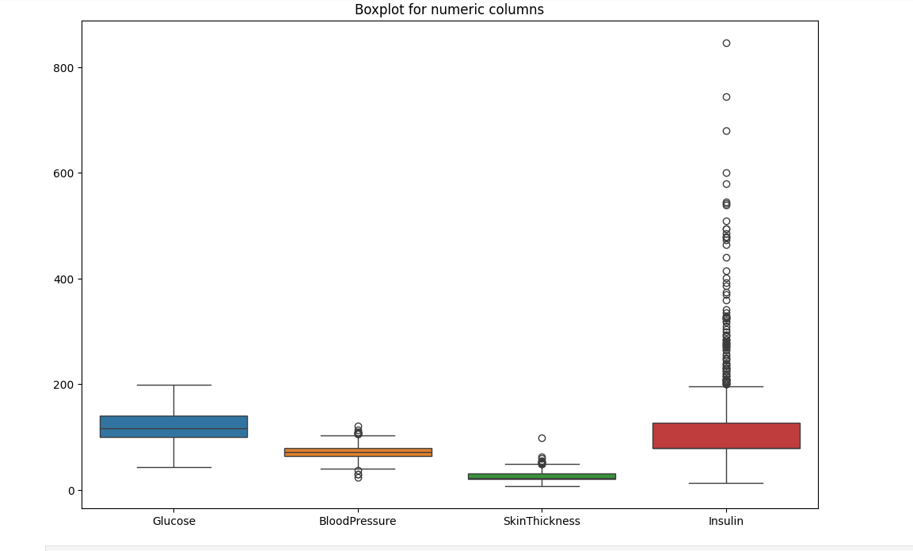
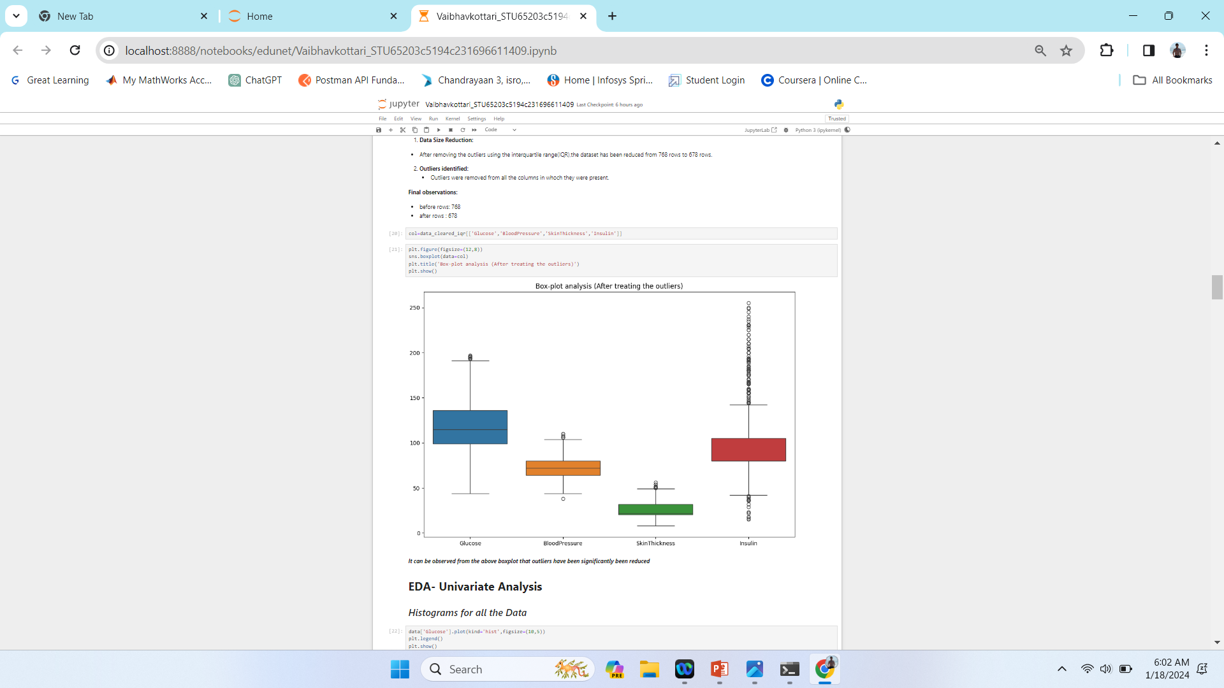
Modelling & Results

Slide 10
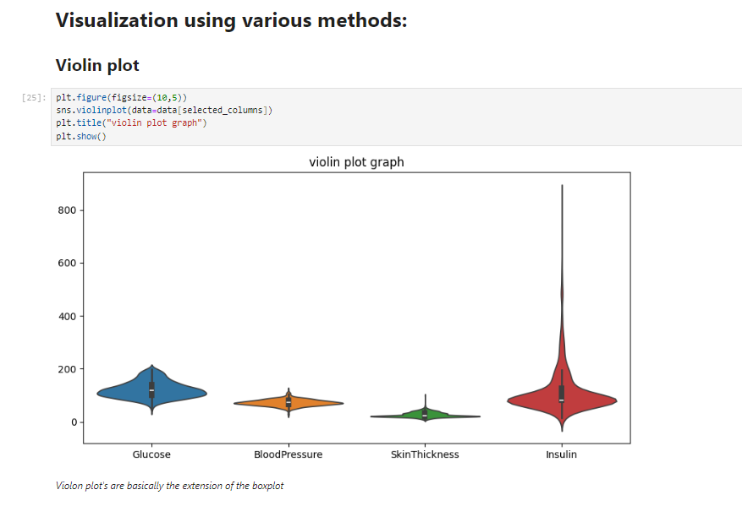
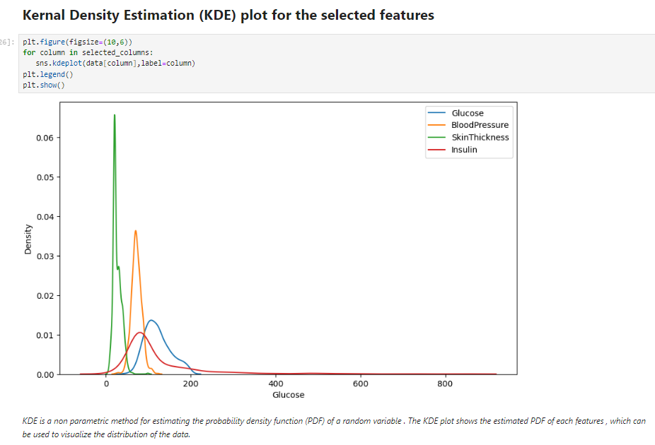
Modelling & Results

Slide 11
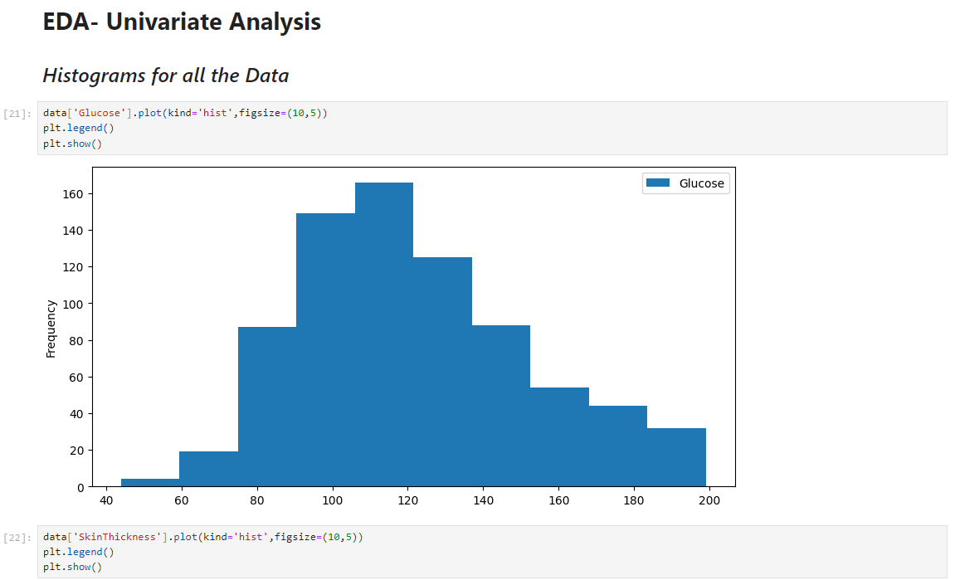
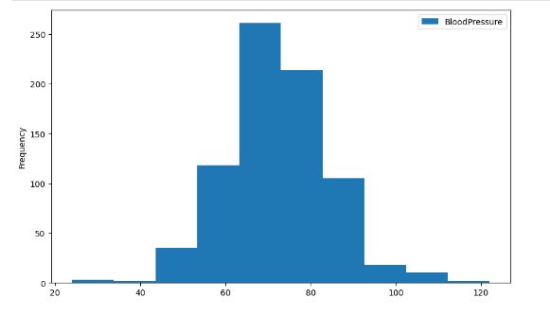
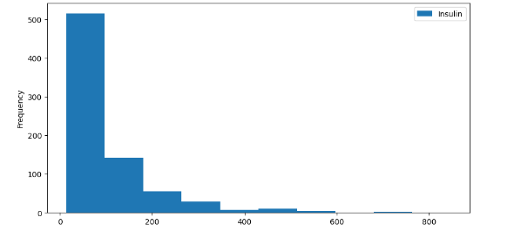
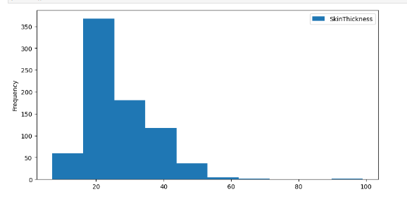
Modelling & Results

Slide 12
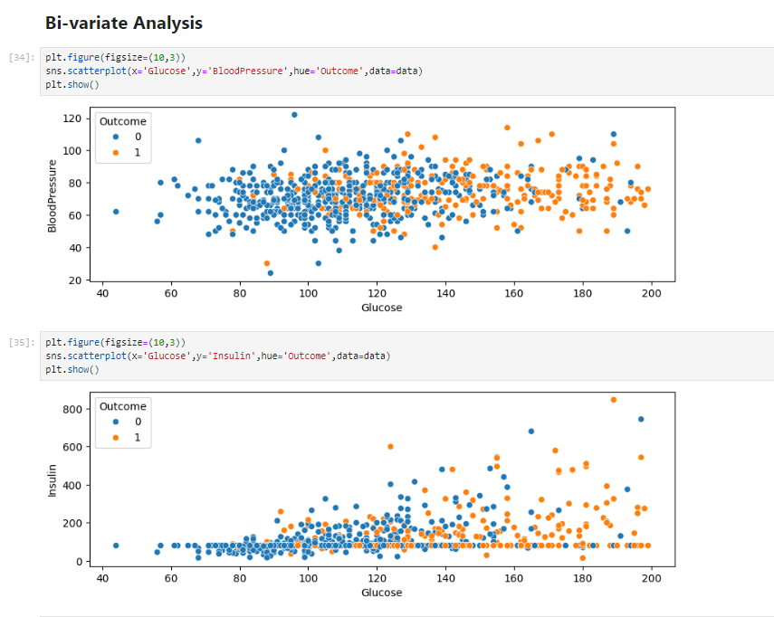
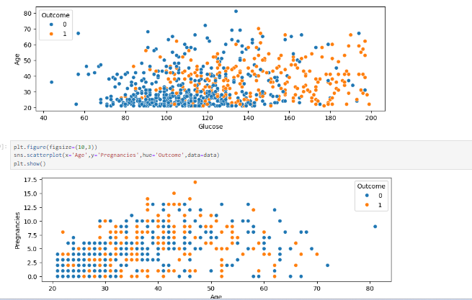
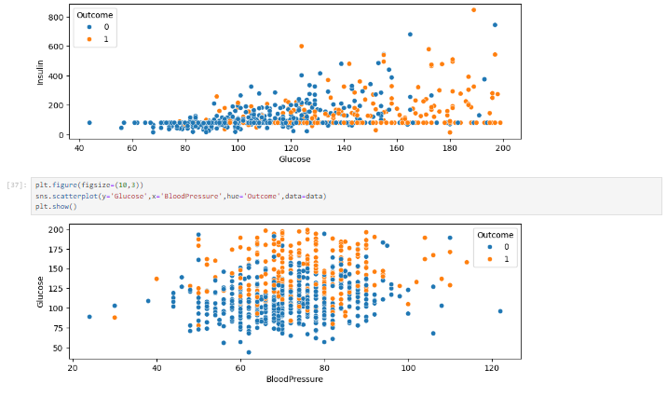
Modelling & Results

Slide 13
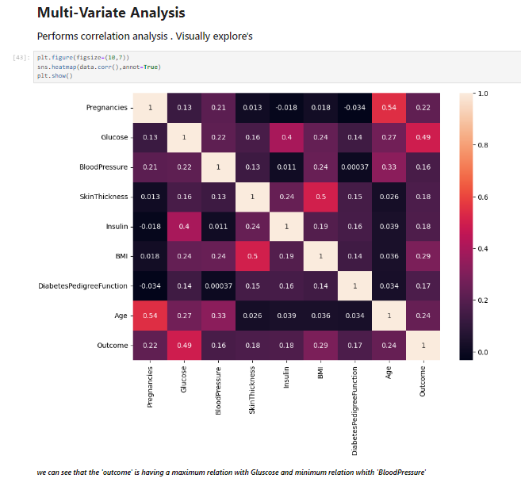
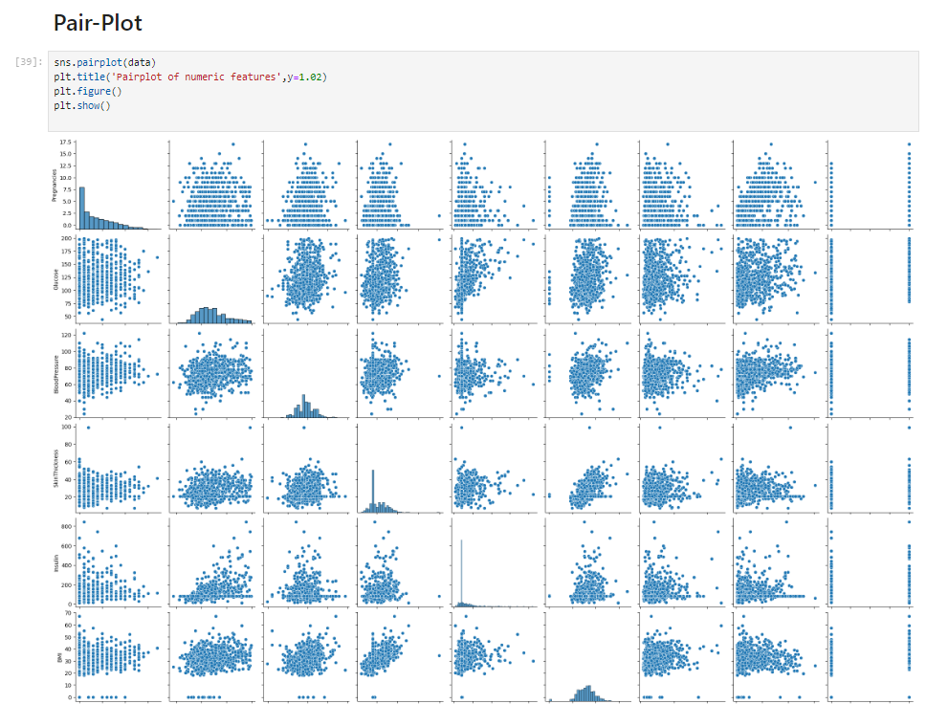
Modelling & Results

Slide 14
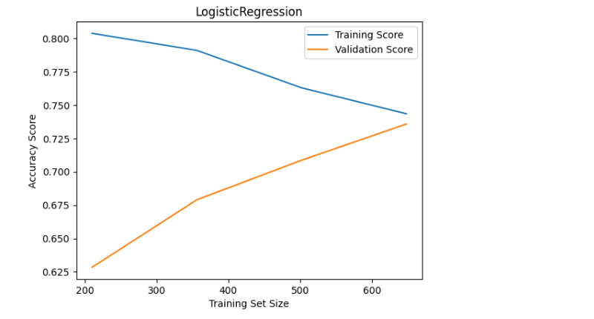
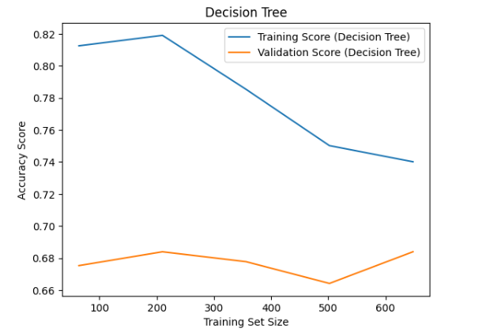
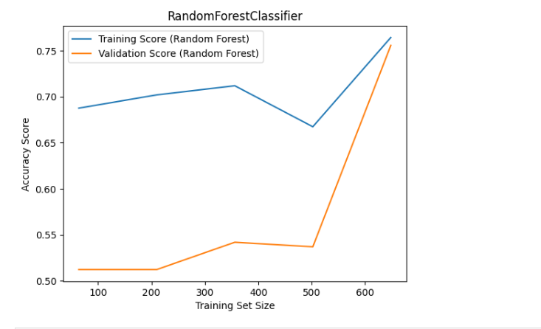
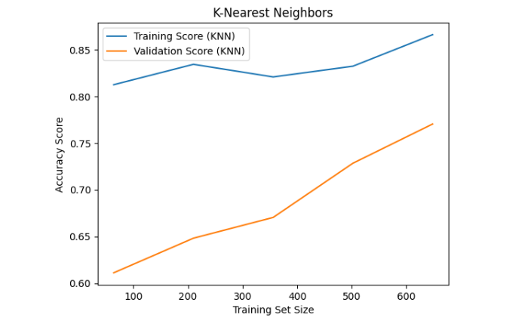
Modelling & Results
Learning Curve for respective models

Slide 15
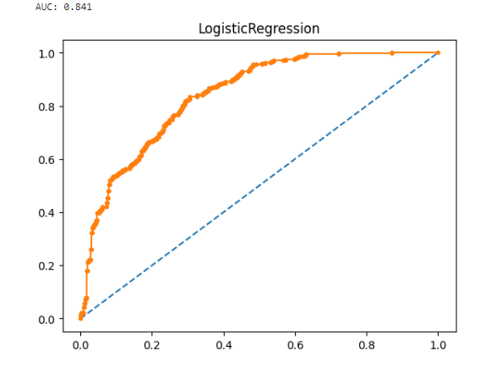
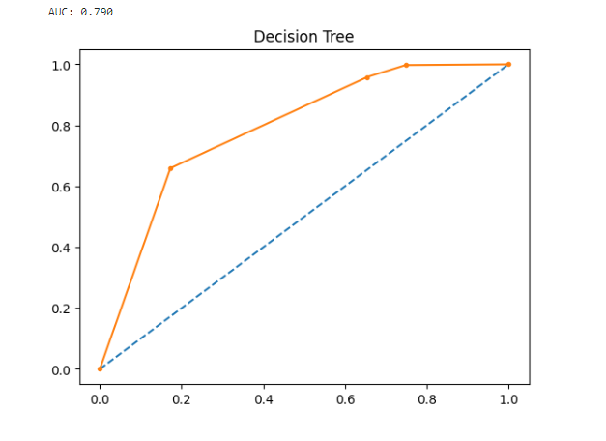
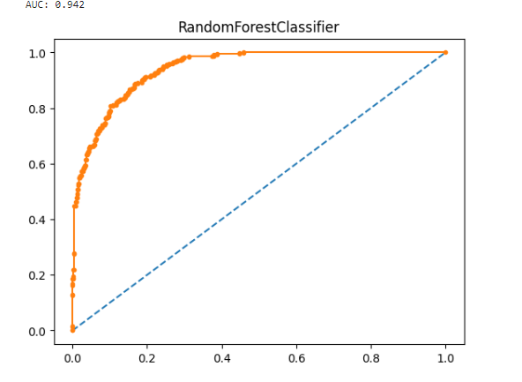
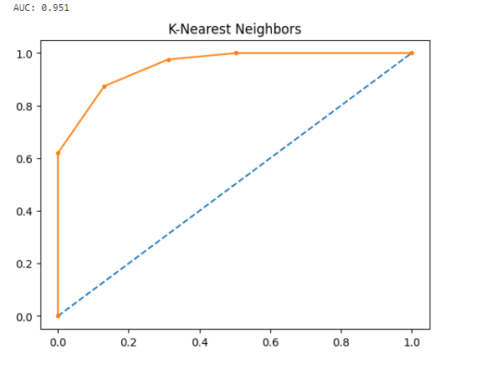
Modelling & Results
ROC curve for respective models

Slide 16
Modelling & Results
Logistic Regression:
- Accuracy: 76%
- Inference: This model stands out with the highest accuracy among all the tested
models.
K-Nearest Neighbors (KNN):
- Accuracy: 69.4%
- Inference: KNN gave the lowest accuracy. Further investigation or tuning might be
needed to improve its performance.
Random Forest and Decision Tree:
- Inference: Random Forest and Decision Tree show potential but may benefit from
tuning. Consider adjusting hyperparameters for better results.
Additional Metrics:
- Additional Results can be obtained from the graph

Slide 17
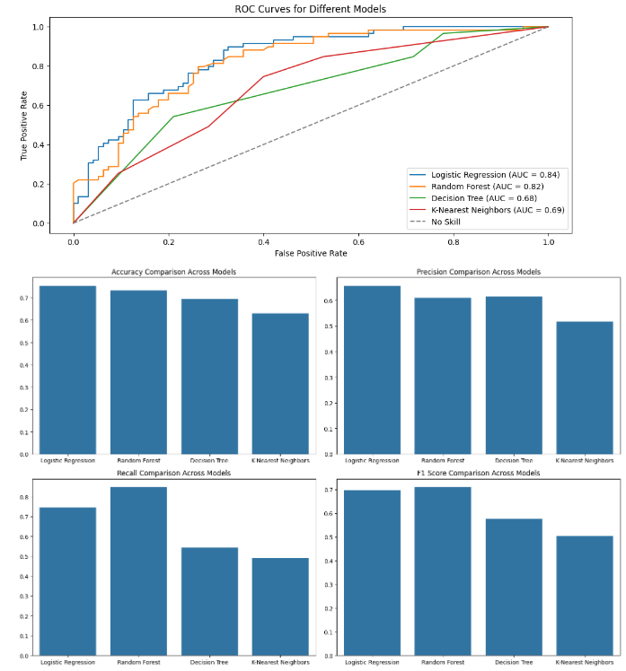
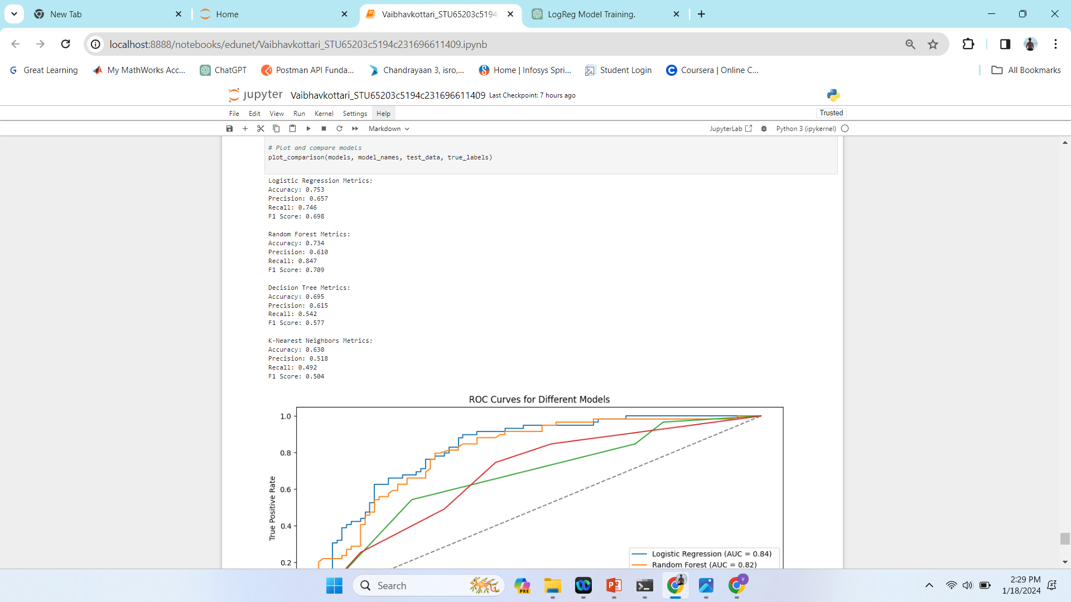
Modelling & Results

Slide 18
Conclusion
This project is a pioneering effort to revolutionize diabetes management. By applying advanced analytics and machine learning, it aims to develop accurate predictive models for early detection. Ethical considerations, personalized interventions, and seamless integration into healthcare systems underscore its commitment to proactive and individualized healthcare, marking a significant stride in diabetes care.

Slide 19
Thank You!
Notes:
Thank You !!

