Slide 1
SQL Capstone Project
Krishna

Slide 2
Objective:
To gain insight into the sales data of Amazon to understand the different factors that affect sales of the different branches.
The amazon table contains the column names like invoice_id, branch, city ,
customer_type, gender, product_line , unit_price, quantity, VAT, date, time, payment_method, cogs, gross_margin, percentage, gross_income, rating,
Threre 17 columns and 1000 records in the given table
There are 3 cities in the table Yangon, Naypyitaw , Mandalay

Slide 3
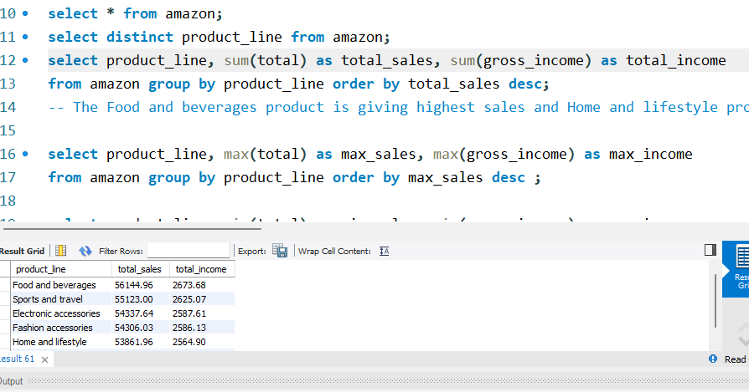
Product Analysis
There are 6 unique product available in three different branches
The Food and beverages product is giving highest sales and Home and lifestyle product is giving least sales
The maximum average rating is for the product food and beverages
The branch C sales are maximum among the other branches

Slide 4
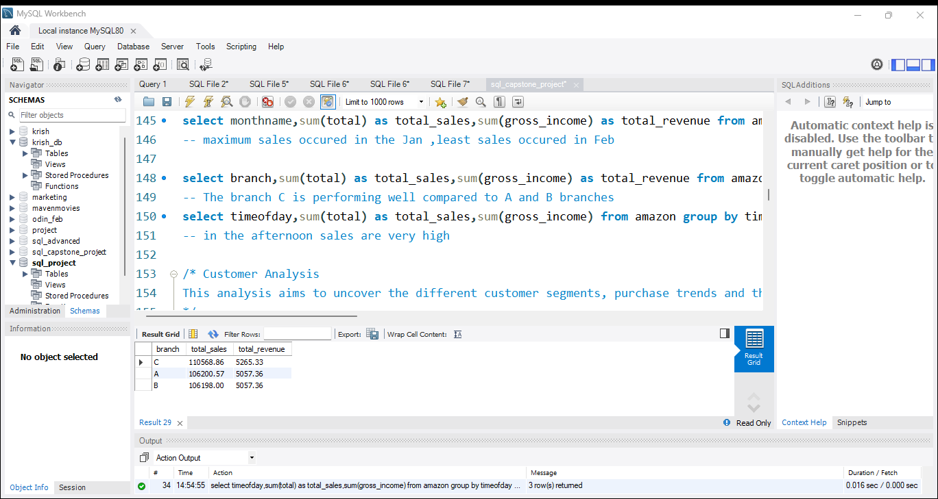
Sales analysis
Maximum sales occurred in the January and least sales are in the month of February.
The branch C is performing well compared to A and B branches.
The timeofday in afternoon the sales are very high

Slide 5
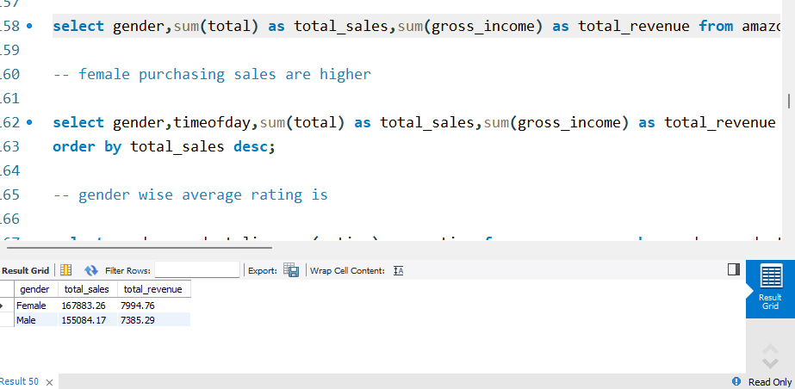
Customer Analysis
The Female purchasing sales are higher then male
The Member type of customer sales are higher
Female customers most purchasing product is Fashion accessories. and male customers mostly purchasing Health and beauty
Maximum male and female customers doing purchase in the afternoon

Slide 6
Business Analysis
There are 3 distinct cities named as Yangon ,Naypyitaw, Mandalay.
branch A belongs to Yangon and branch C belongs to Naypyitaw , B Belongs to Mandalay.
There are 6 unique products available.
The Ewallet and Cash payment methods occur mostly same
most sales happened in the Food and beverages
Jan the total revenue is 5537.95, in Feb the revenue is 4629.70 then Mar revenue 5212.40. In Jan maximum revenue is generated
In the January month the cost of goods are at peaks.
The Food and beverages product generates highest revenue.
In the city named Naypyitaw as highest revenue.
The Food and beverages is paying the highest tax.
The branch C exceed's the average no of products sold.
The product line food and beverages having highest average rating the home and life style having least average rating
The sales in the afternoon are maximum on every day .
The member customer type is giving the highest revenue.

Slide 7
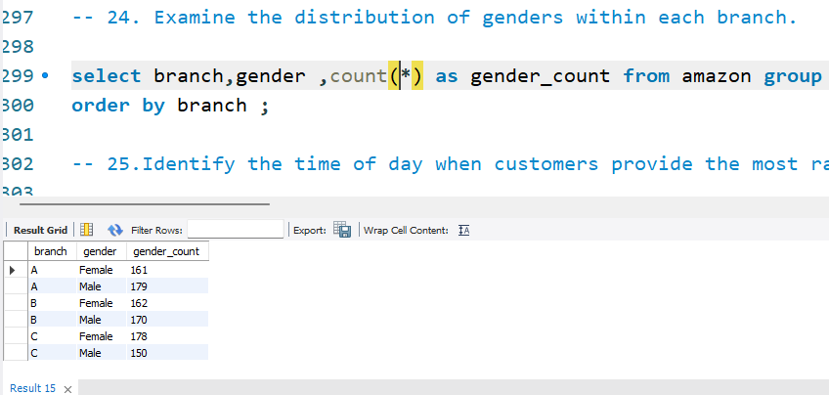
Yangon city as highest vat percentage
Member type of customers are having highest VAT payments
There are 2 distinct customers exist one is member and other normal
3 payment types available.
Member type of customer occurs frequently.
highest purchase frequency gender.
The distribution of genders within each branch

Slide 8
In the afternoon for each branch the customers provide highest ratings.
In the Monday the average rating is highest.
for branches A and C highest ratings in the Friday , for B branch Monday.
Business Questions
1.Q What is the count of distinct cities in the dataset?
select count(distinct city) as distinct cities from amazon;
select distinct city from amazon;
There are 3 distinct cities named as Yangon,Naypyitaw,Mandalay

Slide 9
2 Q.For each branch, what is the corresponding city?
select distinct branch,city from amazon ;
branch A belongs to Yangon and branch C belongs to Naypyitaw , B Belongs to Mandalay
3 Q What is the count of distinct product lines in the dataset?
select count(distinct product_line) as unique_product_count from amazon;
There are 6 unique products available

Slide 10
4. Q Which payment method occurs most frequently?
select payment_method ,count(*) as count_payment_method from amazon group by payment_method order by count_payment_method desc;
the Ewallet and Cash payment methods occur mostly same
5. Q Which product line has the highest sales?
select product_line, sum(total) as total_sales from amazon group by product_line order by total_sales desc limit 1;
most sales happened in the Food and bevarages
6.Q How much revenue is generated each month?
select monthname,sum(gross_income) as total_revenue from amazon group by monthname;
Jan the total revenue is 5537.95, in Feb the revenue is 4629.70 then Mar revenue 5212.40
In Jan maximum revenue is generated

Slide 11
7. In which month did the cost of goods sold reach its peak?
select monthname ,sum(cogs) as total_goods_cost from amazon group by monthname order by total_goods_cost desc;
in the January month the cost of goods are at peaks
8.Which product line generated the highest revenue?
select product_line,sum(gross_income) as total_revenue from amazon group by product_line order by total_revenue desc;
the Food and beverages product generates highest revenue
9.In which city was the highest revenue recorded?
select * from amazon ;select city,sum(gross_income) as total_revenue from amazon group by city order by total_revenue desc ;
in the city named Naypyitaw as highest revenue

Slide 12
10. Which product line incurred the highest Value Added Tax?
select product_line, sum(VAT) as total_tax from amazon group by product_line order by total_tax desc;
The Food and beverages is paying the highest tax
11.For each product line, add a column indicating "Good" if its sales are above average, otherwise "Bad.“
select product_line,total,date, case when total > (select avg(total) as avg_sales from amazon a where a.product_line=b.product_line) then 'Good' else 'Bad' end as sales_performance from amazon b;
12.Identify the branch that exceeded the average number of products sold.
select * from amazon;select branch, avg(quantity) from amazon group by branch having avg(quantity) > (select avg(quantity) from amazon) ;
The branch C exceed's the average no of products sold.

Slide 13
13.Which product line is most frequently associated with each gender?
select product_line,gender ,count(*) as gender_frquency from amazon group by product_line,gender order by gender_frquency desc ;
Fashion accessories product is most frequent with female,-- Health and beauty product is mostly with male category
14. Calculate the average rating for each product line.
select product_line,avg(rating) as avg_rating from amazon group by product_lineorder by avg_rating desc;
15. Count the sales occurrences for each time of day on every weekday.
select dayname,timeofday,count(*) as sales_count from amazon group by dayname,timeofday order by sales_count desc;
the sales in the afternoon are maximum on every day
16.Identify the customer type contributing the highest revenue.
select Customer_type,sum(gross_income) as total_revenue from amazon group by Customer_type order by total_revenue desc ;
the member customer is giving the highest revenue

Slide 14
17. Determine the city with the highest VAT percentage.
select city, sum(VAT/total) as vat_percent from amazon group by city order by vat_percent desc ;
Yangon city as highest vat percentage
18. Identify the customer type with the highest VAT payments
select Customer_type,sum(VAT) ,sum(total) as vat_percent from amazon group by Customer_type order by vat_percent desc ;
the Member type of customers are having highest VAT payments
19. What is the count of distinct customer types in the dataset?
select count(distinct customer_type) as customer_count from amazon;
there are 2 distinct customers exist

Slide 15
20. What is the count of distinct payment methods in the dataset?
select count(distinct payment_method) as payment_method_count from amazon;
3 payment types available
select distinct payment_method from amazon;-- Ewallet ,cash , credit card,
21. Which customer type occurs most frequently?
select customer_type ,count(*) as customer_count from amazon group by customer_typeorder by customer_count desc limit 1;
Member type of customer occurs frequently
22 Identify the customer type with the highest purchase frequency
select customer_type ,count(*) as purchase_frequency from amazon group by customer_typeorder by purchase_frequency desc limit 1;
Member customer type as highest purchase frequency. --

Slide 16
23. Determine the predominant gender among customers. select customer_type, gender , count(*) as gender_count from amazon group by customer_type,genderorder by gender_count desc;-- the predominant gender among the customers is Female.
24.Examine the distribution of genders within each branch.
select branch,gender,count(*) as gender_count from amazon group by branch,genderorder by branch ;
25.Identify the time of day when customers provide the most ratings. select timeofday,count(rating) as rating_count from amazon group by timeofday order by rating_count desc limit 1;-- in the afternoon customer provide maximum ratings
26.Determine the time of day with the highest customer ratings for each branch.
select branch,timeofday,count(rating) as rating_count from amazon group by branch, timeofday order by rating_count desc;
in the afternoon for each branch the customers provide highest ratings

Slide 17
27.Identify the day of the week with the highest average ratings.
select dayname , avg(rating) as avg_rating from amazon group by dayname order by avg_rating desc limit 1;
in the Monday the average rating is highest
28. Determine the day of the week with the highest average ratings for each branch.
select branch,dayname , avg(rating) as avg_rating from amazon group by branch, dayname order by avg_rating desc;
for branches A and C highest ratings in the Friday , for B branch Monday

