Slide 1
Data Services
Mikhail Arov

Slide 2
Between rock (software) and hard place (data).
Data team prepares the weather data.
Other data feeds (piracy, marine bulletins etc.)
Software consumes it.
Bon Voyage System
AROS
Third party products (through API).
This presentation describes the infrastructure of delivery of this data per software request.

Slide 4
What is in the request XML?
<BVS_DATA_REQUEST type="BVS DATA REQUEST" from="mats" imo="0000000" product="BVS" shipname="Mike's Test ship" bvs="7.0.0.41" decoder="1.0.2.17" machineid="IPJACRW">
<SCHEDULES>
<DATE start="2013/6/21" freq="1"/>
</SCHEDULES>
<RUNS>
<RUN_1>09</RUN_1>
</RUNS>
<WEATHER forecast="10" picacy.history="14" interval="H3" ulat="65" llat="10" llon="125" rlon="-105" updatetropicals="0" updatepiracy="0" updatebulletins="0" piracyhistory="14">
<PRESSURE>1</PRESSURE>
<FRONT>1</FRONT>
<HIGHLOW>1</HIGHLOW>
<TROPICAL>1</TROPICAL>
<WIND>1</WIND>
<WAVE>1</WAVE>
<SWELL>1</SWELL>
<ICE>1</ICE>
<SST>1</SST>
<PORTFORECASTS sendupdates="0"/>
<CURRENT>1</CURRENT>
<SEAS>1</SEAS>
<NESTED>
<WEATHER llon="160" rlon="-160" ulat="60" llat="20" hiresinterval="H3">
<CURRENT>1</CURRENT>
<WIND>1</WIND>
<WAVE>1</WAVE>
<SWELL>1</SWELL>
<SEAS>1</SEAS>
</WEATHER>
<WEATHER llon="170" rlon="-155" ulat="50" llat="35" hiresinterval="H3">
<IMAGE>1</IMAGE>
</WEATHER>
</NESTED>
</WEATHER>
</BVS_DATA_REQUEST>

Slide 5
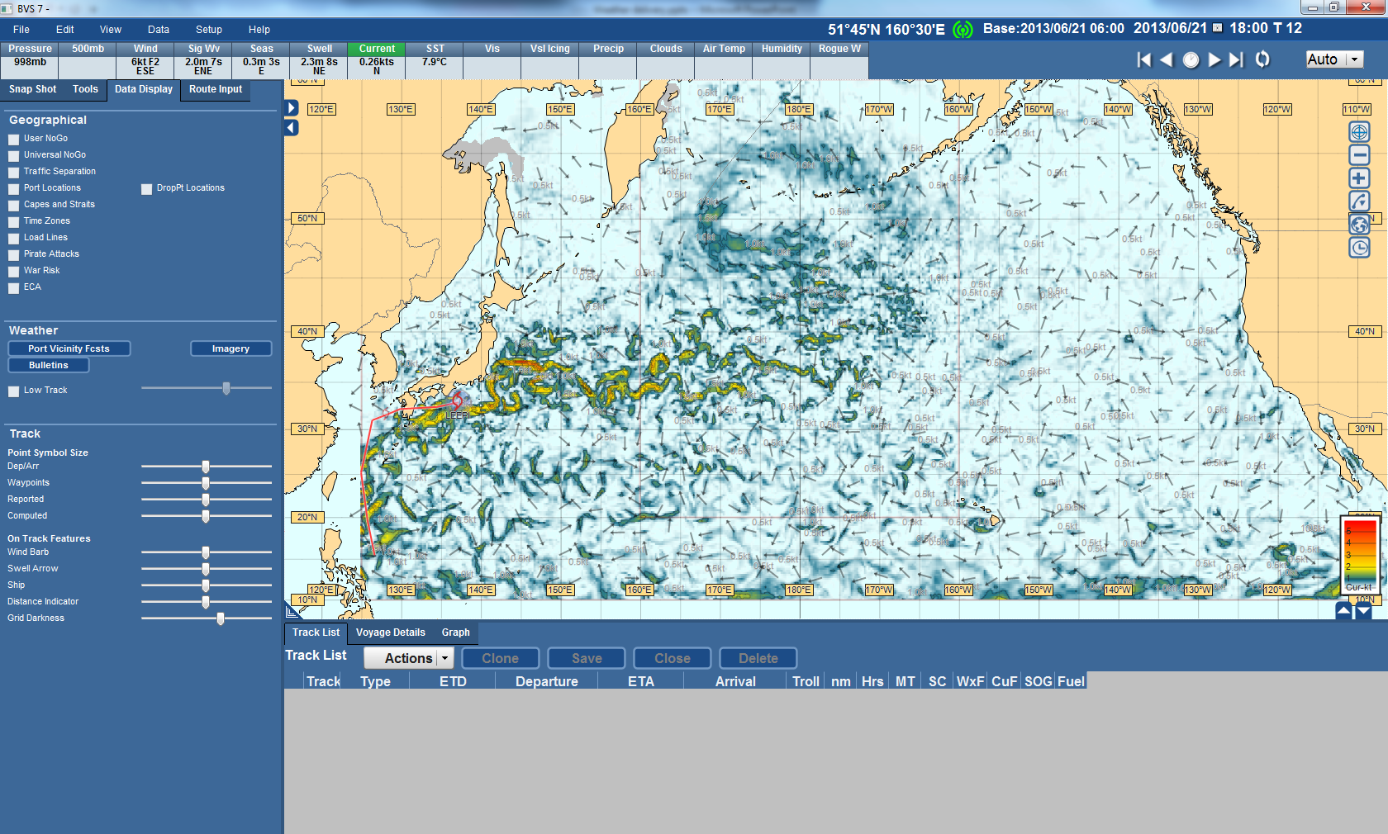
An example of Weather display

Slide 6
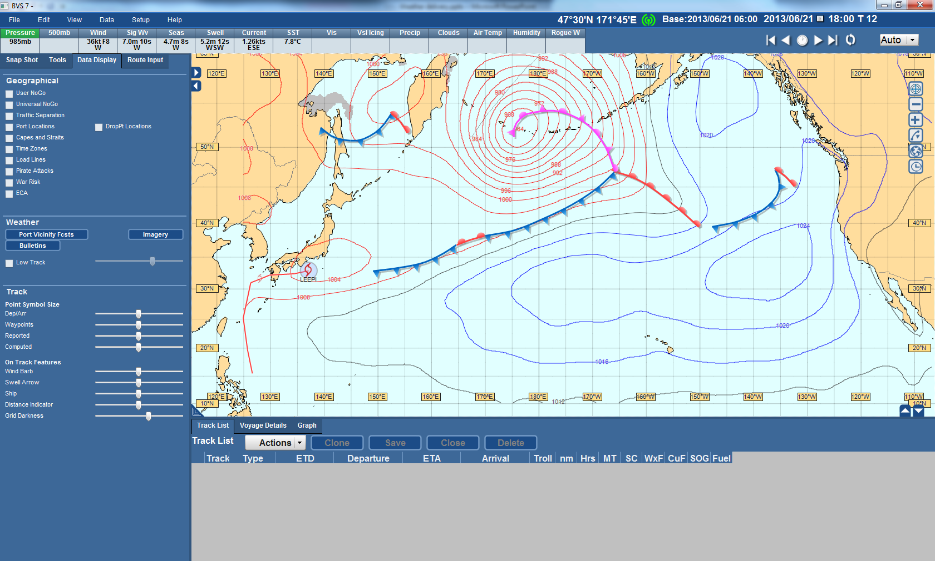
Another example

Slide 7
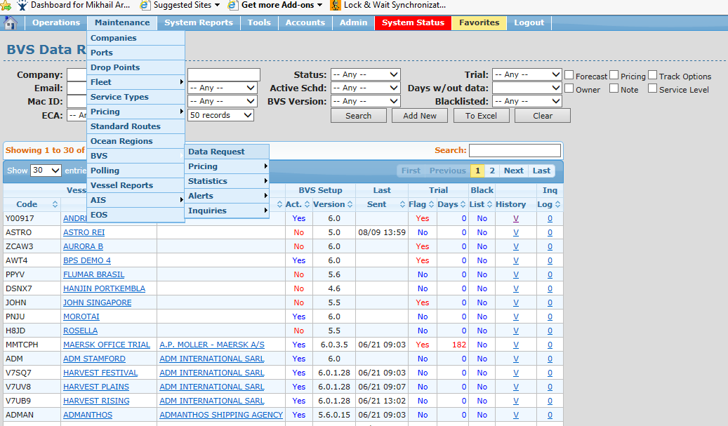
AROS Watches You

Slide 8
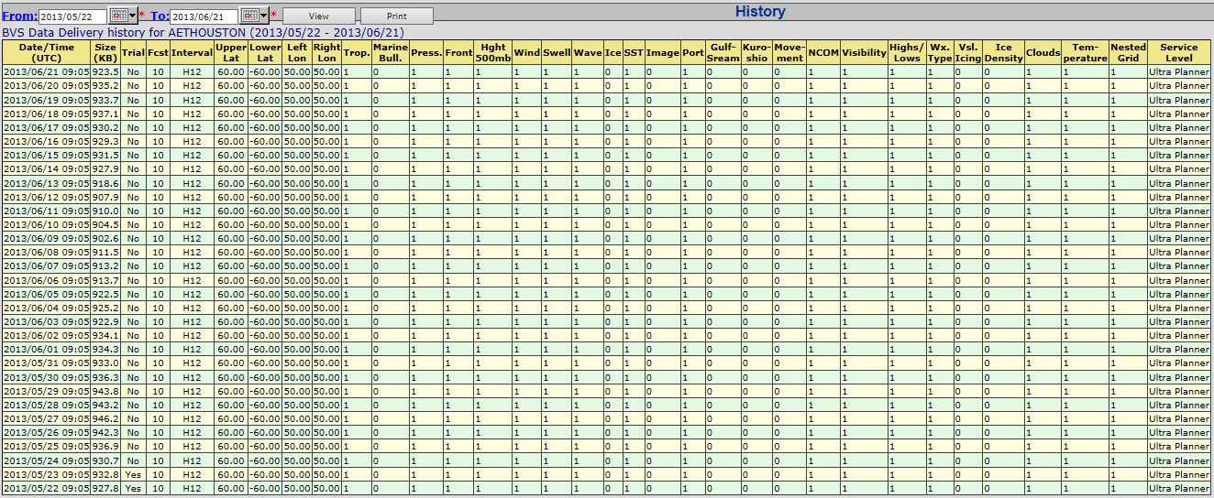
AROS Watches You

Slide 9
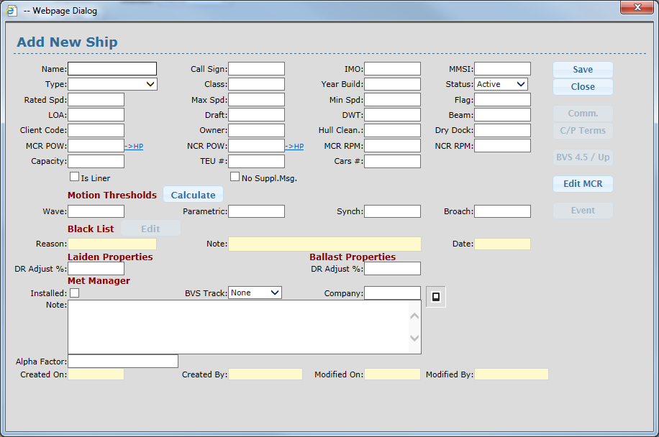
Adding new ship to DB

Slide 10
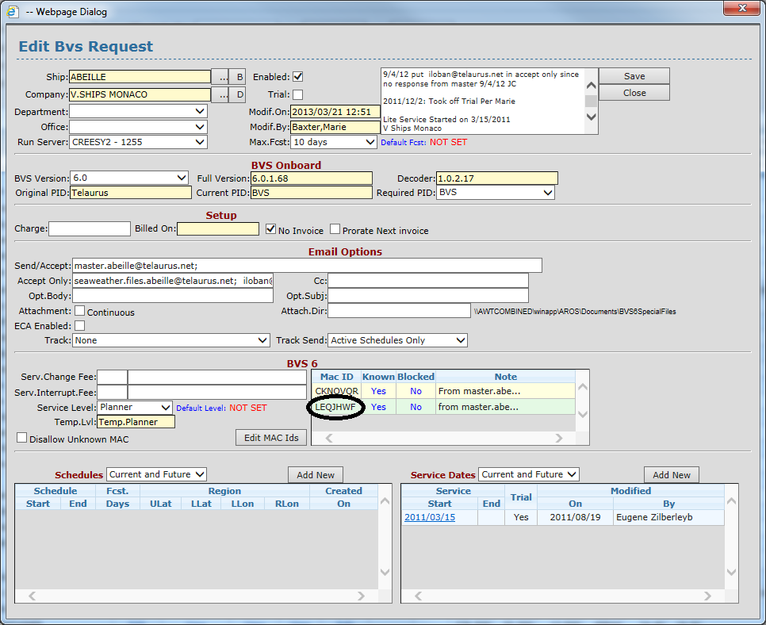
Adding new ship to DB
MAC ID

Slide 11
Email Delivery vs. Broadband
Email Delivery
Should open email account
Sends an email with new data after, also by email
Internet
No action required to send data request
Just need to set Data Request and turn on the system
The data is periodically updated over HTTP
Scheduled Email Delivery
Sends data at specified times

Slide 12
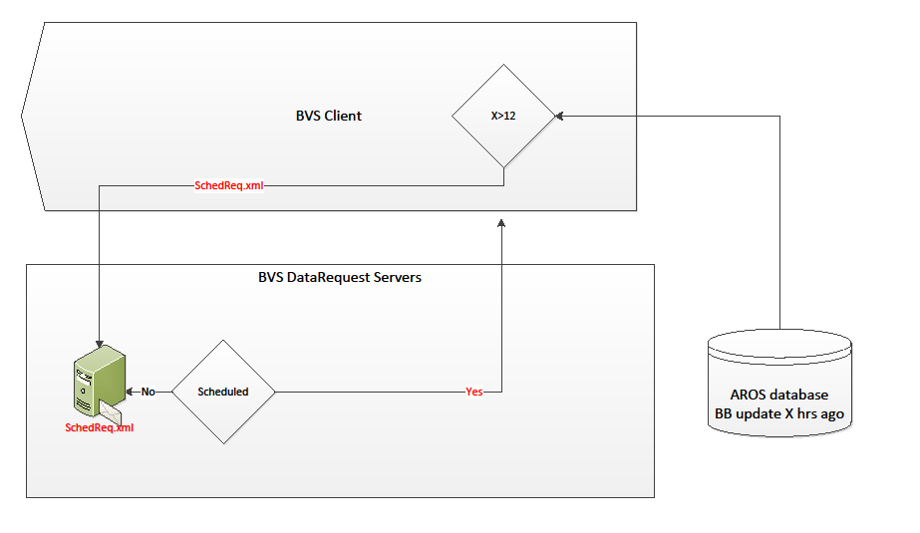
Scheduled update as “a broadband plan B” - backup option

Slide 13
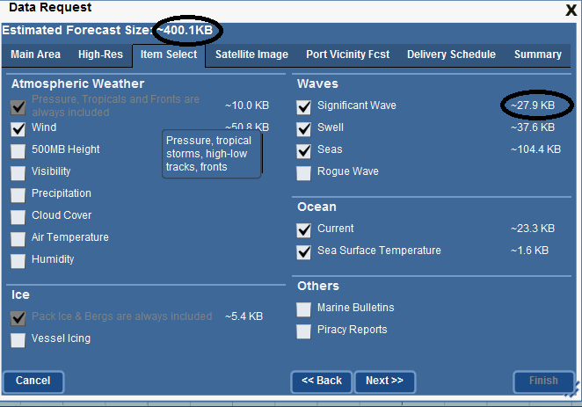
Cost of the email data

Slide 14
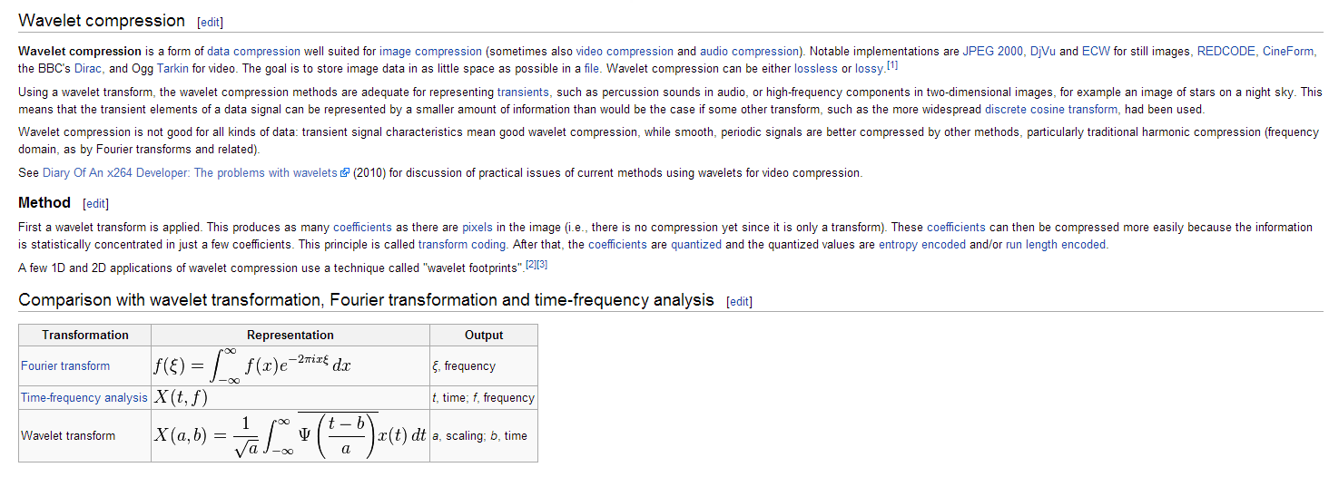
In order to reduce the file size

Slide 15
Conclusions and “live demo”
Weather data for specified region(s) and date(s) has to be prepared.
Additional data feeds (such as piracy and marine bulletins) have to be integrated.
Broadband server has can handle many simultaneous requests.
Failover, logs and security.

