Slide 1

FACE SWAPPING
By Group 5

Slide 2

01
Background
Background of the paper or project you selected.
02
Algorithms
The
Contents
Algorithms that you plan to implement.
03
Analysis
An analysis of what could go wrong and how you plan to resolve it.
04
Timeline
Timeline for doing the work.
05
Distribution
Distribution of the work (what each group member will be doing

Slide 3
01
Background
Background of the paper or project you selected.

Slide 4
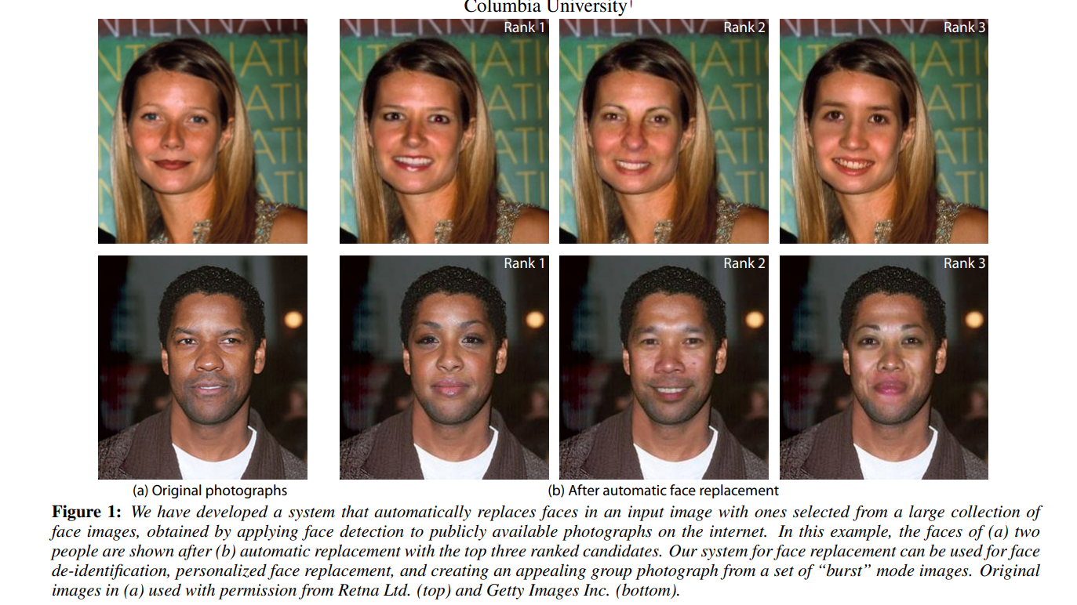
Face Swapping: Automatically Replacing Faces in Photographs，Dmitri Bitouk et al.

Slide 5
02
Algorithms
Algorithms that you plan to implement.

Slide 6
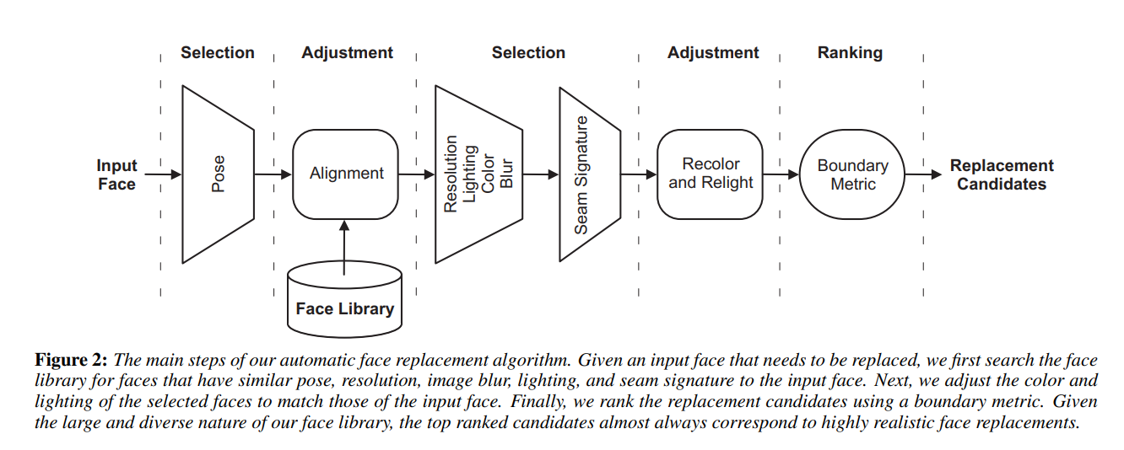
Whole Structure
Face Swapping: Automatically Replacing Faces in Photographs，Dmitri Bitouk et al.

Slide 7
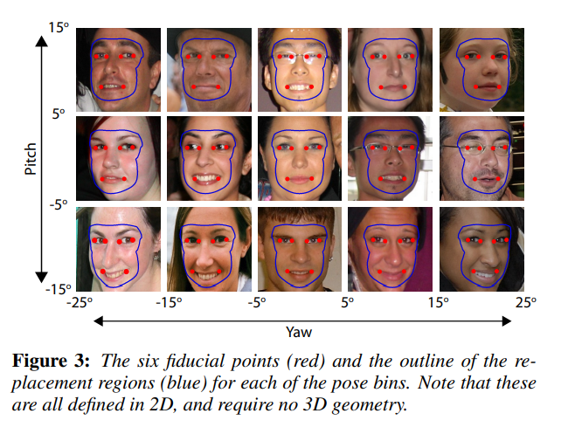
Pose selection
This step will be accomplished by OKAO detector(a web application)
Face Swapping: Automatically Replacing Faces in Photographs，Dmitri Bitouk et al.

Slide 8
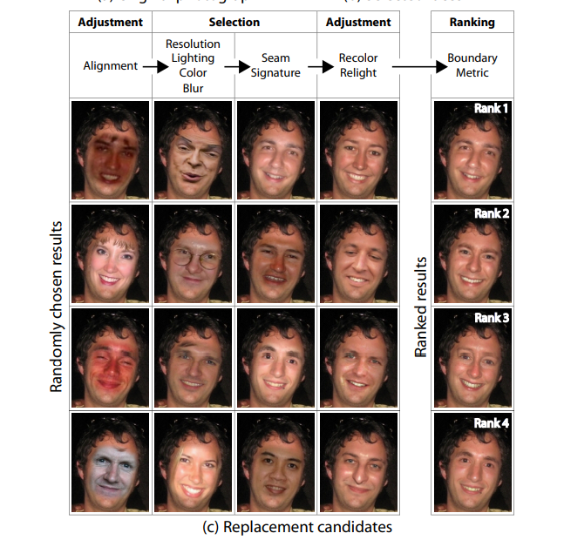
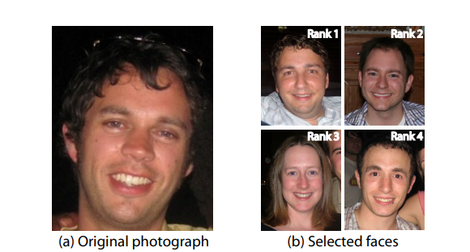
Article’s method

Slide 9
03
Analysis
An analysis of what could go wrong and how you plan to resolve it.

Slide 10
Our Method
Get the given picture’s contour and pose
Revise contour
Extract and replace faces
Wrapping
Boundary seaming

Slide 11
04
Timeline
Timeline for doing the work.

Slide 12
1. Declare Project 9/30
2. Project Plan 10/15
Timeline
3. Module 1\2\3 11/5
4. Module 4 11/10
5. Project Update 12/3

Slide 13
05
Distribution
Distribution of the work (what each group member will be doing.

Slide 14
Yixiao Kou
Hainan Huang
The first 4 steps of Module 2:
1. Getting contour of the face
2. Modify the contour
3.Extract replacement faces
4. Affine transform
1.The last step of Module
2.Appearance adjustment and ranking
1. Collect a lot of pictures to build the replacement face library, then build it.
2. Do a lot of experiments to check the feasibility and accuracy of the program.
Hongxian Ye

Slide 15
Thank
You

