Slide 1
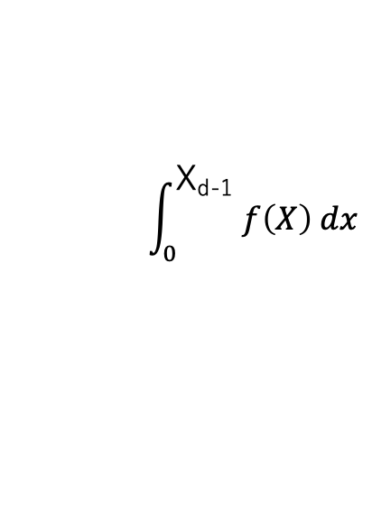
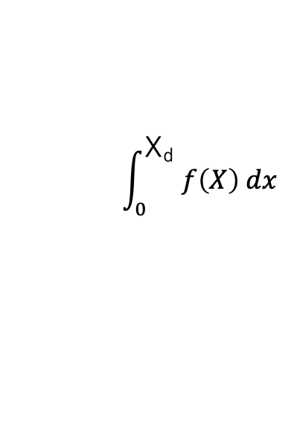
paek count
B
X_{d}
:
min(X)
< 0.05
A+B
$$\int_{0}^{\text{X}\text{d} }{f\left(X\right) dx}$$
A :
$$\int_{0}^{\text{X}\text{d}\text{-1} }{f\left(X\right) dx}$$
B :
peak year
decay year
0
(published year)
X_{p}
X_{d-1}
X_{d}
X
elapsed year

