Slide 1

HAMMY
Noah Koubenec – EDET 735 final project

Slide 2
Game Background
Your neighbors need your help!
Your village has been hit by a terrible storm which has knocked out the power.
No one can leave because the river is flooding.

Slide 3
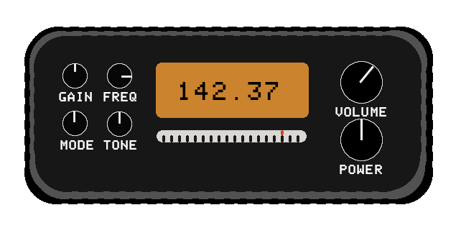
Game Background (continued)
You must find a way to call for help – and you have an idea.
There is an old broken radio in your parents’ basement. If you can figure out how to fix it, you can save your neighbors!

Slide 4
Gameplay and Characters
While pulling out the radio, you discover a notebook with important clues.
As you try to fix the radio and get in touch with someone, friends from the village will help you.
> Zoe, your best friend, knows all about electronics and can help you fix the radio.
> Mr. Stevens used to be in the Army and knows how to set up an antenna.
> Micah, your brother, is a math whiz and can help with frequencies.

Slide 5
Conclusion
To meet the challenge and save your village, you will need to learn how the radio is built and how to use it.
This won’t be easy, and you will have to solve many problems along the way – but you know you can do it!
All images and graphics are in the public domain and are available at OpenGameArt.org.

